Slide 1
Feature selection using Recursive Feature Elimination
Monir Zaman

Slide 2
Feature selection
Feature selection is an important step in the machine learning workflow. It is process of identifying important predictors and remove unnecessary features.
Why needed:
Feature selection useful to prevent overfitting
Reduce dimensions
Helps to understand the data

Slide 3
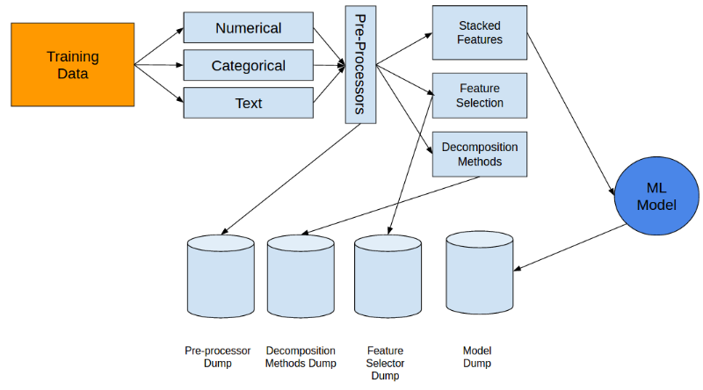
Feature selection in Machine learning workflow
Typically applied between data-preprocessing and model building.
Image courtesy: http://s5047.pcdn.co/wp-content/uploads/2016/07/abhishek_25.png

Slide 4
Feature selection algorithm
Univariate feature selection
  Example: Correlation-based selection
Multivariate feature selection
  Example: Recursive feature elimination using Cross-Validation (RFECV)

Slide 5
  Recursive feature elimination using Cross-Validation (RFECV)
RFECV applies RFE on k-fold cross-validation of the training dataset
  RFE stands for Recursive feature elimination
  RFE recursively removes features by m features at a time. Default m = 1. It repeats the process until all the features are exhausted or number of features reached the threshold of minimum number of features to select

Slide 6
  Recursive feature elimination (rfe)

Slide 7
X
Y
Program flow of rfe (_rfe_single_fit)
# bedrooms | Area | Age | Price (1k)
3 | 1200 | 10 | 560
3 | 980 | 13 | 520
3 | 1200 | 20 | 410
5 | 1600 | 4 | 880
Scores ( r-squared on Test set)
.78
ranking
# bedrooms | Area | Age
1 | 1 | 1
model.feature_importance
# bedrooms | Area | Age
.6 | .3 | .1
  Task: Calculate scores of the feature set
Model fit on Train set
Train
Test

Slide 8
X
Y
Program flow of rfe (_rfe_single_fit)
# bedrooms | Area | Age | Price (1k)
3 | 1200 | 10 | 560
3 | 980 | 13 | 520
3 | 1200 | 20 | 410
5 | 1600 | 4 | 880
Scores ( r-squared on Test set)
.78 | .88 (delayed unitll next round)
ranking
# bedrooms | Area | Age
1 | 1 | 2
model.feature_importance
# bedrooms | Area | Age
.6 | .3 | .1
Model fit on Train set
Train
Test
# bedrooms | Area | Age
.6 | .3 | .1
  Task: Remove worst performing feature

Slide 9
X
Y
Program flow of rfe (_rfe_single_fit)
# bedrooms | Area | Age | Price (1k)
3 | 1200 | 10 | 560
3 | 980 | 13 | 520
3 | 1200 | 20 | 410
5 | 1600 | 4 | 880
Scores ( r-squared on Test set)
.78 | .88 | .6 (delayed unitll next round)
ranking
# bedrooms | Area | Age
1 | 2 | 3
model.feature_importance
# bedrooms | Area
.56 | .44
Model fit on Train set
Train
  Task: Remove worst performing feature
Test
# bedrooms | Area
.56 | .44

Slide 10
Recursive feature elimination (rfe) is repeated until
#(remaining features) >= n_features_to_select
where n_features_to_select is a parameter passed during runtime
When n_features_to_select is None, then
n_features_to_select = Total number of features / 2

Slide 11
  Recursive feature elimination using cross-validation (rfecv)

Slide 12
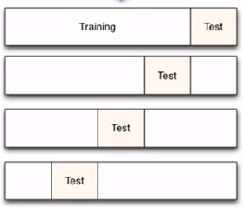



Program flow of rfecv.fit method
rfecv repeats rfe with k-fold cross validation
Scores ( r-squared on Test set)
.56 | .67 | .4
.33 | .8 | .9
.78 | .88 | .2
.5 | .79 | .6
$$\sum{=\text{2.17}}$$
$$\sum{=\text{3.14}}$$
$$\sum{=\text{2.1}}$$

Slide 13
Program flow of rfecv.fit method
Position where cv scores reach its peak is selected as the optimal number of features (aka n_features_to_select)
In the following example, number of optimal features is 2
Total CV Scores ( reverse order)
(1 feature)
(2 features)
(3 features)
2.1 | 3.4 | .2.17

Slide 14
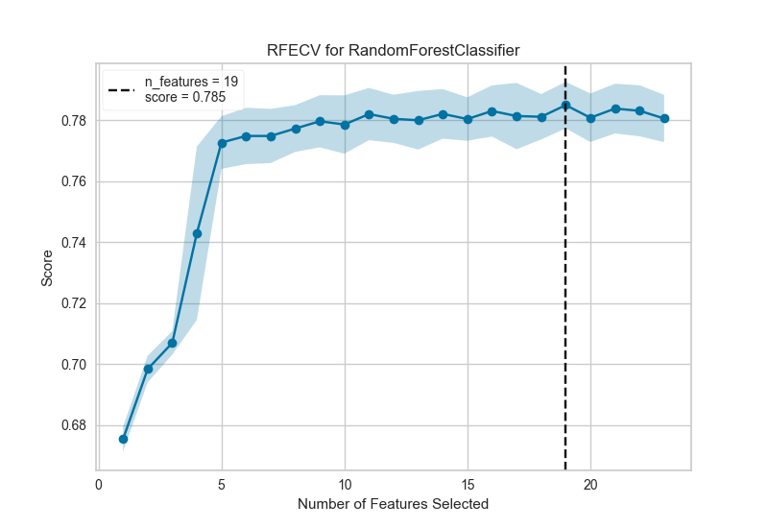
Example of CV scores plot where optimal number of features is 19
- Helps us to decide the minimum number of features needed
- Calls rfe one more time with n_features_to_select = (Total # features) – peak_indx
on the entire dataset.
- Last call changes ranking but not CV.scores

