Slide 1

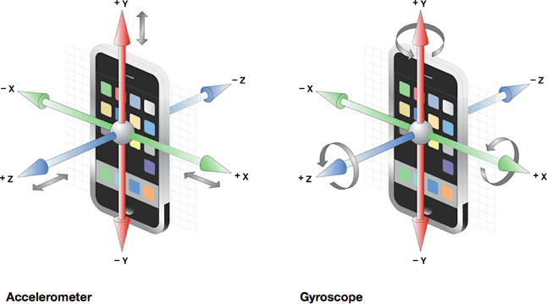
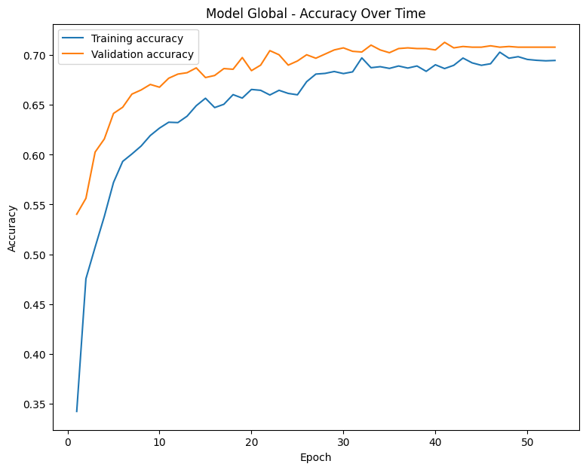
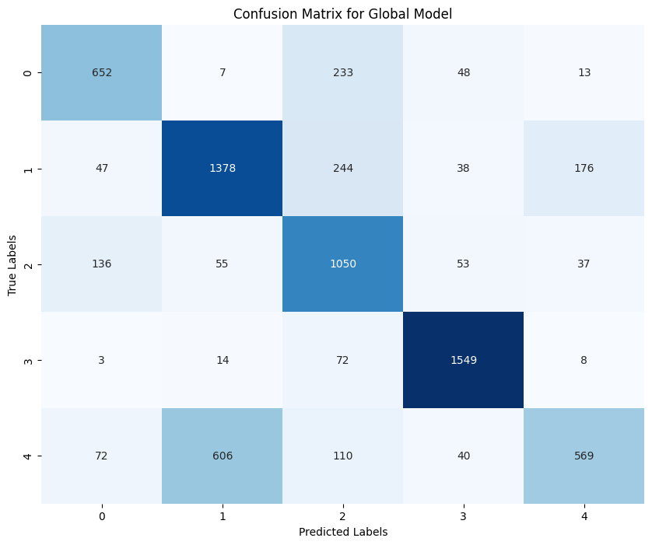


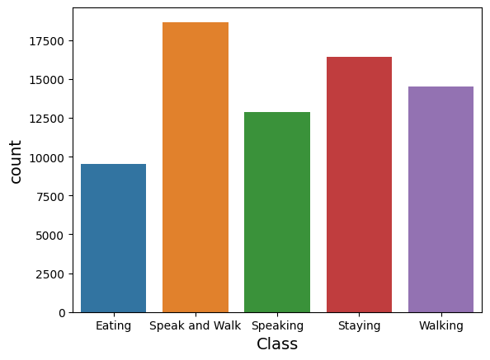
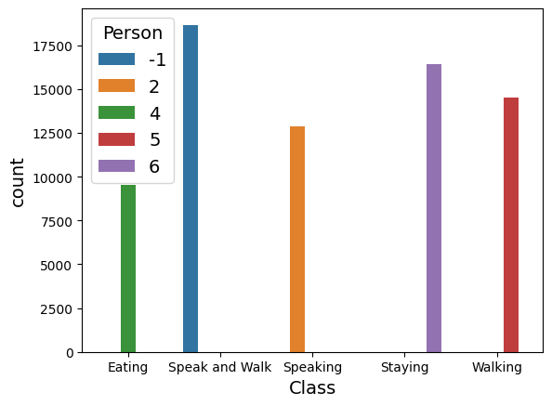
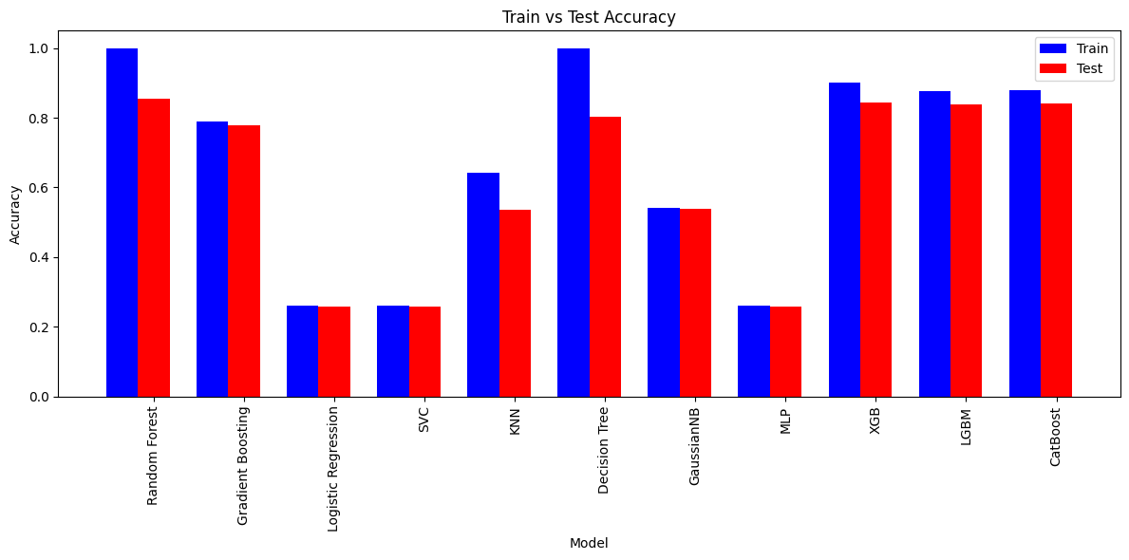
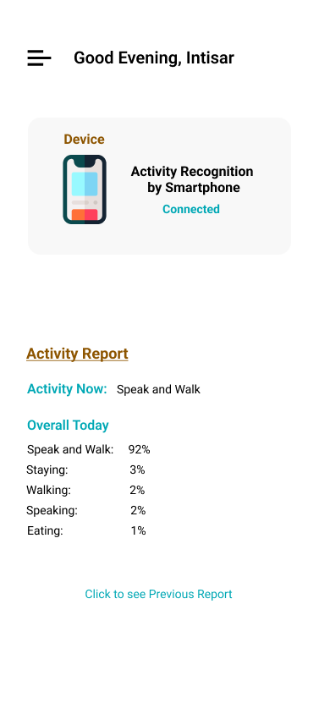
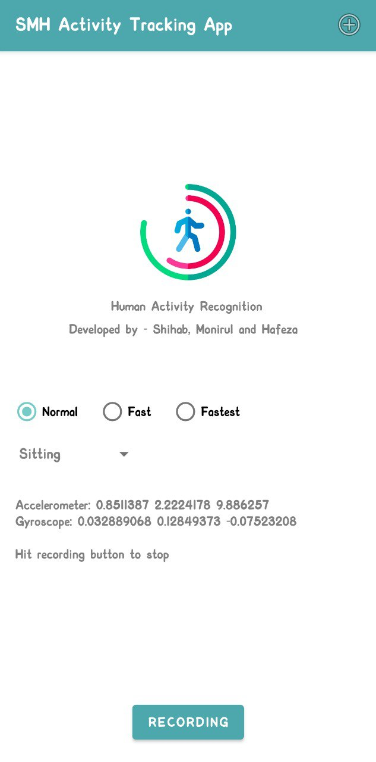

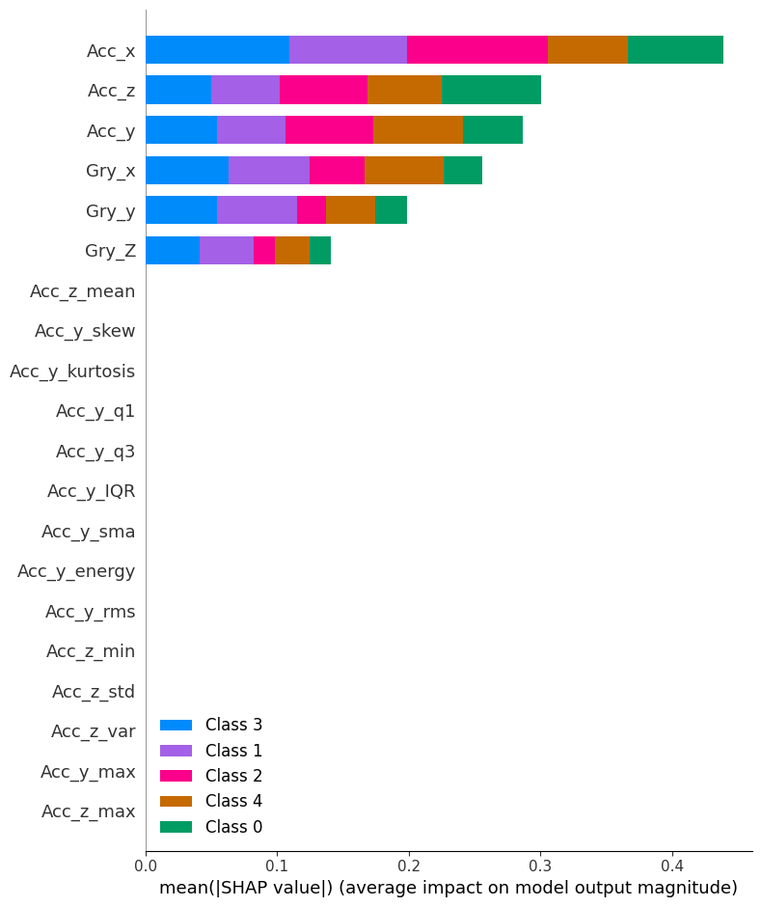
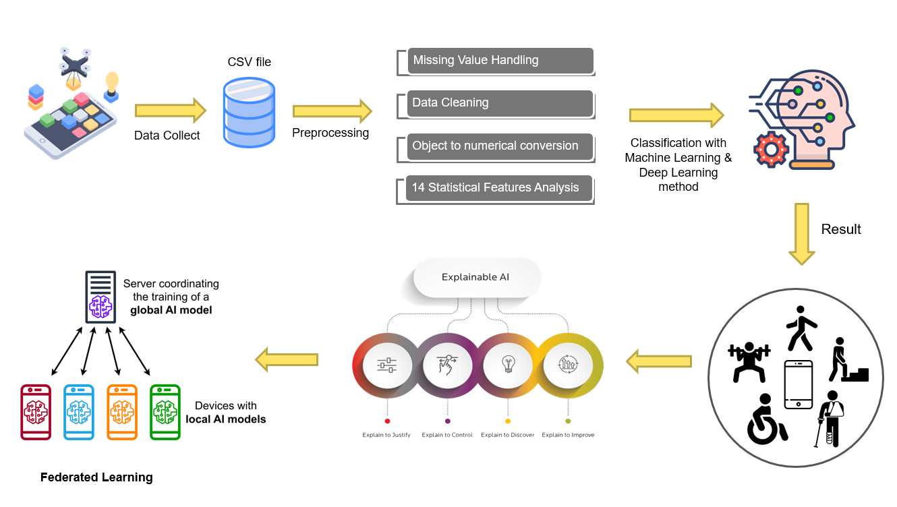
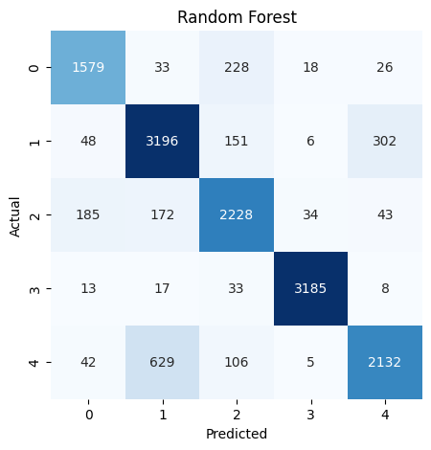
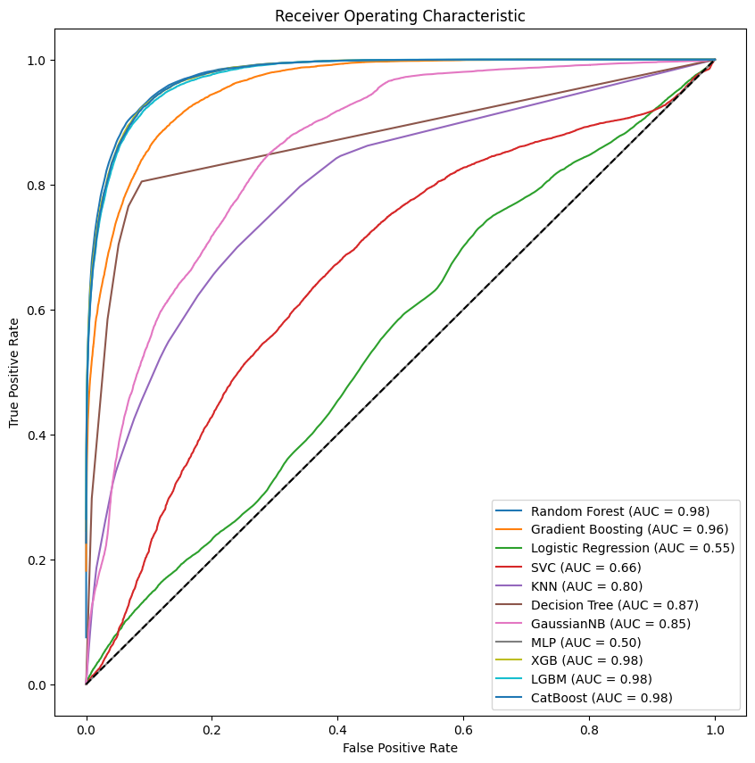
Human Activity Recognition Using Multiple Learning & XAI Techniques From Wearable Sensor Data Md Shihab Reza, Monirul Islam Mahmud & Hafeza Akter Department of ECE, North South University. Supervisor: Mr. Intisar Tahmid Naheen
Abstract
We have applied 10 Machine Learning model and 3 Deep Learning Models where Random Forest gives the highest accuracy of 85%.
We have analyzed 14 Statistical Features Extraction.
We have implemented Explainable AI techniques (SHAP and LIME) in this research work.
Lastly, we implemented Federated Learning technique in our project with 3 clients, where we achieved 72% accuracy on Global Model.
We have developed a Mobile App called “SMH Activity Tracking App” which will collect sensor data and predict the activity.
We emphasize the critical need for elder patient monitoring, considering the global shortage of nurses. Implementing HAR systems holds the potential to significantly improve elder patient care, addressing this pressing issue.
Our study focuses on Human Activity Recognition (HAR) using accelerometer and gyroscope data. We explore various techniques including machine learning, deep learning, Federated Learning, and Explainable AI, achieving high accuracies of 85% for Random Forest and 82% for our top-performing deep learning model ANN. By employing SHAP values and LIME, we interpret model decisions effectively.
Furthermore, our exploration of Federated Learning, with a 72% accuracy for the global model, underscores the collaborative approach's efficacy in enhancing elder patient care.
Accelerometer
Gyroscope
Federated Learning yielded a combined Global Model with 72% accuracy with 3 clients, showcasing effective collaborative learning.
Proposed Mobile App
Dataset & Features
Result Analysis
• Our dataset comprises 72,000 entries, collected from Japan.
• It captures 3D Accelerometer and Gyroscope data from 6 individuals performing activities like walking, speaking, and eating.
• Key features include Time, Acceleration (Acc_x, Acc_y, Acc_z), Gyroscope (Gry_x, Gry_y, Gry_Z), Person, and Activity Class.
Random Forest achieved 85% accuracy, making it the top-performing machine learning model. Artificial Neural Network (ANN) Attained 82% Accuracy, establishing it as the best performing deep learning model.
XAI SHAP Technique identified ACC_X as the most important feature in the random forest, reinforcing its significance in model interpretability for machine learning.
Conclusion & Future Work
Conclusion:
Explored various machine learning and deep learning models for human activity recognition, with Random Forest and Artificial Neural Network (ANN) models demonstrating superior performance.
Showcased the transformative potential of Explainable AI and Federated Learning in enhancing elder patient monitoring, providing a pivotal contribution to the study's outcomes.
Future Work:
Aim to refine underperforming models such as AdaBoost and Long Short-Term Memory (LSTM) for improved accuracy.
Increase the Federated Learning accuracy.
Improve user interface of our app.
Methodology

