Slide 1
Human Activity Recognition
Monirul Islam Mahmud
Shihab Reza Adit
Hafeza Akter

Slide 2
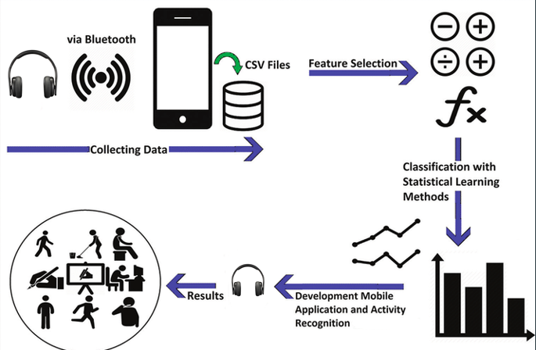
Project Goal

Slide 3
How far I reached:
Collected Private dataset.
Data Preprocessing
Statistical Feature half completed
90% EDA completed
SVM and Random forest model applied.
Check Accuracy.
Next Work:
Statistical Feature full complete
Full EDA complete
Machine Learning Model Apply
Visualize when accuracy get higher
or lower for specific feature.

Slide 4
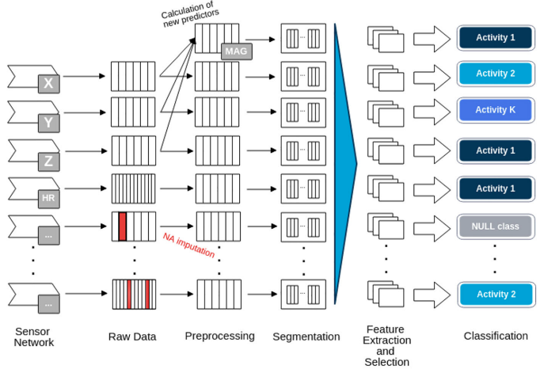
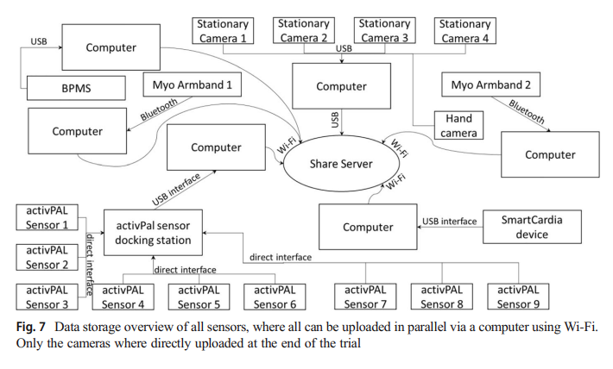
First Paper
Name: Advanced Sensing and Human Activity Recognition in Early Intervention and Rehabilitation of Elderly People
Abstract: (1) Application of a human activity recognition (HAR) system to support elderly people (2) Monitors activity patterns and intervenes when there are changes in behavior or critical events occur (3) Utilize machine learning methods from the field of HAR to detect human activities.
Methodology:

Slide 5
Major Contribution:
Using Camera, Accelerometer, Gyroscope and Magnetometer for data collect.
Down sampling procedure was performed to set all sensors to the same sampling frequency
Video and Data will be transferred to Shared Server via Wi-Fi.
Building a HAR database how the labels were generated for the collected data.

Slide 6
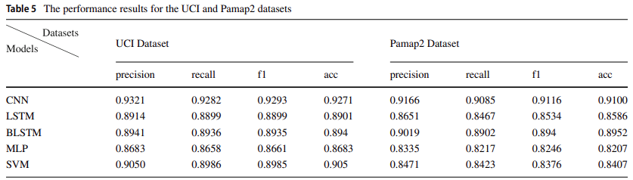
Second Paper
Name: Deep Learning Models for Real-time Human Activity Recognition with Smartphones.
Methodology: (1) Applied SVM, LSTM, BLSTM, CNN, MLP models. (2) UCI public dataset and private dataset was measured by Reiss and Strickere et al. which recorded 18 daily physical activities used.
Major Contribution:
Applied both Machine Learning and Deep Learning models.
(2) Used both Public and Private Dataset.

Slide 7
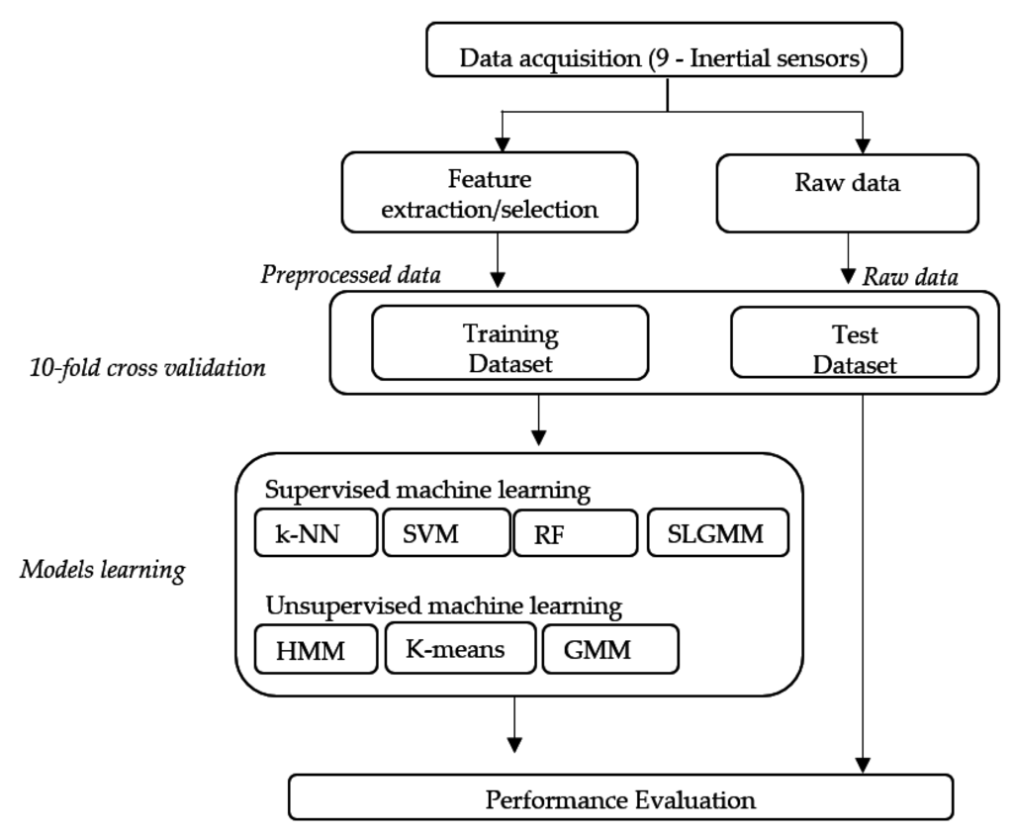
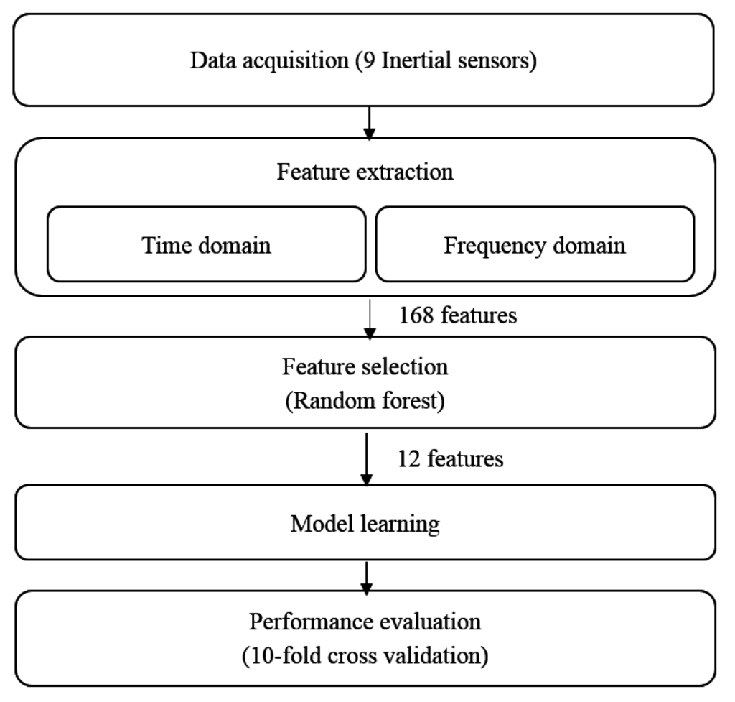
Third Paper
Name: Physical Human Activity Recognition Using Wearable Sensors
Abstract: Different classification techniques used to recognize human activities from wearable inertial sensor data. The k-NN classifier provides the best performance compared to other supervised classification algorithms, while the HMM classifier provides the best results among unsupervised classification algorithms.
Methodology:

Slide 8
Major Contribution:
Applied k-Nearest Neighbors (k-NN) classification to differentiate between nine human activities using time-domain features obtained from three uni-axial accelerometers.
Applied SVM techniques to discriminate between falls and other activities using a microphone and tri-axial accelerometer, achieving recognition rates ranging between 84% and 96%.
Random Forests (RF) algorithm, which combines decision trees using the bagging method and randomization, improves classification performance compared to a single-tree classifier.

Slide 9
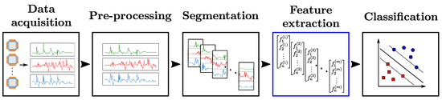
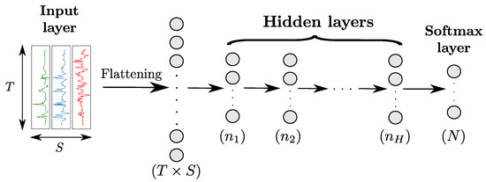
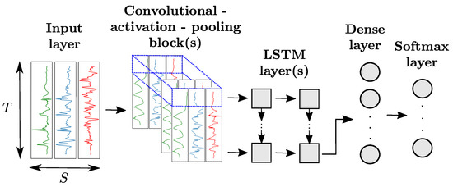
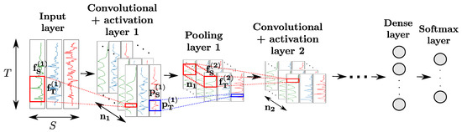
Fourth Paper
Name: Comparison of Feature Learning Methods for Human Activity Recognition Using Wearable Sensors.
Methodology:

Slide 10
Major Contribution:
The results demonstrate that feature extraction methods based on automatic learning, such as CNN and LSTM, outperform traditional hand-crafted features.
Hybrid CNN-LSTM architecture achieves consistent top performance on both benchmark datasets.
Fusion of codebook and deep learning features improves classification results.

Slide 11
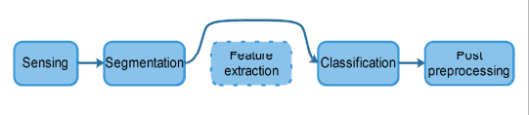
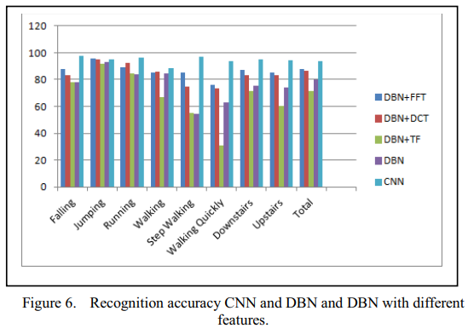
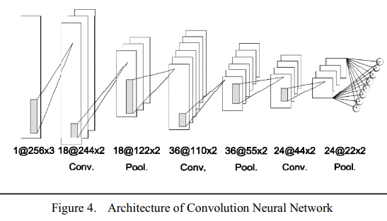
Fifth Paper
Name: A Deep Learning Approach to Human Activity Recognition Based on Single Accelerometer.
Abstract: They propose an acceleration-based human activity recognition method using Convolution Neural Network (CNN) with an average accuracy of 93.8% without feature extraction methods.
Methodology:

Slide 12
Major Contribution:
This paper proposes an acceleration-based HAR algorithm using CNN.
The experiments are executed on a large dataset of eight kinds of typical activities with 31688 samples from 100 subjects.
The results show that the CNN works well, reaches an accuracy of 93.8%. The proposed model is accurate and robust without any feature extraction.

