Slide 1
Human Activity Recognition
Monirul Islam Mahmud
MD. Shihab Reza
Hafeza Akter

Slide 2
Unique Contribution
1st Paper
2nd Paper
Focuses on HAR of elderly people using gyroscope and accelerometer data.
Various machine learning and deep learning algorithms to recognize activities.
This approach can provide assistance to elderly people by monitoring their activities
Kidney stone is formed when salts and certain minerals such as calcium and uric acid are accumulated in urine. It is caused because of inadequate intake of water.
It mainly occurs when our body lacks fluid and accumulates a lot of waste.

Slide 3
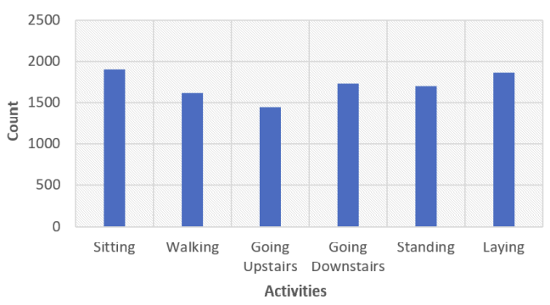
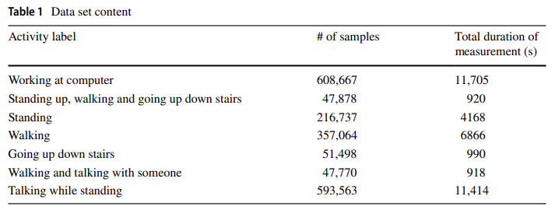
Dataset Details
Dataset contains 10,299 private sample. 8240 Training Data & 2059 Testing Data.
6 different categories of user activity: sitting, walking, going upstairs, going downstairs, standing & lying.
Dataset contains Public data.
7 different categories of user activity: working at computer, walking, going upstairs, going downstairs, standing & talking.

Slide 4
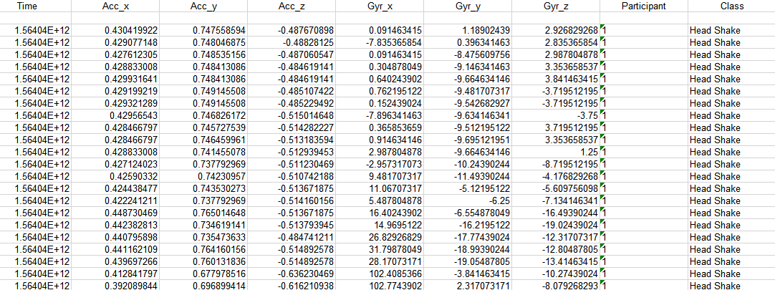
Comparison with our dataset
Dataset contains data from 6 people.
7 different categories of user activity: Eating, Headshake, Nodding, Speak and Walk, Speaking, Staying, Walking.
Feature of our Dataset are Time, Accelerometer value from x, y and z axis, Gyroscope value from x, y and z axis, Participant num and Class name.

Slide 5
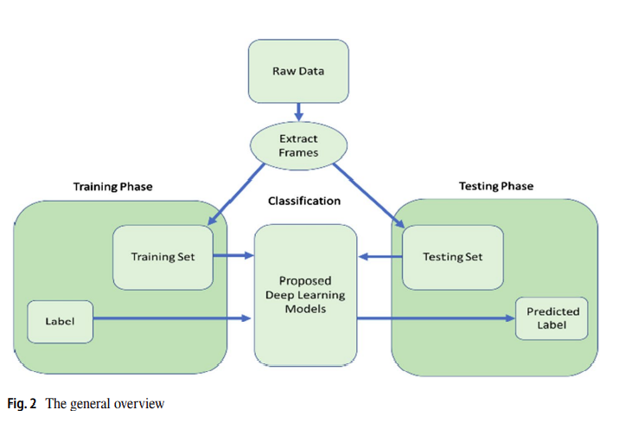
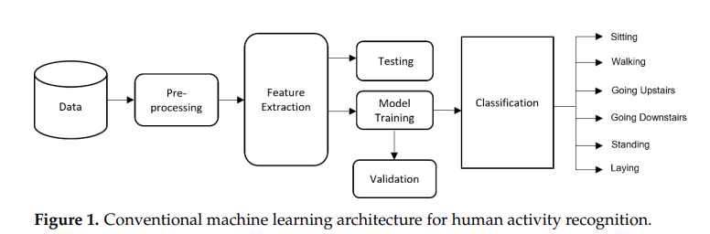
Methodology
ML Model: (1) Random Forest (2) K-NN (3) SVM
DL Model: (1) ANN, (2) LSTM
DL Model: (1) CNN, (2) Convolutional LSTM (3) 3D CNN
EDA & PP: Only PCA is used.
Best Model: 3D CNN fed by Convolutional LSTM
Accuracy of 93.69%
Best Model: LSTM – Accuracy of 95.04%

Slide 6
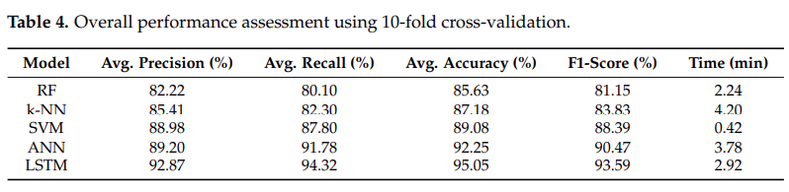
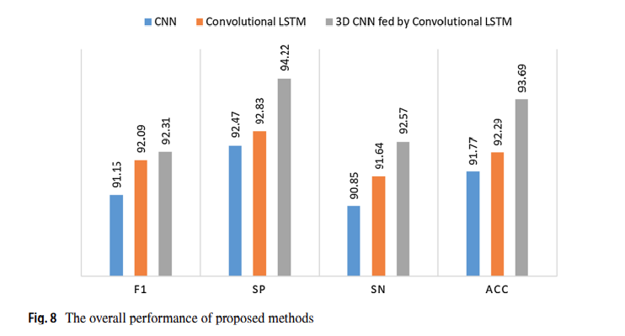
Result Analysis
1st Paper
2nd Paper

Slide 7
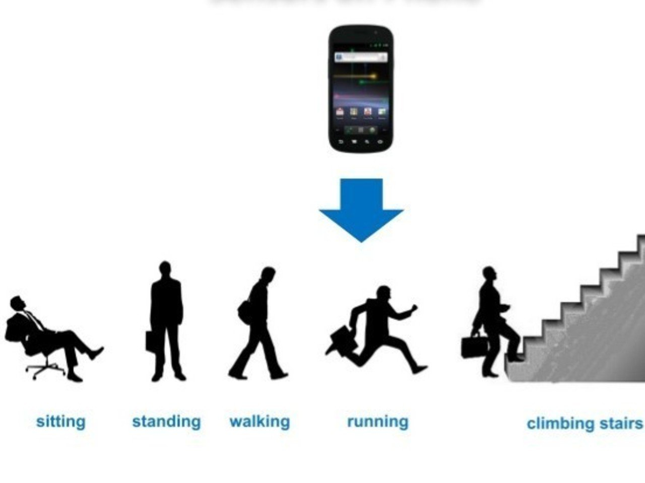
Future Work & Our idea
Work on Elderly People’s wellbeing.
Use different ML and DL algorithms.
Goal - more accuracy gain.
Arable Device of Cambridge University.
Raw data from 6 person’s activity.

Slide 8
Reference
[1] A. Hayat, F. Morgado-Dias, B. P. Bhuyan, and R. Tomar, “Human Activity Recognition for Elderly People Using Machine and Deep Learning Approaches,” MDPI, May 26, 2022. https://www.mdpi.com/2078-2489/13/6/275
[2] Ç. B. Erdaş and S. Güney, “Human Activity Recognition by Using Different Deep Learning Approaches for Wearable Sensors - Neural Processing Letters,” SpringerLink, Feb. 19, 2021. https://link.springer.com/article/10.1007/s11063-021-10448-3

Slide 9
Thank You!

