Slide 1
Human Activity Recognition
Monirul Islam Mahmud (2011839042)
Md. Shihab Reza (1931229042)
Hafeza Akter (1922175042)

Slide 2
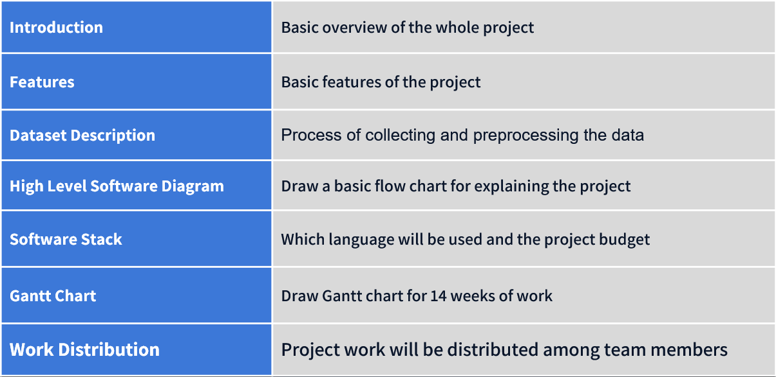
Table of Contents

Slide 3
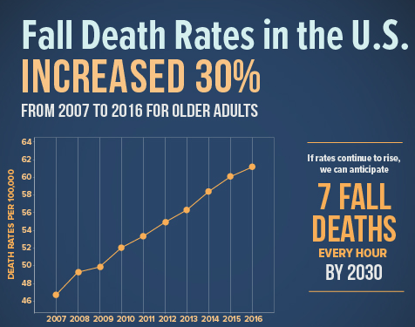
Brief about Project
Human Activity Recognition (HAR) is the process of automatically identifying human activities from data gathered from sensors or other sources.
Goals:
The goal of this study is to explore sensor technology for sensing experiment by using the accelerometer and gyroscope and to identify supervised machine learning and deep learning classifier to achieve the best activity recognition performance.
The main goal of this project is Elder Care center and Patient monitoring system. By using human activity recognition, we can detect elder person's activities and it will ensure their safety as well as it will make nurses' and doctors’ task more easier.

Slide 4
Motivation
As Fall death rate is increasing dramatically worldwide, we want to improve the safety and quality of life for elderly individuals.
Human activity recognition can prevent fall deaths in elderly people by detecting potential fall events and alerting emergency services.
Human activity recognition can also be used to track and monitor the health and wellbeing of elderly individuals, helping to detect potential health issues.

Slide 5
Dataset Features
Wearable Devices: Smartphone Accelerometers (Numerical), Gyroscopes (Numerical).
Smartphones: In smartphone there existed built in Accelerometers (Numerical), Gyroscopes (Numerical) and camera (image data).
Demographic features: Eating (Categorical), Walking (Categorical), Exercise (Categorical), Standing (Categorical).
Private Dataset
Public Dataset
We will collect private data from ML labs those are working with human activity recognition (HAR).
We will collect the datasets from Kaggle, Zindi and UCI datasets.

Slide 6
Poject Dataset
Public Dataset
Private Dataset
We will collect the datasets from Kaggle, Zindi and UCI datasets.
We will collect private data from ML labs those are working with human activity recognition (HAR).

Slide 7
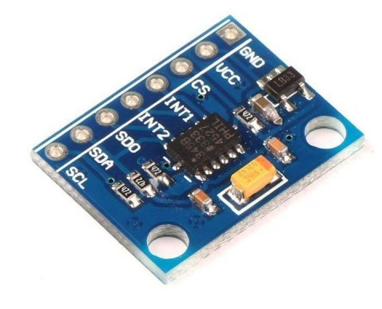
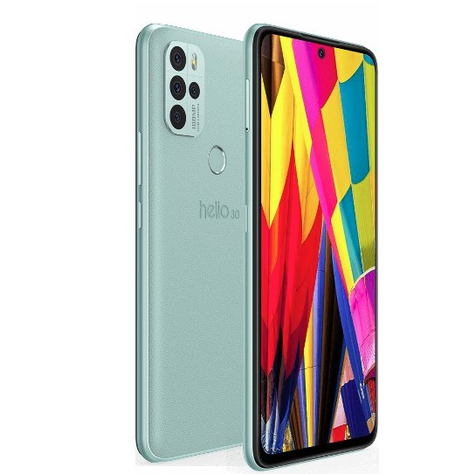
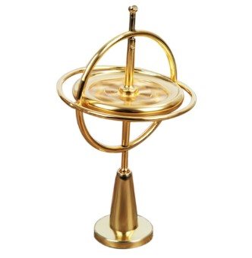
Software Stack
Language: Python
Machine Learning Algorithm: Decision Tree, Random Forest, SVM, K-Nearest Neighbor.
Deep Learning Algorithm: CNN, ANN.
IDE: Jupyter Notebook
Accelerometer
Smartphone
The price of the accelerometer is around 500 BDT.
Any smartphone with camera and GPS tracker will be okay.
Gyroscope
The price of the Gyroscope is around 1000 BDT

Slide 8
Project Budget
Project Workflow
Accelerometer
Gyroscope
Smartphone
The price of the accelerometer is around 500 BDT.
The price of the Gyroscope is around 1000 BDT
Any smartphone with camera and GPS tracker will be okay.

Slide 9











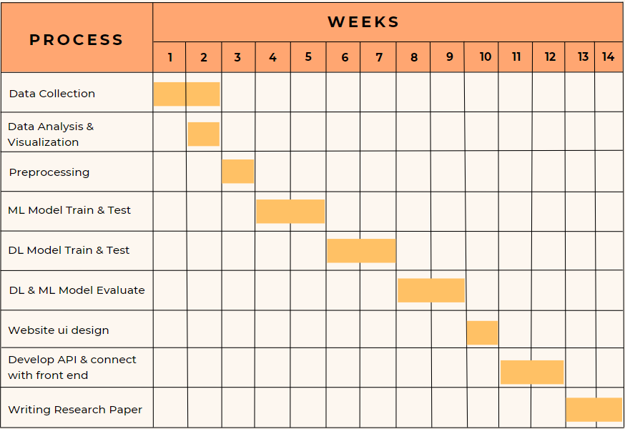
Project Workflow
Missing Value Analysis
Data Cleaning
Object to numerical conversion
CSV files
Data Collect
Preprocessing
Result
Classification with Supervised Machine Learning & Deep Learning method
Feature Selection
and Extraction

Slide 10
Gantt Chart
Work Distribution

Slide 11
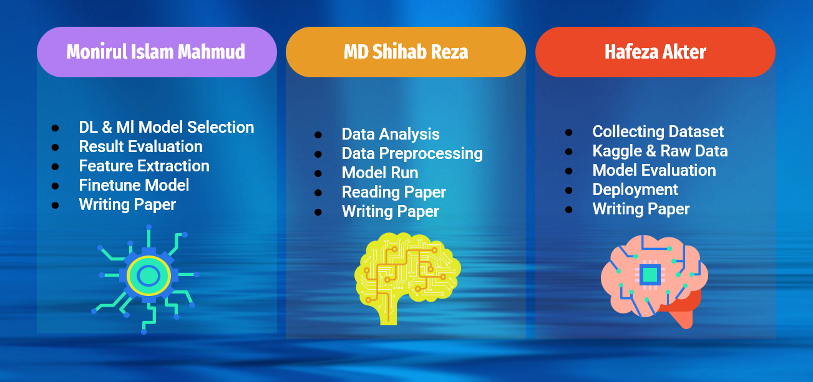
Work Distribution
[1] L. Schrader et al., “Advanced Sensing and Human Activity Recognition in Early Intervention and Rehabilitation of Elderly People - Journal of Population Ageing,” SpringerLink, Feb. 24, 2020. https://link.springer.com/article/10.1007/s12062-020-09260-z
[2] S. Wan, L. Qi, X. Xu, C. Tong, and Z. Gu, “Deep Learning Models for Real-time Human Activity Recognition with Smartphones - Mobile Networks and Applications,” SpringerLink, Dec. 30, 2019. https://link.springer.com/article/10.1007/s11036-019-01445-x
[3] Y. Chen and Y. Xue, “A Deep Learning Approach to Human Activity Recognition Based on Single Accelerometer,” 2015 IEEE International Conference on Systems, Man, and Cybernetics, Oct. 2015, Published, doi: 10.1109/smc.2015.263.

Slide 12
Reference
[1] L. Schrader et al., “Advanced Sensing and Human Activity Recognition in Early Intervention and Rehabilitation of Elderly People - Journal of Population Ageing,” SpringerLink, Feb. 24, 2020. https://link.springer.com/article/10.1007/s12062-020-09260-z
[2] S. Wan, L. Qi, X. Xu, C. Tong, and Z. Gu, “Deep Learning Models for Real-time Human Activity Recognition with Smartphones - Mobile Networks and Applications,” SpringerLink, Dec. 30, 2019. https://link.springer.com/article/10.1007/s11036-019-01445-x
[3] Y. Chen and Y. Xue, “A Deep Learning Approach to Human Activity Recognition Based on Single Accelerometer,” 2015 IEEE International Conference on Systems, Man, and Cybernetics, Oct. 2015, Published, doi: 10.1109/smc.2015.263.
Thank You!

Slide 13
Thank You!

