Slide 1
Stroke Prediction using Machine Learning Techniques
Monirul Islam Mahmud (2011839042)
Hafeza Akter (1922175042)
Team – Neural Ninjas

Slide 2
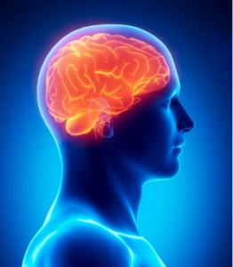
Brief Overview
Stroke occurs when the blood flow to various areas of the brain is disrupted. Our project aims to predict the likelihood of an individual having a stroke.
Accurate and efficient method of stroke prediction that can aid in the early detection of stroke.
The project uses machine learning algorithms to analyze large volumes of health data and identify patterns and risk factors associated with stroke.
Overall, the stroke prediction project has the potential to improve healthcare outcomes and reduce the burden of stroke on individuals and society.

Slide 3
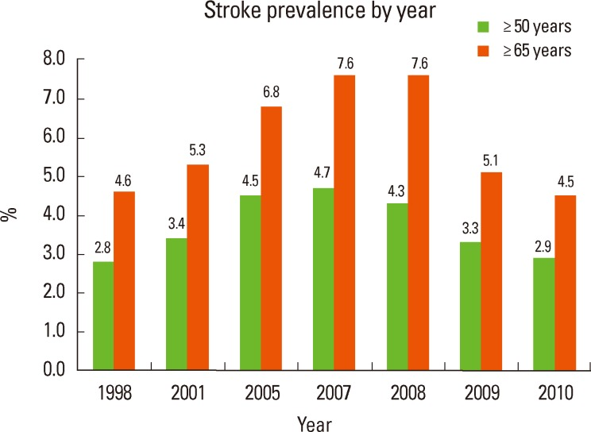
Motivation
According to the World Health Organization, stroke is the second leading cause of death globally.
Motivation for this project is to develop a more accurate and efficient method of stroke prediction.
Also motivated by the need to address the increasing burden of stroke globally and the potential of machine learning algorithms to improve early detection and prevention strategies.

Slide 4
Project Dataset
Public Dataset
Raw Dataset
And
We have collected 48,000 public data from Kaggle, Zindi and UCI datasets.
We will try to collect private data from any hospital or doctor.

Slide 5
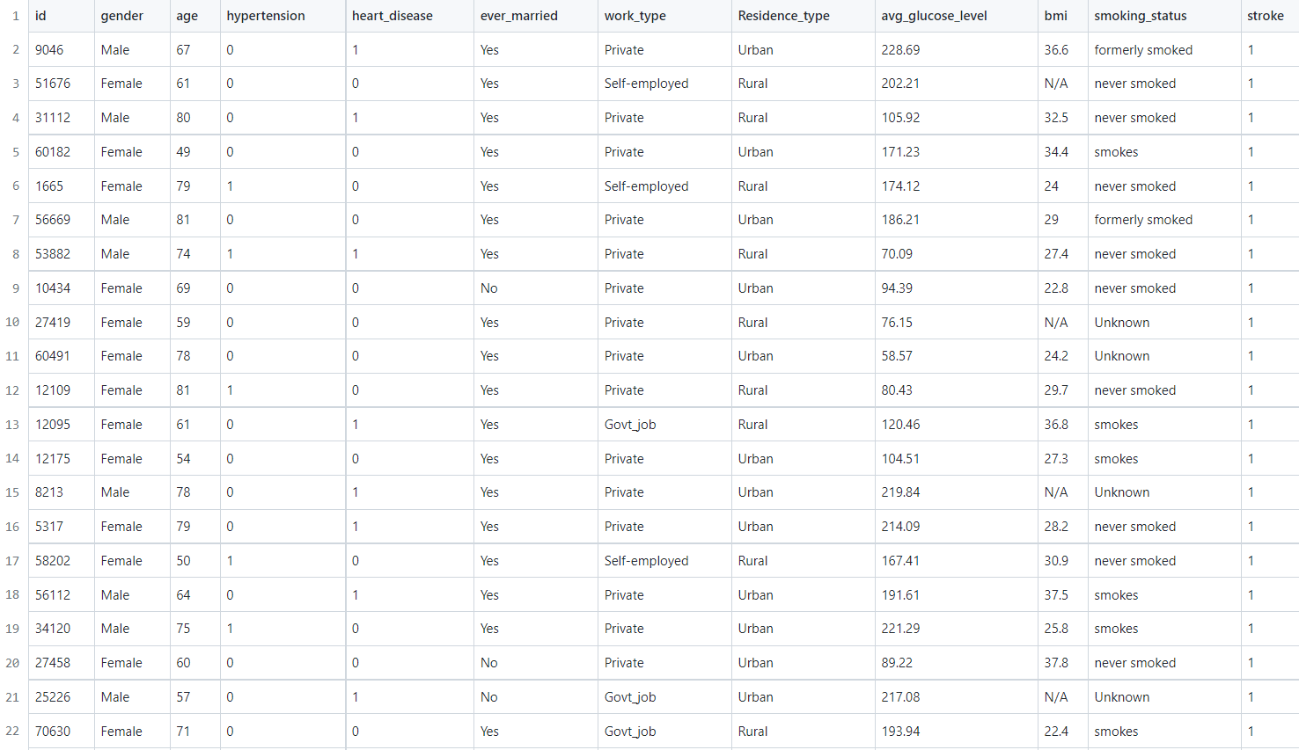
Sample Dataset

Slide 6
Dataset Features
Categorical Data
Numerical Data
Gender
Hypertension
Heart disease
Married
Work type
Residence type
Smoking status.
Age
Glucose level
BMI.

Slide 7

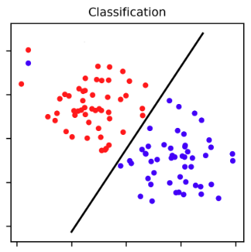
Problem Type
Supervised
Classification

Slide 8
Software Stack & Budget
Language: Python
Machine Learning Algorithm: Decision Tree, Random Forest,
K-nearest Neighbor, Logistic Regression.
IDE: Jupyter Notebook
Budget: As this will be software based project, we don’t need any hardware. So there will be no budget for the project. We just need to spend our valuable time.

Slide 9
Flow Diagram
Data Collection
EDA & Preprocessing
Train the Model
Model Evaluation
Deployment

Slide 10
High Level Software Diagram
ML Model
Front End
(Input)
Backend
Result

Slide 11
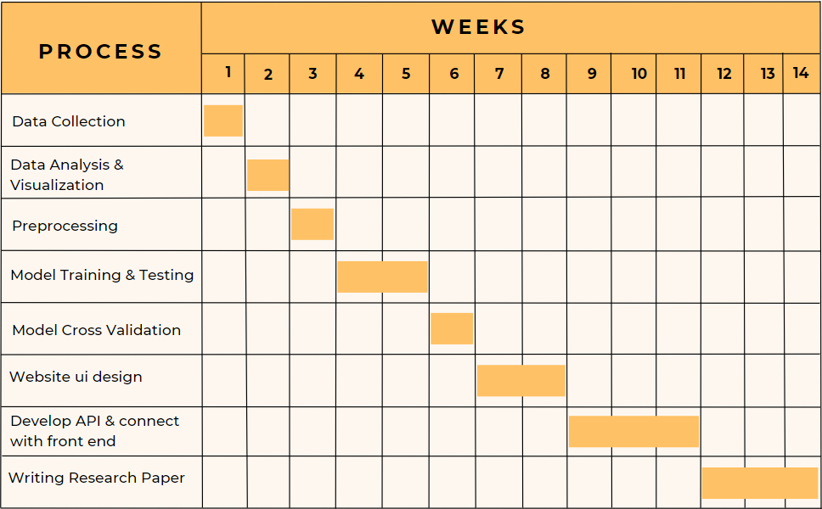
Gantt Chart

Slide 12
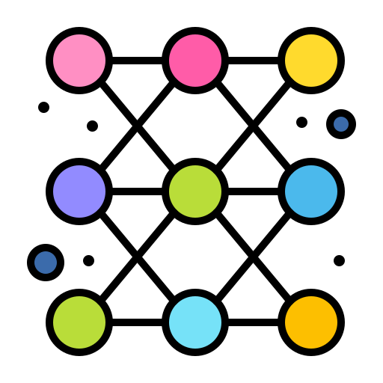
Work Distribution
Monirul Islam Mahmud
Hafeza Akter
ML Model Selection
Feature Extraction
Model Training
Cross Validation
Backend API Develop
Writing Paper
Collecting Dataset
Data Preprocessing
Model Testing
Model Evaluation
Website Ui develop
Writing Paper

Slide 13
Reference
[1] T. Liu, W. Fan, and C. Wu, “A hybrid machine learning approach to cerebral stroke prediction based on imbalanced medical dataset.” Artificial Intelligence in Medicine, vol. 101, p. 101723, Nov. 2019, doi: 10.1016/j.artmed.2019.101723.
[2] C.-Y. Hung, W.-C. Chen, P.-T. Lai, C.-H. Lin, and C.-C. Lee, “Comparing deep neural network and other machine learning algorithms for stroke prediction in a large-scale population-based electronic medical claims database.” 2017 39th Annual International Conference of the IEEE Engineering in Medicine and Biology Society (EMBC), Jul. 2017, Published, doi: 10.1109/embc.2017.8037515.
[3] M. S. Sirsat, E. Fermé, and J. Câmara, “Machine Learning for Brain Stroke: A Review,” Journal of Stroke and Cerebrovascular Diseases, vol. 29, no. 10, p. 105162, Oct. 2020, doi: 10.1016/j.jstrokecerebrovasdis.2020.105162.

Slide 14
Thank You!

