Slide 1
EEE 468 Design and Verification of a RISC- V Multicycle Processor and a Memory Controller with Wishbone Interface
Group 05
1706022 Voktho Das
1706023 Rasel Mia
1706025 Tauhid Shahriar
1706040 Habibullah Khan
1706041 Deb Indronil Sajib
1706042 Monirul Islam
1706054 Tiasa Mondal

Slide 2
Objectives
Design of a RISC-V based Processor
Verification
Synthesis
Physical Design

Slide 3
SpecificationS
Compatible with RISC-V ISA
Global Clock (positive edge triggered: clk)
Global Reset (negative edge triggered: rst_n)
Memory controller with an industry standard interface : WISHBONE
Core_Select Signal

Slide 4
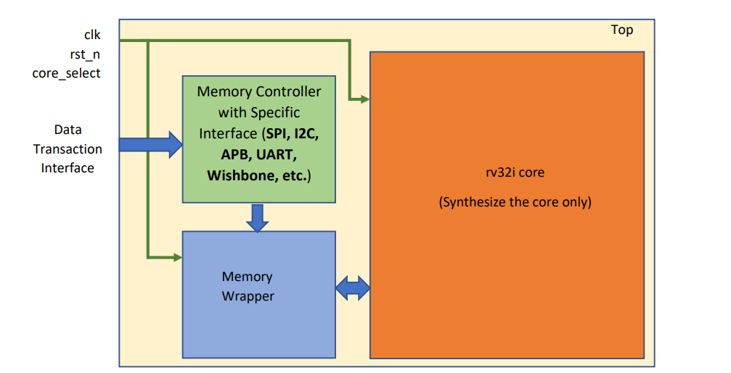
Rv32i Core
Core_Select | Functionality
0 | 1. Memory controller interface will be active to write data into the memory.
1 | 1. Core will start to work 2. Core side interface of the memory will be active to read and write data into the memory

Slide 5
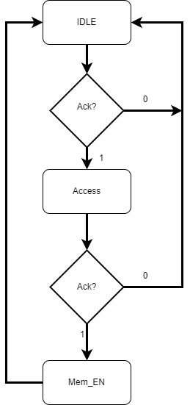
Memory Controller fsm

Slide 6
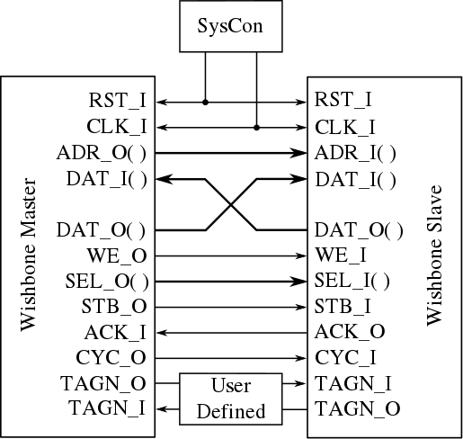
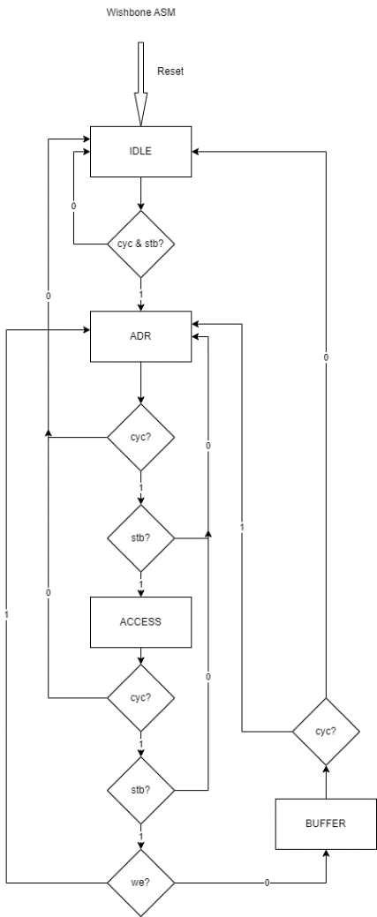
Wishbone Interface

Slide 7
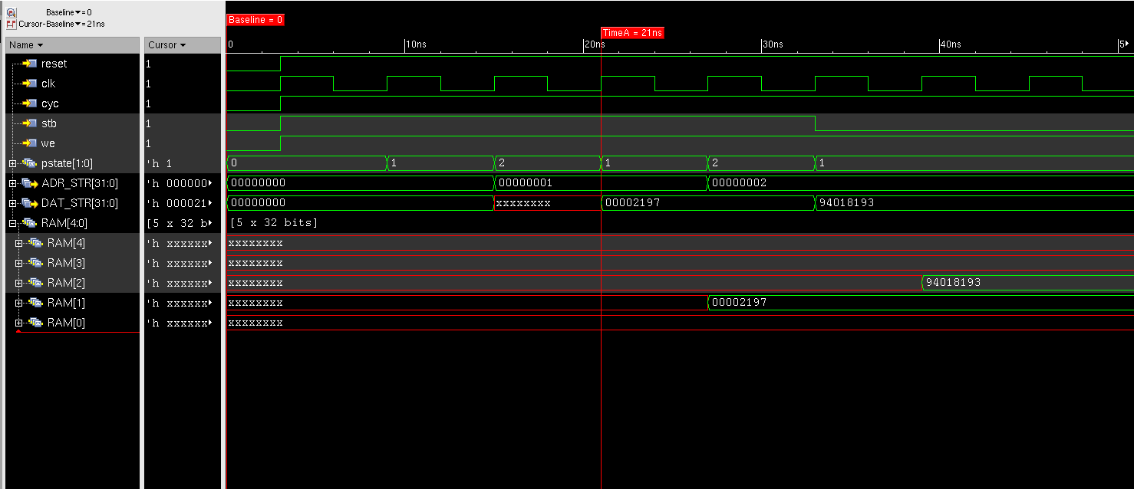
Wishbone: Verification (Write)

Slide 8
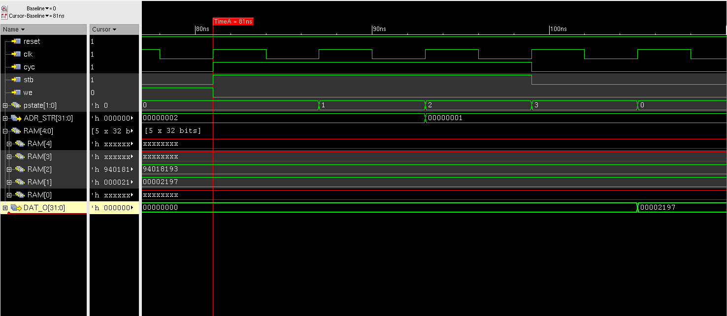
Wishbone: Verification (Read)

Slide 9
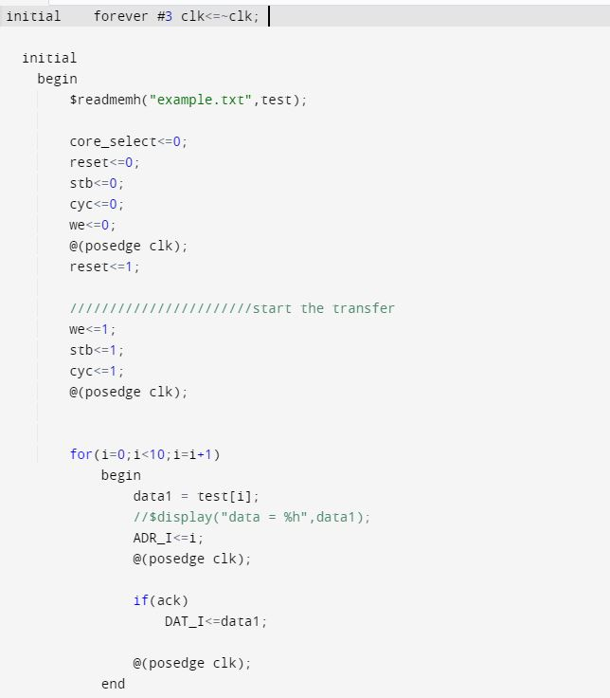
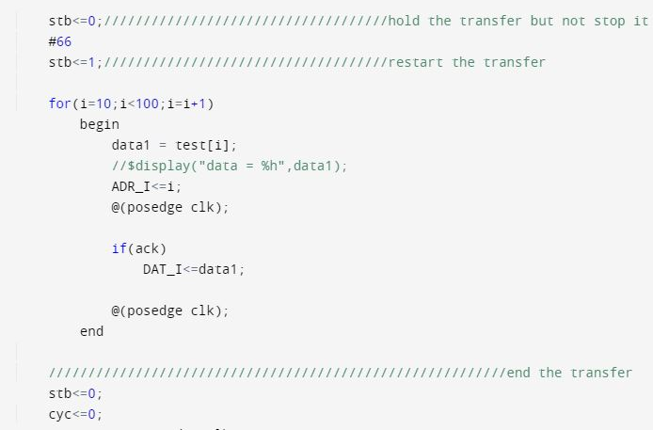
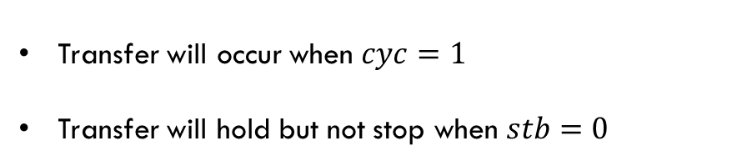
Wishbone (master)
Transfer will occur when $cyc=1$
Transfer will hold but not stop when $stb=0$

Slide 10
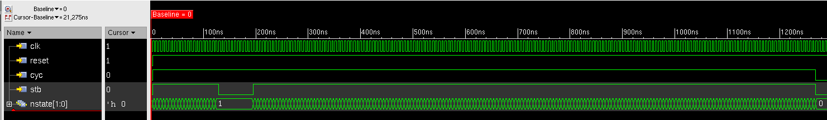
Wishbone: Verification (Hold)
NUMBER OF INSTRUCTIONS=69
Required Cycle= 136

Slide 11
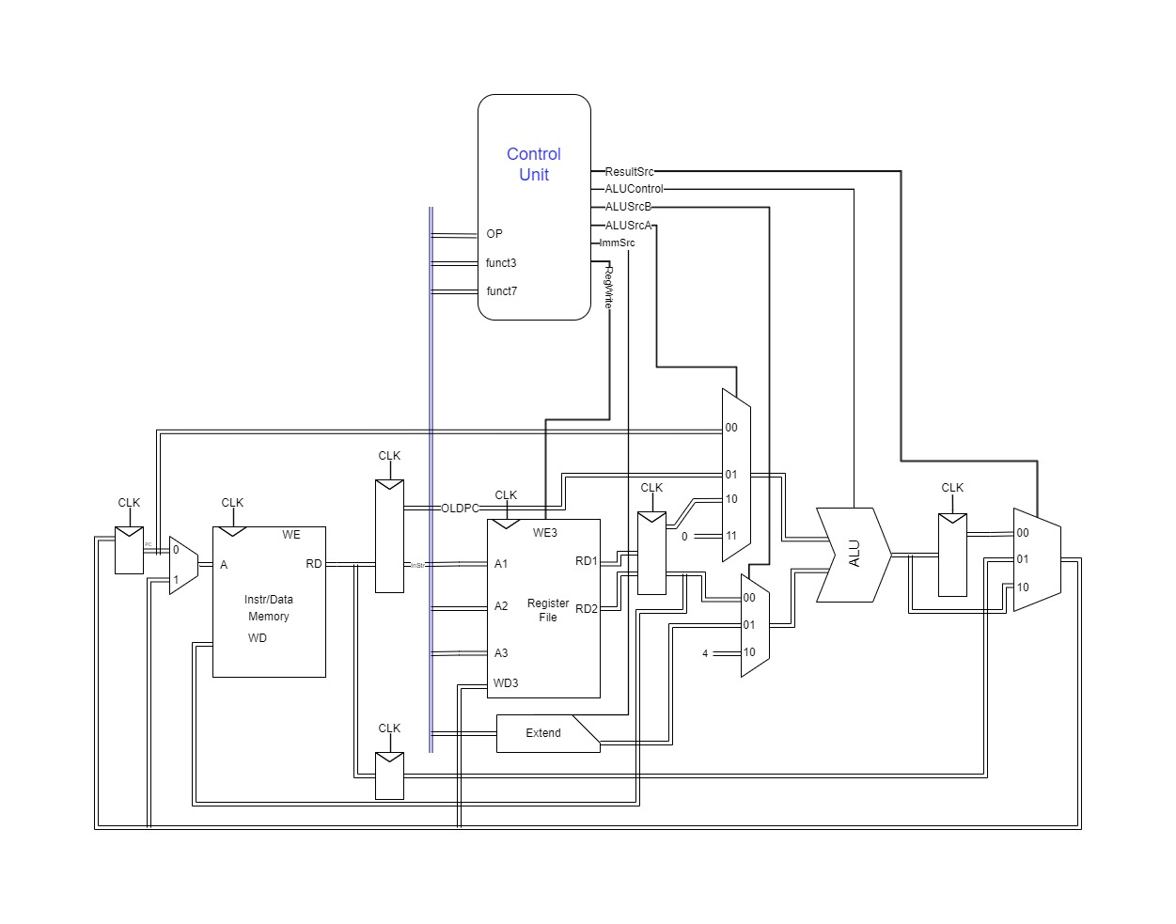
Core MicroArchitecture

Slide 12
Supported Instructions
R- Type | I- Type | U Type | S Type | B- Type | J- Type
add | addi | auipc | sw | beq | jal
sub | lw | lui |  | bne
sll | slli |  |  | blt
slt | slti |  |  | bge
xor | xori
srl | srli
sra | sra
or | ori
and | andi
 | jalr

Slide 13
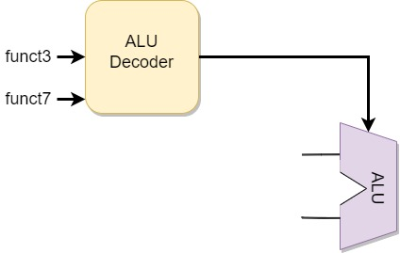
ALu
ALUControl | Function
4'b0000 | add
4'b0001 | subtract
4'b0010 | and
4'b0011 | or
4'b0100 | xor
4'b0101 | slt
4'b0110 | sll
4'b0111 | srl
4'b1000 | sra
ALUControl

Slide 14
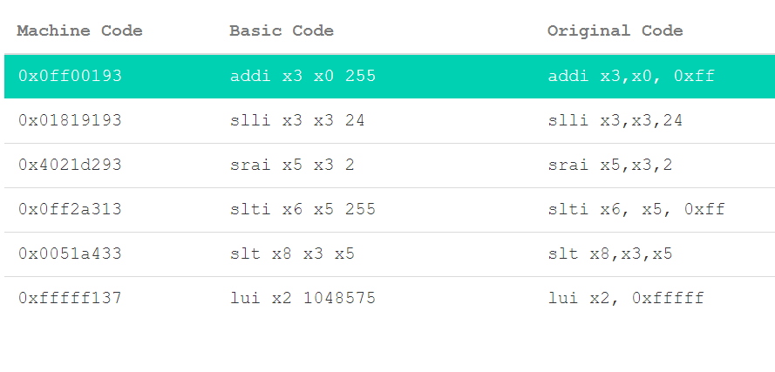
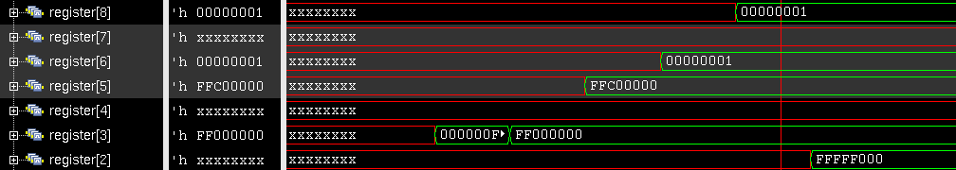
Some Instructions

Slide 15
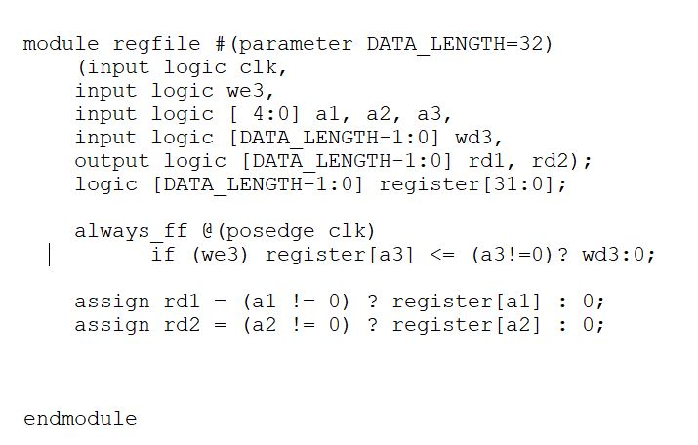
Zero Register (x0)
x0 is hardwired to zero
A feature of rv architecture
No data is written to x0
x0 will always read 0

Slide 16
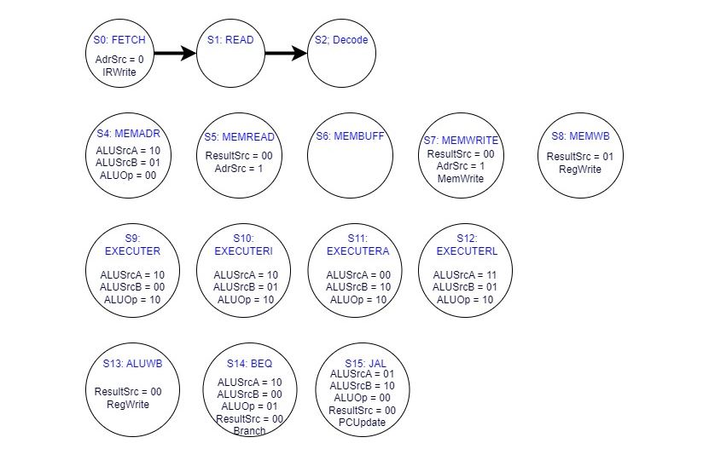
States of the Controller FSM

Slide 17
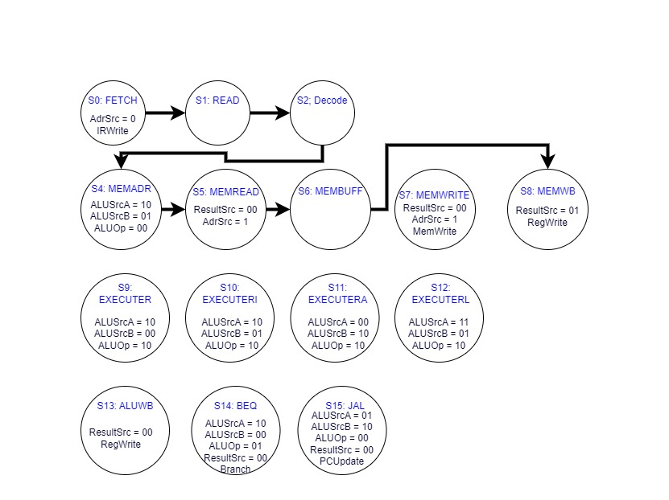
Example state diagram: lw
lw: Load Word
lw rd , imm (rs1)

Slide 18
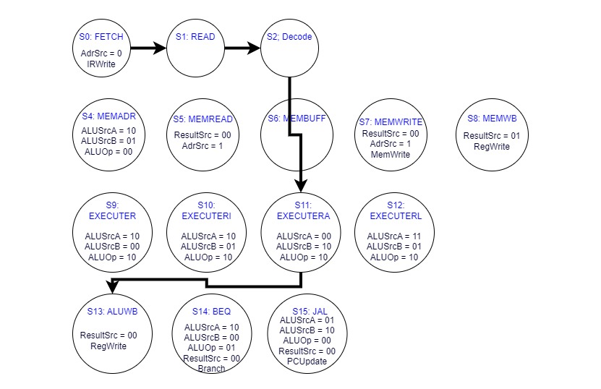
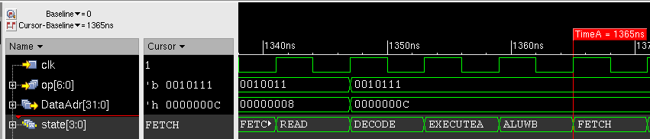
Example state diagram: auipc
auipc: add upper immediate to pc
auipc rd , upimm
rd = {upimm, 12'b0} + PC

Slide 19
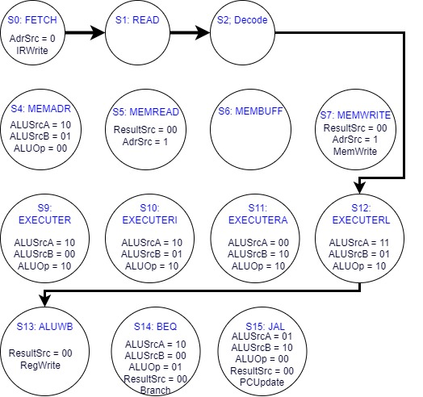
Example state diagram: lui
lui: load upper immediate
lui rd , upimm
rd = {upimm, 12'b0}

Slide 20
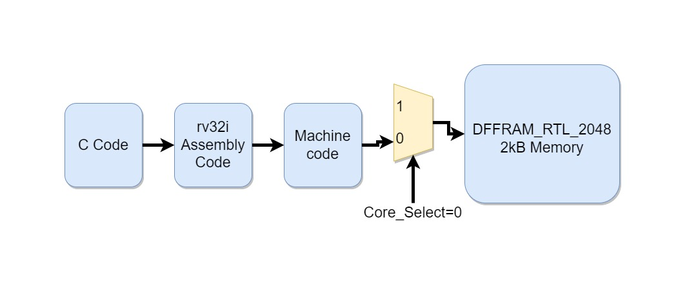
Verification

Slide 21
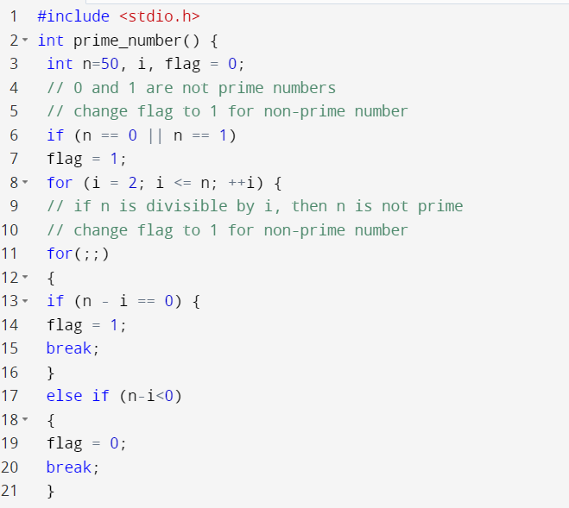
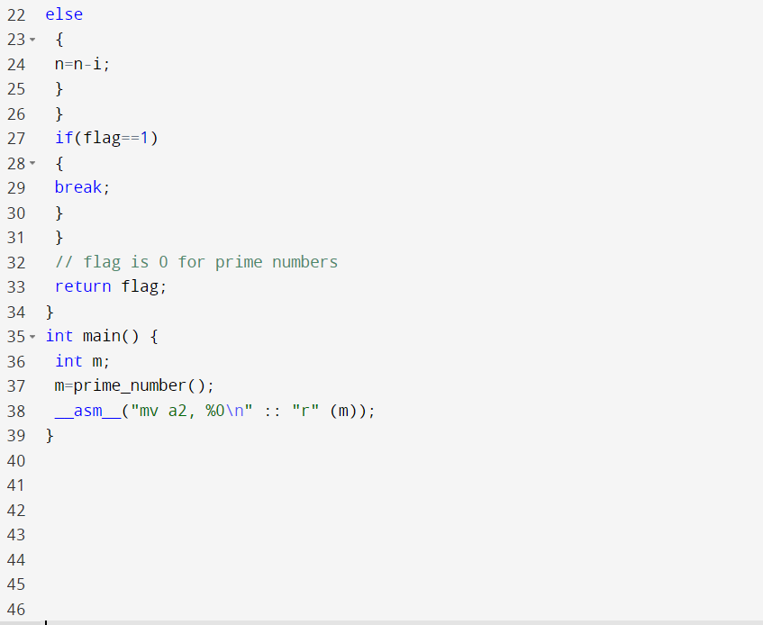
Benchmark C Code
R[12]=0 when prime number
R[12]=1 when non-prime number

Slide 22
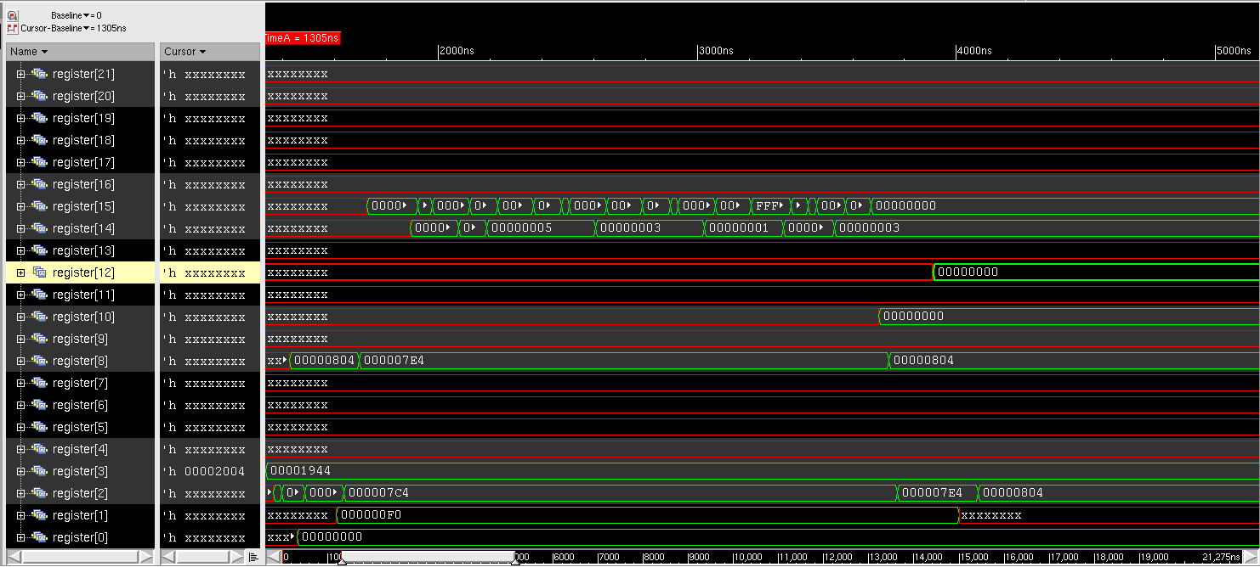
Result: Prime-Number (N=3)
Required Cycle=369

Slide 23
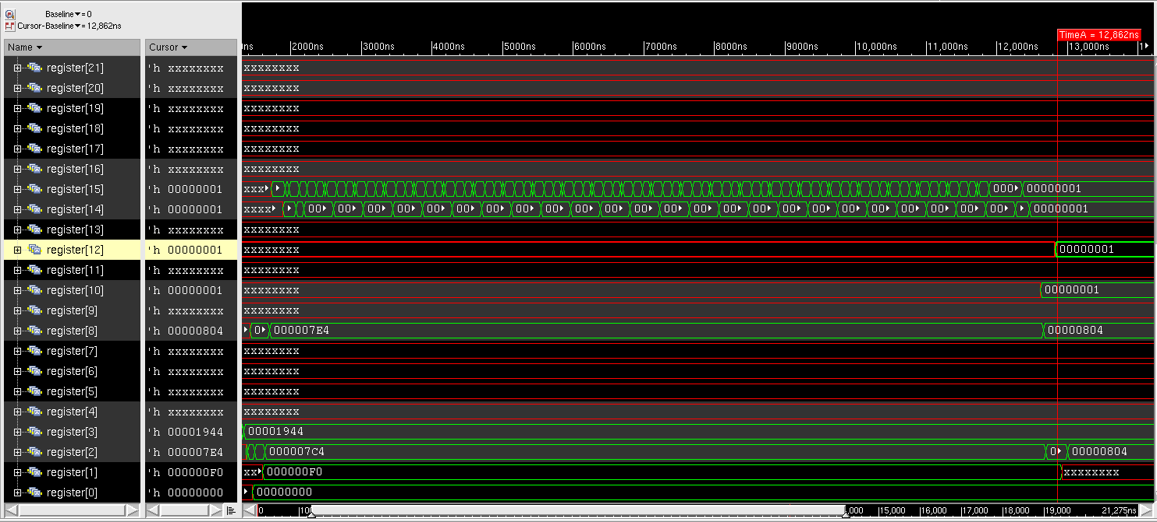
Result: Non-Prime-Number (N=50)
Required Cycle=1926

Slide 24
Thank You
✨

