Slide 1

Trustworthy Keylogger Detection:
A Comprehensive Analysis of Ensemble Techniques and Feature Selections
Monirul I. Mahmud
Data Science for Cybersecurity (CISC 5660)

Slide 2
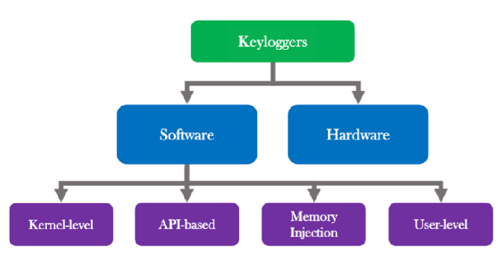
Keylogger
Software or hardware tool that records every keystroke a user makes.
Capture sensitive info - Passwords, Credit Card details, and Messages.
Types:
Software keyloggers: installed as programs or scripts.
Hardware keyloggers: USB or inline devices attached to
keyboard cables.

Slide 3
Motivation
Keylogger attacks rose 45% in 2023 globally.
Traditional antivirus solutions often fail to detect sophisticated keyloggers.
Random Forest, LightGBM, gradient boosting, decision trees, CNN and CatBoost as classifiers, and correlation-based feature extraction method, Combinatorial-Based Fuzzy Inference System, hybrid feature selection methods are commonly used methods. [1],[2],[3],[4],[5]
Identified Research Gap
Ensemble models lacking transparency, Lack of Feature selection techniques, Limited works of XAI techniques like SHAP or LIME in keylogger detection.

Slide 4
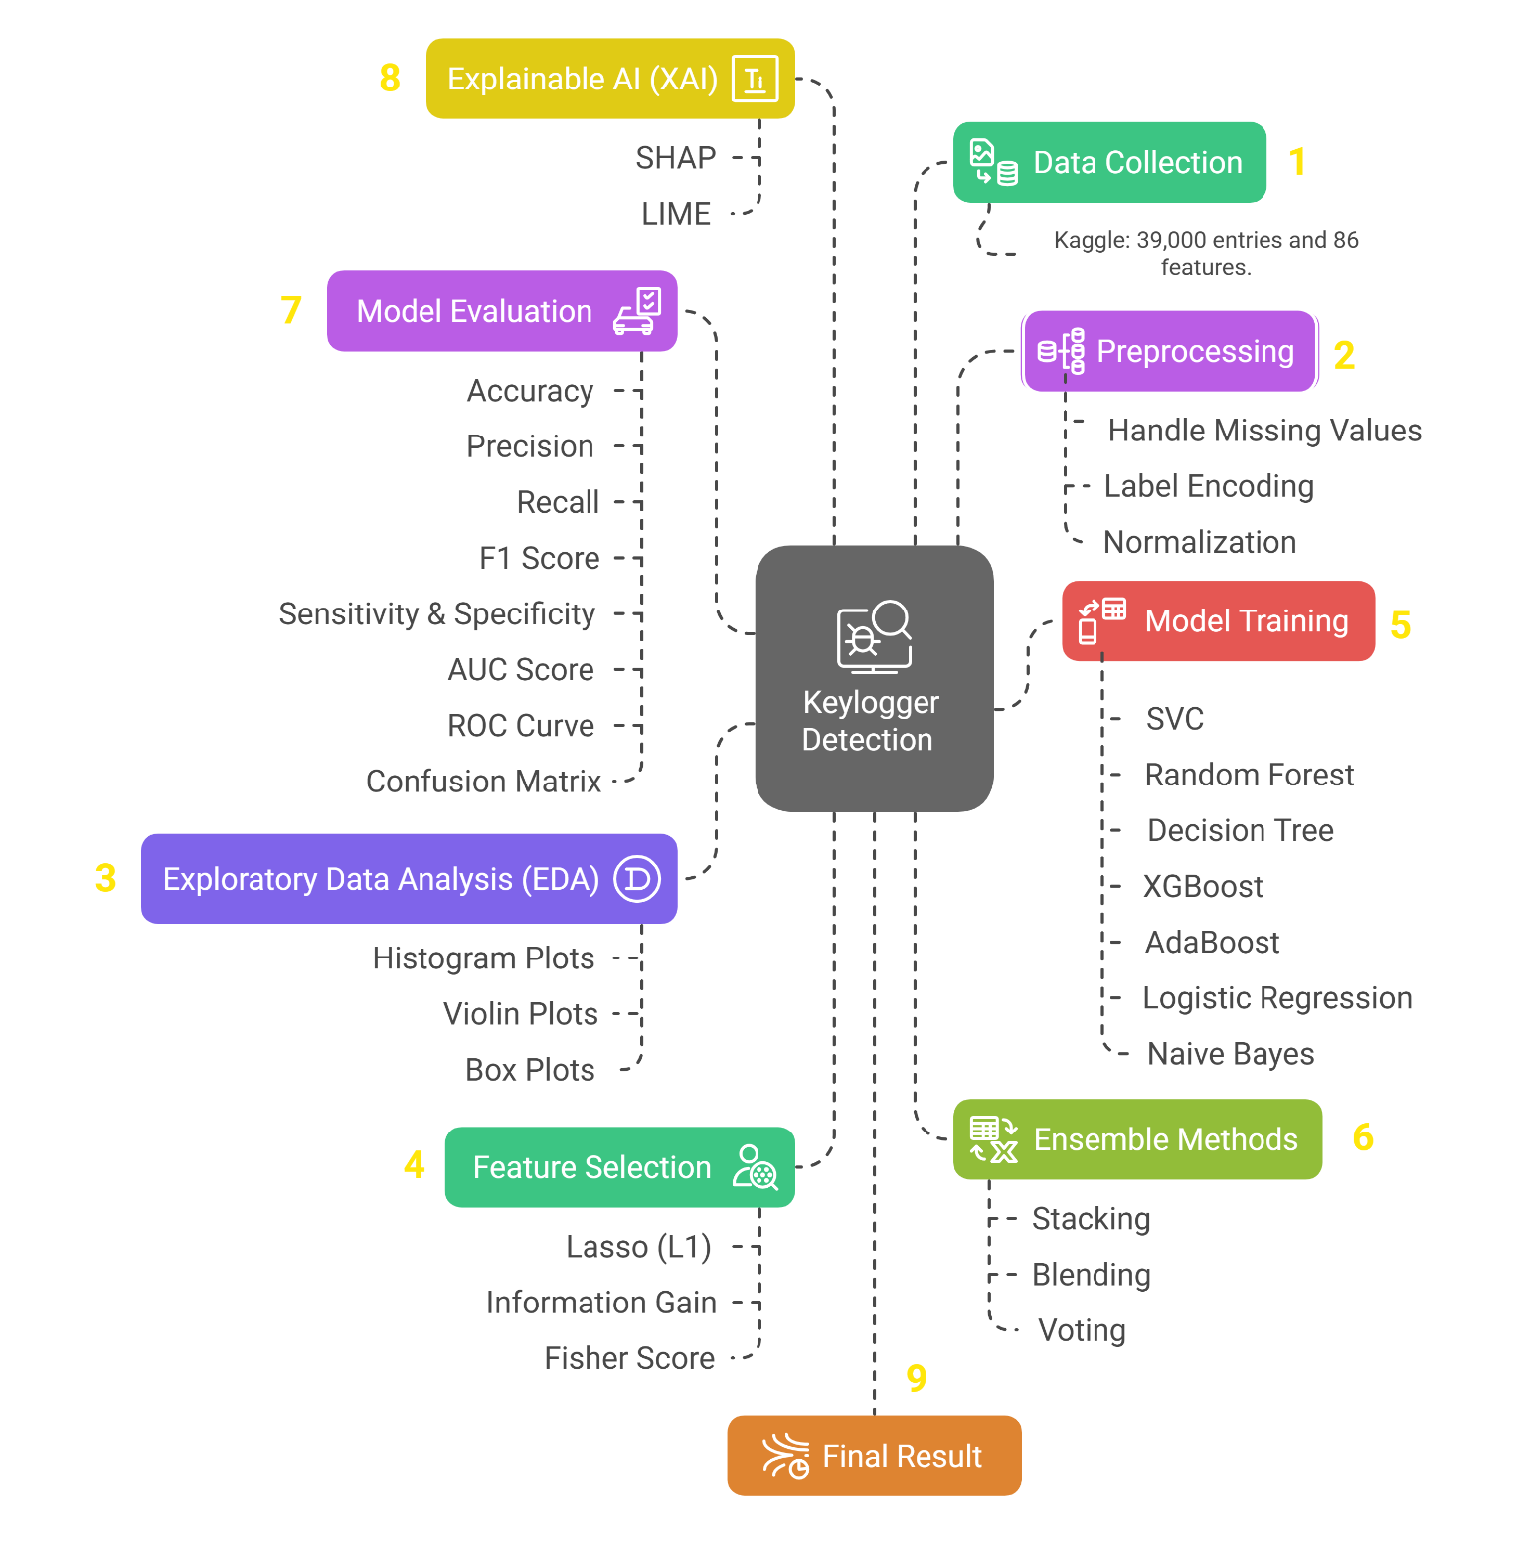
Methodology

Slide 5
Dataset Details

Slide 6

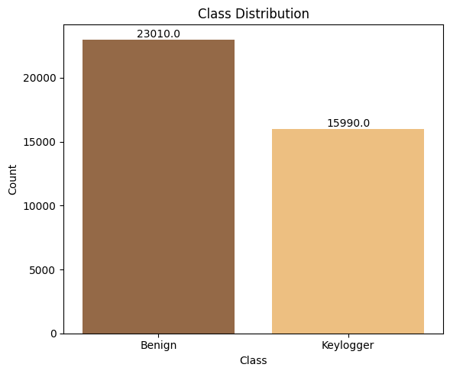
Dataset Details
Dataset is publicly available on Kaggle.
Contains network traffic data with features related to packet flows.
It includes 39,000 entries and 86 features.
2 Target Labels - 23010 Benign and 15990 Keylogger.

Slide 7
Exploratory Data Analysis (EDA)

Slide 8
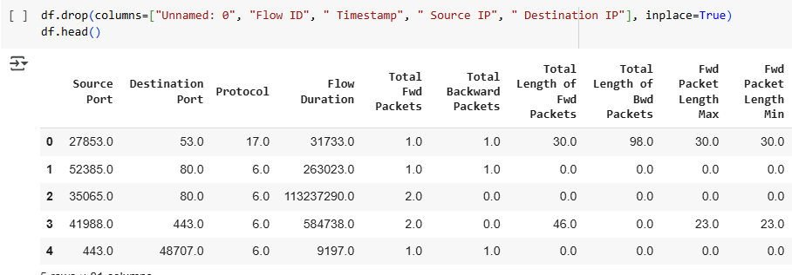
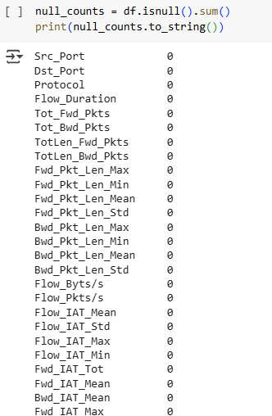
Exploratory Data Analysis (EDA)
Removed 5 unnecessary columns (e.g., Flow ID, IPs), final 81 features.
Check Null values - 0 Null values.

Slide 9
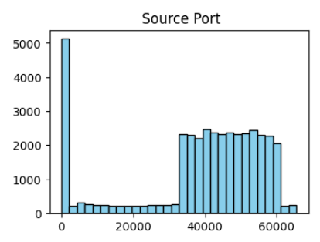
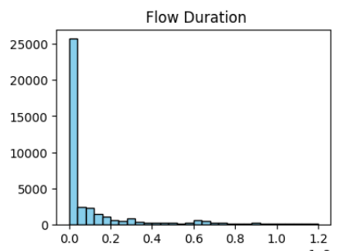
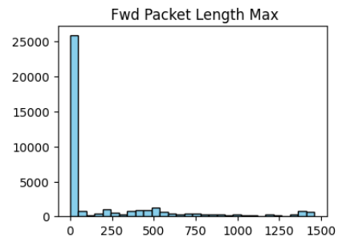
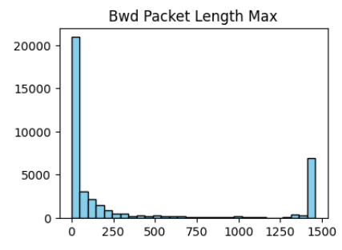
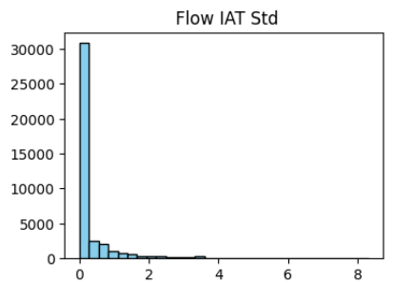
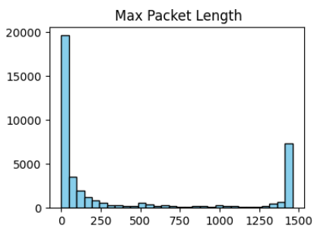
Histogram

Slide 10
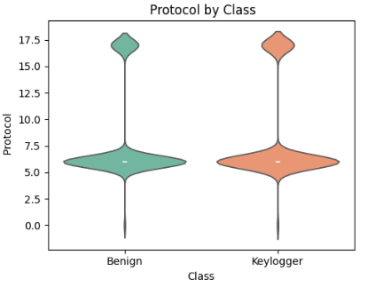
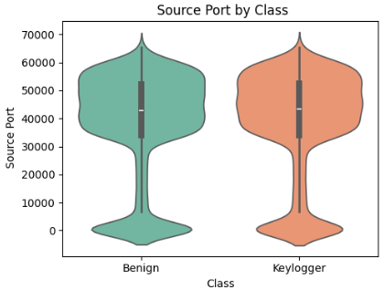
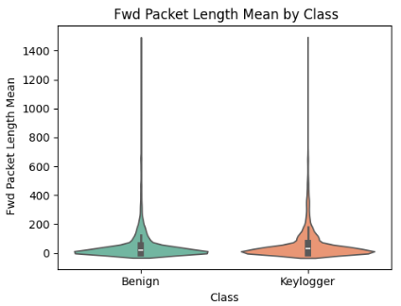
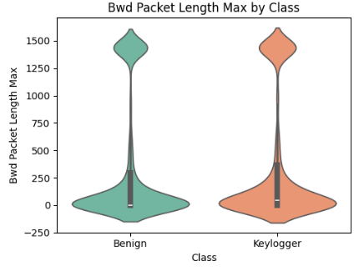
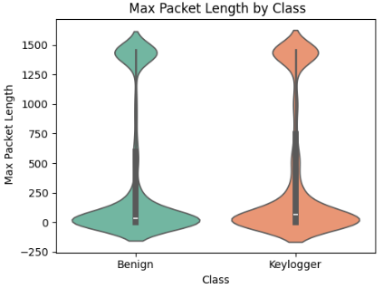
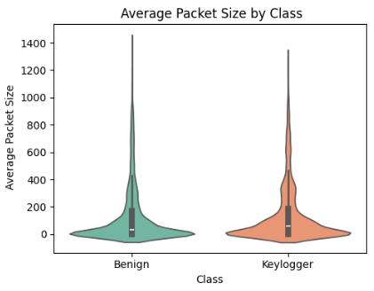
Violin Plot

Slide 11
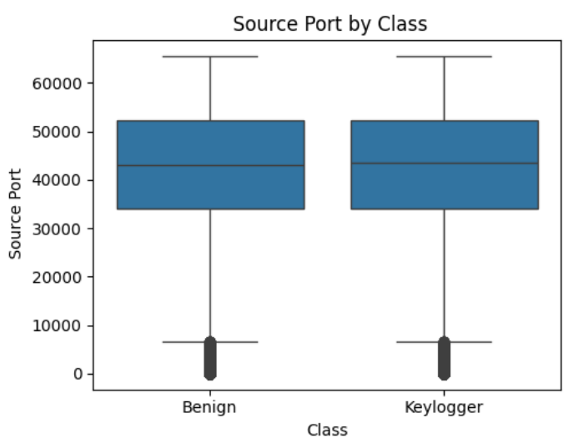
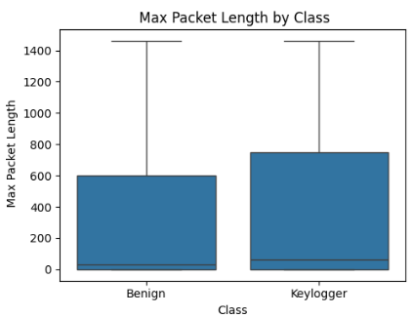
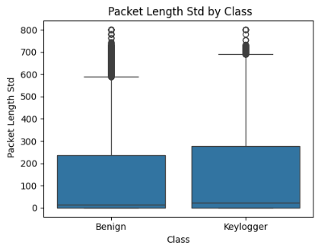
Box Plot

Slide 12
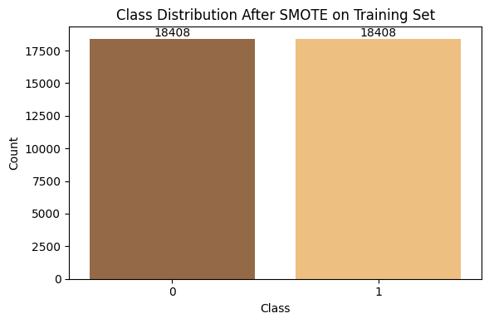
Class Balance with SMOTE
Issue: Class imbalance (fewer keylogger instances)
Solution: SMOTE applied to oversample the minority (keylogger) class by generating synthetic samples.
Impact: Enhanced model performance for keylogger detection.

Slide 13

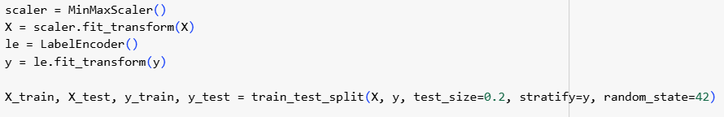
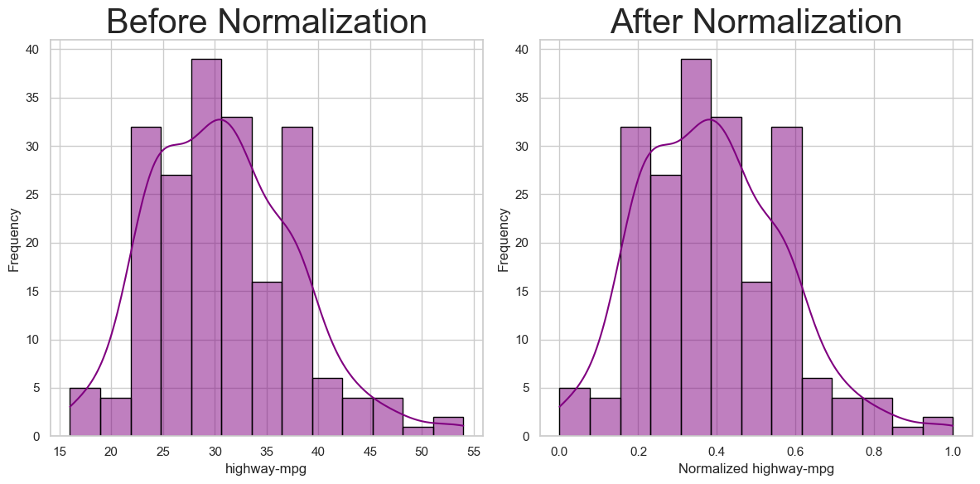
Preprocessing
Class | Label Encoder
Benign | 0
Keylogger | 1
Label Encoding
Normalization

Slide 14
Feature Selections
Information Gain | Lasso L1 | Fisher Score
Measures the reduction in entropy (uncertainty) when splitting data using a feature. | Minimizes a loss function (like MSE) with an L1 penalty by shrinking some feature coefficients to zero. | Computes the ratio of variance between classes and variance within classes for each feature.
Evaluates features independently | Considers feature interactions via model fitting. | Evaluates features independently
Best for categorical data | Effective for high-dimensional numerical data | Best for numerical features with clear class separation

Slide 15
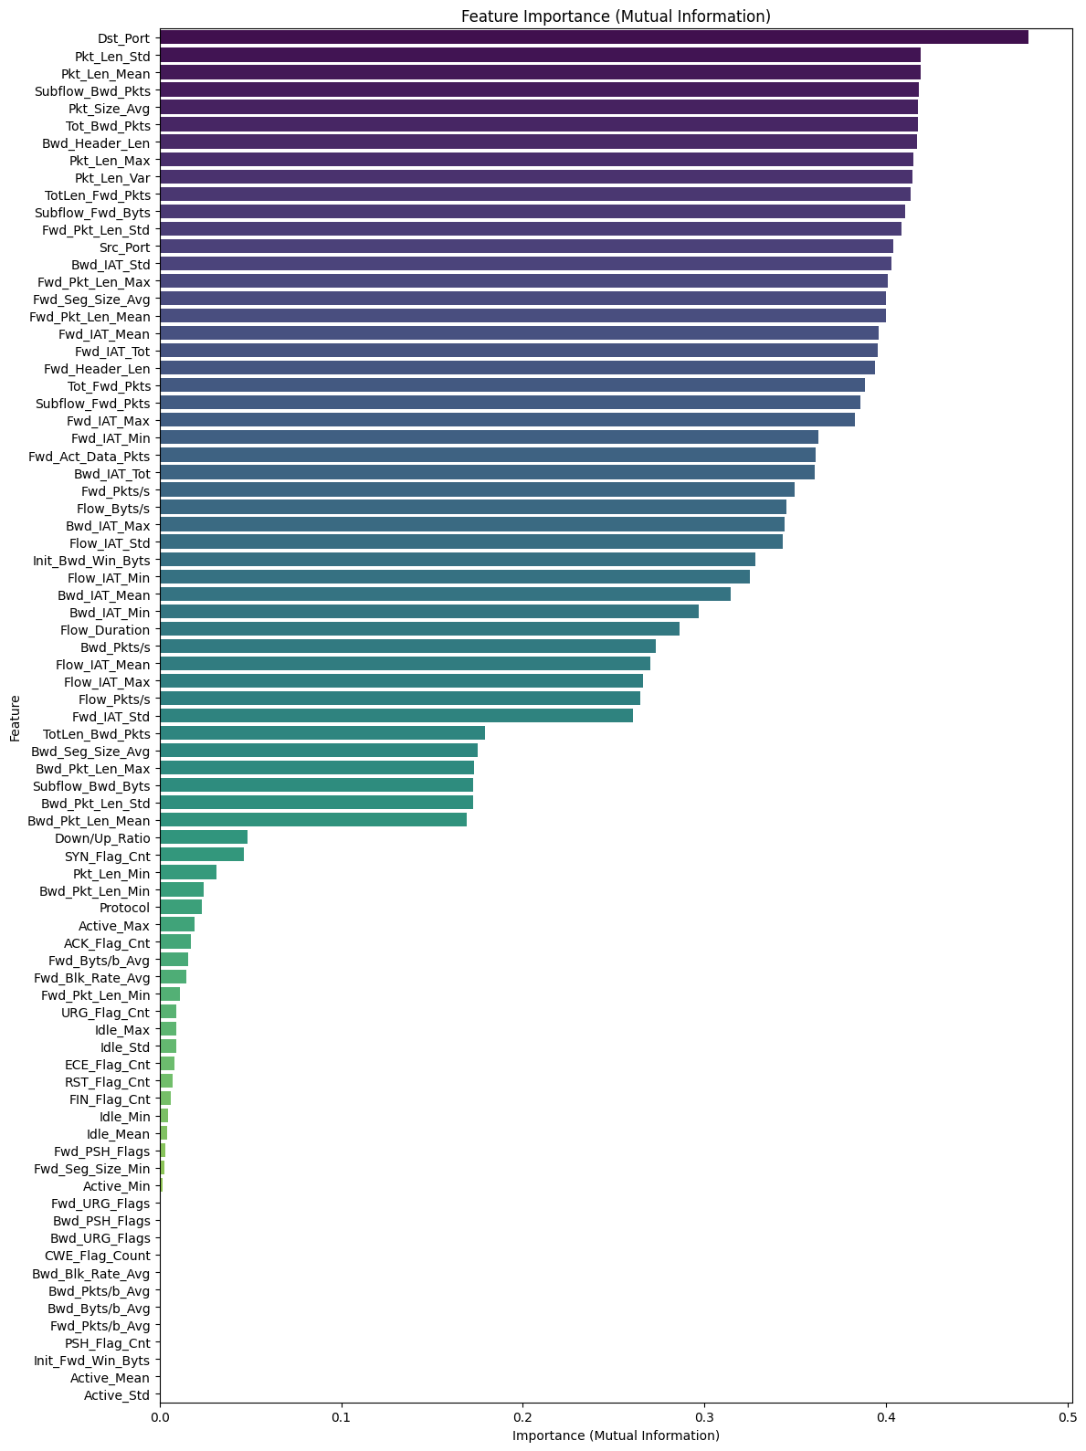
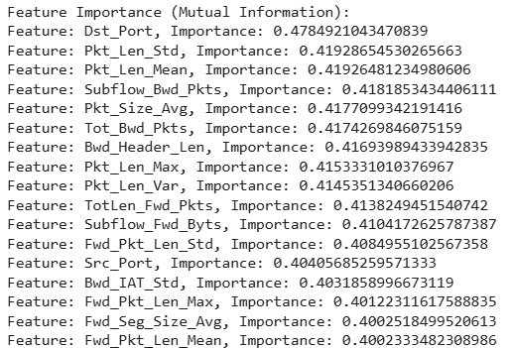
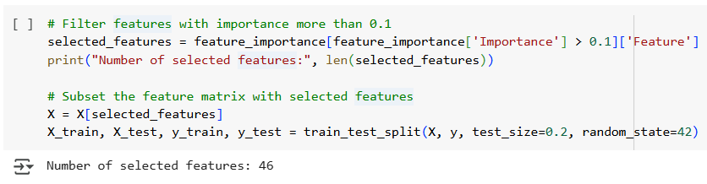
Information Gain

Slide 16
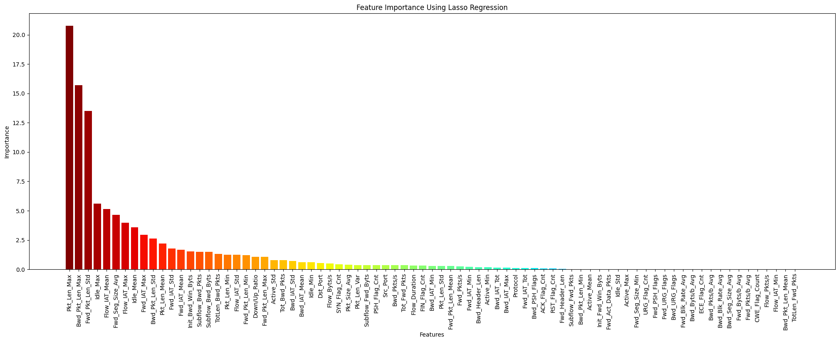
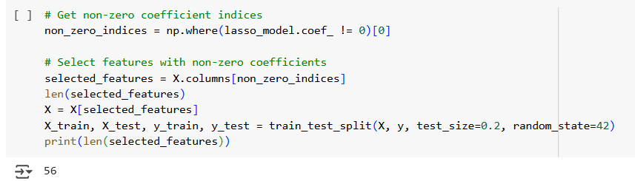
Lasso L1

Slide 17
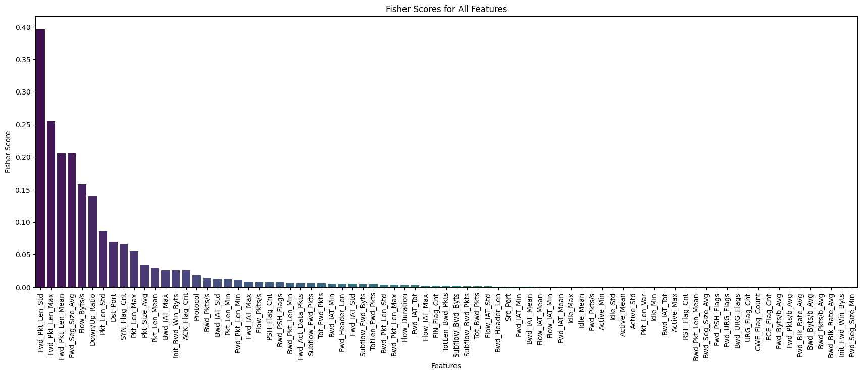
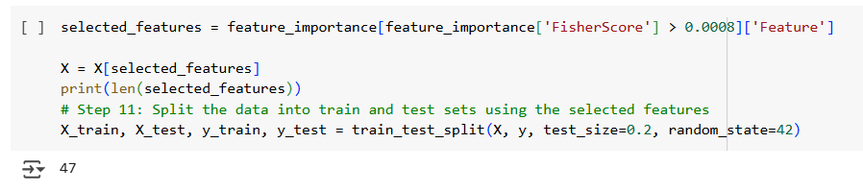
Fisher Score

Slide 18
Ensemble Methods
Voting | Stacking | Blending
Averages predictions (soft or hard voting) from base models directly. | Trains a meta-model on base model predictions. | Trains a meta-model on base model predictions.
Uses full training data for all base models and final prediction. | Base models use training data, meta-model trains on their outputs made on Training data. | ase models trained on training data, meta-model trained on predictions made on test/validation data.
Risk of data leakage is Low. | Risk of data leakage is Low. | Risk of data leakage is High.

Slide 19
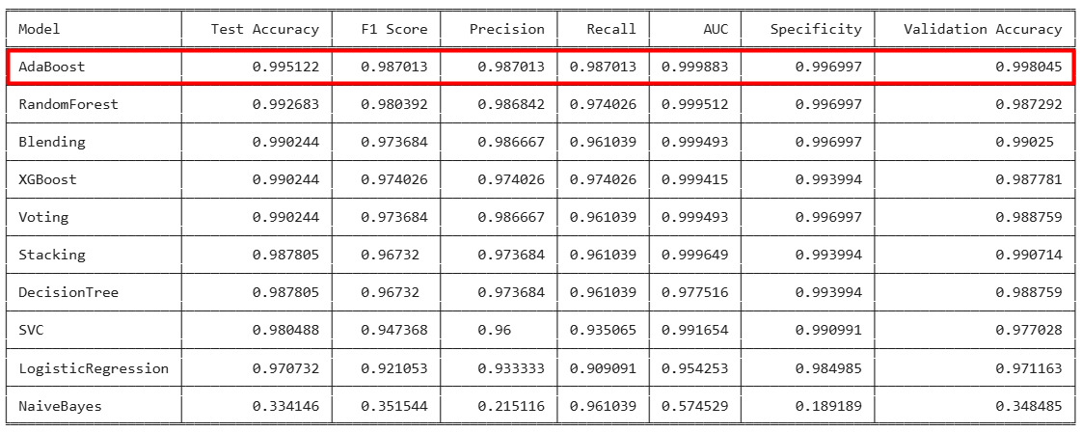
Result Analysis
(Without Feature selections)

Slide 20
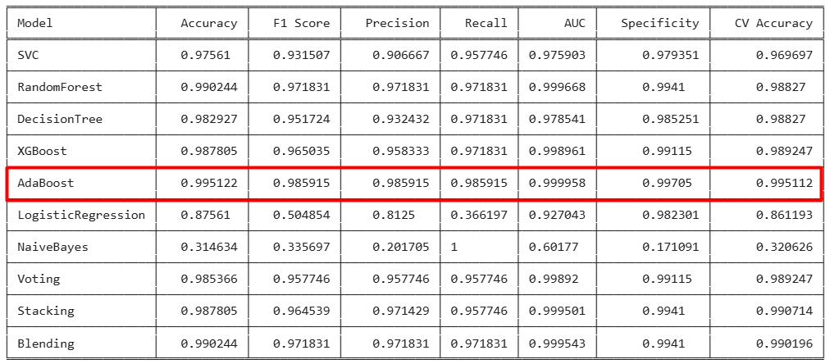
Result Analysis
(Information Gain)

Slide 21
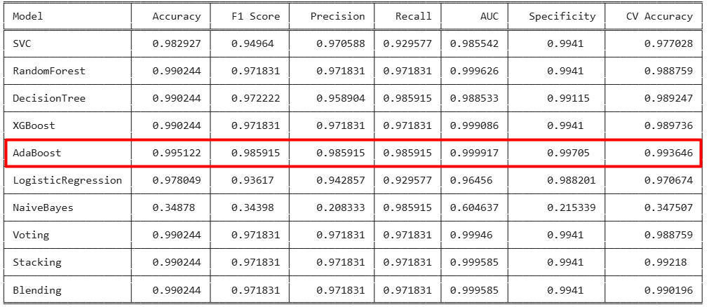
Result Analysis
(Lasso L1)

Slide 22
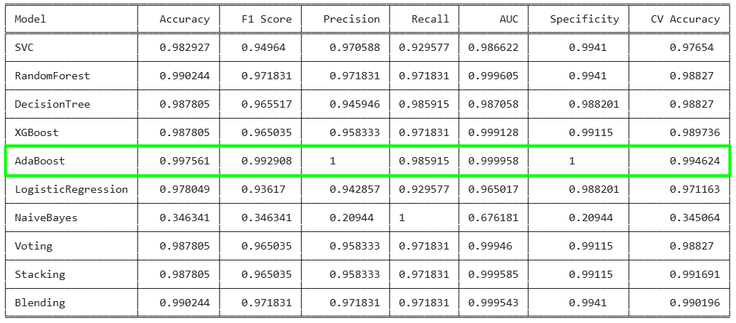
Result Analysis
(Fisher Score)

Slide 23
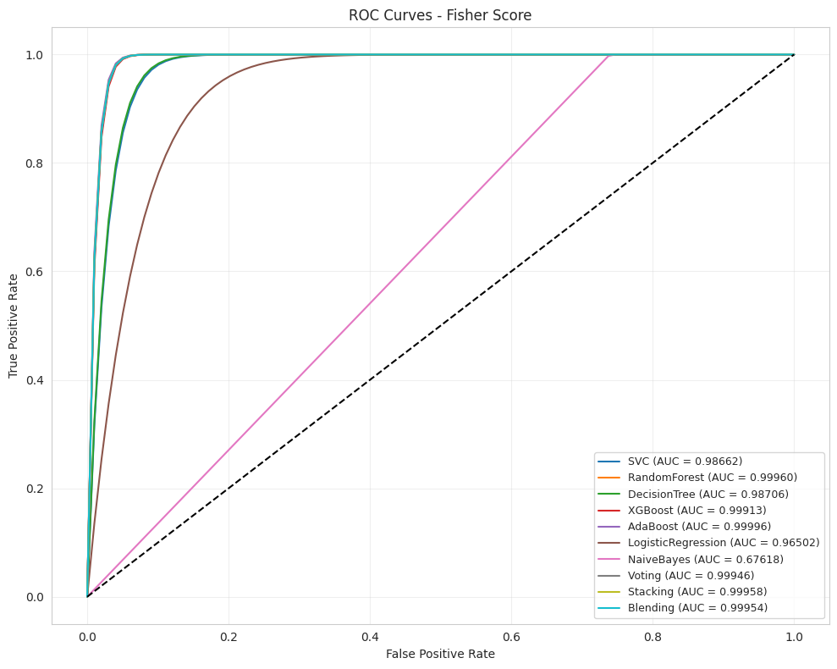
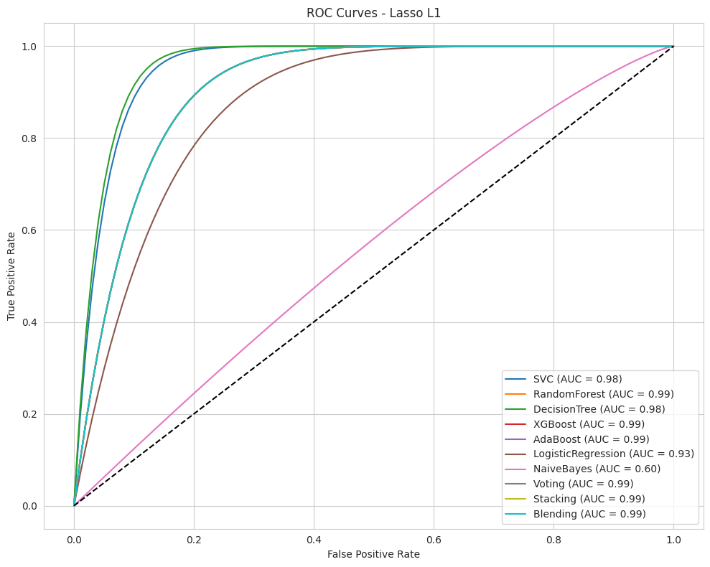
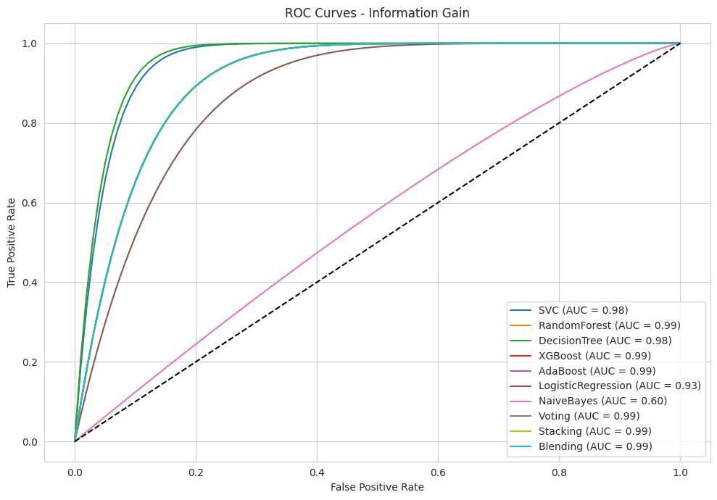
ROC Curve
Fisher Score
Lasso L1
Information Gain

Slide 24
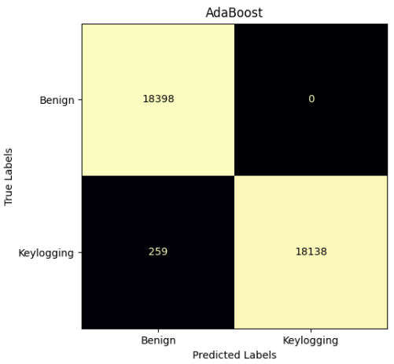
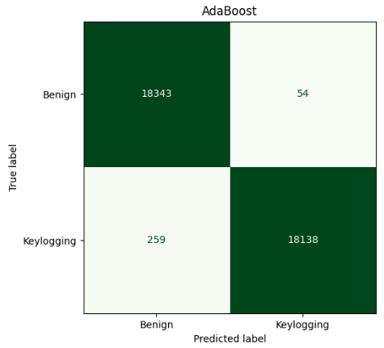
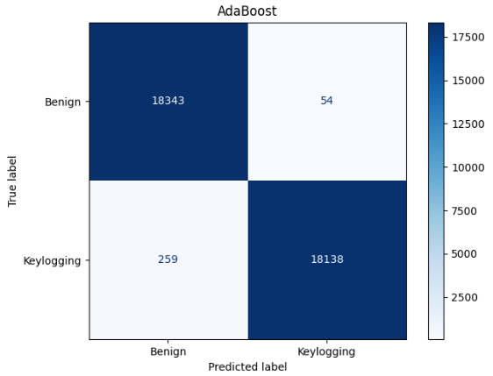
Confusion Matrix
Fisher Score
Lasso L1
Information Gain

Slide 25
Explainable AI

Slide 26
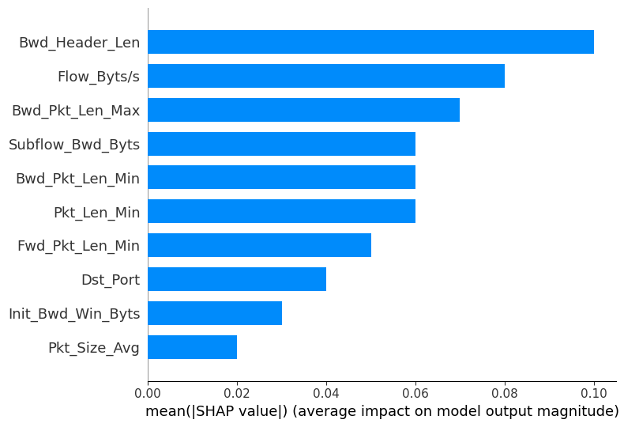
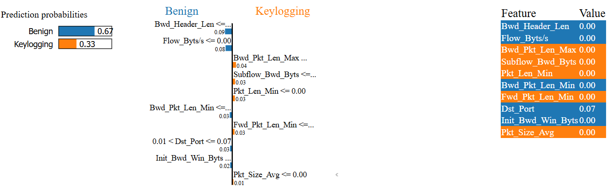
Explainable AI
SHAP
LIME

Slide 27
References
Y. Balakrishnan and R. P N, "An analysis on Keylogger Attack and Detection based on Machine Learning," 2023 International Conference on Artificial Intelligence and Knowledge Discovery in Concurrent Engineering (ICECONF), Chennai, India, 2023, pp. 1-8, doi: 10.1109/ICECONF57129.2023.10083937.
D. Levshun, "Selection of Machine Learning Methods for Keylogger Detection Based on Network Activity," 2024 16th International Conference on COMmunication Systems & NETworkS (COMSNETS), Bengaluru, India, 2024, pp. 19-24, doi: 10.1109/COMSNETS59351.2024.10427503.
Awotunde, J.B., Sur, S.N. (2025). An Enhanced Keylogger Detection Systems Using Recurrent Neural Networks Enabled with Feature Selection Model. In: Dhar, S., Mukhopadhyay, S., Do, DT., Sur, S.N., Imoize, A.L. (eds) Advances in Communication, Devices and Networking. ICCDN 2024. Lecture Notes in Electrical Engineering, vol 1243. Springer, Singapore. https://doi.org/10.1007/978-981-97-6465-5_42
Ayo, F. E., Awotunde, J. B., Olalekan, O. A., Imoize, A. L., Li, C.-T., & Lee, C.-C. (2023). CBFISKD: A Combinatorial-Based Fuzzy Inference System for Keylogger Detection. Mathematics, 11(8), 1899. https://doi.org/10.3390/math11081899
K. Srinivasan, "Keylogger Malware Detection Using Machine Learning Model for Platform-Independent Devices," 2023 International Conference on Emerging Trends in Networks and Computer Communications (ETNCC), Windhoek, Namibia, 2023, pp. 1-6, doi: 10.1109/ETNCC59188.2023.10284942.
M. Sirigiri, D. Sirigiri, R. Aishwarya and R. Yogitha, "Malware Detection and Analysis using Machine Learning," 2023 7th International Conference on Computing Methodologies and Communication (ICCMC), Erode, India, 2023, pp. 1074-1081, doi: 10.1109/ICCMC56507.2023.10083809.

Slide 28

Thank You

