Slide 1
DUPLICATE QUERY IDENTIFIER
(S³)

Slide 2
What is DQI?
It’s Semantic Sentence Similarity.
It’ll identify that how much these given sentences are same in terms of meaning.
How can I be a good geologist?
Same meaning
What should I do to be a great geologist?

Slide 3
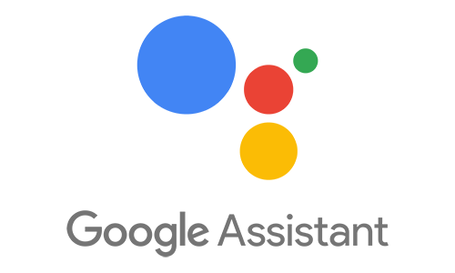


APPLICATION
Machine Translation
Google Search Engine
Chatbot (Google Assistant, Siri, Alexa)
Quora ,Stack Overflow etc.

Slide 4
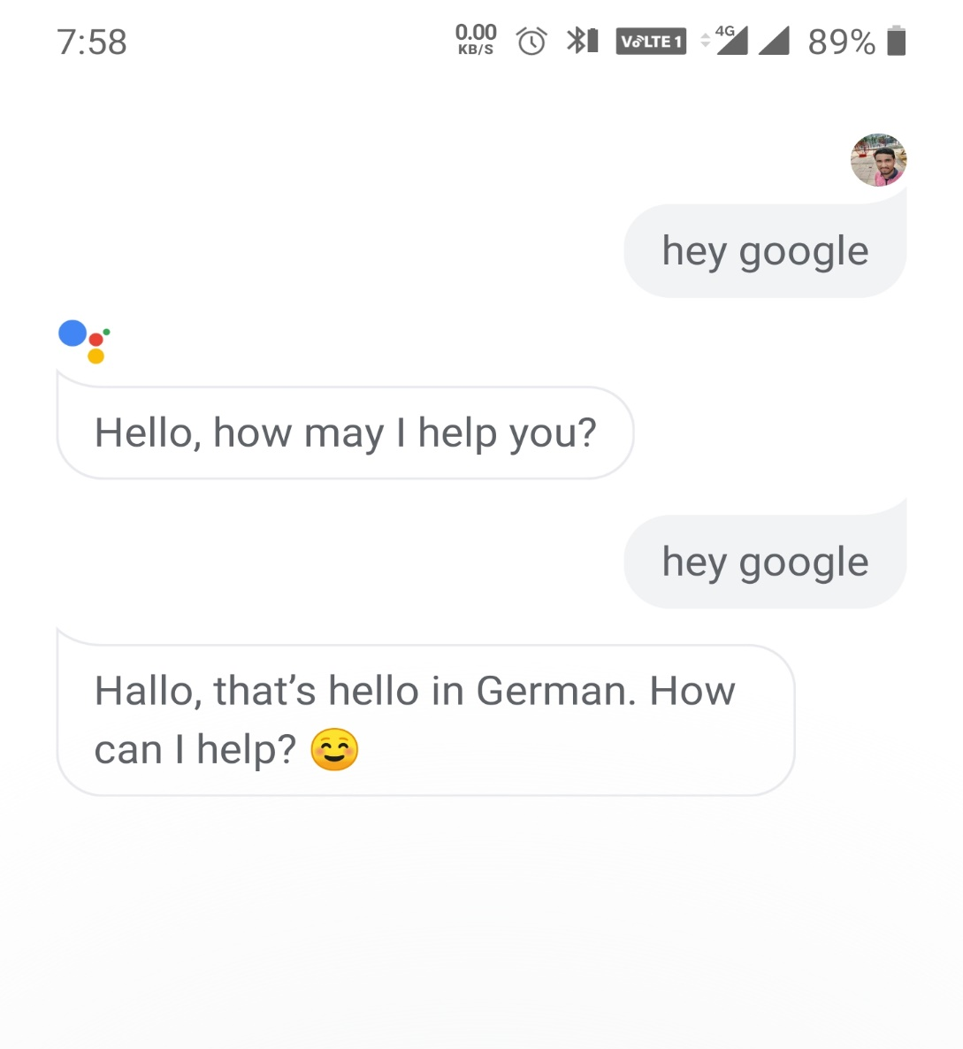

Slide 5
The Learning Process
Data Gathering
Data Preprocessing
Feature Extraction
Model Building
Model Evaluation
Model Deployment

Slide 6
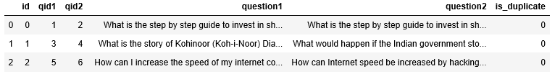
Data Gathering
qid1
qid2
question1
question1
Is_duplicate
features
kaggle

Slide 7
Data(text) Preprocessing
Input
Sentence
Remove Punctuation
Stemming
Output Sentence
Why does Oberon punish Titania in "A Midsummer Night\'s Dream"?
Why does Oberon punish Titania in A Midsummer Night Dream

Slide 8
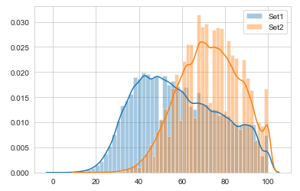
Feature Extraction
Basic Features
Advanced Features
Word embedding based Features
If the Extracted features is correlated with the target variable , only than your feature can increase your model accuracy.

Slide 9
Feature Extraction
Basic Features
freq_qid1
freq_qid2
q1len
q2len
q1_n_words
q2_n_words
word_Common
word_Total
word_share
freq_q1+freq_q2
freq_q1-freq_q2
How do we prepare for UPSC?
How do I prepare for civil service?
What is the best/most memorable thing you've ever eaten and why?
What is the most delicious dish you've ever eaten and why?

Slide 10
Feature Extraction
Advanced Features
cwc_min
cwc_max
csc_min
csc_max
ctc_min
ctc_max
last_word_eq
first_word_eq
abs_len_diff
mean_len
fuzz_ratio
fuzz_partial_ratio
token_sort_ratio
longest_substr_ratio
How can I learn computer security?
How can I get started to learn information security?
Will Modi win in 2019?
Can Narendra Modi become Prime Minister of India in 2019?

Slide 11
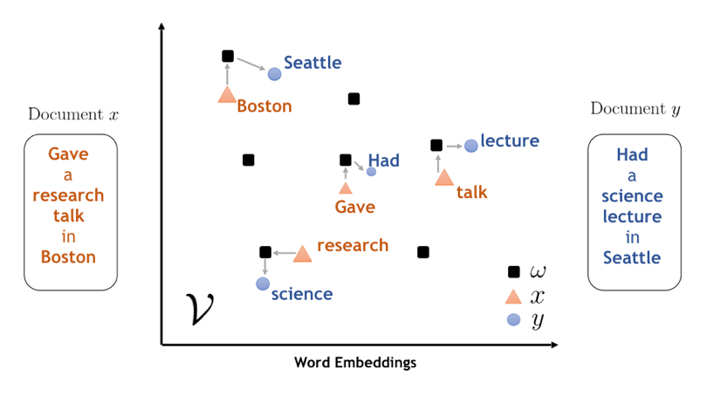
Feature Extraction
Word Embedding
Word2vec
Fasttext
Glove
What is the best memorable thing you've ever eaten and why?
What is the most delicious dish you've ever eaten and why?

Slide 12
Model Building
Random Forest
Model Evaluation
Logloss Measure

Slide 13


Model Deployment

