Slide 1
LENDING CLUB ASSIGNMENT SUBMISSION
Name:

Slide 2
The company wants to understand the driving factors (or driver variables) behind loan default, i.e. the variables which are strong indicators of default. The company can utilise this knowledge for its portfolio and risk assessment.

Slide 3
<Problem solving methodology>
Credit Risk Business understanding → Handling Missing values-→ Formatting data-→ Identifying target variable-→ Uni variate Analysis-→ Bi-variate Analysis

Slide 4
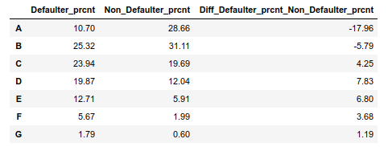
Grade change impact on determination of a consumer going to default or not

Slide 5
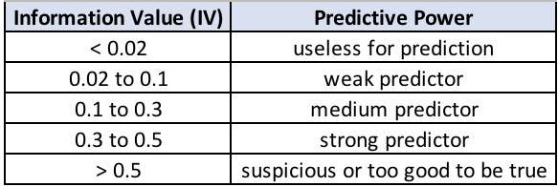

Weight of evidence analysis shows mths_since_last_delinq is a strong predictor as the information value 0.36 falls between 0.3 to 0.5 range.

Slide 6
title and is_defaulter_derv:
Looking at the chi_2 result, it becomes apparent that there is no significant influence of title on the chances of getting default or not.
P_value for chi_2 test between is_defaulter_derv and title 0.96
purpose and is_defaulter_derv:
Looking at the chi_2 result, it becomes apparent that there is a significant influence of purpose on the chances of getting default or not.
P_value for chi_2 test between is_defaulter_derv and purpose 0.0
home_ownership and is_defaulter_derv:
Looking at the chi_2 result, it becomes apparent that there is a significant influence of home_ownership on the chances of getting default or not.
P_value for chi_2 test between home_ownership and is_defaulter_derv 0.0
pub_rec and is_defaulter_derv:
Looking at the chi_2 result, it becomes apparent that there is a significant influence of pub_rec on the chances of getting default or not.

Slide 7
When the Target variable changes from Non_Defaulter to Defaulter
There is a significant negative change of (-17.96)% in GRADE A.
There is a significant negative change of (-5.79)% in GRADE B.
There is a significant positive change of 4.25% in GRADE C.
There is a significant positive change of 7.83% in GRADE D.
There is a significant positive change of 6.80% in GRADE E.
There is a significant positive change of 3.68% in GRADE F.
There is a slight positive change of 1.19% in GRADE G.

Slide 8
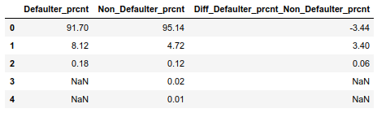
<Analysis>

Slide 9
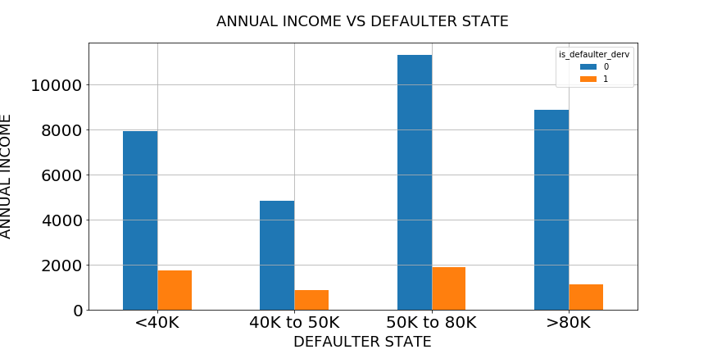
Annual Salary less than 40K and between 50K to 80K have got more chances to default.

Slide 10
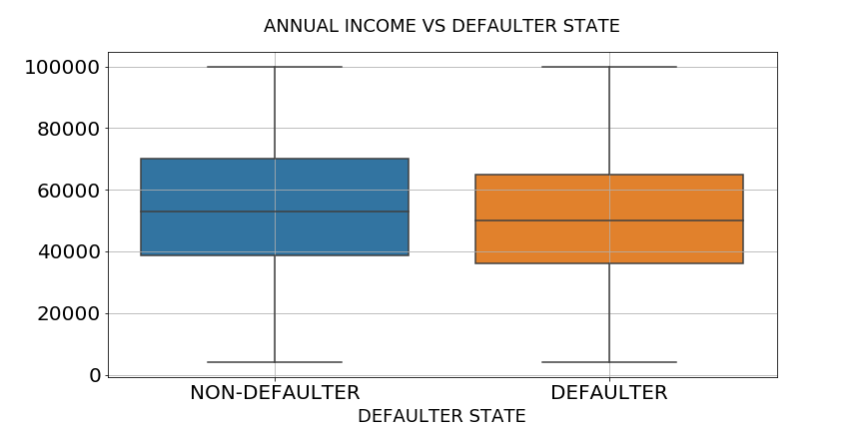
The chances of getting default gets influenced by annual income range.

Slide 11
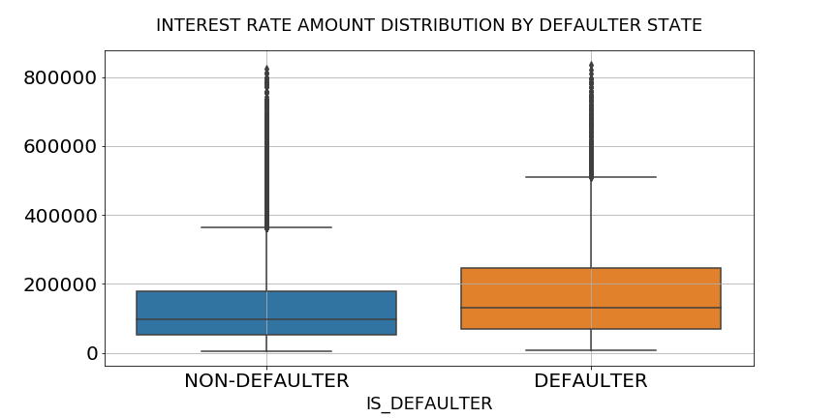
The higher interest rate amount increases the chances of getting default.

Slide 12
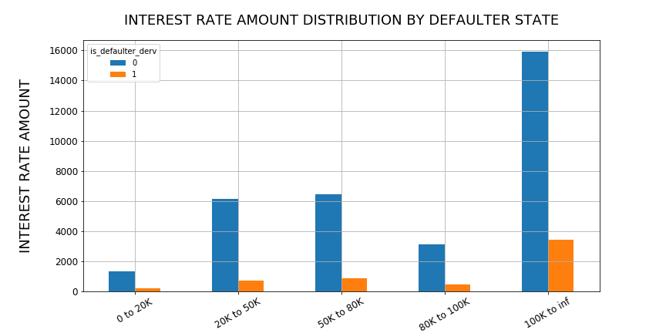
The high interest rate amount increases the chances of getting default.

Slide 13
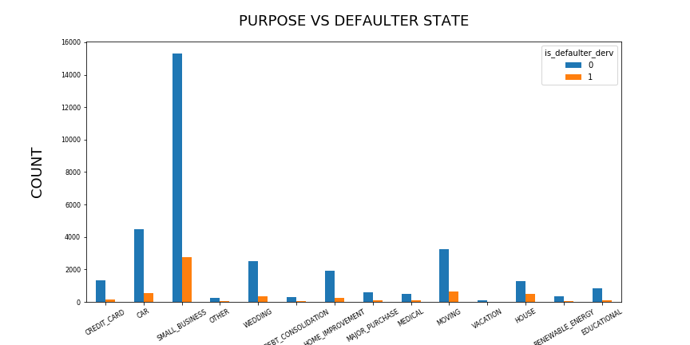
Purpose of the loan plays a significant role in determining the chances of getting default or not. As it can be observed that if the loan purpose is debt_consolidation, home_improvement, other, small_business and credit_card then there are chances of getting default is high unlike other loan purpose.

Slide 14
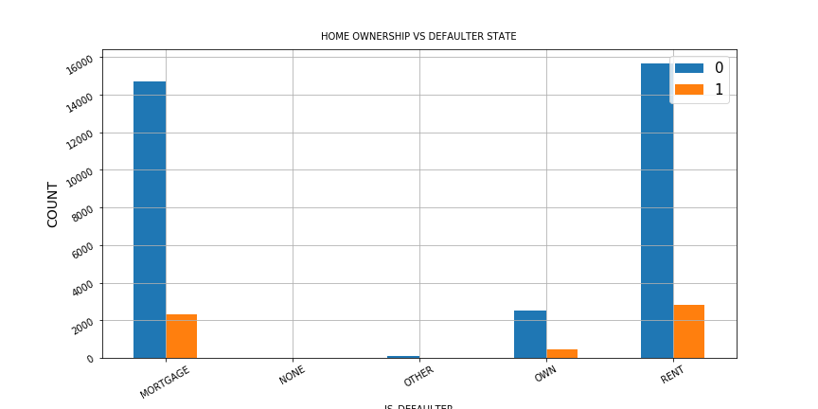
It seems the one who owns home has lesser chance of becoming defaulter and greater for those who are on rent and mortgage

Slide 15
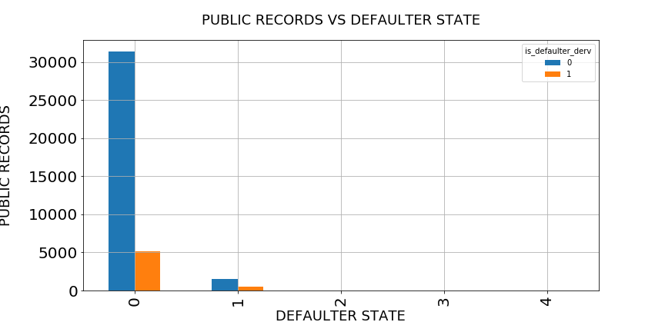
High number of Public records implies high risk, as the x-scale category number increases the Public records number decreases, which in turn reduces the chances of getting default.

Slide 16
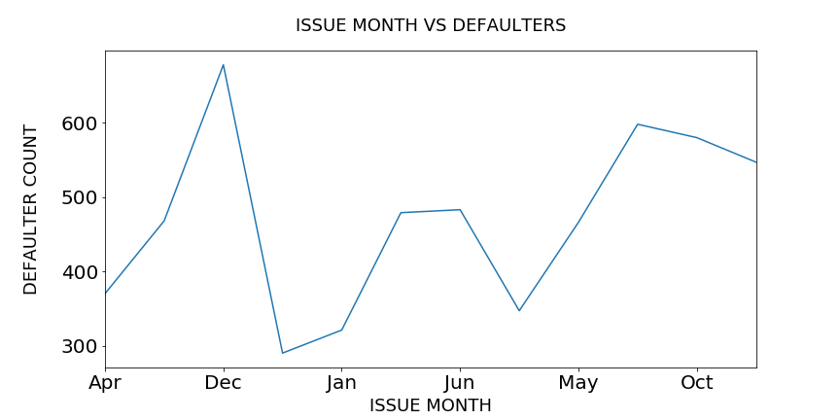
The Month of December and November has got high number of defaulters unlike other months.

Slide 17
<Conclusions>
Exploratory analysis shows, loan issued month, no. of months since last deliquency, purpose of the loan, ownership status of a home, loan grade assigned to a consumer, no. of public records, annual income and interest amount on loan

