Slide 1
Secure Data Hiding in Image Using Steganography
CAPSTONE PROJECT
Presented By: Monish K
Student Name : Monish K
College Name & Department :Sri Venkateswara College of Engineering & Computer Scince

Slide 2
OUTLINE
Problem Statement
Technology used
Wow factor
End users
Result
Conclusion
Git-hub Link
Future scope

Slide 3
Problem Statement
With increasing cyber threats, there is a need for a secure and imperceptible method to hide confidential data within images. This project aims to develop an efficient steganographic technique that ensures data security, robustness against attacks, and minimal image distortion. The system should balance payload capacity, security, and imperceptibility, making it suitable for secure communication, digital watermarking, and forensics

Slide 4
Technology used
🔹 Programming Language → Python (for encoding and decoding images)
🔹 Libraries Used:
PIL (Pillow) → Image processing
NumPy → Handling pixel data as arrays
🔹 Concepts Implemented:
Steganography → Hiding text inside image pixels
LSB (Least Significant Bit) Encoding → Modifying the lowest bit of pixel values to store secret data
Binary Encoding → Converting text to binary before hiding
🔹 Platform:
Google Colab → Running Python code online

Slide 5
Wow factors
High Security → Uses LSB Steganography, making hidden data undetectable to the human eye.
No Visible Changes → The encoded image looks identical to the original.
Lightweight & Fast → Works efficiently without large computational power.
Universal Compatibility → Can hide data in any image format (PNG, JPG, etc.).
Customizable Encoding → Can be extended to hide more data or encrypt messages.
Simple & Effective → Uses minimal libraries but achieves secure data hiding.

Slide 6
End users
Cybersecurity Professionals → For secure data transmission and digital watermarking.
Journalists & Activists → To protect sensitive information from surveillance.
Government & Defense → For confidential communication and secure intelligence sharing.
Forensic Experts → To embed and retrieve hidden clues in digital evidence.
Corporate Organizations → For secure document sharing and copyright protection.
Individuals & Privacy Enthusiasts → For personal data protection and secret messaging.

Slide 7
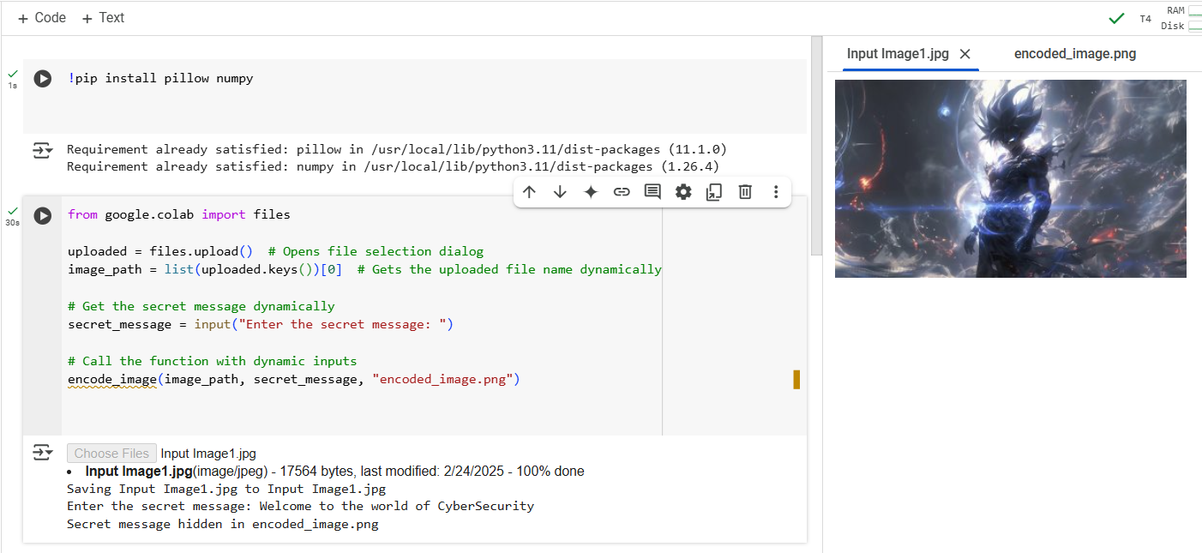
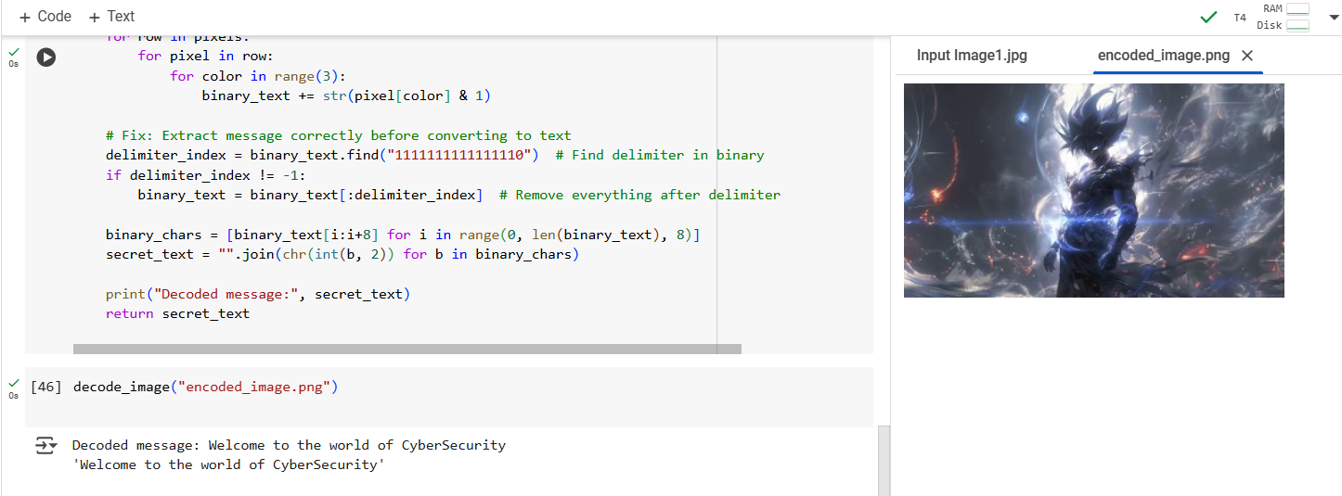
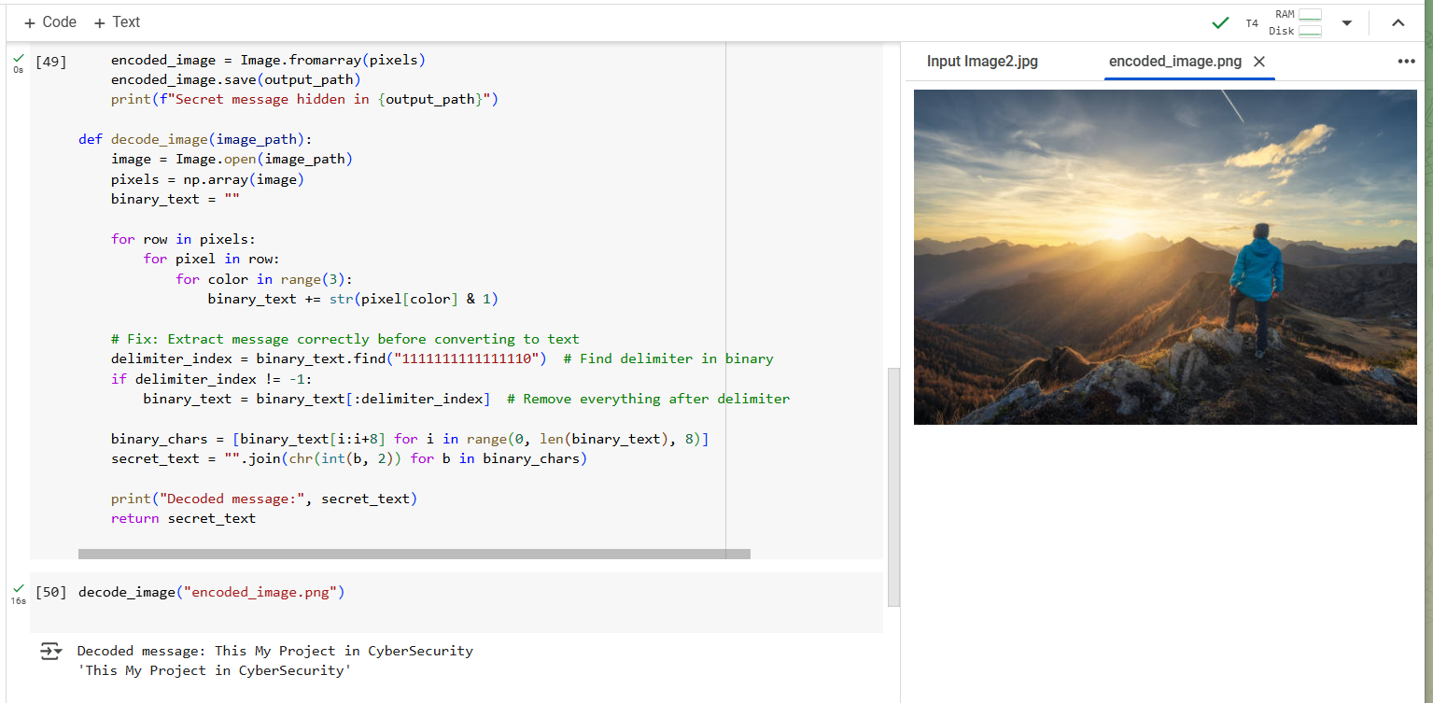
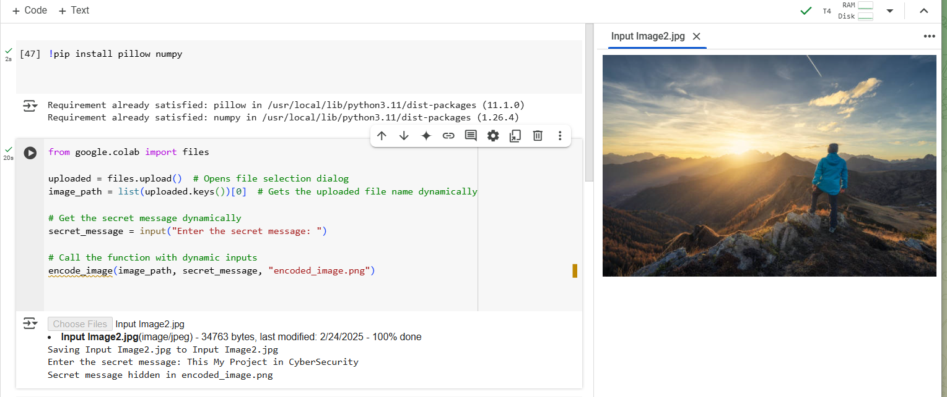
Results

Slide 8
Conclusion
This project successfully addresses the problem of secure data hiding in images using steganography. By implementing LSB (Least Significant Bit) encoding, it ensures that secret messages are embedded within image pixels without noticeable visual changes. The extracted message remains intact, proving the reliability of this approach.
The solution is efficient, lightweight, and secure, making it suitable for applications in cybersecurity, confidential communication, and digital watermarking. With further enhancements like encryption and larger data capacity, this method can be even more robust for real-world use cases

Slide 9
GitHub Link
GitHub Link :https://github.com/Monish-maker/Stegnography.git

Slide 10
Future scope(optional)
Enhanced Security → Integrate encryption techniques (AES, RSA) to further protect hidden messages.
Increased Data Capacity → Optimize encoding to store larger messages without noticeable image distortion.
Multi-Format Support → Extend compatibility to various image formats, including GIFs and BMPs.
Video Steganography → Expand the technique to embed secret data in video frames.
AI-Based Detection Prevention → Improve resistance against steganalysis using AI-based techniques.
Cross-Platform Usability → Develop a web or mobile application for easy encoding and decoding.

Slide 11
THANK YOU

