Slide 1

Extended ER Project Educational Institute MIS 631 WS Prof. Joseph Morabito
Group 4
Rohan Puthran
Monish Bangera
Mihir Kadam
Aashi Jain
Mayank Vyas

Slide 2
Table of Content
Project Scope
High level Approach and Central Model
Entity Relationship Models
Information Models
Data Models
Contracts

Slide 3
Project Scope
The project mainly focuses on how the data is handled in any educational institution.
The educational institution comprises of there main buildings and college of studies (phases1,2&3) .
Each Building is dedicated for one college of study i.e., Engineering, Hotel Management and Management & MBA.
Every college has its own way of operation, organizational architecture and data structure.

Slide 4
High level Approach
Educational Institute / University
Engineering (Phase1)
Hotel Management (Phase2)
Management/ MBA
(Phase3)
Courses
Staff
Departments
Students
Student Committee
Staff
Other Facilities
Students
Student Committee
Courses
Staff
Students
Student Committee

Slide 5
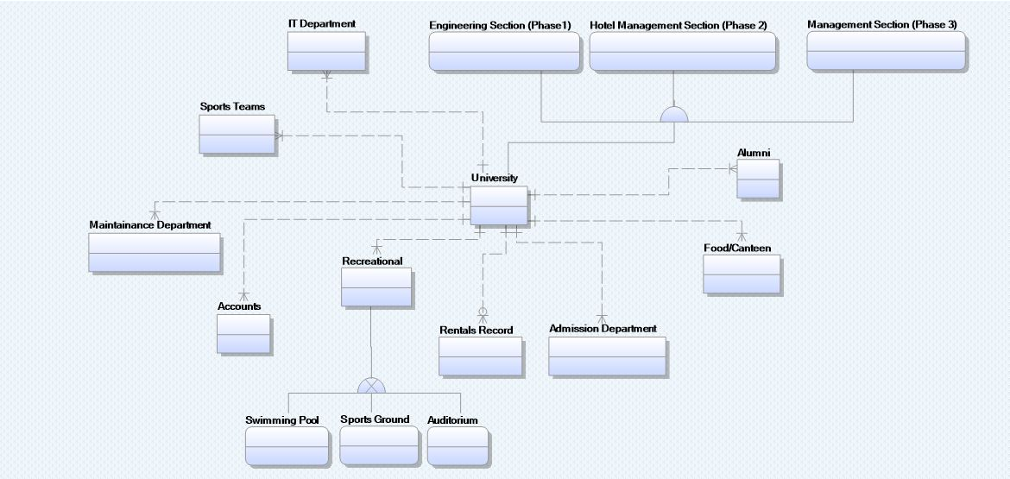
Central Model of the Educational Institution

Slide 6
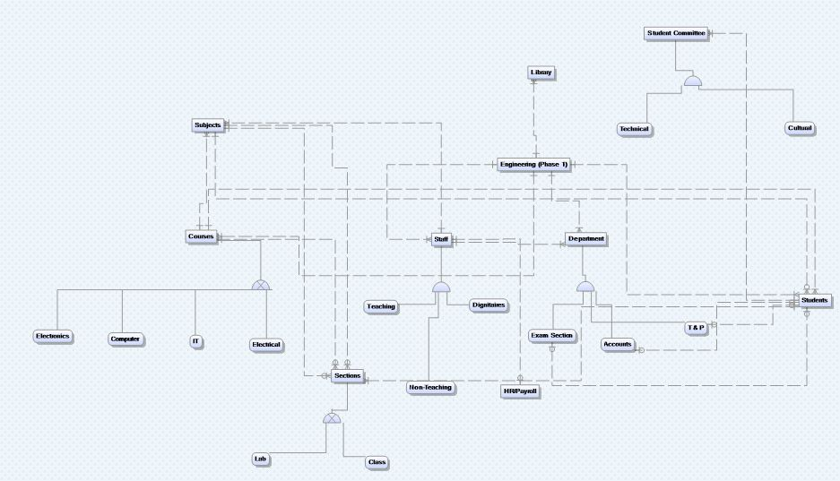
Entity Relationship Model (Engineering)

Slide 7
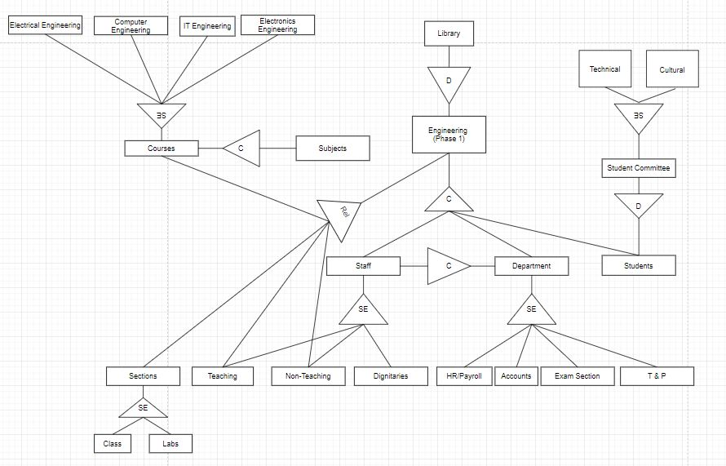
Information Model (Engineering)

Slide 8
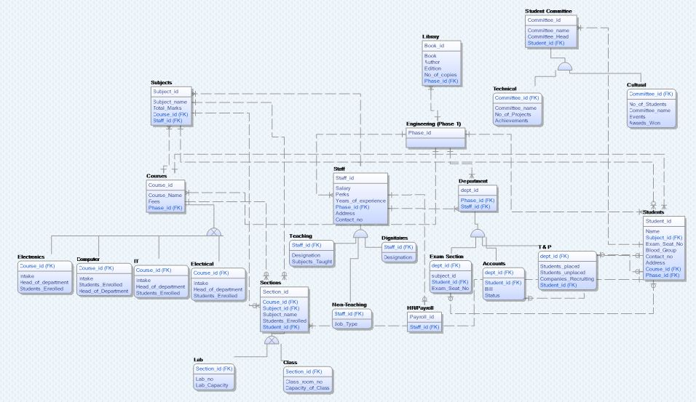
Data Model (Engineering)

Slide 9
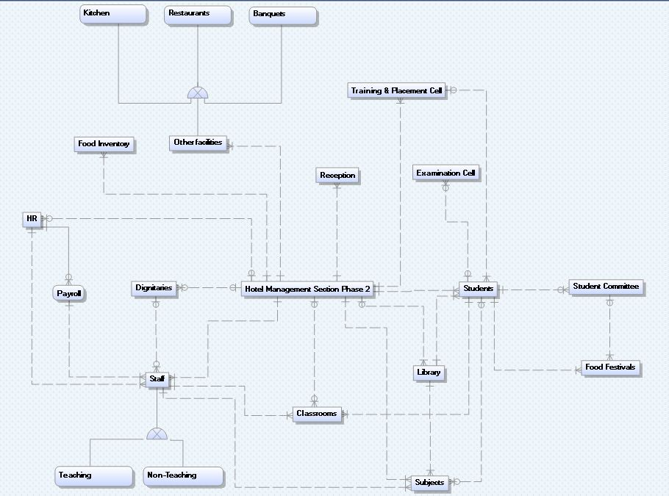
Entity Relationship Model (Hotel Management)

Slide 10
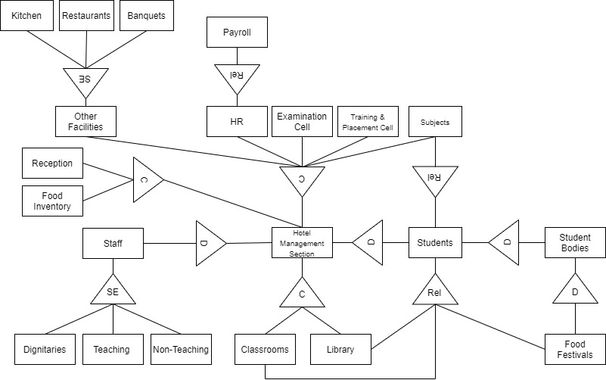
Information Model (Hotel Management)

Slide 11
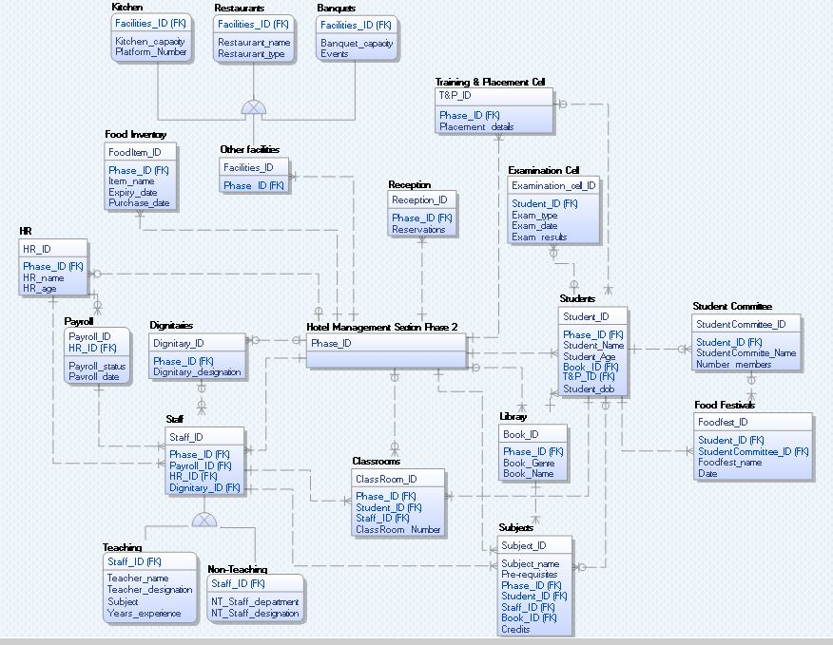
Data Model (Hotel Management)

Slide 12
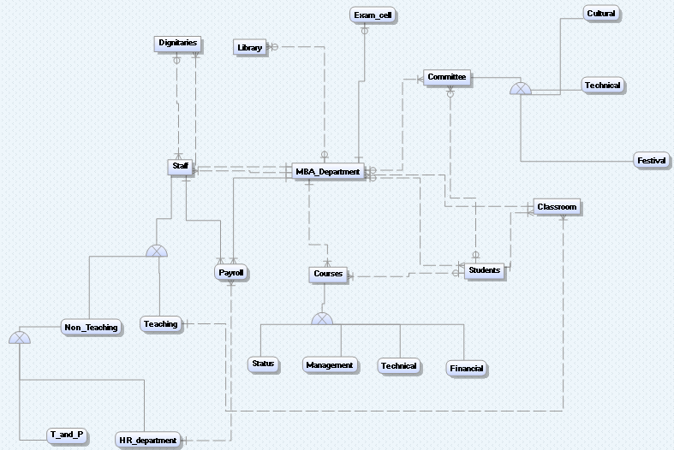
Entity Relationship Model (Management/MBA)

Slide 13
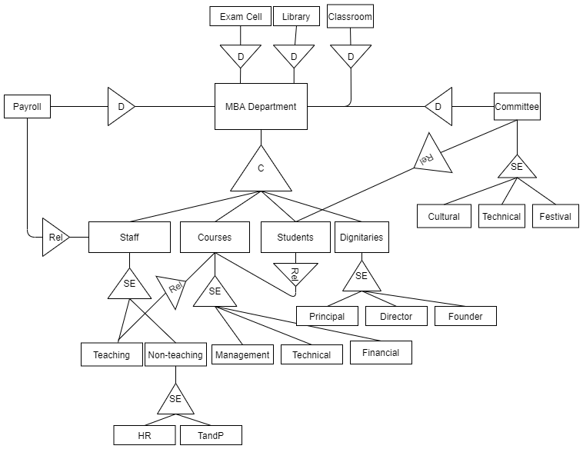
Information Model (Management/MBA)

Slide 14
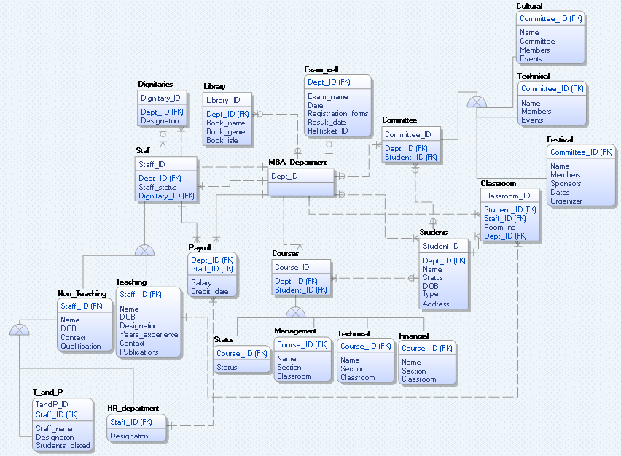
Data Model (Management/MBA)

Slide 15
Contracts
Contracts define and communicate rules of behaviour.
Contracts exist at all levels in systems analysis, design, and implementation; in fact, contracts exist at all levels in an organization and in society–We use contracts all the time – e.g., to purchase real estate.
Though properties of contracts may differ based on their intended uses, contracts have some properties in common: The essential property is that a contract explicitly and declaratively defines a behaviour (or in info systems, we say an operation).
A contract should describe–What the operation must achieve and under what circumstances (semantics) and its signature (parameters).

Slide 16
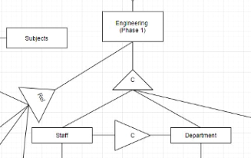
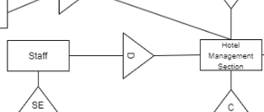
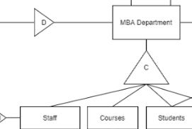
Specifications of Employee on-boarding
INVARIENT
An employee belongs to at most one department
A department consists of zero to many employee
PRECONDITION
The department and employee exists
POSTCONDITION
The employee belongs to the department.
The department has all the old employees and the additional new employee. (increment employee count by one)
TRIGGER
The department has approved an employee on-boarding request

Slide 17
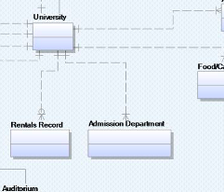
Specifications of student on-boarding
INVARIENT
A student belongs to at most one field of specific college studies class.
A specific course class consists of zero to n number of students (120 in case of engineering field class)
PRECONDITION
The course class and student exists
POSTCONDITION
The student belongs to one class of course
The course class has old students and the additional new students for new class of same course.
TRIGGER
The admission department has approved the student on-boarding request

Slide 18
Specifications of granting Student Scholarship
INVARIENT
A student belongs to at most one field of engineering studies class.
An engineering field class consists of zero to 120 students
PRECONDITION
The engineering field class and student exists
POSTCONDITION
The student belongs to one field of engineering
The field of engineering has old students and the additional new students.
The department has all the old employees and the additional new employee. (increment employee count by one)
TRIGGER
The admission department has approved the student on-boarding request

Slide 19
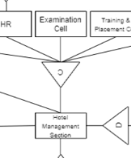
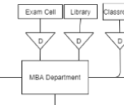
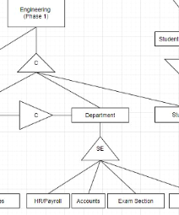
Specifications for Conducting an Exam
INVARIENT
The examinations are conducted for all the students at the end of every semester.
The examination follows the standardized college format.
PRECONDITION
A student belongs to at most one course of studies class.
The syllabus is taught completely to the students and the examination fees is paid.
POSTCONDITION
The student is allowed to give the examination.
TRIGGER
The examination is conducted as scheduled following the guidelines of the college and institution.

Slide 20
Specifications for student to complete under graduation (engineering)
INVARIENT
The Student belonged to at most one field of engineering studies
The Student has qualified the requirements for under graduation
PRECONDITION
A student belongs to at most one field of engineering studies class
POSTCONDITION
The student has fulfilled the requirements of the undergraduate engineering studies
The student is an alumni of the college/university
TRIGGER
The the student is qualified as an undergraduate in the field of engineering.

Slide 21
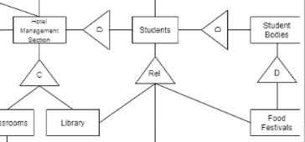
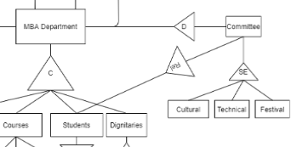
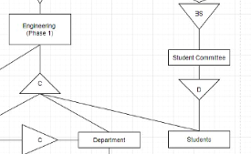
Specifications for student on-boarding for “Student’s Committee”
INVARIENT
A student belongs to at most one course of studies class.
A student has a position in the student’s committee
PRECONDITION
A student belongs to at most one class of course studies.
A student qualifies the requirements for the position of the student’s committee.
POSTCONDITION
A position in the council is held by the student.
TRIGGER
The fulfillment of the requirement qualifies the student to take the position in the council

Slide 22
Thank you !

