Slide 1

Work-let Name: Reverse prompt generator - Take image as input and model should output best prompt to get similar image
Worklet Details
Worklet ID: 23GAI32
College Name: SRM Institute of Technology
The prompt produced by the model is relevant to the image provided
The prompt being generated is under 3 seconds
There is presence of ROT(Redundant, Obsolete and Trivial) data which decreases the accuracy to 75%
KPIs achieved till now
Any Challenges/ Issues faced
Next Steps
Implementing a light-weight model to increase accuracy
Increased the accuracy of Fast mode
Model can produces prompt relevant to the image
Caption Model name-”Blip-large”
Clip Model name-” ViT-L-14/openai"
Key Achievements/ Outcome till now
Date: 06/05/2024

Slide 2
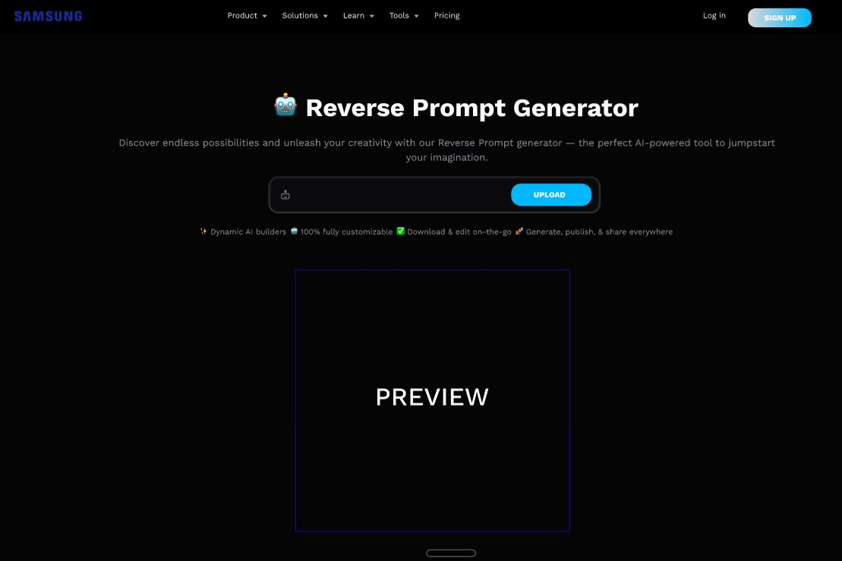

Slide 3
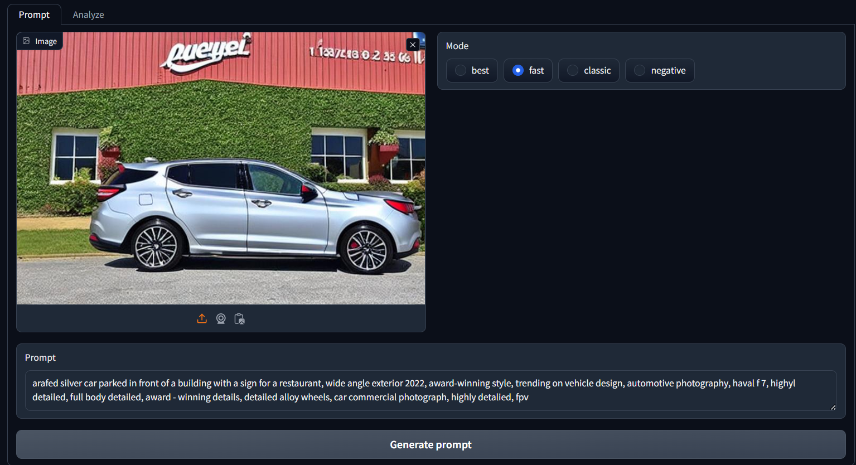

Slide 4
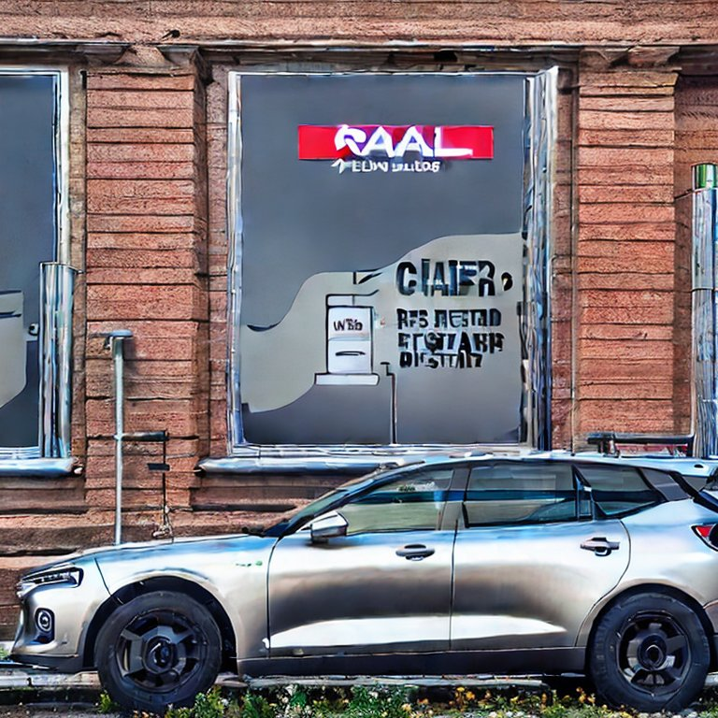
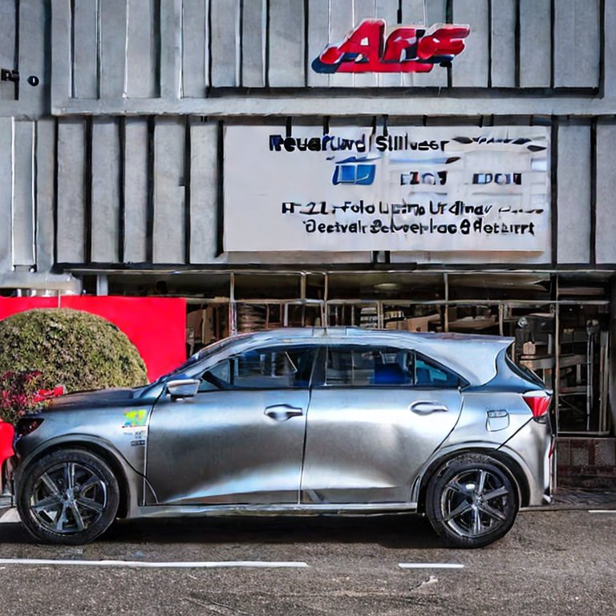
The prompt being generated into image using Stable Diffusion 2.1

Slide 5
KPI’s Achieved until Now
The prompt should be relevant to the image
The inference time should be less than 5 seconds
ALL of our initial KPI’s have been achieved

Slide 6
Technical challenges and how the team solved it
The previous model that was being used wasn’t able to produce the images at lower than 5 seconds inference time
We pivoted to a new model BLIP large
We finetuned the Fast mode to give more accurate prompts in the lowest amount of time

Slide 7
RESULTS TILL NOW
Our model gives us relevant prompt for the image
The average inference time is 1.5secs~3.5secs.
The Accuracy is around 70-80%(after fine tuning and around ~70% before)

Slide 8
Upcoming month’s plan
Implementing a light-weight model to increase accuracy
Ask specific questions about an image

Slide 9
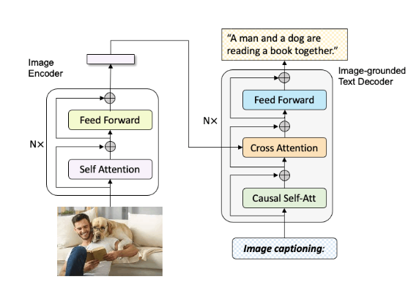
Model info
Caption Model Name- BLIP LARGE(Bootstrapping Language-Image Pre-training for Unified Vision-Language Understanding and Generation)
Model Pretrained on COCO dataset
Usage-You can use this model for conditional
and un-conditional image captioning

Slide 10
Clip Model Name- ViT-L-14/openai
Model Type:
The model was also developed to test the ability of models to generalize to arbitrary image classification tasks in a zero-shot manner.
Transformer architecture as an image encoder and uses a masked self-attention Transformer as a text encoder
ResNet image encoder
Dataset : DiffusionDB
Description: DiffusionDB is the first large-scale text-to-image prompt dataset. It contains 14 million images generated by Stable Diffusion using prompts and hyperparameters specified by real users.
Supported Tasks: The unprecedented scale and diversity of this human-actuated dataset provide exciting research opportunities in understanding the interplay between prompts and generative models, detecting deepfakes, and designing human-AI interaction tools to help users more easily use these models.

