Slide 1

Work-let Name: Reverse prompt generator - Take image as input and model should output best prompt to get similar image
Worklet Details
Worklet ID: 23GAI32
College Name: SRM Institute of Technology
The prompt produced by the model is relevant to the image provided
The prompt being generated is under 3 seconds
There is presence of ROT(Redundant, Obsolete and Trivial) data which decreases the accuracy to 75%
KPIs achieved till now
Any Challenges/ Issues faced
Next Steps
All steps have been completed
Increased the accuracy of Fast mode
Model can produces prompt relevant to the image
Caption Model name-”Blip-large”
Clip Model name-” ViT-L-14/openai"
Key Achievements/ Outcome till now
Date: 06/05/2024

Slide 2
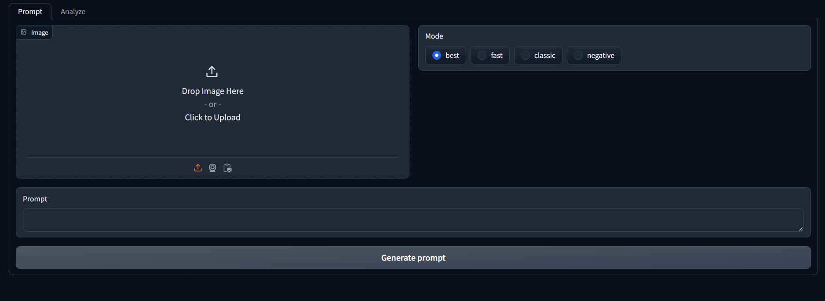
FRONT- END

Slide 3
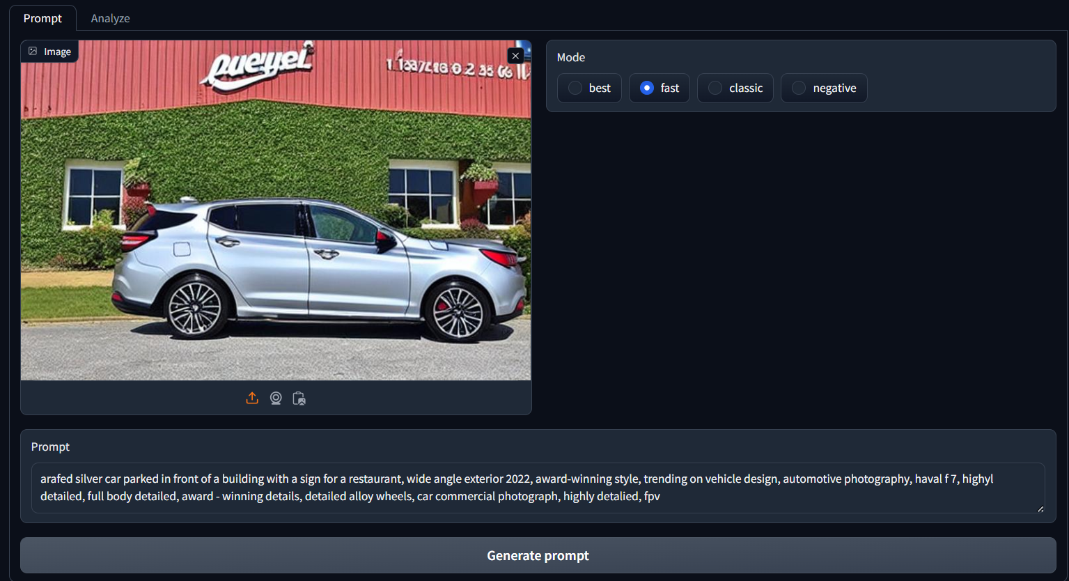

Slide 4
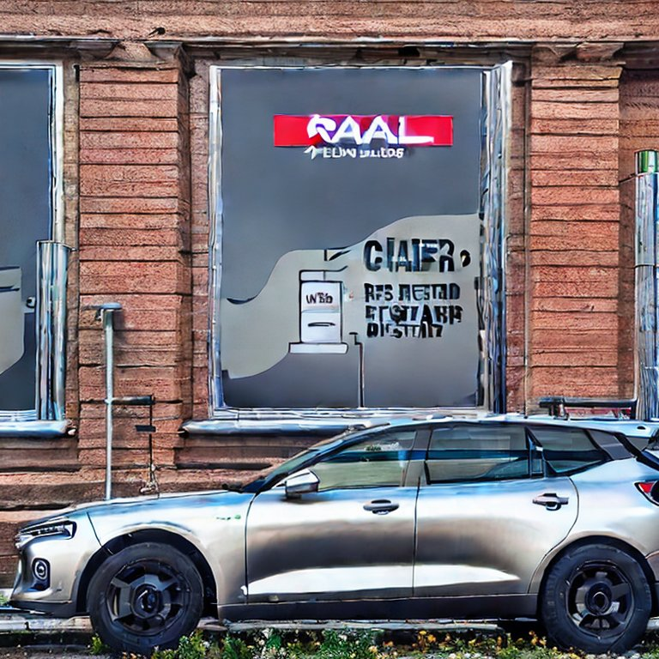
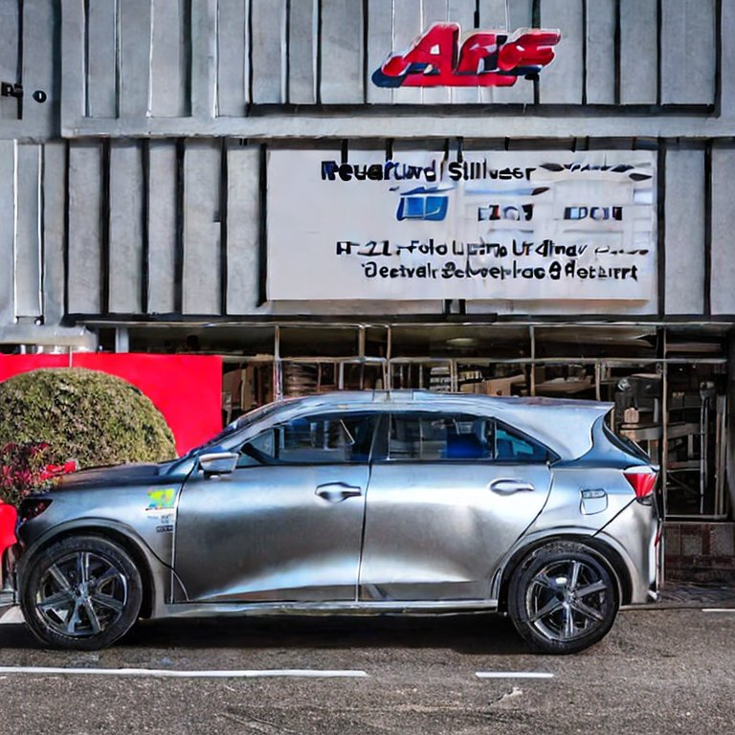
The prompt being generated into image using Stable Diffusion 2.1

Slide 5
KPI’s Achieved until Now
The prompt should be relevant to the image
The inference time should be less than 5 seconds
ALL of our initial KPI’s have been achieved

Slide 6
Technical challenges and how the team solved it
The previous model that was being used wasn’t able to produce the images at lower than 5 seconds inference time
We pivoted to a new model BLIP large
We finetuned the Fast mode to give more accurate prompts in the lowest amount of time

Slide 7
RESULTS TILL NOW
Our model gives us relevant prompt for the image
The average inference time is 1.5secs~3.5secs.
The Accuracy is around 75-85%(after fine tuning and around ~70% before)

Slide 8
USE CASE OF OUR MODEL
Generate accurate image descriptions for setting scenes or characters
Provide precise image descriptions for language learning and comprehension exercises
Create exact image prompts to maintain brand consistency in visual content
Use detailed image descriptions to inspire artwork or design elements
Ensure consistency in visual themes with accurate image prompts for posts
Can also be used in medical field while checking the x-ray , scans , etc….

Slide 9
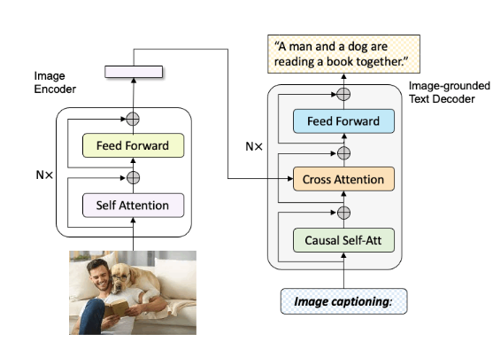
Model info
Caption Model Name- BLIP LARGE(Bootstrapping Language-Image Pre-training for Unified Vision-Language Understanding and Generation)
Model Pretrained on COCO dataset
Usage-You can use this model for conditional
and un-conditional image captioning

Slide 10
Clip Model Name- ViT-L-14/openai
Model Type:
The model was also developed to test the ability of models to generalize to arbitrary image classification tasks in a zero-shot manner.
Transformer architecture as an image encoder and uses a masked self-attention Transformer as a text encoder
ResNet image encoder
Dataset : DiffusionDB
Description: DiffusionDB is the first large-scale text-to-image prompt dataset. It contains 14 million images generated by Stable Diffusion using prompts and hyperparameters specified by real users.
Supported Tasks: The unprecedented scale and diversity of this human-actuated dataset provide exciting research opportunities in understanding the interplay between prompts and generative models, detecting deepfakes, and designing human-AI interaction tools to help users more easily use these models.

Slide 11
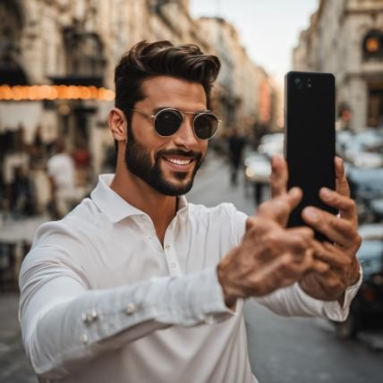
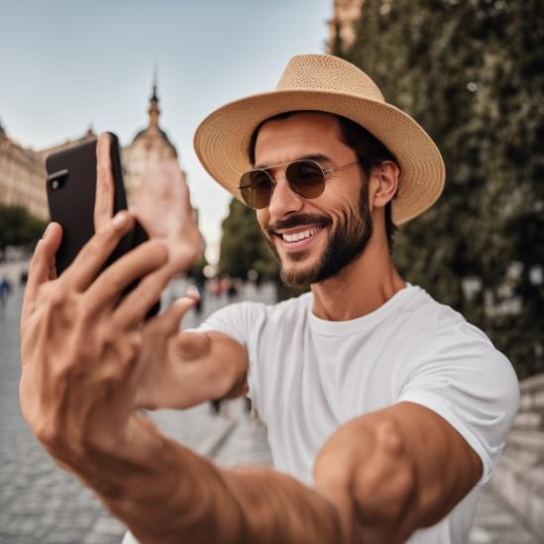
INPUT IMAGE :
PROMPT CHECK:
PROMPT FOR THE INPUT IMAGE : a man taking a selfie with his cell phone, a picture, by Emma Andijewska, shutterstock, smiling fashion model, sophisticated well rounded face, budapest, tiktok video

Slide 12
THANK YOU

