Slide 1
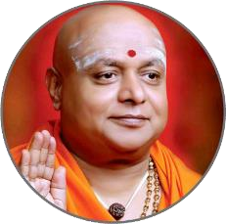


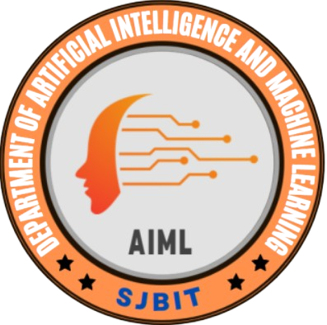
||Jai Sri Gurudev||
Sri Adichunchanagiri Shikshana Trust®
SJB INSTITUTE OF TECHNOLOGY
DEPARTMENT OF ARTIFICIAL INTELLIGENCE AND MACHINE LEARNING
Major Project Phase-II (BAI786)
Topic:- AI-Powered Agriculture System
Presented by:
AASIM PASHA -1JB22AI002
BENAKA R N -1JB22AI008
MONISH K -1JB22AI032
SUMUKH.S.M -1JB23AI405
Under the Guidance of
Mrs. Deepa Kulkarni
Asst. Professor
Dept of AIML, SJBIT

Slide 2

OUTLINE
Abstract
Introduction
Literature Survey
Problem Statement
Objectives
System Requirements
System Architecture
DFD/ Sequence Diagram
Algorithm /Methodology
Snapshots
Graphs
Test Case
Conclusion
References

Slide 3
ABSTRACT
The rapid advancements in Artificial Intelligence (AI) and the Internet of Things (IoT) are revolutionizing traditional farming practices, leading to the development of AI-powered smart agriculture systems.
This project develops an AI-Powered Smart Agriculture System to tackle critical farming inefficiencies. It features an advanced leaf disease detection system using computer vision and a Convolutional Neural Network (MobileNetV2), achieving 94% accuracy in early disease identification from leaf imagery to prevent crop loss.
Integrated with IoT sensors and a Arduino, the system also automates precision irrigation, reducing water consumption by 28%. A real-time Flask dashboard enables remote monitoring and control. This integrated solution offers a scalable approach to enhance crop health, resource efficiency, and sustainability in modern agriculture.

Slide 4
Introduction
Traditional farming relies on inefficient methods for irrigation and disease control, leading to significant water waste and crop losses. This project presents an AI and IoT-powered smart agriculture system that transforms these practices through real-time monitoring and automation.
Our solution integrates sensor networks with computer vision, utilizing the MobileNetV2 model for efficient disease detection with over 94% accuracy. The system employs affordable hardware components including microcontrollers and sensors, complemented by a web dashboard for real-time monitoring.
Testing demonstrated 28% water savings while maintaining optimal crop health through automated irrigation control. This approach enables proactive, data-driven farming that optimizes resources and enhances sustainability for future food security needs.
.

Slide 5
Literature Survey
Reference | Authors | Publication Year | Main Focus | Affiliation | Full Link
Artificial Intelligence in Smart Agriculture: Applications and Challenges | Nitin, Satinder Bal Gupta | 2023 | Reviews AI techniques applied in smart agriculture, discussing key applications, challenges, and future opportunities. | Indira Gandhi University, Mirpur, India | https://doi.org/10.55003/cast.2023.254427
Farming in the Digital Age: Smart Agriculture with AI and IoT | Ali Ashoor Issa, Safa Majed, S. Abdul Ameer, Hassan M. Al-Jawahry | 2024 | Explores the integration of AI, IoT, and sensor technologies in modern farming to enhance productivity and sustainability. | Iraq | https://doi.org/10.1051/e3sconf/202447700081
Affordable Artificial Intelligence – Augmenting Farmer Knowledge with AI | Peeyush Kumar, Andrew Nelson, Zerina Kapetanovic | 2023 | Describes cost-effective AI approaches for precision farming that improve decision-making by predicting micro-climate conditions on farms. | Microsoft | https://arxiv.org/abs/2303.06049
Integration of Smart Drones and AI into Agriculture – A Review | Palli, A. & Kumar, H. | 2024 | Reviews the role of AI-powered drones in precision farming, focusing on applications such as crop monitoring, smart irrigation, and yield estimation. | University of Maryland, College Park, USA | https://www.nacaa.com/file.ashx?id=24de847d-2a46-4815-a37c-ffc84451e339

Slide 6
Literature Survey
Reference | Authors | Publication Year | Main Focus | Affiliation | Link
Deep Learning for Smart Agriculture: A Survey on Crop Disease Detection and Classification | A. K. Singh, S. Saha | 2024 | Highly Relevant. Surveys recent deep learning models, particularly CNNs like MobileNet and ResNet, for automating plant disease identification from leaf images. This is a direct justification for your disease detection module. | Indian Institute of Technology, Kharagpur, India | ScienceDirect
Machine Learning and IoT for Smart Irrigation Systems: A Review | P. K. S. Prakash, S. K. Gupta | 2023 | Highly Relevant. Directly analyzes the ML models and IoT sensor networks used for building automated irrigation systems. It provides the foundational context for your smart water management component. | Vellore Institute of Technology, Vellore, India | IEEE Xplore
A Comprehensive Review on IoT-based Smart Agriculture System using Machine Learning | R. K. Kodali, S. Yerroju | 2023 | System-Level Relevance. Reviews the overall architecture of systems that integrate IoT and ML, which perfectly describes your project's dual-component structure. It helps validate your system design. | National Institute of Technology, Warangal, India | IEEE Xplore
Edge AI for Smart Agriculture: A Review | T. Zhang, Y. Chen | 2024 | Critical for Implementation. Discusses deploying lightweight AI models on edge devices (like Arduino), which is crucial for making your disease detection low-latency and operable without constant cloud connectivity. | Nanyang Technological University, Singapore | ACM Digital Library
Convolutional Neural Networks for Leaf-Based Plant Disease Identification: A Comparative Study | A. M. S. S. Weerasinghe, P. M. K. Fernando | 2023 | Directly Supports Model Choice. A comparative study of CNN architectures on datasets like PlantVillage, which provides empirical evidence for selecting a model like MobileNetV2 based on its accuracy and efficiency. | University of Moratuwa, Sri Lanka | ResearchGate

Slide 7
System Requirements
Hardware Requirements:
Arduino: Controls sensors and AI models..
Soil Moisture Sensor: Automates irrigation.
Water Pump: Controlled by Arduino for irrigation.
Relay Module: Manages electrical devices like pumps.
Software Requirements:
TensorFlow/Keras: Trains CNN models to classify plant diseases.
Python: Integrates AI, sensors, and automation.
MobileNetV2: For real-time disease detection.
Flask/Django: Web app for real-time sensor data visualization.

Slide 8
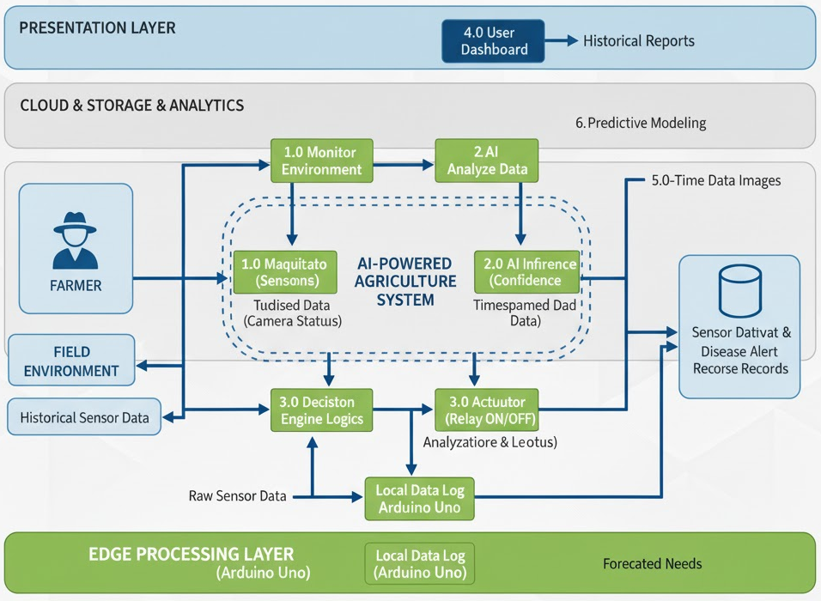
System Architecture
1. Field Layer (Sensors & Actuators) Monitors soil, climate, and plants. Controls devices like water pumps.
2. Edge AI Layer (Arduino & MobileNet V2) Processes data locally. Uses MobileNet V2 for real-time plant disease detection.
3. Cloud & Analytics Layer (Optional) Stores historical data and runs predictive models for forecasts.
4. User Interface (Dashboard) Web/mobile app for live monitoring, alerts, reports, and manual control.
Flow: Field Data → Edge AI Analysis → Instant Action / Cloud Storage → Farmer Dashboard.

Slide 9
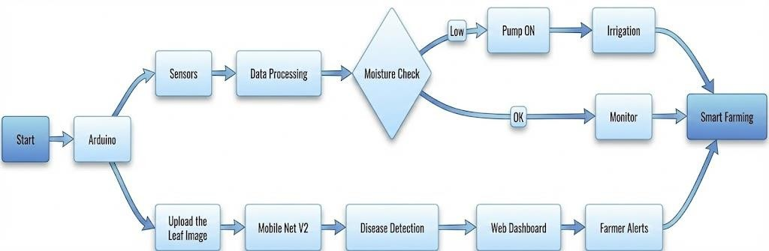
Block Diagram

Slide 10
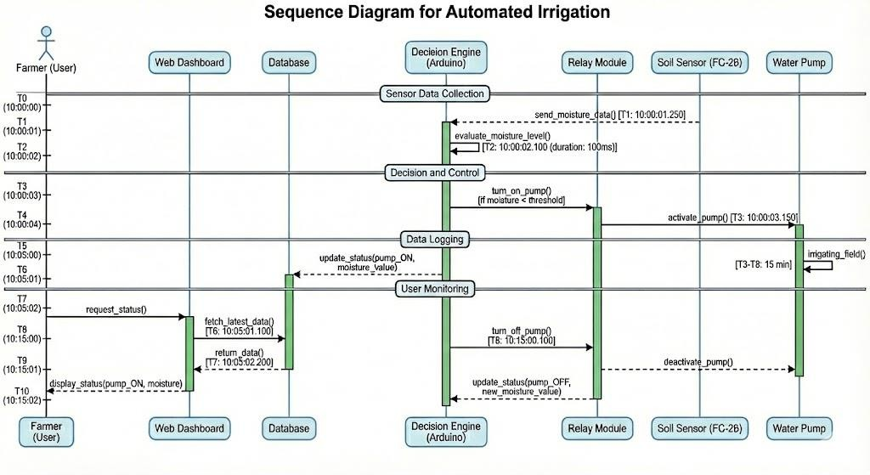
Sequence Diagram for Automated Irrigation

Slide 11
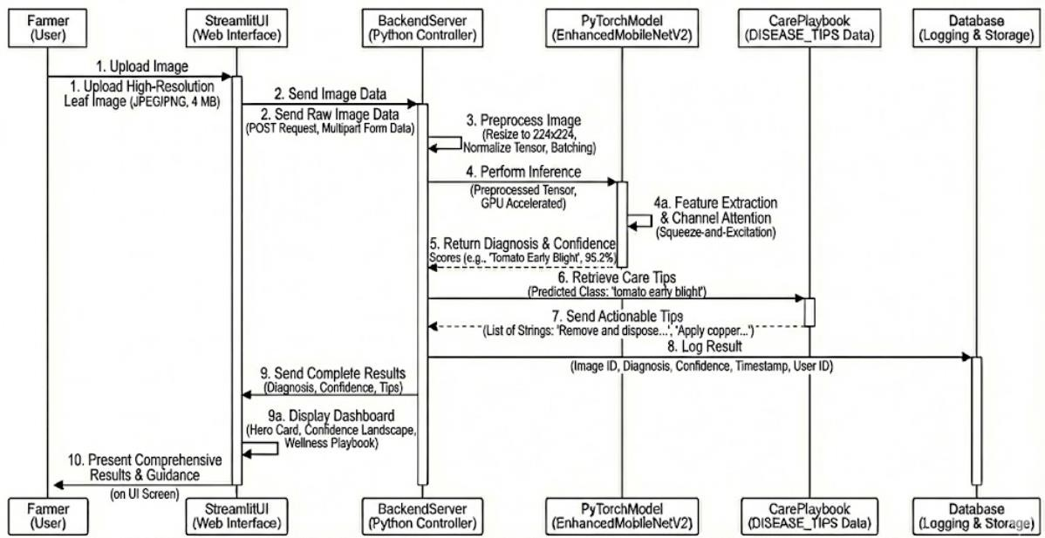
Sequence Diagram for Disease Detection

Slide 12
Methodology
Convolutional Neural Networks (CNNs) for plant disease prediction :
Automatically extract features (colour, texture, spots)
Achieve high accuracy (>90%)
Handle noise and lighting variations
Work on both edge devices and servers
Support real-time detection with Arduino Uno
Integration of MobileNet V2 Model:
Lightweight CNN for mobile and embedded vision tasks
Uses inverted residuals and linear bottlenecks for better efficiency
Depthwise separable convolutions reduce computation and parameters
Pre-trained on ImageNet for quick transfer learning
Achieves 94% accuracy in plant disease detection
Fast and optimized for real-time IoT and edge applications

Slide 13
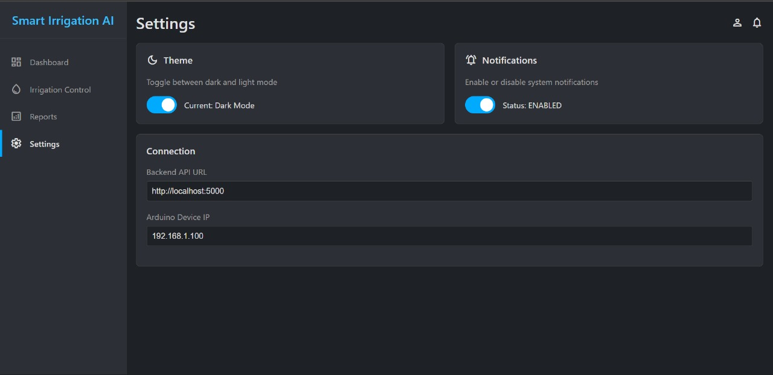
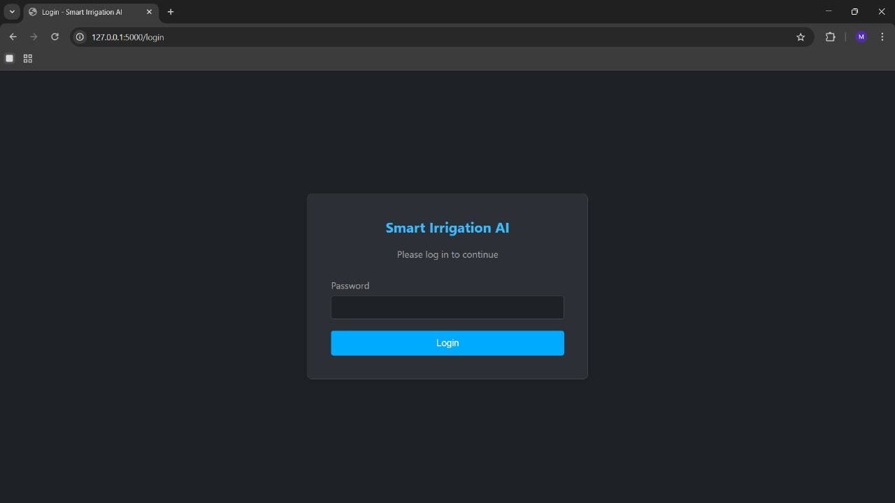
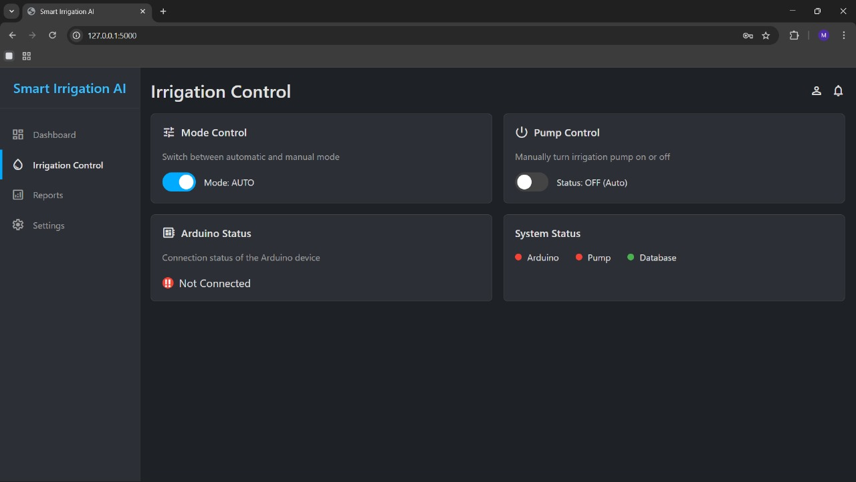
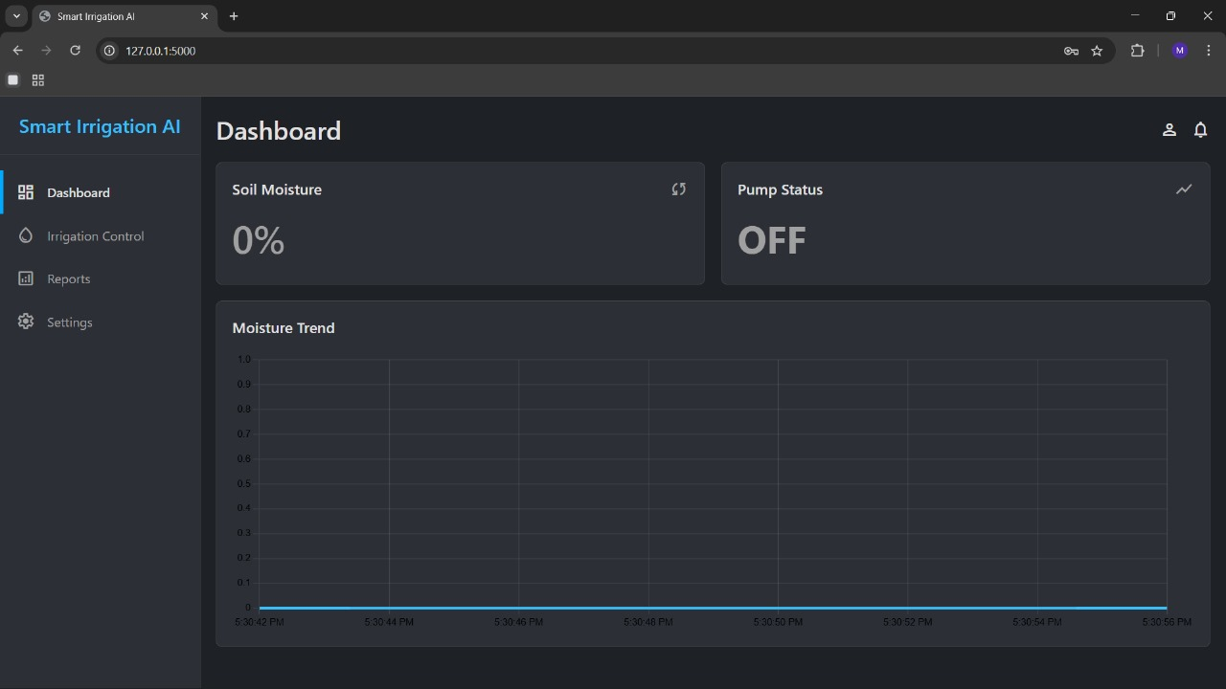

Slide 14
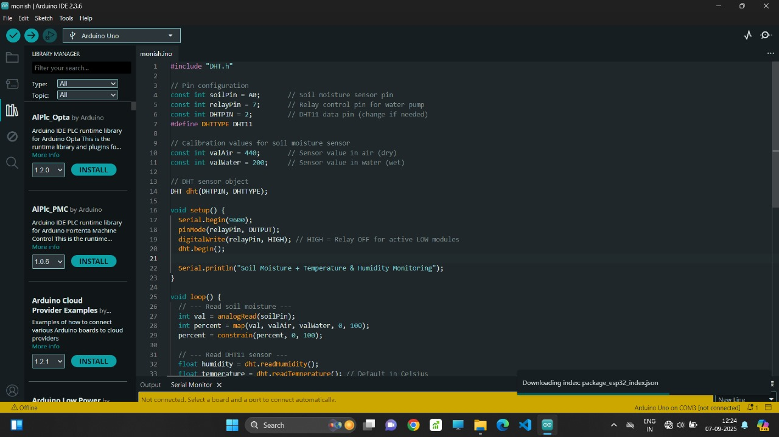
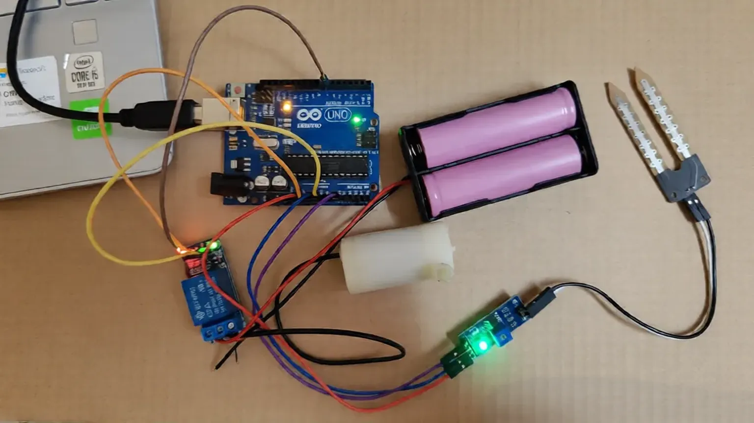
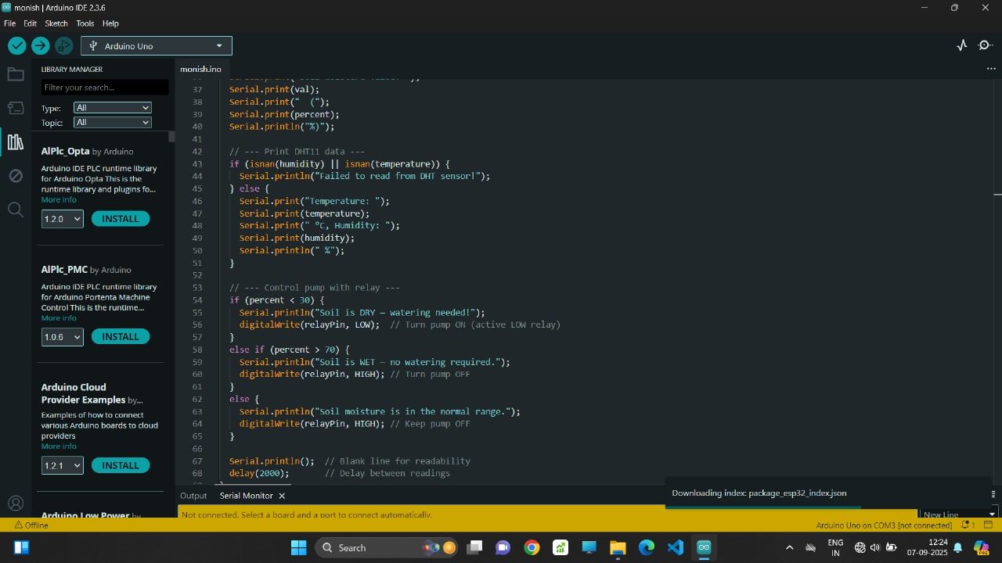

Slide 15
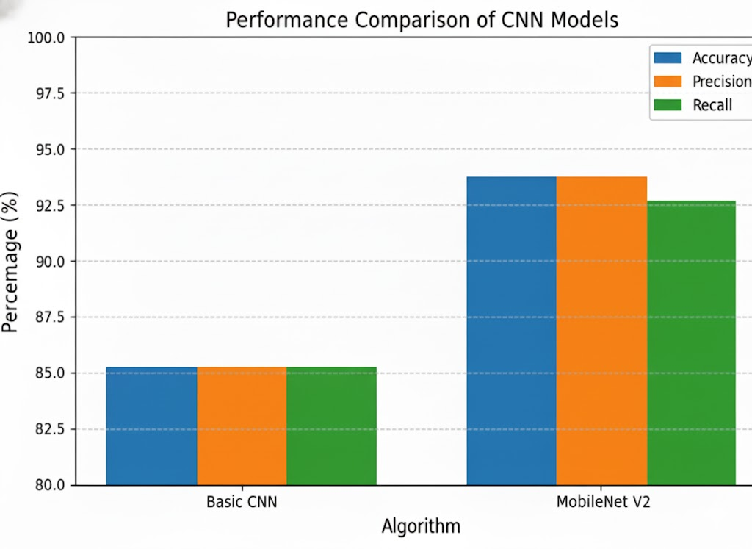
Graph

Slide 16
Test Cases
Condition | Input/Action | System Response | Result
Soil moisture < 30% | Dry soil detected | Pump turns ON automatically | ✅ Passed
Soil moisture > 70% | Wet soil detected | Pump remains OFF | ✅ Passed
Sensor disconnected | No data from soil sensor | System triggers Error / Fallback Mode | ✅ Passed
Cloud connectivity lost | Internet unavailable | Local data storage is activated | ✅ Passed

Slide 17
Advantages
Early Disease Detection – Reduces crop loss.
Precision Irrigation – Saves water, prevents over-irrigation.
Automation – Reduces manual labor, saves time.
Data-Driven Decisions – Improves farm planning.
Scalability – Works for small and large farms.
Sustainability – Improves soil health, reduces chemicals.
Higher Yield – Boosts crop quality and productivity.
Limitations
High Setup Cost – Expensive sensors and devices.
Technical Skills Needed – Farmers require training.
Internet & Power Dependency – Needs stable connectivity.
.

Slide 18
Conclusion
Transformative Impact – Combines AI, IoT, and automation to enable data-driven, sustainable farming.
Precision Farming – Uses smart irrigation, disease detection, and monitoring to boost yield and cut resource waste.
Tech Integration – Employs CNN-based vision, sensors, and automated irrigation to solve core farming issues.
Scalable Design – Modular setup ensures easy deployment, even in low-resource areas.
System Synergy – Smooth hardware–software integration ensures reliability.
Efficiency & Sustainability – Improves productivity while supporting global sustainable agriculture goals.

Slide 19
Future Predictions
Future Predictions Autonomous Farming: Robotic tractors, drones, and harvesters managing sowing, irrigation, pest control, and harvesting with minimal human input.
Ultra-Accurate Yield Forecasting: Satellite + IoT + AI enabling >99% accurate yield prediction and early detection of yield gaps.
Predictive Pest & Disease Control: AI forecasting outbreaks and drones applying micro-doses of treatment only where needed.
Smart Crop Recommendations: AI suggesting profitable crops based on soil, climate, and market data.
Farmer AR/Voice Assistance: Hands-free voice commands and AR-guided decision-making in the field.

Slide 20
References
1. S. P. Mohanty, D. P. Hughes and M. Salathé, Using Deep Learning for Image-Based Plant Disease Detection, Frontiers in Plant Science, Vol. 7, 2016, p. 1419.
2. M. Tan and Q. V. Le, EfficientNet: Rethinking Model Scaling for Convolutional Neural Networks, Proc of the 36th International Conference on Machine Learning, PMLR 97, 2019, pp. 6105–6114.
3. Food and Agriculture Organization of the United Nations, The future of food and agriculture – Trends and challenges, Rome, 2017.
4. McKinsey & Company, Agriculture’s connected future: How technology can yield new growth, 2020.
5. Nitin and S. B. Gupta, Artificial Intelligence in Smart Agriculture: Applications and Challenges, CAST, Vol. 1, No. 1, 2023.
6. P. Kumar, A. Nelson, Z. Kapetanovic and R. Chandra, Affordable Artificial Intelligence – Augmenting Farmer Knowledge with AI, arXiv preprint arXiv:2303.06049, 2023.
7. Aashu, K. Rajwar, M. Pant and K. Deep, Application of Machine Learning in Agriculture: Recent Trends and Future Research Avenues, arXiv preprint arXiv:2405.17465, 2024.
8. A. A. Issa, S. Majed, S. A. Ameer and H. M. Al-Jawahry, Farming in the Digital Age: Smart Agriculture with AI and IoT, E3S Web of Conferences, Vol. 477, 2024, p. 00081.
9. O. Turgut, I. Kok and S. Ozdemir, AgroXAI: Explainable AI-Driven Crop Recommendation System for Agriculture 4.0, arXiv preprint arXiv:2412.16196, 2024.
10. A. Palli and H. Kumar, Integration of Smart Drones and AI into Agriculture – A Review, National Agricultural Compliance Assistance Association, 2024.

Slide 21
Thank You

