Slide 1
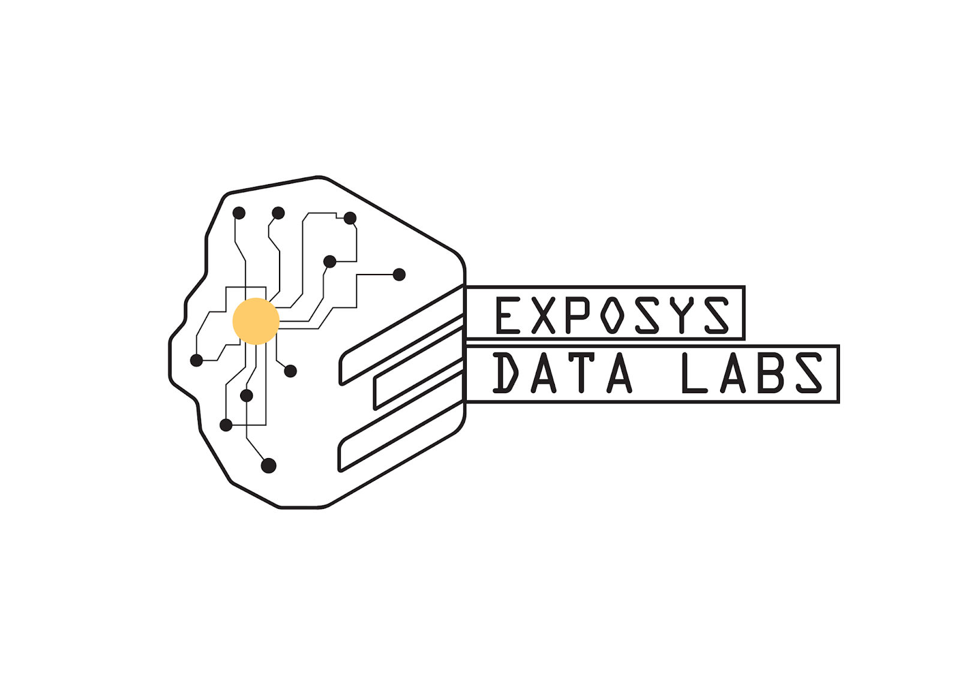
DATA SCIENCE
Presentation By
Bathini Monish Kamal

Slide 2

Introduction
Clustering
Applications of clustering
K-means Clustering
Application of k-means
Libraries
Customer segmentation using k-means algorithm
7

Slide 3

Introduction
What is data science..?
Data Science is a detailed study of the flow of information from the colossal amounts of data present in an organization’s repository.
Data science is all about using data to solve problems.
The problem could be decision making such as identifying which email is spam and which is not.
The main tasks in involved for data scientist includes data collection, cleaning, and data analysis.

Slide 4
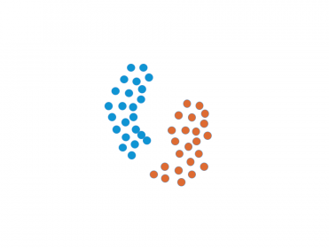
Clustering
Clustering is one of the most popular unsupervised classification technique.
It is a process of grouping a set of physical or abstract objects into clusters
Eg: (customer, product etc.)
A cluster is a collection of data objects that are similar to one another within the same cluster and are dissimilar to objects in other clusters.
It is a distance based method.
Common distance measure is Euclidian distance.

Slide 5
Example
One of the most common example for clustering is a web document search.
A web search engine often returns thousands of pages in response to a broad query , making it difficult for users to browse or to identify relevant information.
Clustering methods can be used to automatically group the retrieved documents into a list of meaningful categories.

Slide 6
Applications of Clustering
Clustering has a large number of applications spread across various domains.
Some of the most popular applications of clustering are:
Recommendation engines
Market segmentation
Social network analysis
Search result grouping
Medical imaging
Image segmentation
Crime analysis

Slide 7
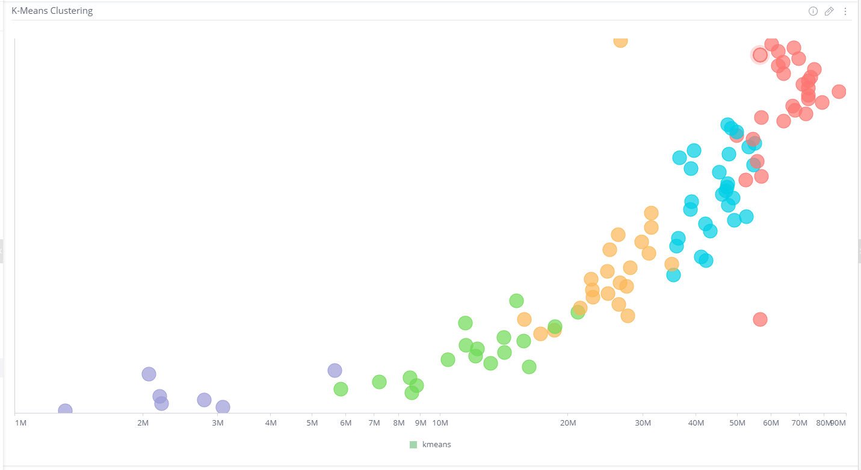
K-means clustering
K-means is one of the simplest unsupervised learning algorithms that solve the well known clustering problem.
Algorithm for K-means:
1.Group data into k clusters by:
a) Determining the k-centroid.
b) Group the data points to the nearest centroid.
2.Algorithm works by iterating between two stages until the data
points converge.

Slide 8
Application of k-means
Customer segmentation
Customer Segmentation is a popular application of unsupervised learning.
Using clustering, identify segments of customers to target the potential user base.
They divide customers into groups according to common characteristics like gender, age, interests, and spending habits so they can market to each group effectively.

Slide 9
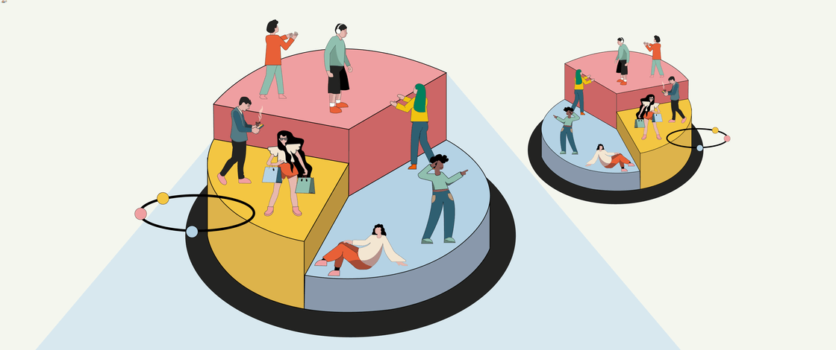
Customer Segmentation
What is Customer Segmentation?
Customer Segmentation is the process of division of customer base into several groups of individuals that share a similarity in different ways that are relevant to marketing such as gender, age, interests, and miscellaneous spending habits.
This project is implemented using python.
First we import the required dataset.
Next import NumPy ,pandas, matplotlib , seaborne libraries.

Slide 10
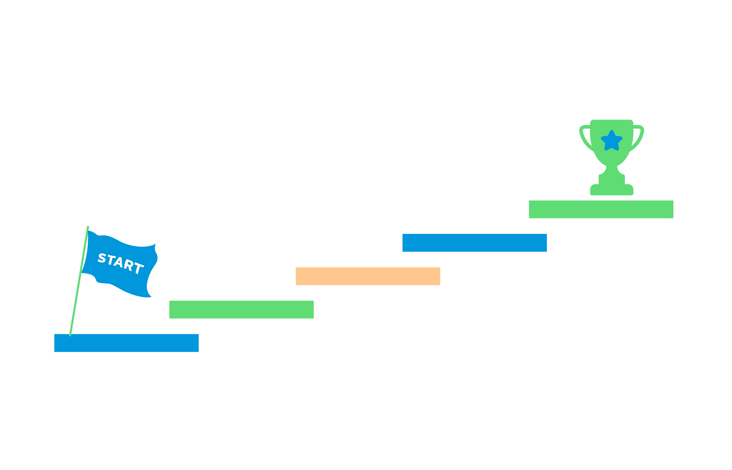
Steps:
This project is implemented using python.
First we import the required dataset.
Next import NumPy, pandas, matplotlib, seaborn libraries.
Then read the csv file and visualize some plots.
The first plot in our project shows the ages distribution which is bar plot.
Likewise we used different plots for gender and to analyze annual income, spending scores.
Then divide the age into different ranges and visualize the graph against no of customers, likewise for spending score and income also.
We used scikit-learn for kmeans.
The k value can be found by using elbow method.

Slide 11


