Slide 1
Enumeration Types in Java
What this covers
1. Java enum background
2. Syntax overview
3. Feature matrix
4. Design analysis
5. Case study
6. Beyond normal usage
7. Java-side conclusion
Deliverable 2
Monish M Gasikanti
Vansh Mago
Zayn Shareef
Notes:
[Sources]
- Project deliverables provided by the user.

Slide 2

Language Background
When Java added enums, why they were added, and what problem they solved
Before Java 5
What changed in Java 5.0
Why this mattered
Java developers commonly used public static final int constants or the typesafe enum pattern. Oracle notes that the typesafe enum pattern was verbose, error-prone, and its constants could not be used in switch statements.
Oracle's language guide says that Java 5.0 added linguistic support for enumerated types. The enum declaration created a full-fledged class rather than a glorified integer.
Enums made APIs safer and more readable. They let the compiler distinguish one domain of constants from another, and they also allowed fields, methods, interfaces, and iteration through values().
Simple enum declaration
Enums arrived in Java 5.0 (2004).
They solved the safety and readability problems of int constants.
Java enums were designed as objects with behavior, not as raw numeric labels.
Notes:
[Sources]
- Oracle enum guide: Java 5.0 added linguistic support; typesafe enum pattern was verbose and could not be used in switch statements: https://docs.oracle.com/javase/8/docs/technotes/guides/language/enums.html
- Oracle tutorial on enum types and enum keyword: https://docs.oracle.com/javase/tutorial/java/javaOO/enum.html

Slide 3
Syntax Overview
Basic declaration, assignment, and built-in enum information
Basic enum usage
What to point out
Important caution
1 enum TrafficLight {
2 RED, YELLOW, GREEN
3 }
4
5 TrafficLight light = TrafficLight.RED;
6 System.out.println(light.name());
7 System.out.println(light.ordinal());
• enum is a language keyword
• constants are scoped as Type.CONSTANT
• name() returns the declared name
ordinal() is available, but it should not be treated as stable business data. Reordering constants can change ordinals and break logic if code depends on them.
What this demonstrates
This syntax directly supports Deliverable 1 Program 1: declaration, variable assignment, and printing. It also shows that enum values are not assigned custom integers by default; they have names and ordinals.
Notes:
[Sources]
- Oracle tutorial: enum keyword, predefined constants, and use cases for fixed sets of values: https://docs.oracle.com/javase/tutorial/java/javaOO/enum.html
- Java Language Specification section 8.9 (Enum Classes): https://docs.oracle.com/javase/specs/jls/se21/html/

Slide 4
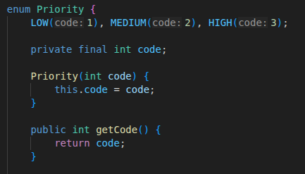
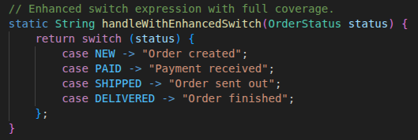
Syntax Overview
Enums with fields, constructors, methods, and switch expressions
Enum with state and behavior
Enhanced switch expression
Why this matters
Java enums are class-like: they can store data, expose methods, and participate in structured control flow. This is much richer than treating enums as plain integers.
Connection to Deliverable 1
Program 3 uses enum fields and methods. Program 2 uses both classic switch and enhanced switch to show exhaustiveness behavior and missing-case handling.
Notes:
[Sources]
- Oracle enum guide: enums are full-fledged classes with methods and fields; they are Comparable and Serializable: https://docs.oracle.com/javase/8/docs/technotes/guides/language/enums.html
- JEP 361 switch expressions and exhaustiveness: https://openjdk.org/jeps/361

Slide 5
Feature Matrix (Part 1)
Required Appendix A categories for Java enums
Feature Category | Java
Basic Declaration | Uses the built-in enum keyword. Constants are declared inside the enum body. By default, Java gives each constant a name and ordinal position; custom fields can be added, but they are not automatic integer values.
Underlying Type | Each enum is a special class that extends java.lang.Enum. Enum values are reference types, not raw ints, so the design is strongly type-safe.
Associated Values / Data | Yes. Each enum constant can carry fixed data through constructor arguments and fields, such as code, label, or message.
Methods on Enums | Yes. Java enums can define methods, implement interfaces, and even provide constant-specific behavior.
Exhaustiveness Checking | Classic switch statements are permissive. Enhanced switch expressions are stricter; JEP 361 states that switch expressions must be exhaustive.
Notes:
[Sources]
- Oracle tutorial and enum guide for declaration, values(), and class-like behavior: https://docs.oracle.com/javase/tutorial/java/javaOO/enum.html ; https://docs.oracle.com/javase/8/docs/technotes/guides/language/enums.html
- Java SE 21 Enum API: common base class and serialization behavior: https://docs.oracle.com/en/java/javase/21/docs/api/java.base/java/lang/Enum.html
- JEP 361 on switch expression exhaustiveness: https://openjdk.org/jeps/361

Slide 6
Feature Matrix (Part 2)
Required Appendix A categories for Java enums
Feature Category | Java
Iteration | Built in through values(), which returns the constants in declaration order. Reflection is optional, not required, for ordinary iteration.
Comparability & Ordering | Enum constants can be compared with == safely. They are Comparable, and compareTo() / ordinal() reflect declaration order.
Serialization | Java enum classes are serializable and receive special handling from the serialization mechanism. The serialized representation cannot be customized. For JSON, many libraries serialize by name; renaming constants can break compatibility.
Namespace & Scoping | Constants are scoped by the enum type, for example OrderStatus.PAID, so they do not pollute the outer namespace unless imported statically.
Nullability | Enum variables can be null because they are reference types. If code calls a method on a null enum, Java throws NullPointerException at runtime.
Notes:
[Sources]
- Oracle enum guide on values() iteration and Comparable/Serializable: https://docs.oracle.com/javase/8/docs/technotes/guides/language/enums.html
- Java SE 21 Enum API on serialization behavior: https://docs.oracle.com/en/java/javase/21/docs/api/java.base/java/lang/Enum.html

Slide 7
Design Analysis
Why Java enums were designed as classes
Type system rationale
Object-oriented rationale
Library and language fit
Java is statically typed, so enum values are designed as a dedicated reference type rather than as ints. That makes API boundaries clearer and lets the compiler reject unrelated constant domains.
Java enums are class-like because Java leans heavily on object-oriented modeling. Fields, methods, constructors, and interfaces let an enum own both its data and its behavior.
Enums work well with switch, collections, serialization, and for-each loops. Oracle also provides specialized collections such as EnumSet and EnumMap for efficient use of enum keys and values.
Java enums are more structured than the “named int” style used in many older languages.
The design favors safety and maintainability over maximum flexibility.
This makes enums especially strong for domain modeling and fixed-state logic.
Notes:
[Sources]
- Oracle enum guide on enums as full-fledged classes and on Comparable/Serializable: https://docs.oracle.com/javase/8/docs/technotes/guides/language/enums.html
- Java SE 21 Enum API noting specialized collections for enums: https://docs.oracle.com/en/java/javase/21/docs/api/java.base/java/lang/Enum.html

Slide 8
Design Analysis
Strengths and trade-offs of Java enums
Strengths
Trade-offs
• Strong type safety
• Fields, constructors, and methods
• Good fit for switch-based logic
• Clear scoping and API readability
• Built-in iteration with values()
• More verbose than lighter scripting approaches
• Null is still possible at runtime
• ordinal() can be misused as persistent data
• Not ideal for fresh per-use payloads the way algebraic data types are
Key point for the demo: Java enums reduce many constant-related bugs, but they do not eliminate all runtime mistakes.
Notes:
[Sources]
- Oracle enum guide on class-like behavior, iteration, and stronger type distinctions than int constants: https://docs.oracle.com/javase/8/docs/technotes/guides/language/enums.html
- Java SE 21 Enum API on serialization and base-class behavior: https://docs.oracle.com/en/java/javase/21/docs/api/java.base/java/lang/Enum.html

Slide 9
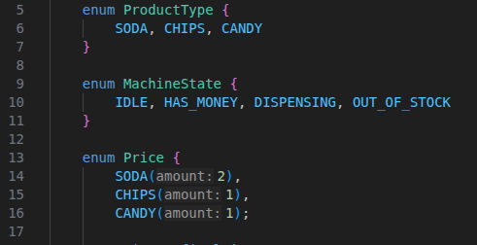
Case Study
Using enums to structure a vending-machine state model
Core enum set
Problem
Why enums helped
Outcome
A vending machine has a fixed product set, a fixed price set, and a fixed state machine. If strings or ints are used everywhere, logic becomes harder to track and easier to misuse.
Enums drove the logic: state transitions, price lookup, stock checks, and valid product choices all flowed through named types.
The code became easier to read, safer to maintain, and easier to present in the live demo. Removing the enums would require a real redesign, not just a search-and-replace.
ProductType fixed the legal product values.
MachineState made the control flow explicit.
Price bound product names to pricing data.
This is an example where enum design enabled a well-structured solution.
Notes:
[Sources]
- Case-study code is based on the user's Deliverable 1 Java program for Applied Enumeration.

Slide 10
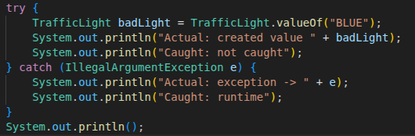
Beyond Normal Usage
Invalid lookup and Java's enum safety model
Program 1 edge case
Expected
Actual
What this reveals
The lookup should fail because BLUE is not one of the declared constants.
Java throws IllegalArgumentException at runtime when valueOf cannot find a matching constant.
Java does not let arbitrary enum values exist directly. Invalid values usually enter through a lookup path such as valueOf or a custom mapper.
Sample output
1 Expected: valueOf with an invalid name
2 should fail at runtime.
3
4 Actual: exception ->
5 java.lang.IllegalArgumentException:
6 No enum constant ... TrafficLight.BLUE
7 Caught: runtime
Notes:
[Sources]
- Java tutorial on fixed predefined constants and enum usage: https://docs.oracle.com/javase/tutorial/java/javaOO/enum.html
- User Deliverable 1 Program 1 code sample adapted for presentation.

Slide 11
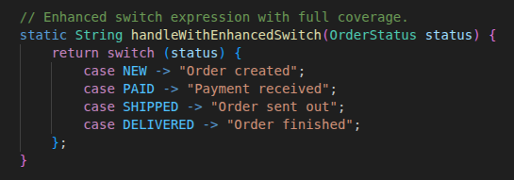
Beyond Normal Usage
Missing cases and exhaustiveness in switch logic
Enhanced switch expression
Classic switch statements are not required to be exhaustive.
JEP 361 says switch expressions must be exhaustive for all possible values.
In the demo code, default is used to keep the program runnable when a case is deliberately left out or when a new enum constant is added later.
Notes:
[Sources]
- JEP 361, section on exhaustiveness: switch expressions must be exhaustive; switch statements are not required to be exhaustive: https://openjdk.org/jeps/361
- User Deliverable 1 Program 2 code sample adapted for presentation.

Slide 12
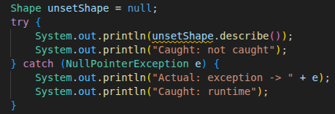
Beyond Normal Usage
Nullability and method calls on null enum references
Program 3 edge case
Expected
Actual
What this reveals
Calling an enum method on null should fail because null is not a valid object instance.
Java throws NullPointerException at runtime.
Enums are safer than int constants, but they are still reference types. Null must still be handled carefully in application code.
Sample output
1 Beyond Normal Usage: invoke method
2 on a null variable
3
4 Actual: exception ->
5 java.lang.NullPointerException
6 Caught: runtime
Notes:
[Sources]
- User Deliverable 1 Program 3 code sample adapted for presentation.

Slide 13
Conclusion
Best use cases
Less ideal when
Language comparison
• Large structured systems
• Domain models with fixed states
• Safer API design
• Switch-driven business logic
• Cases where fields and methods belong with the enum
• Maximum flexibility matters more than safety
• You want fresh per-use payloads instead of fixed constants
• Boilerplate cost matters more than structure
Java is stronger on structure and type safety, while the final team conclusion can compare that against Python's flexibility and lighter syntax.
Bottom line: Java enums are best when fixed states need strong names, strong structure, and compiler-friendly control flow.
Notes:
[Sources]
- Comparative conclusion here is a synthesis based on official Java enum documentation and the user's Deliverable 1 Java code examples.
- Primary references: Oracle enum guide, Java tutorial, Java SE 21 Enum API, JEP 361.

