Slide 1



STEP 4/9
Instructions that can finally see how you're doing.
Seat the clamp past the hose bead
STARTUPS @ HARVARD · 20 OCT 2026 · MONISH SARAVANA
CONCEPT MOCK · STOCK PHOTO
Notes:
Hi, I'm Monish. Praxis is AI guidance for the physical world: instructions that can finally see how you're doing. This is what a new maintenance technician sees through the glasses: one short instruction, a small progress mark, and a green check when the step is done. The photo is stock with a mocked-up HUD; the product behind it is real and I'll show the numbers.

Slide 2

02 / 06
THE PROBLEM
1 year
TYPICAL ON-THE-JOB TRAINING · BLS
DAY ONE
WORKS ALONE
01
02
03
04
05
06
07
08
09
10
11
12
before a new maintenance technician works alone.
9–14 months
before a new hire is profitable, in a survey of 35 aviation repair stations. Some took 24.
Most of it is shadowing a senior tech
BLS OCCUPATIONAL OUTLOOK HANDBOOK · 2017 REPAIR-STATION SURVEY
Notes:
BLS says on-the-job training for these jobs typically lasts more than a year. In a 2017 survey of 35 aviation repair stations, new hires took 9 to 14 months on average to become profitable, and some took 24. Most of that learning is shadowing a senior tech, which nobody budgets for: it shows up as lost senior-tech hours. Sources in docs/POSITIONING.md [P8, P22].

Slide 3
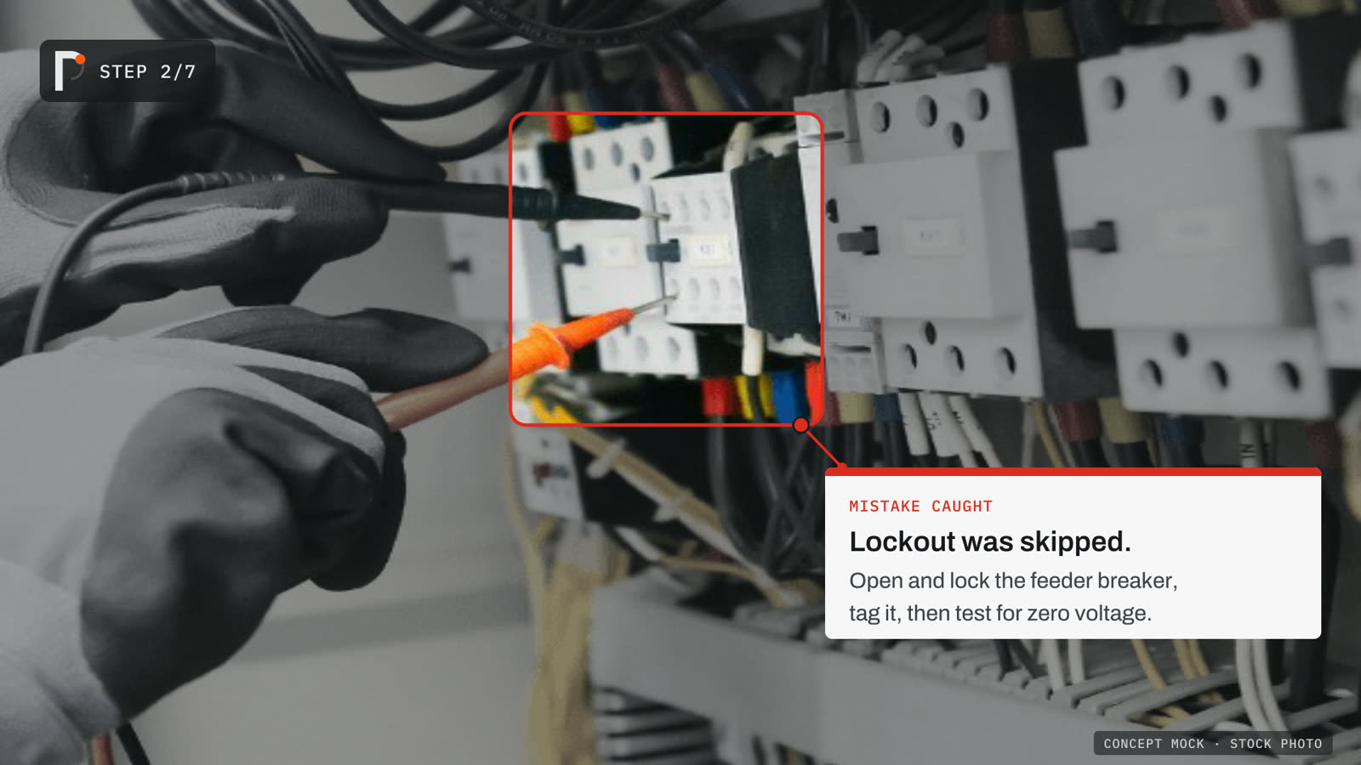
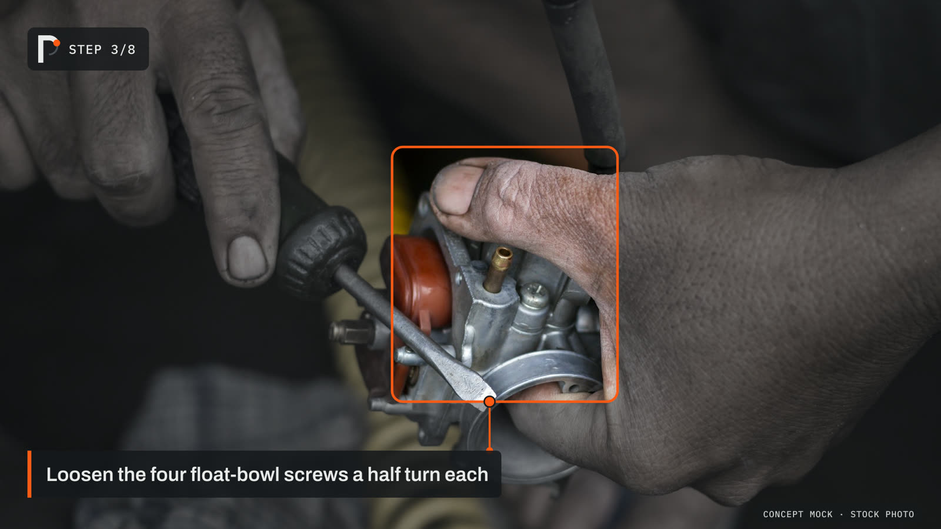
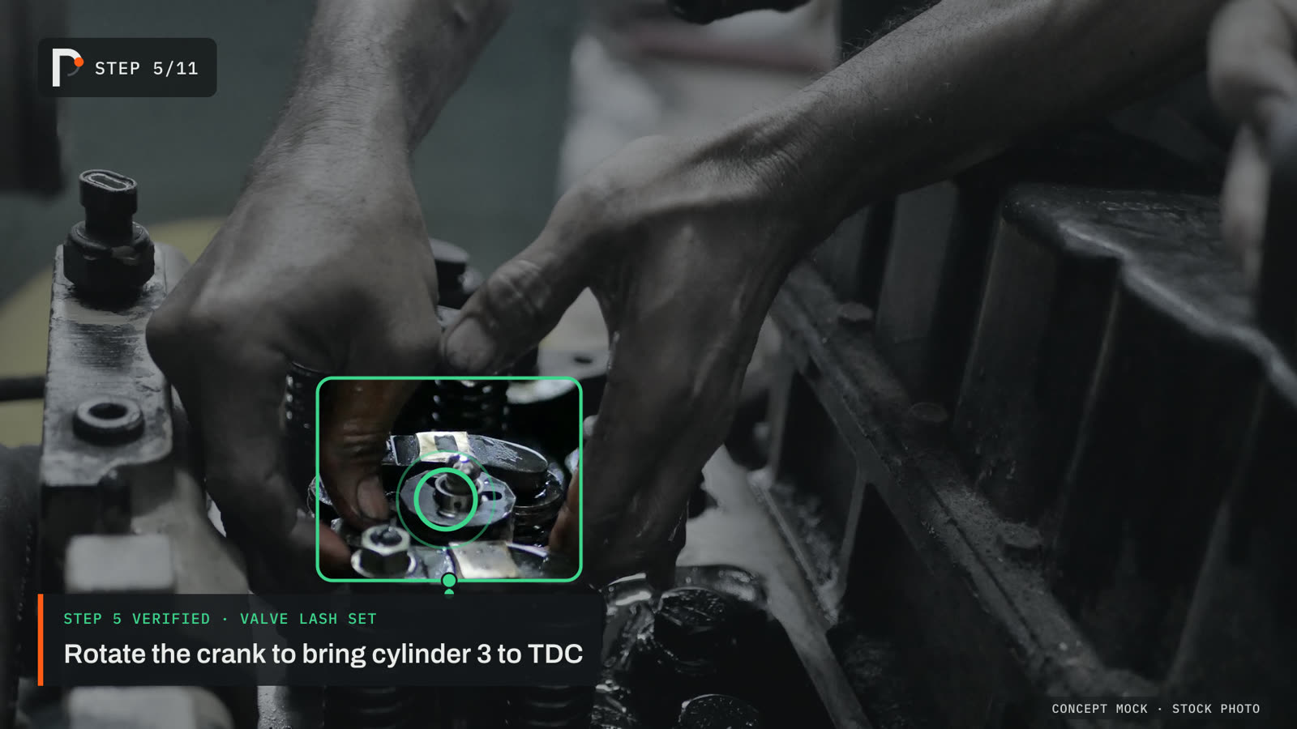
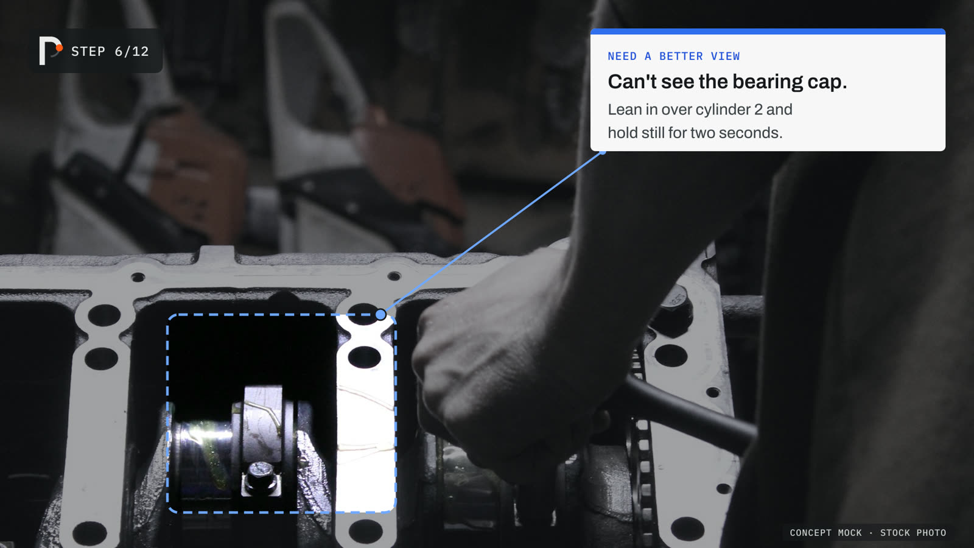
ON THE JOB
Small and quiet until something goes wrong.
STEP TRACKING
VERIFIED
ASKS FOR A BETTER VIEW
MISTAKE CAUGHT
It knows where you are in the procedure, so it can tell when a step was skipped.
Notes:
This is the product on the job. Most of the time it's small and quiet: a progress mark and one short instruction. It lights up when it matters: here it caught that lockout was skipped and says exactly how to fix it. It confirms finished steps, and when it can't see well it asks for a better view instead of guessing. Full-screen versions of each are in the appendix. These are concept mocks on stock photos.

Slide 4
02 · HOW IT WORKS
A tracking problem,
not a seeing problem.
WHERE YOU ARE: STEP 5
0:41 ON STEP · TYPICAL 0:25
S1
S2
S3
S4
S5
S6
S7
S8
S9
Notes:
Our conviction: coaching someone through physical work is a tracking problem, not a seeing problem. Praxis keeps a running belief about which step you're on (these bars), how long you've been on it versus how long it usually takes, and how sure it is. It only asks a big model when something happens. The bars are illustrative.

Slide 5
HOW PRAXIS WORKS · ENGINE v0
The frontier model is one swappable part. The tracking engine around it is ours.
Procedure compiler
manual → task graph · 8 procedures for $4.16
OURS
task graph
State tracker
where you are in the procedure
Bayesian semi-Markov model
EVERY FRAME · ON THE DEVICE · ~50 MS
OURS
Event detector
did a step end?
OURS
Perception
SigLIP2
V-JEPA 2 · hands
Policy
speak? verify?
flag? ask?
Camera
first-person
4 frames / s
OPEN MODEL
OURS
Coach
voice + HUD · speaks only
when confident
OURS
Task recognizer
which job is it?
OURS
S1
S2
S3
S4
S5
S6
S7
session records
14% of frames
evidence
ONLY WHEN SOMETHING HAPPENS
Flywheel + local student
0.03 ms per check, free
34% fewer frontier calls
Verifier
fast: Jev · 151 ms
hard cases: Claude Opus · 3.8 s
Calibration
error
0.22 → 0.02
OURS
RENTED · SWAPPABLE
OURS
Ours
Open model, on device
Rented, swappable
48 held-out clips (public CaptainCook4D) · results/RESULTS.md
Notes:
Walk it left to right along the orange path, which is what happens on every frame, on the device, in about 50 ms: open models turn the frame into features, our detector and recognizer feed our state tracker, and the policy decides whether the coach says anything. Below, in the dark, is the only rented part: on 14% of frames the tracker asks a verifier one typed question (Jev in 151 ms, Claude Opus for hard cases). We calibrate the answer and feed it back. Every session trains our local student, which already handles routine checks. Swapping the rented model is a one-line config change.

Slide 6

06 / 06
RESULTS · SAME FRONTIER MODEL, SAME FRAMES
54%
5×
cheaper
step accuracy with our state tracker around the model
per minute of video: $0.018 versus $0.085
PRAXIS
PRAXIS
MODEL EVERY 5 S
MODEL EVERY 5 S
Same model. Our layers make it better and cheaper.
48 HELD-OUT CLIPS · RESULTS/RUNS/FUSED_ORACLE.JSON
Notes:
Like-for-like: the same frontier model, the same frames. Called every 5 seconds without state it tracks the step 48% of the time. With our layers around it, 54%, and about 5x cheaper ($0.018 vs $0.085 per minute) because most checks never leave the device. Bars are drawn to scale. Measured on 48 held-out first-person clips from a public cooking dataset (CaptainCook4D): say so if asked.

Slide 7


STEP 3/8
Loosen the four float-bowl screws a half turn each
CONCEPT MOCK · STOCK PHOTO
Notes:
Step tracking. Praxis recognizes the job by itself and keeps a running belief about which step you're on. The screen stays quiet: a progress mark, one short instruction, and the part it's talking about.

Slide 8
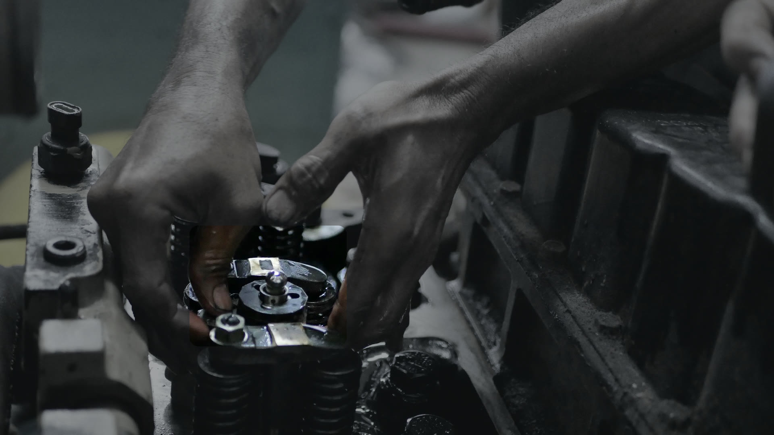

STEP 5/11
STEP 5 VERIFIED · VALVE LASH SET
Rotate the crank to bring cylinder 3 to TDC
CONCEPT MOCK · STOCK PHOTO
Notes:
Verified. When the step is done, a green ring confirms it and the instruction moves on. No one has to tick a checklist.

Slide 9
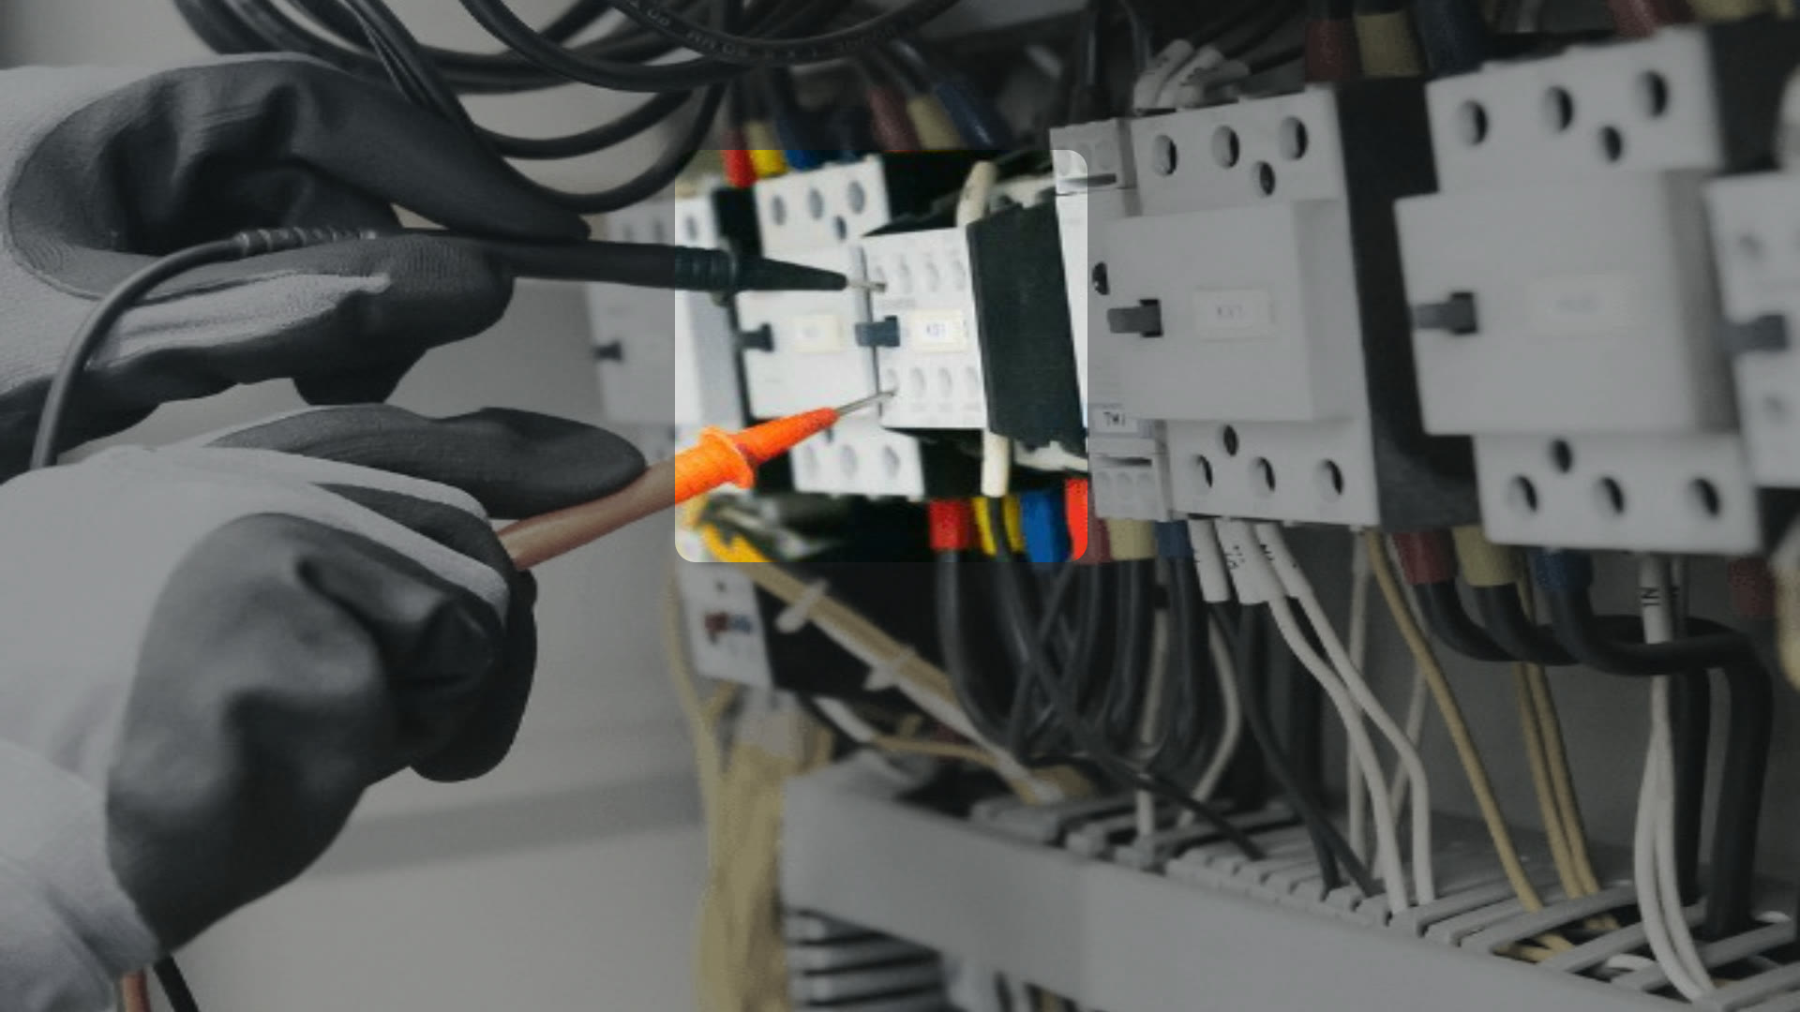
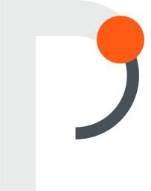
STEP 2/7
MISTAKE CAUGHT
Lockout was skipped.
Open and lock the feeder breaker, tag it, then test for zero voltage.
CONCEPT MOCK · STOCK PHOTO
Notes:
Mistake caught. This is the moment that matters: Praxis knows where you are in the procedure, so it can tell that lockout was skipped and say exactly how to fix it. Out-of-order mistakes are the most common error type in our eval data, and you can only see them if you track state.

Slide 10
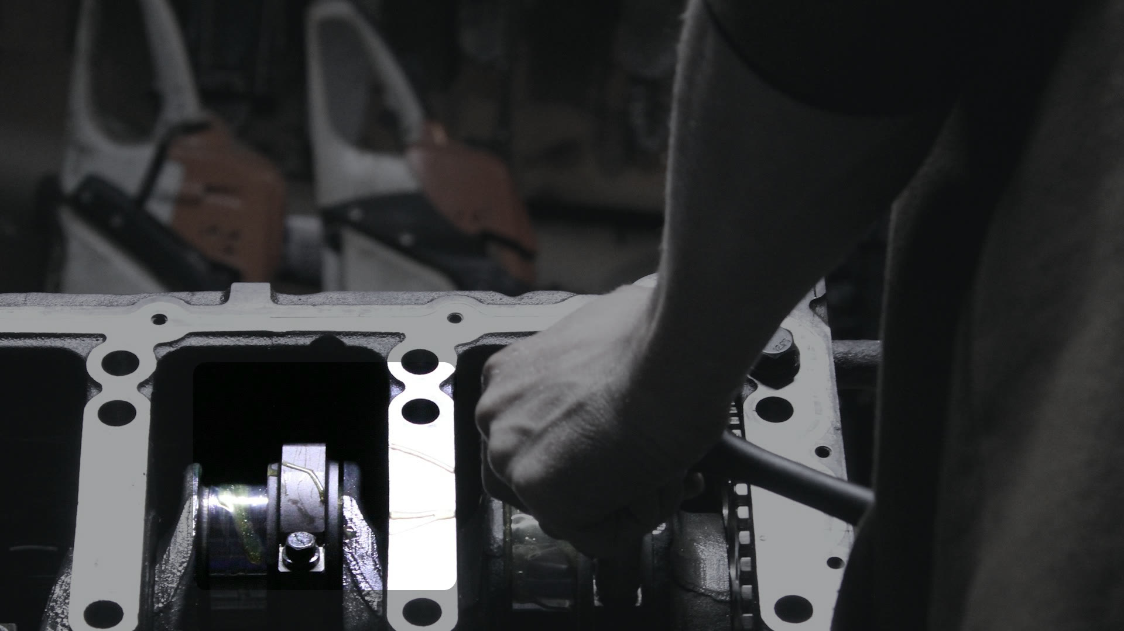
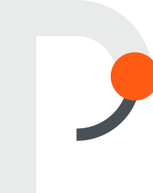
STEP 6/12
NEED A BETTER VIEW
Can't see the bearing cap.
Lean in over cylinder 2 and hold still for two seconds.
CONCEPT MOCK · STOCK PHOTO
Notes:
Needs a better view. When it isn't sure, it asks instead of guessing. On blurred or blocked views it asked for a better look 77-98% of the time and was never confidently wrong.

Slide 11
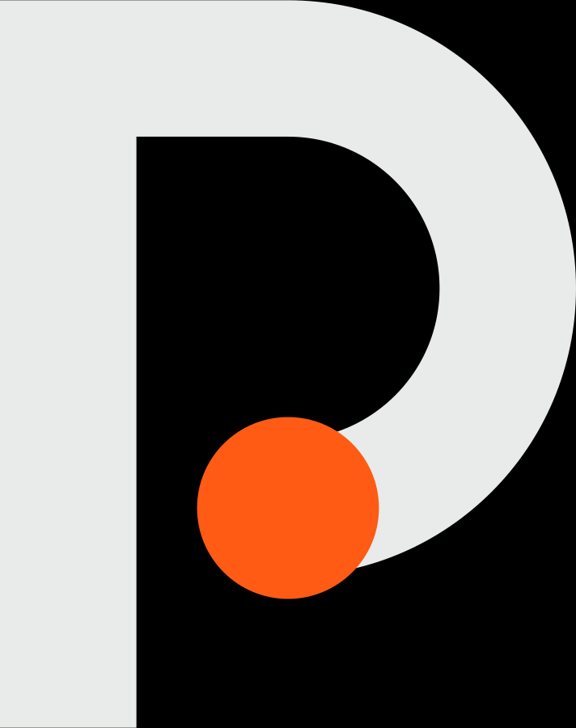
Instructions that can finally see how you're doing
STARTUPS @ HARVARD · 20 OCT 2026
MONISH SARAVANA · FOUNDER
Notes:
Backup cover (B). Use it if the photo cover feels too busy on the venue projector.

