Slide 1



STEP 4/9
Instructions that can finally see how you're doing
Seat the clamp past the hose bead
STARTUPS @ HARVARD · 20 OCT 2026 · MONISH SARAVANA
CONCEPT MOCK · STOCK PHOTO
Notes:
Hi, I'm Monish. Praxis is AI guidance for the physical world: instructions that can finally see how you're doing. This is what a new maintenance technician sees through the glasses: one short instruction, a small progress mark, and a green check when the step is done. The photo is stock with a mocked-up HUD; the product behind it is real and I'll show the numbers.

Slide 2
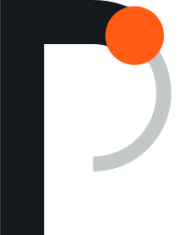
A new maintenance technician takes about a year to work alone
THE PROBLEM
>1 yr
9–14 mo
of on-the-job training is typical for industrial machinery mechanics and maintenance workers.
before a new hire is profitable, in a survey of 35 aviation repair stations. Some took 24.
Sources: BLS Occupational Outlook Handbook · 2017 aviation repair-station survey
Notes:
BLS says on-the-job training for these jobs typically lasts more than a year. In a 2017 survey of 35 aviation repair stations, new hires took 9 to 14 months on average to become profitable, and some took 24. Most of that learning is shadowing a senior tech, which nobody budgets for: it shows up as lost senior-tech hours. Sources in docs/POSITIONING.md [P8, P22].

Slide 3


STEP 3/8
Loosen the four float-bowl screws a half turn each
CONCEPT MOCK · STOCK PHOTO
Notes:
Step tracking. Praxis recognizes the job by itself and keeps a running belief about which step you're on. The screen stays quiet: a progress mark, one short instruction, and the part it's talking about.

Slide 4
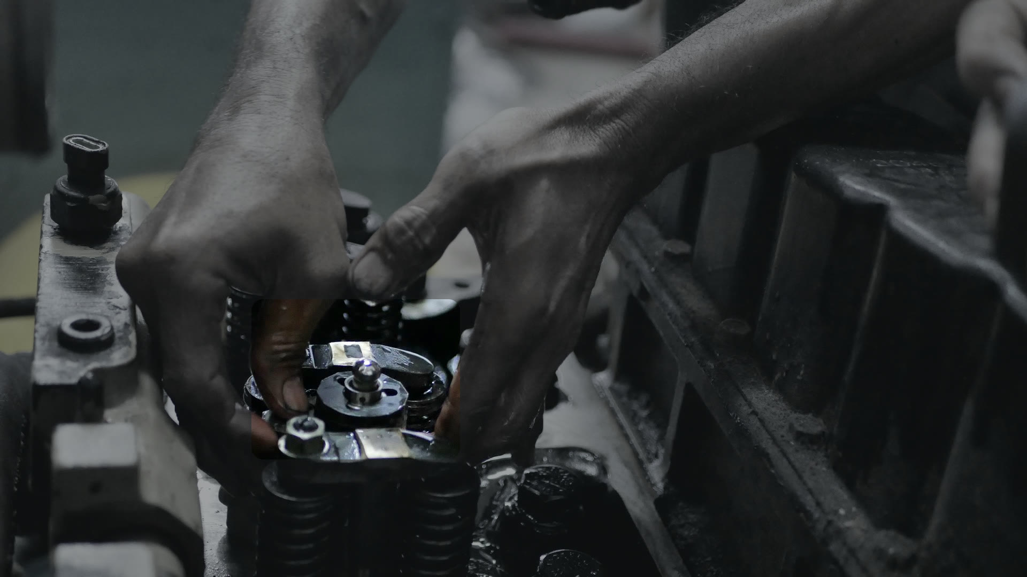

STEP 5/11
STEP 5 VERIFIED · VALVE LASH SET
Rotate the crank to bring cylinder 3 to TDC
CONCEPT MOCK · STOCK PHOTO
Notes:
Verified. When the step is done, a green ring confirms it and the instruction moves on. No one has to tick a checklist.

Slide 5
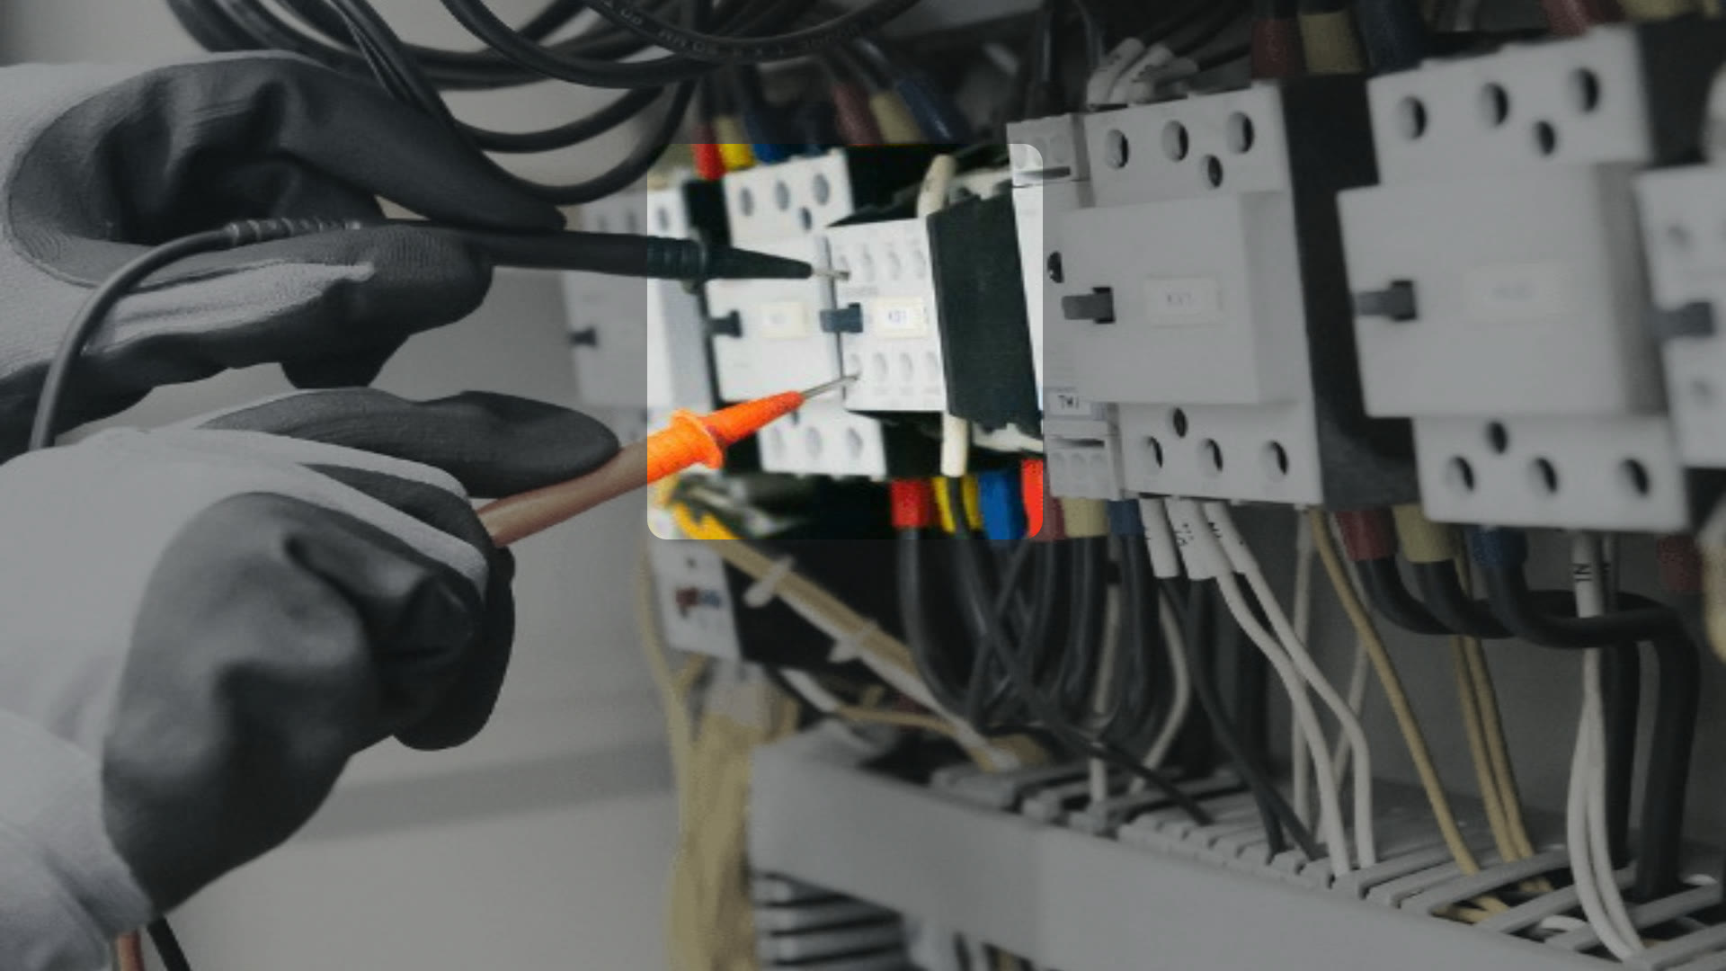
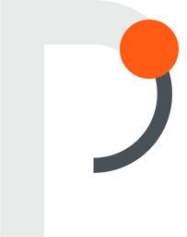
STEP 2/7
MISTAKE CAUGHT
Lockout was skipped.
Open and lock the feeder breaker, tag it, then test for zero voltage.
CONCEPT MOCK · STOCK PHOTO
Notes:
Mistake caught. This is the moment that matters: Praxis knows where you are in the procedure, so it can tell that lockout was skipped and say exactly how to fix it. Out-of-order mistakes are the most common error type in our eval data, and you can only see them if you track state.

Slide 6
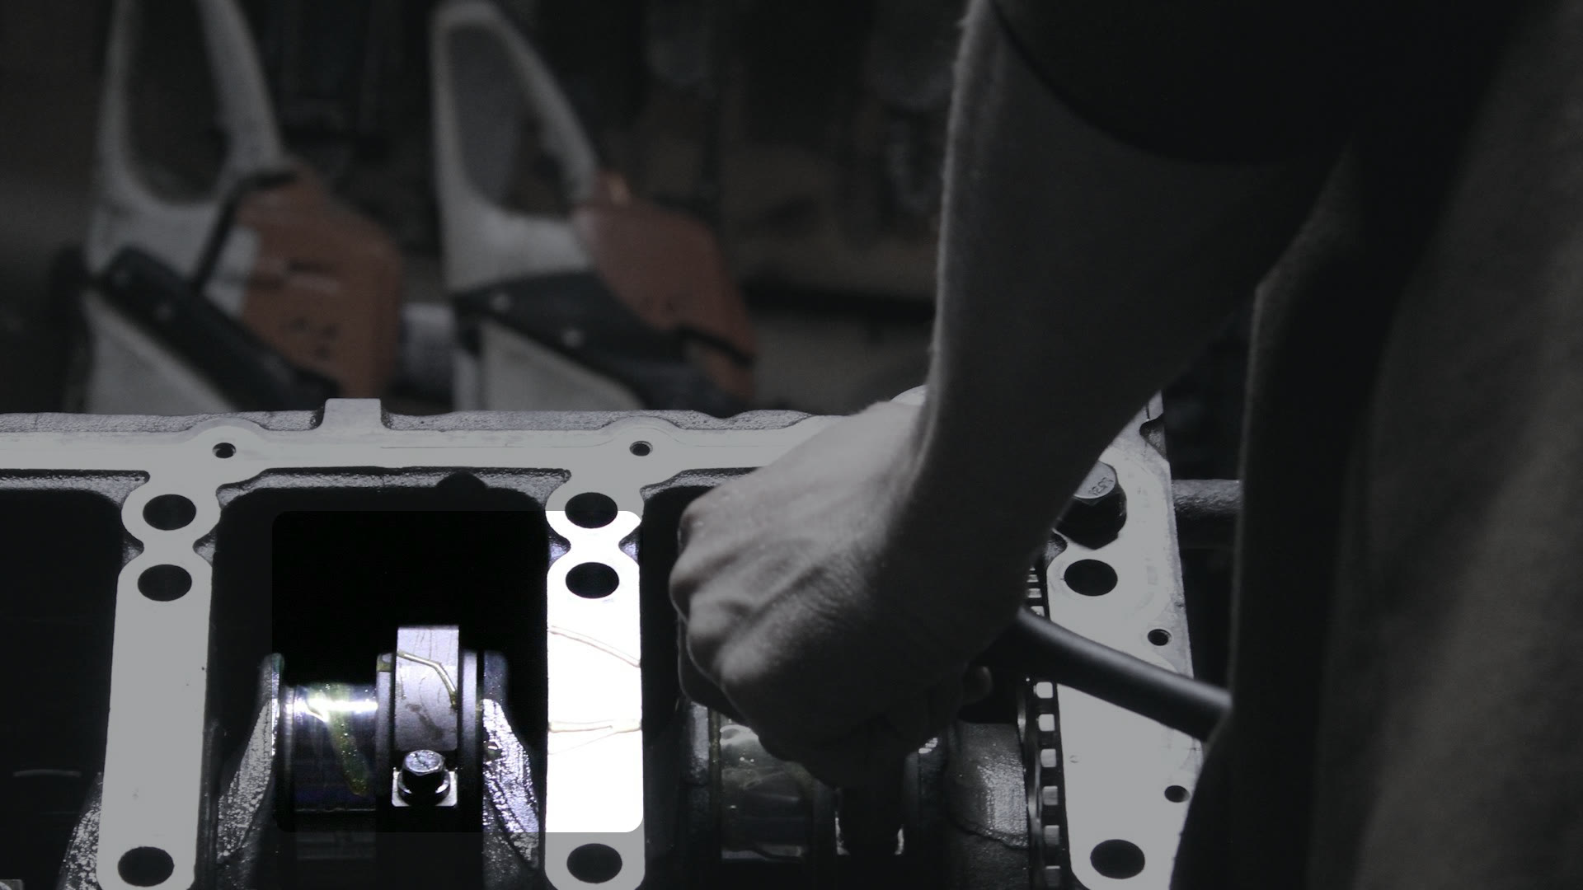

STEP 6/12
NEED A BETTER VIEW
Can't see the bearing cap.
Lean in over cylinder 2 and hold still for two seconds.
CONCEPT MOCK · STOCK PHOTO
Notes:
Needs a better view. When it isn't sure, it asks instead of guessing. On blurred or blocked views it asked for a better look 77-98% of the time and was never confidently wrong.

Slide 7

A tracking problem, not a seeing problem
02 · HOW IT WORKS
Praxis keeps a running belief about where you are in the procedure, and speaks only when it's sure.
Notes:
Our conviction: coaching someone through physical work is a tracking problem, not a seeing problem. Most competitors either stream video to a big model and hope, or bolt a camera to one workstation. We keep a belief about where the person is, and only ask a big model when something happens.

Slide 8
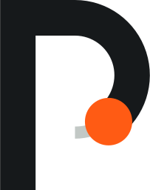
The frontier model is one swappable part. The tracking engine around it is ours
HOW PRAXIS WORKS · ENGINE v0
Ours: code and trained weights
Open model, frozen, runs on the device
Rented API behind a typed interface
Procedure compiler
Turns a manual into a task graph the engine can track
steps · checks · common mistakes · typical durations
8 procedures compiled
96 steps · 207 checks
267 known mistakes
$4.16 total, one-time
OURS
OFFLINE, ONCE PER PROCEDURE
FAST PATH · EVERY FRAME · ON THE DEVICE
3.1× FASTER THAN REAL TIME
library
task graph
Camera
Live video
first-person
4 frames / s
webcam or file
glasses adapter:
not yet tested
Perception
What's in view
SigLIP2 · 20 ms/frame
hands · 6 ms/frame
V-JEPA 2 · 221ms @1Hz
Event detector
Did a step just end?
F1 0.38 vs rule 0.24
State tracker
Where you are in the procedure
Bayesian semi-Markov model
over the task graph
Policy
Should it say anything?
speak
verify
flag a mistake
ask for a better view
expand the detail
OURS
OPEN MODEL
OURS
OURS
OURS
Coach
Voice + HUD
speaks only
when confident
Task recognizer
Which job is this?
73% top-1, 40 s
OURS
→ P(step)
→ time on step
→ uncertainty
S1
S2
S3
S4
S5
S6
S7
step ends · unsure · stuck
SLOW PATH · ONLY WHEN SOMETHING HAPPENS
session records
14% of frames
evidence
Flywheel + local student
Every session becomes training data
student: 0.03 ms per check, free
takes routine checks: 34% fewer frontier calls
Verifier
Answers one typed question
fast: Jev · 151 ms · 88% of calls
hard cases: Claude Opus · 3.8 s
Calibration
Trusts each answer
the right amount
error 0.22 → 0.02
OURS
RENTED · SWAPPABLE
OURS
Measured on 48 held-out first-person clips from a public dataset (CaptainCook4D) · results/RESULTS.md · docs/CLAIMS.md
Notes:
Walk it left to right. Open models on the device turn every frame into features. Our state tracker keeps a running belief about which step you're on, using a task graph we compiled from the manual. Only when something happens (a step ends, it's unsure, or you're stuck) does it ask a rented model one typed question: that's 14% of frames. We calibrate the answer and feed it back, and the policy decides whether to say anything. Every session becomes training data, and our local student already handles routine checks. If asked 'isn't this a wrapper?': same model with and without our layers is 48% vs 54% step accuracy at a fifth of the cost, and swapping the rented model is a one-line config change.

Slide 9
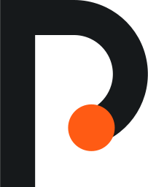
Same frontier model. Better tracking at a fifth of the cost
RESULTS
54% vs 48%
step accuracy with our state tracker, versus calling the model every 5 seconds
$0.018 vs $0.085
per minute of video
48 held-out clips · results/runs/fused_oracle.json
Notes:
Like-for-like: the same frontier model, the same frames. Called every 5 seconds without state it tracks the step 48% of the time. With our layers around it, 54%, and about 5x cheaper because most checks never leave the device. These were measured on 48 held-out first-person clips from a public cooking dataset (CaptainCook4D). Say so if asked: procedures are procedures; the maintenance pilot is what we want to fund.

Slide 10

Instructions that can finally see how you're doing
STARTUPS @ HARVARD · 20 OCT 2026
MONISH SARAVANA · FOUNDER
Notes:
Backup cover (B). Use it if the photo cover feels too busy on the venue projector.

