Slide 1



STEP 4/9
Instructions that can finally see how you're doing
Software for smart glasses that coaches new maintenance technicians from a company's existing manuals.
Seat the clamp past the hose bead
Startups @ Harvard · October 20, 2026 · Monish Saravana

Slide 2
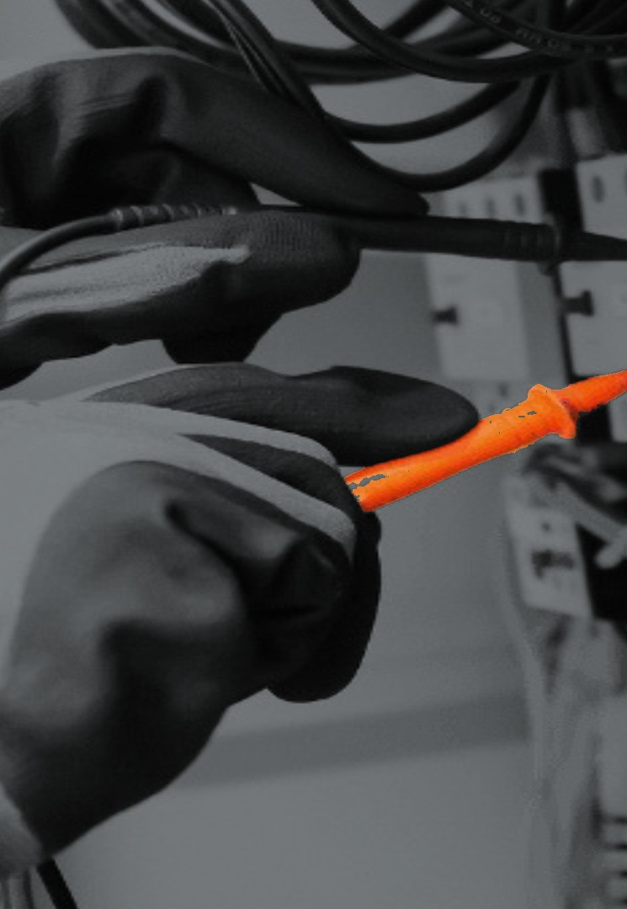

Training new technicians is expensive
Problem
Each new hire learns by shadowing an experienced technician, and that time comes off the job.
Total cost to hire and ramp up one maintenance technician
$10–15k
including recruiting fees, onboarding time and lost productivity
~255,000
US maintenance and repair openings a year, each one needing someone to train them
In a 2017 survey of 35 aviation repair stations, new hires took 9–14 months to become profitable.
“The hardest AND most expensive part is training new techs …”
Casey Czarnowski, Healthcare Sterile Processing Association (HSPA), discussed this week
Notes:
Sources: Reliability magazine (A. Gager), hiring + ramp-up estimate · BLS Occupational Outlook Handbook, openings · ARSA member survey of 35 repair stations, 2017 · HSPA email reply, Oct 19 2026 (docs/OUTREACH.md) · photo: Unsplash

Slide 3
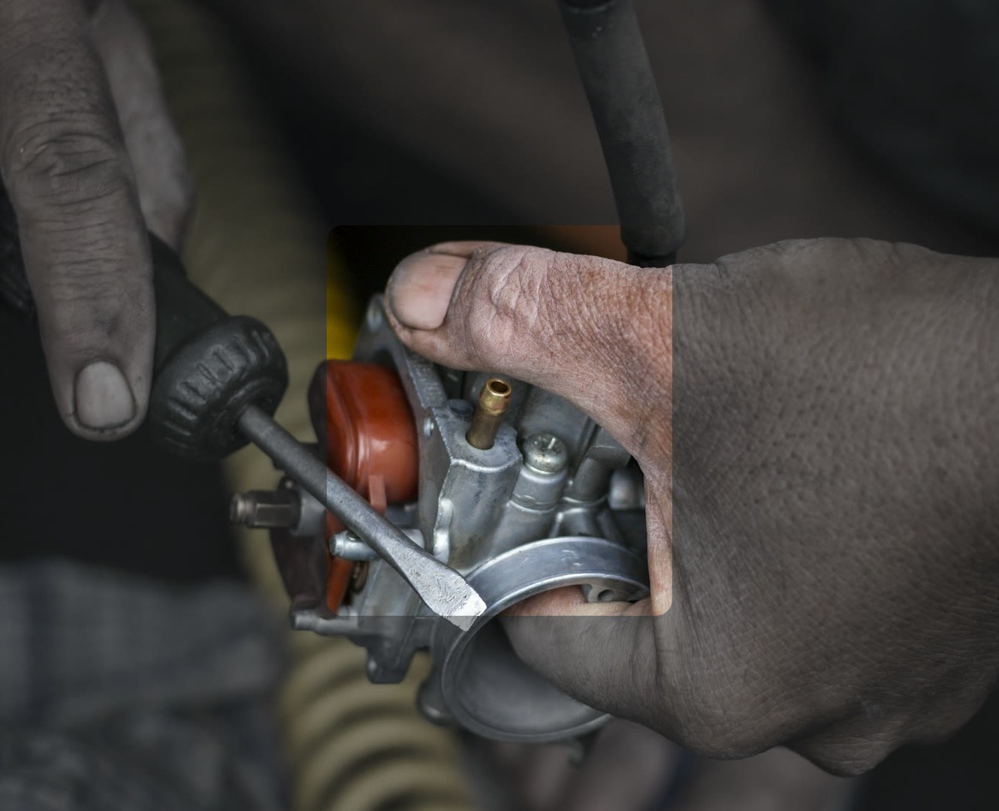
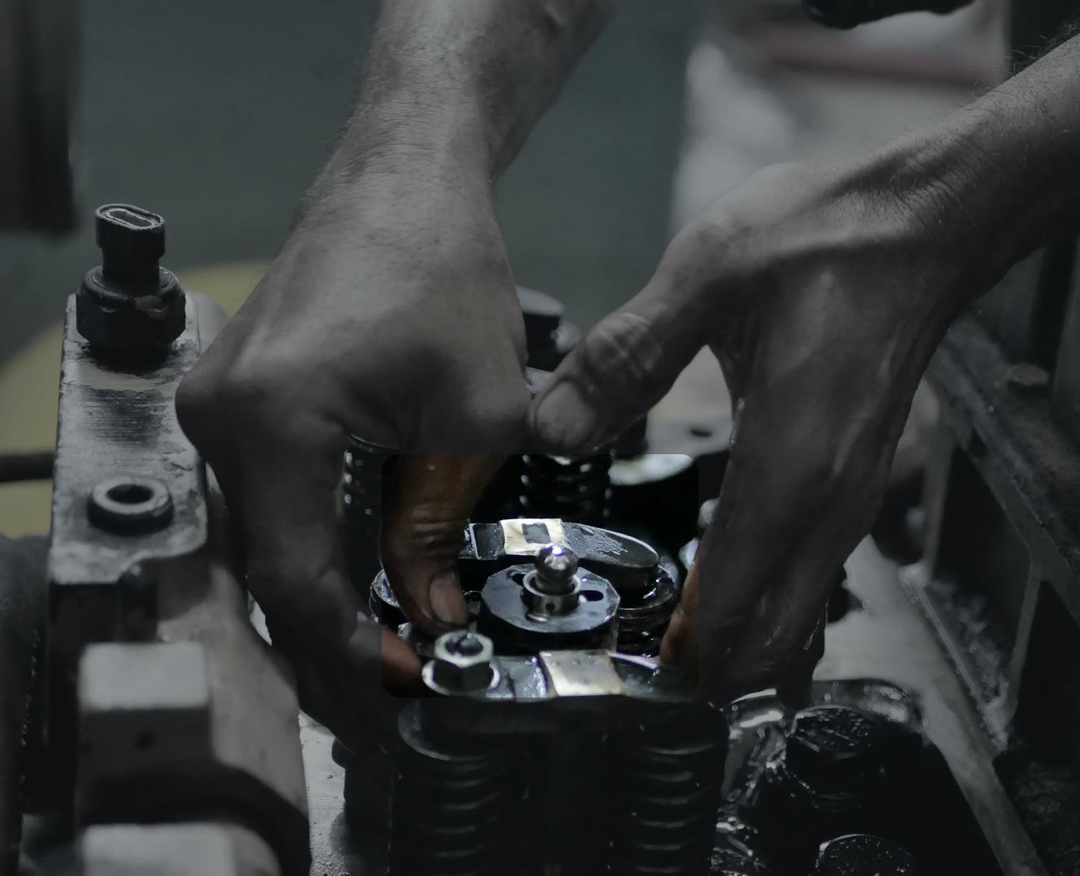
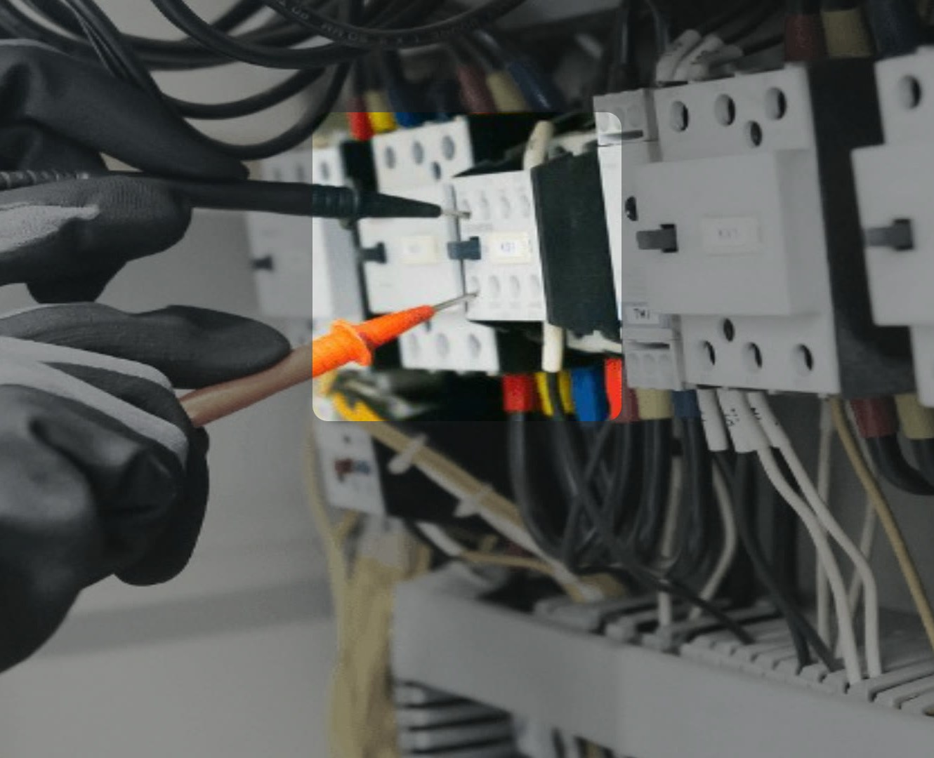
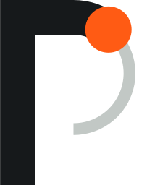
Praxis coaches the job through smart glasses
Product
1 Upload the manual
2 Praxis compiles it
3 Tech wears glasses
4 Praxis tracks the job
5 Verifies key steps
1
Says the next step
2
Checks the work
3
Catches a mistake
Step 5 verified · valve lash set
Next: rotate the crank to TDC
Mistake caught
Lockout was skipped.
Lock and tag the feeder breaker first.
Loosen the four float-bowl screws
Built for new technicians in plant maintenance, facilities, HVAC service and equipment repair.
Notes:
Sources: Concept mocks on Unsplash stock photos (brand/mocks/CREDITS.md)

Slide 4

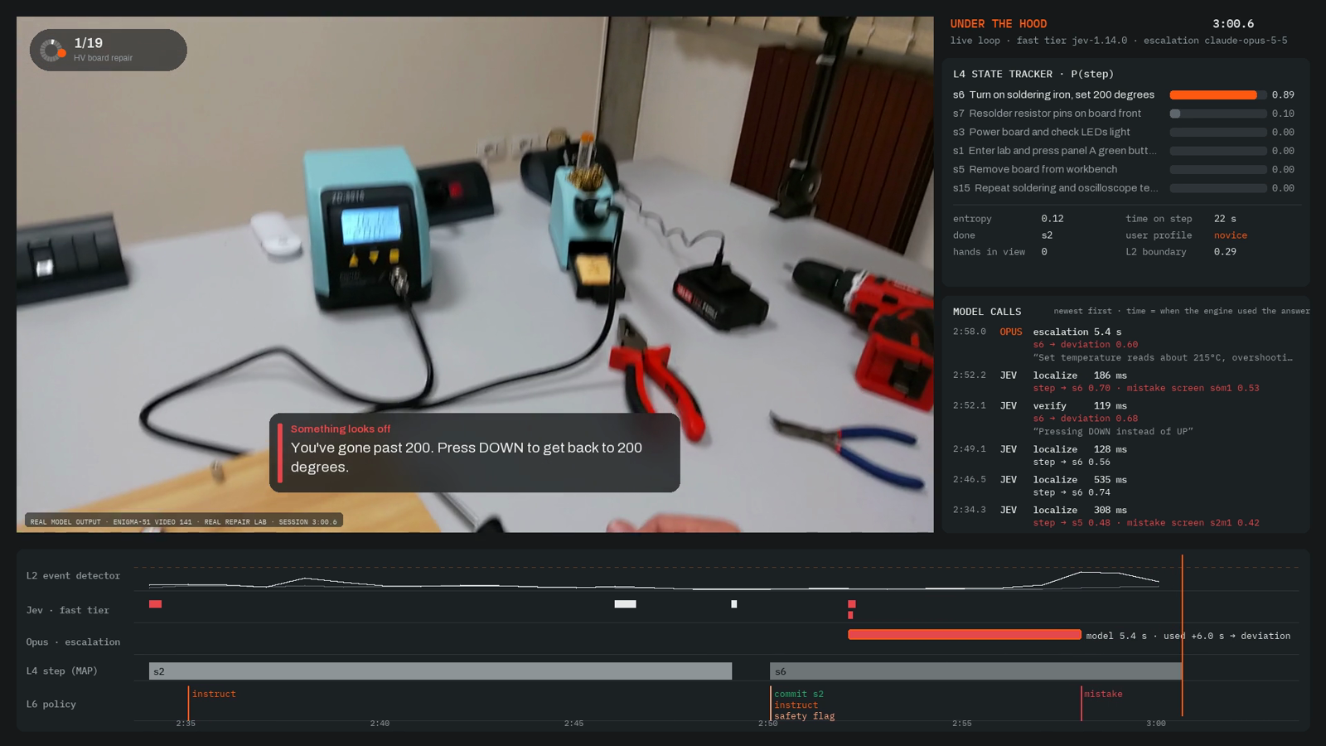
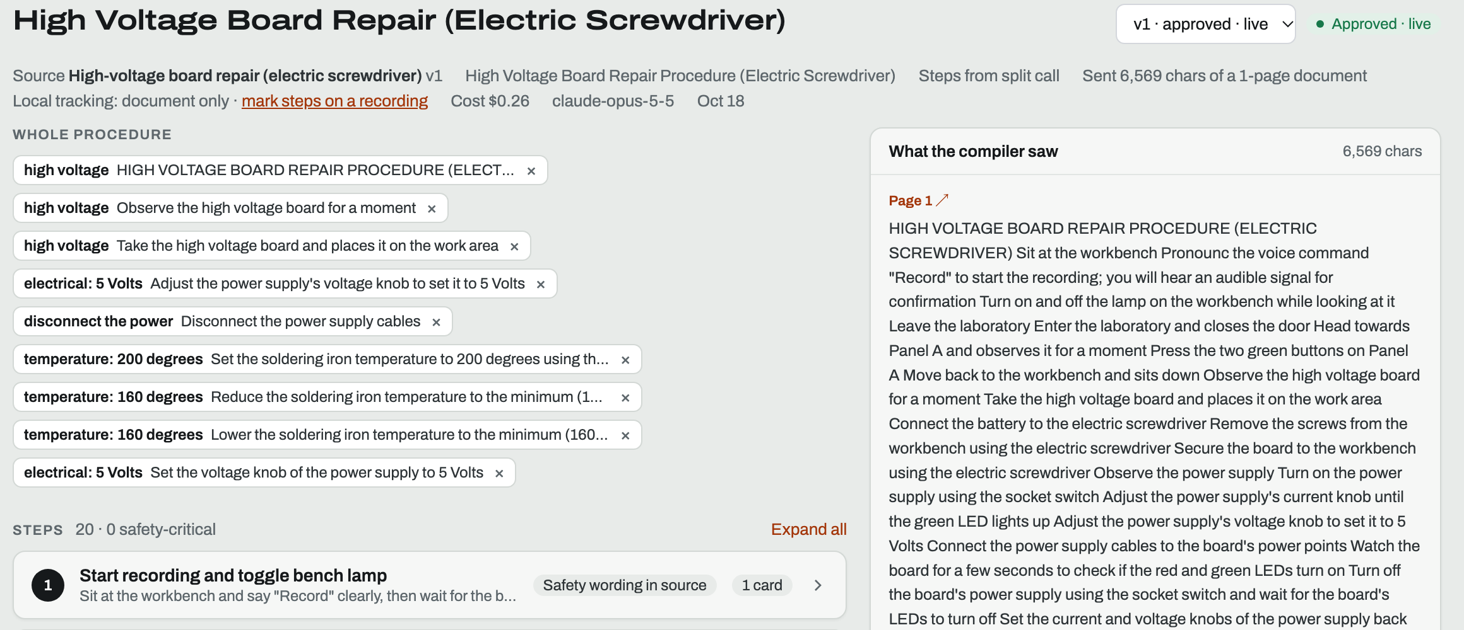
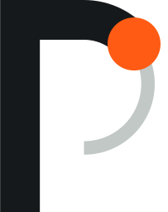
This is already a working software system
Built so far
1 A manager uploads the manuals they already have
3 The live app tracks the job (engineer view)
2 Praxis compiles a procedure; the manager reviews and approves it
Company backend: upload, index, compile, approve built
Tracking engine and evaluation harness built
Live app with spoken coaching built, real time on video
Meta glasses adapter coded, not device-tested
Viture/NVIDIA glasses adapter coded, not device-tested
Android XR glasses planned
Notes:
Sources: Screenshots of the Praxis company backend (Reclamation FIST manuals; ENIGMA-51 procedure) and the live app's engineer view of session 20261018_152645

Slide 5
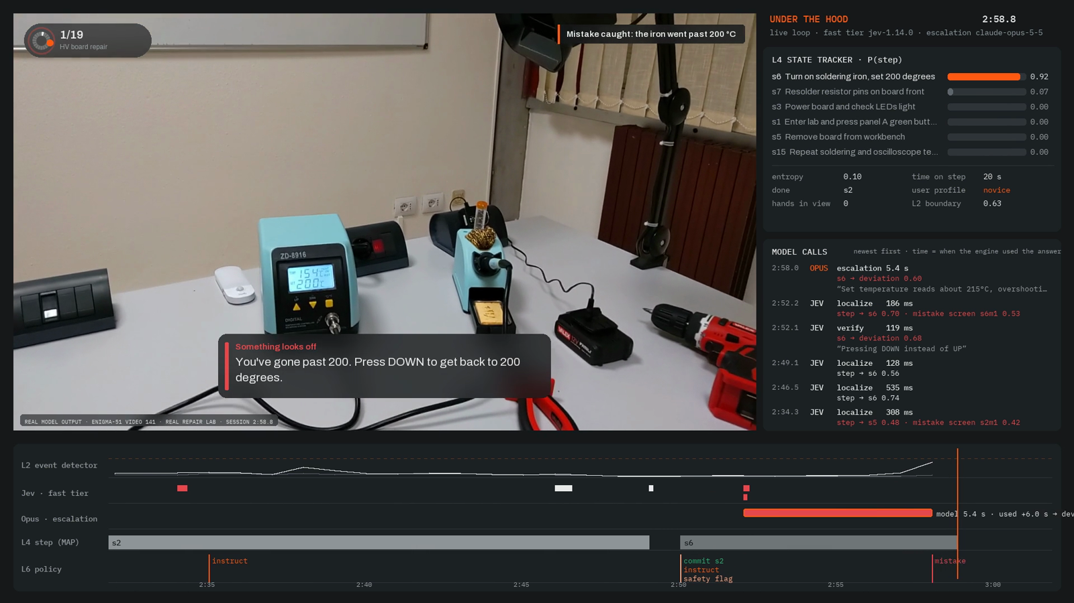
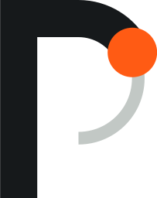
We already run a real repair procedure live
Live test
Real repair, start to finish
16:40
a high-voltage board repair, filmed first-person in an industrial lab
Training on this exact job
None
Praxis started from the lab's written procedure
Model cost
≈$1
of model calls per coached hour, measured across our evaluation
Notes:
Sources: Praxis live session on ENIGMA-51 video 141 · renders/demo/README.md · results/backend/enigma_live_141.json

Slide 6
How it works
The system tracks the job instead of querying a model constantly
Procedure compiler
manual → task graph: steps, order, timing, checks
Company manual
OURS
task graph
Every frame, on the device
Event detector
did something happen?
Temporal state tracker
Bayesian semi-Markov model · belief over the current step, time on step and next step
Policy
speak · verify · stay silent · ask for a better view
OURS · TRAINED
OURS · TRAINED
OURS
Perception
SigLIP 2 · V-JEPA 2 · hand features
OPEN MODEL
First-person video
Task recognizer
which procedure is this?
OURS · TRAINED
Coach
voice · HUD
OURS
question
evidence
Local student
routine checks on the device, free
Fast verifier
if the student is unsure: one typed question, ~150 ms
Frontier escalation
if still unsure: the hard cases only
Calibration
turns answers into honest confidence
Only when something happens
OURS · TRAINED
RENTED · SWAPPABLE
RENTED · SWAPPABLE
OURS
Ours
Ours, trained on labeled recordings
Open model
Rented, swappable in one line

Slide 7
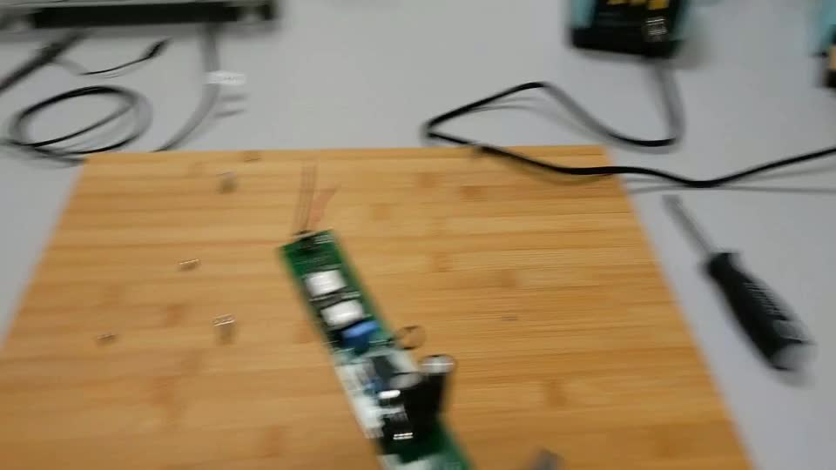
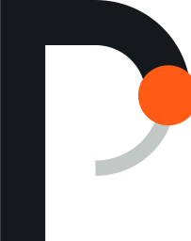
Same frontier model, better system
Measured
We compared Praxis with calling the same model (Claude Opus 5.5) every 5 seconds, on 48 first-person videos neither had seen.
8× fewer calls to the frontier model
When it can't see, it says so
Every 5 seconds
2,817
Praxis
351
5× cheaper per minute of video
Every 5 seconds
$0.085
Praxis
$0.018
“Look closely at the soldering station display, upper right.”
Praxis at 4:25 in the live repair, with the display half out of frame
About $1
Better tracking
of model calls per coached hour, against $200 a month per trainee
It follows the step more accurately than the baseline while asking the frontier model 8× less
77–98%
of blurred or blocked checks: Praxis asked to see it again
Up to 73%
the every-5-seconds baseline named the wrong step with confidence
Notes:
Sources: results/runs/fused_oracle.json vs baseline_stateless.json (48 held-out CaptainCook4D clips, 235 min, one run each) · results/metrics.json call_mix · results/l5/visual_uncertainty.json (60 checks per condition)

Slide 8

Smart-glasses hardware is finally open to software
Why now
AI glasses shipped per year, worldwide
Platforms opening to outside developers
15M+
2025
Meta opens a developer preview: outside apps can use its glasses' camera
Sept 2026
Meta's toolkit reaches 1.0: camera, microphones and speakers for outside apps
8.7M
Fall 2026
Google's first Android XR glasses arrive: audio, with a camera
2.1M
Q1 2027
Viture and NVIDIA ship Helix: safety glasses that coach workers on procedures in real time
2024
2025
2026 forecast
Three years ago we would have had to build the glasses.
Now we build the software that runs on them.
Notes:
Sources: Omdia: 8.7M AI glasses shipped in 2025 (+322%), >15M forecast for 2026; 2024 backed out from the growth rate · Meta Wearables Device Access Toolkit docs and changelog · Google I/O 2026 (Android XR audio glasses this fall) · Viture Helix release, 16 Jun 2026

Slide 9

We don't need to win the glasses hardware race
Competition
Other approaches
Praxis the maintenance software
Procedure software MaintainX, Tulip, Augmentir
Steps on a screen. It can't see the work.
Procedure compiler
Task state
Verification
When to speak
Records
Maintenance models
Fixed cameras Retrocausal, Invisible AI
Watch one station. They can't follow a tech around a machine.
A thin adapter for each device
General assistants Meta AI, Gemini Live
Answer about what's in view, with no procedure or step state.
Meta
Ray-Ban, Oakley, Display
Google
Android XR, with Samsung
Viture
Helix, with NVIDIA
Future devices
the next platform
Viture Helix + NVIDIA Our closest competitor
Real-time coaching sold with its own glasses. We want Praxis to run on Helix too.
They build the glasses. Every new device is one more adapter for Praxis.
Notes:
Sources: Vendor product pages and docs, checked 17 Oct 2026 · Viture Helix release, 16 Jun 2026

Slide 10

Maintenance is where we start, and Praxis pays for itself
Market
Maintenance new-hire onboarding in the US, per year
Start maintenance new-hire onboarding
~255k
×
$200
×
~6
≈
$306M
Next all maintenance and field service
new maintenance techs
a month per trainee
months of onboarding
a year, at our pricing hypothesis
Then technical onboarding in manufacturing, utilities, aviation, telecom, labs
One new technician
A 50-technician maintenance team
Hire + ramp burden today
$10–15k
about 5 new hires a year
$50–75k
Praxis, six months
$1,200
Our cost to serve
~$270
~77% gross margin today, ~90% with our local model
$6k
Pays for itself if it removes roughly 8–12% of that burden.
hire + ramp burden
Praxis a year
We start with small and mid-size maintenance teams. 98% of US manufacturers have fewer than 500 employees, and there one maintenance manager can approve a paid pilot. The pilot measures senior-tech hours, days until a new tech works alone, and rework.
Notes:
Sources: BLS OEWS + Occupational Outlook Handbook: ~255k openings a year on ~2.47M maintenance and repair jobs (about 1 in 10) · Reliability magazine (A. Gager): $10–15k to recruit, hire and ramp a maintenance tech, including recruiting fees · Eptura: hidden onboarding cost is experienced staff supervising and double-checking new hires · NAM: 98% of US manufacturers have fewer than 500 employees · cost to serve: $0.018/video-min measured × ~250 coached hours · $200/month is our hypothesis; Tulip lists ~$100 (Essentials) and ~$250 (Professional) per interface a month

Slide 11

We sell to maintenance managers, one paid pilot at a time
Go-to-market
1
2
3
4
5
Maintenance manager
Demo on their own manual
Short paid pilot
Annual agreement
Expand
at a plant, facilities team, HVAC company or repair shop
a procedure their new techs already struggle with
the success metric is agreed first, like days until a new tech works alone
$200 a month per active-trainee license
every new hire, then other sites
How pricing works
Second path: trade schools
One active-trainee license = one employee being onboarded: $200 a month, unlimited coaching sessions
Students learn hands-on skills with Praxis and bring it to their first employer.
Five techs onboarding at once = five licenses. When one finishes, the license moves to the next hire
“We would be open to an experiment like this.”
Sonny Hunt, COO, The Fiber School (FiberOptic.com), discussed this week
Glasses are shared site equipment. 10 licenses with 3 people coached at the same time needs about 3 pairs
We don't resell hardware. Sites buy supported glasses directly
Notes:
Sources: Pricing is our hypothesis · fiber-optic school email reply, Oct 19 2026 (docs/OUTREACH.md)

Slide 12

I've built real-time vision systems for the physical world,
and I've helped grow startups
Founder
Engineering and research
Startups and growth
60,000+
LipTrac
Real-time visual speech recognition. Conv3D + bidirectional GRU, tested with 12 participants. Provisional patent filed.
$50k
Qurios Ventures · co-founder, CMO
Built a 14,000+ member community in about four months. Acquired by Crimson Education for $1.3M.
video frames
MRR, from under $1k
217.9%
OCTOPAS
Autonomous oil-spill cleanup: aerial computer vision, path planning and marine robotics. Published; provisional patent filed.
13
Claisen Health · co-founder, CMO
Ran acquisition across UGC, influencers and Reddit as the company raised $200k from angels.
better collection than conventional methods
person growth team
7 years
Competitive robotics
World Championship qualifier. Autonomous control, sensor fusion, OpenCV and path planning. My open-source FTC Coach has 25,000+ users.
$300k
Acely AI (YC W18)
One of 6 marketing interns picked from 1,500 applicants.
FTC team captain
attributable revenue
Harvard College Applied Mathematics + Computer Science
Notes:
Sources: Monish Saravana resume (Oct 2026) · Startups @ Harvard application · LipTrac provisional US 63/812,158 · OCTOPAS provisional US 63/813,616, Florida Water Resources Journal

Slide 13

Coaching comes first. Our own models and
skill records come next
Roadmap
Later
Then
Physical AI, two ways in
Next
Verified skills and certification partners
Now
Maintenance-specific models
A Build our own robot models
trained on step-verified recordings customers opted in
Maintenance coaching and verification
Techs and employers build verified skill histories in Praxis. Certified techs bring Praxis to their next job.
With customer permission, real maintenance recordings make our state and checking models better and cheaper.
Paid pilots. New techs coached from their own company's manuals.
B Sell to physical-AI labs
license consented data and our step checker
What AI labs pay for human training data keeps climbing
$2B
Mercor's run-rate from selling expert human data to AI labs
>$100M
>$1B
$3.2B → $16.3B
$0.76B
$1B
a year that robotics companies already spend buying real-world data
that Figure has committed to data and compute over the next 12 months
the AI training-data market, 2025 to the 2033 forecast
Dec 2025
Feb 2026
Jun 2026
Notes:
Sources: Mercor: CEO via Dealroom (Jul 2026), gross run-rate; Dec 2025 is a Sacra estimate · robotics data spend: Micro1 CEO estimate, MIT Technology Review (Apr 2026) · Figure, Introducing Index (Aug 2026) · Grand View Research, AI training dataset market (2026–2033 edition)

Slide 14

$10k gets us to the first paid pilot
Ask
$3,000
$2,500
$2,000
$1,500
$1,000
Model training
Devices + capture
Maintenance data
Pilot inference
Company + legal
GPU time to retrain the step tracker, event detector and local checker on real maintenance footage
Supported glasses and capture gear to run Praxis end to end at a real site
Pay techs and trade-school students to record and label ~80 hours of real work, with consent
About 1,400 coached hours at today's measured cost
Formation and the contracts a paid pilot needs
By April
Models retrained on real maintenance footage
Praxis running end to end on real glasses at a real site
A first paid pilot, with the success metric agreed before launch
Notes:
Sources: $10,000 over six months · same amounts as the application · data: ~$25/h contributor rate (estimate) · inference: $1.08 per coached hour, measured

