Slide 1
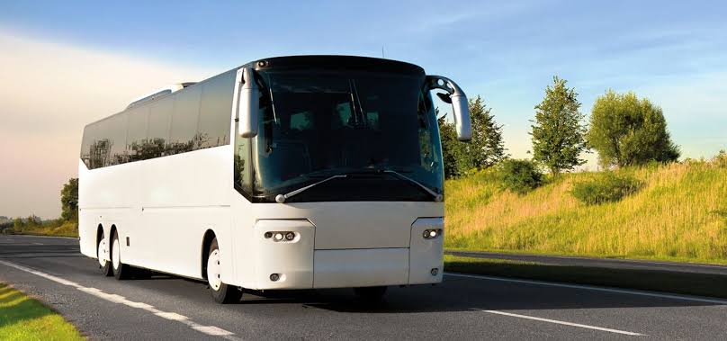
“LAKSHMI NARAIN COLLEGE OF TECHNOLOGY”
2019-2020
“BUS TICKET RESERVATION SYSTEM”
SUBMITTED TO:- SUBMITTED BY:-
Prof. Abhishek Dwivedi
Prof. Chanchal Lohi
Sanya Gupta
IT-B
0103IT181098

Slide 2


ABSTRACT
Traveling is a large growing business across all countries. Bus reservation system deals with maintenance of records of details of each passenger. It also includes maintenance of information like schedule and details of each bus.
Our Bus Travel Facility is provides Bus ticket Reservation System. In our System we can provides different types of buses categories like Express, Volvo, etc.
In our system we can manage all types of Passenger data & bus data. All details that is related to Traveling like fare details,Seat availability, details of Booking, bus details, seating arrangements, inquiry,delete a bus from the file etc.
In our system we can provide the features to the passenger like the passenger could choose the available seats own itself, that is not provided by any other Agency.

Slide 3
PROBLEM STATEMENT
We observed the working of the Bus reservation system and after going through it, we get to know that there are many operations, which they have to do manually. It takes a lot of time and causing many errors while data entry. Due to this, sometimes a lot of problems occur and they were facing many disputes with customers. To solve the above problem, and further maintaining records of passenger details, seat availability, price per seat, bill generation and other things, we are offering this proposal of computerized reservation system.
By using this software, we can reserve tickets from any part of the world, through telephone lines, via internet. Customer can check availability of bus and reserve selective seats.

Slide 4
INTRODUCTION
This Bus reservation system is very effective and efficient for the user to book the tickets for their respective Homes.
In this project user gives only the useful data and further validation is done in an effective way.
The focus of the project is to computerize traveling company to manage data, so that all the transactions become fast and there should not be any error in transaction like calculation mistake, bill generation. It replaces all the paper work. It keeps records of all bills also, giving to ensure 100% successful implementation of the computerized Bus reservation system and other things.
This reservation system has two modules. First module helps the customer to enquire the availability of seats. Second module helps him to reserve a ticket :-
First module retrieves data from file required for enquire.
Second module inserts values into the files on reservation.
This system uses the concept of File Handling majorly. It uses majorly all the File handling features.

Slide 5
OBJECTIVE:-
Existing System
Existing system is totally on book and thus a great amount of manual work has to be done. The amount of manual work increases exponentially with increase in services.
Needs a lot of working staff and extra attention on all the records.
In existing system, there are various problems like keeping records of items, seats available, prices of per/seat and fixing bill generation on each bill.
Finding out details regarding any information is very difficult, as the user has to go through all the books manually.
Major problem was lack of security.
Our System
Ensure data accuracy.
Records are efficiently maintained by File Handling.
File Handling also provides security for the information.
Availability of seats can be enquired very easily.
More Security.
Minimum time needed for the various processing.
Better Service.
Minimum time required.

Slide 6
TECHNOLOGY USED
1.Operating System: Windows 10
2.Front End:
C++
C++ is a high-level programming language developed by Bjarne
Stroustrup at Bell Labs. C++ adds object-oriented features to its predecessor, C. C++ is one of the most popular programming language for graphical applications, such as those that run in Windows and Macintosh environments.
This language is very fast because of which it is widely used in developing different games or in gaming engines.
3. Back End:
Code Blocks
Code::Blocks is a free, open-source cross-platform IDE that supports multiple compilers including GCC, Clang and Visual C++. It is developed in C++ using wxWidgets as the GUI toolkit. It is developed for windows and linux.

Slide 7
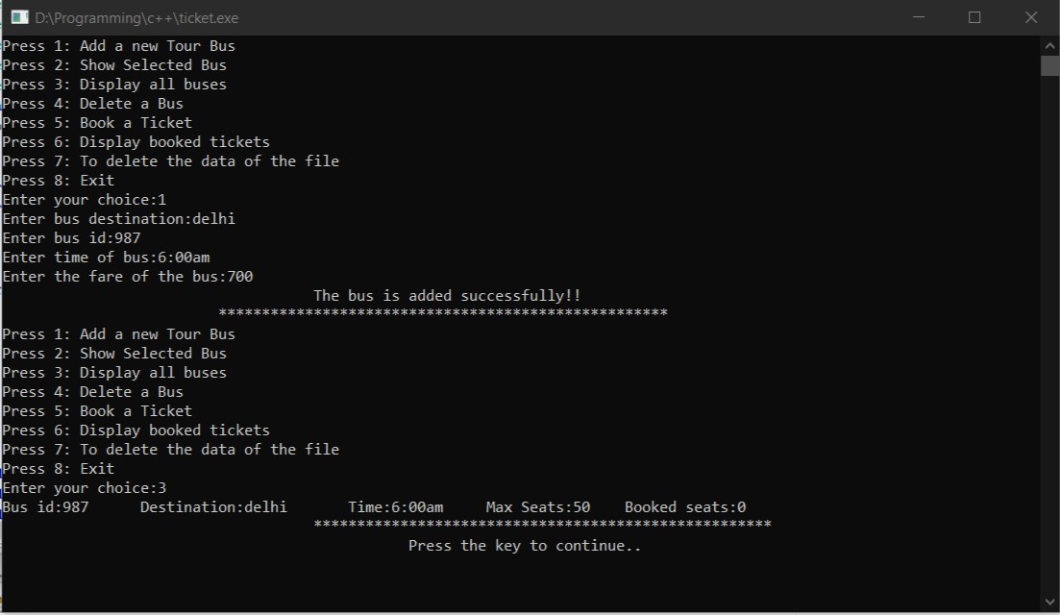
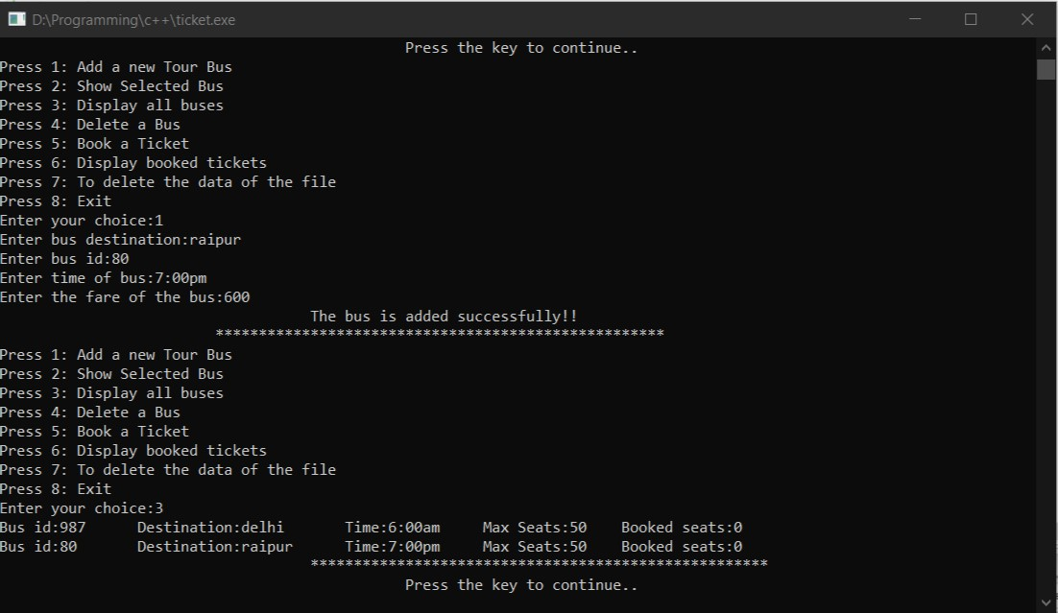
OUTPUT

Slide 8
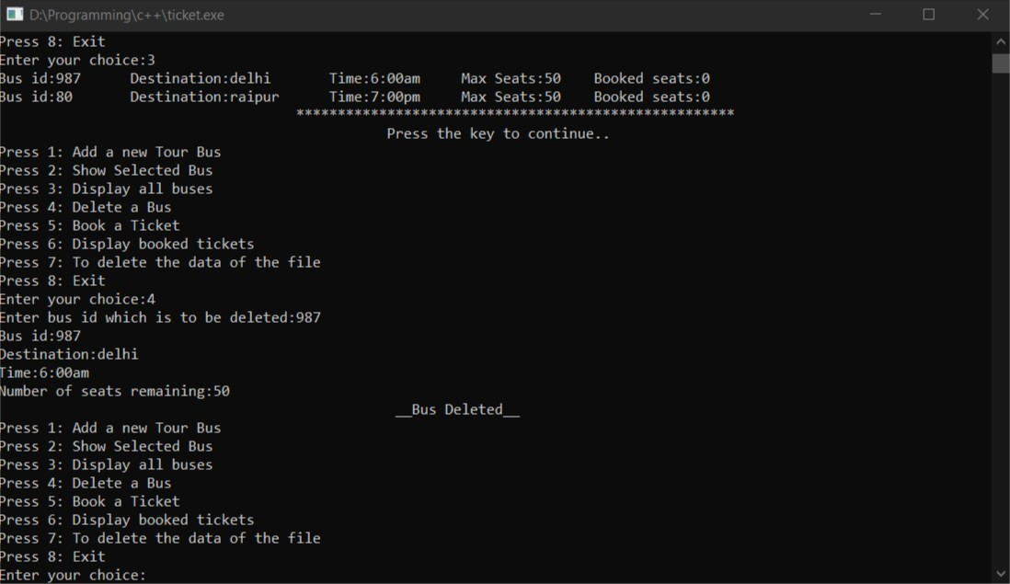
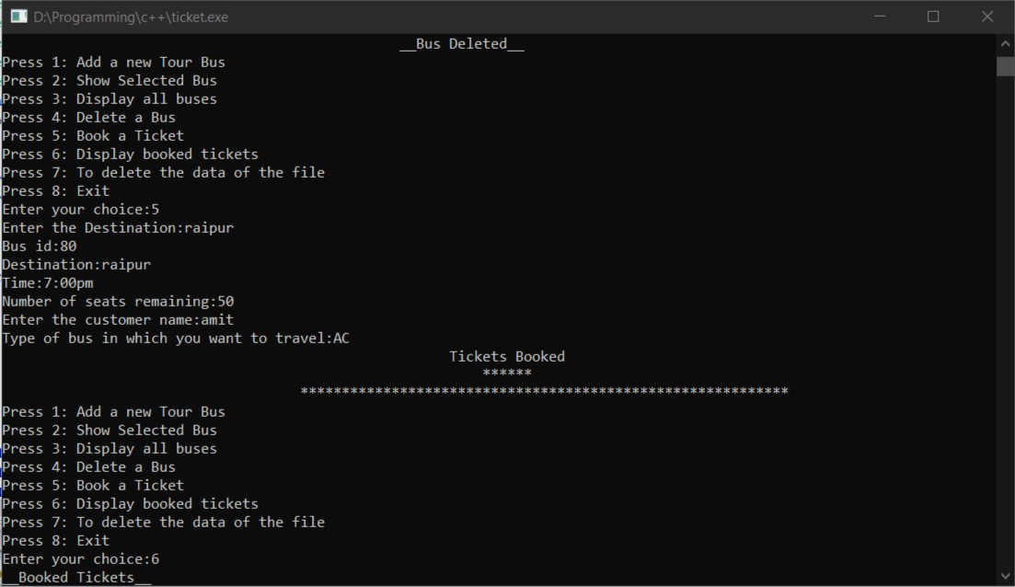

Slide 9
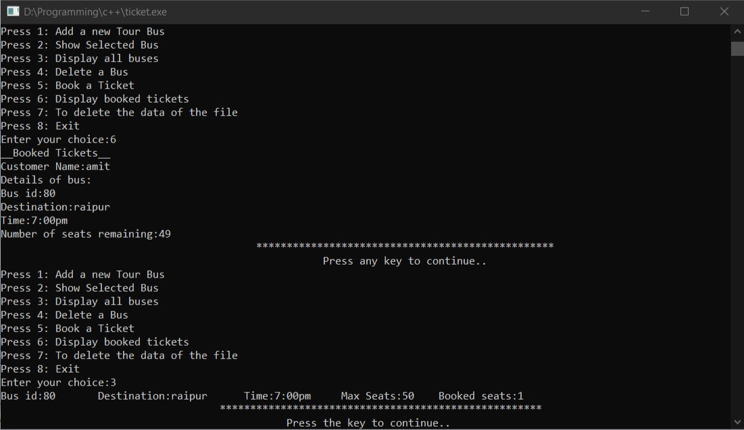
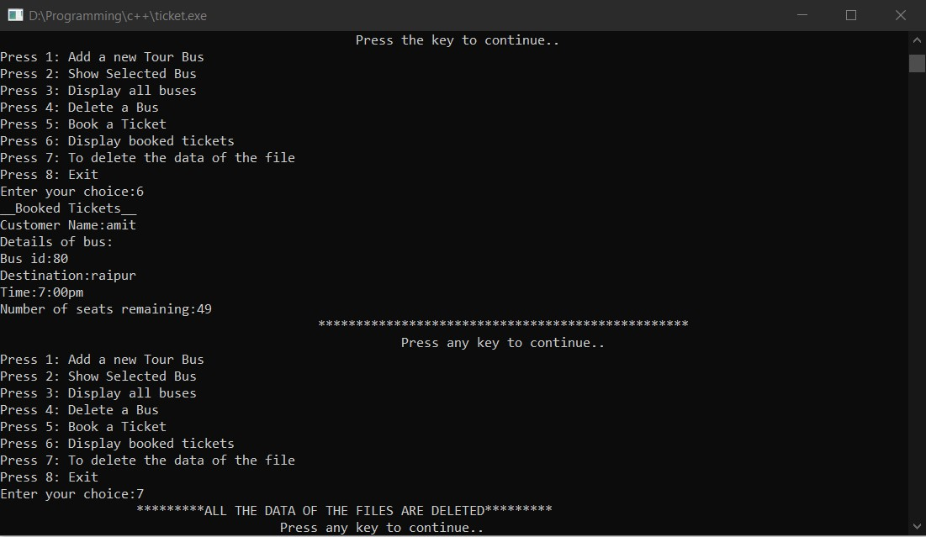

Slide 10
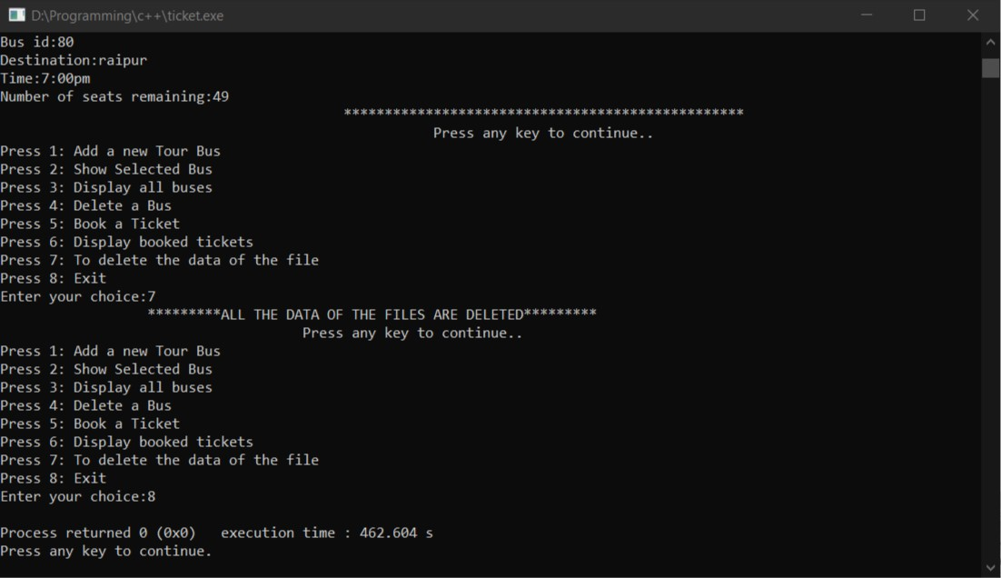

Slide 11
DRAWBACKS
User can not delete the booked ticket.
The above drawback an cause loss of money of the user.
No Graphics used in this project.
This project might be proved as boring project.
CONCLUSION
This project is really a very helpful project.
We can use this project while travelling in the bus.
Time efficient.
THANK YOU !!

