Slide 1

BNMIT An Autonomous Institution under VTU Approved by AICTE, Accredited as Grade A Institution by NAAC. All eligible branches Accredited by NBA upto 30.06.2028
Data Science (23CSE163)
“Deep Learning-Based Solar Flare Prediction Using Solar Magnetogram Data”
Nandu D Monisha K
1BG23CS088 1BG23CS085
Under the guidance of
Prof. Priyanka S
Assistant Professor
Dept. of CSE, BNMIT, Bengaluru

Slide 2
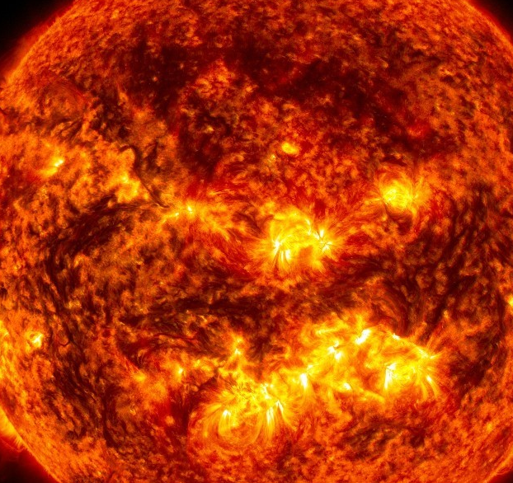
INTRODUCTION
System deployed using Streamlit for real-time prediction
Solar flares are high-energy bursts from the Sun that affect satellites, communication, and power systems.
Dataset: JSOC images + NOAA solar activity data
Model predicts: Flare / No Flare
Existing methods rely on manual/statistical approaches and miss complex patterns.
This project uses Deep Learning (CNN) on solar magnetogram images.
Notes:
z

Slide 3
LITERATURE SURVEY
Existing Methods
Vs
Proposed Approach
PAPER
METHOD
LIMITATION
OUR IMPLEMENTATION
Bobra (2015)
ML + SVM
No image learning
CNN on magnetogram images
Nishizuka (2018)
Deep Neural Network
Weak dataset
Optimized CNN
Huang (2018)
CNN
No NOAA data
Data fusion (JSOC + NOAA)
Ahmed (2013)
SVM
Weak feature extraction
Deep spatial feature extraction
RESEARCH GAP
Lack of integrated deep learning approach combining magnetogram images and solar activity data for accurate real-time prediction.
CNN-based models perform better for image-based solar flare prediction.

Slide 4
PROBLEM STATEMENT & OBJECTIVES
Problem Statement
Developing an automated deep learning system for accurate solar flare prediction using magnetogram images and solar activity data.
Develop a CNN-based model to classify Flare / No Flare
Integrate JSOC magnetogram images + NOAA data
Apply preprocessing (normalization, resizing, noise reduction)
Compare models (CNN, CNN+LSTM, ViT)
Deploy system using Streamlit (real-time prediction)
Evaluate using Accuracy, Precision, Recall, F1-score
Objectives

Slide 5
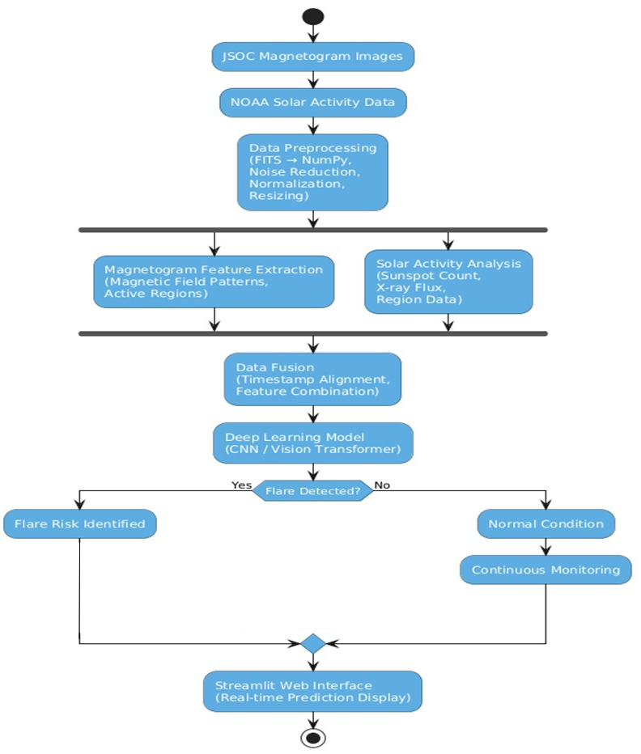
METHODOLOGY
Tools Used
Python – Core programming language
VS Code – Development environment
Development
Machine
Learning
Keras – Convulution Neural Network
Data
Processing
NumPy, Pandas – Data handling & preprocessing
OpenCV – Image processing (resize, normalize)
Matplotlib, Seaborn – Accuracy, loss, confusion matrix
Visualization
Data
Sources
JSOC – Magnetogram images
NOAA – Solar activity data

Slide 6




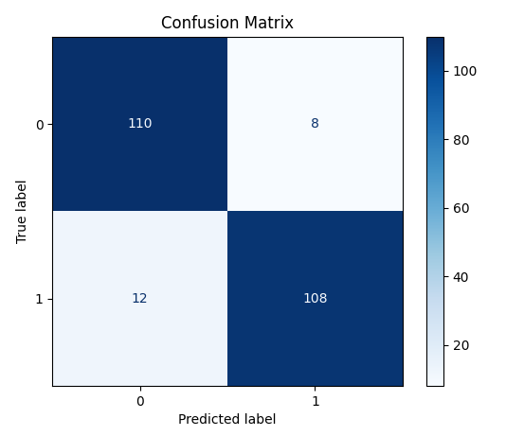
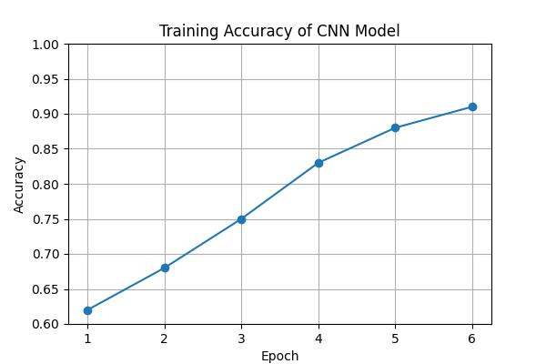
RESULTS & DISCUSSION
Experimental Setup
Key Results
Final Accuracy
Error Reduction
91% (Optimized CNN)
Low false predictions (Reduced False Positives)
Dataset: JSOC + NOAA
Input Size: 256 × 256 images
Model: CNN (Keras)
Loss: Binary Crossentropy
Feature Learning
Model successfully learns spatial magnetic patterns from magnetogram images
Generalization
Stable performance on unseen validation data
Preprocessing:
Noise reduction
Normalization
Image resizing
Train/Test: 80/20 split
Output: Binary Classification (Flare / No Flare)
Evaluation Validation
Detection Performance
Confusion matrix confirms strong classification between Flare and No-Flare events
High flare detection rate (True Positives ↑)
Performance Metrics — Optimized CNN (Proposed Model)
DEMO LINK
Training Accuracy Curve of the CNN Model
Confusion Matrix of Model Performance

Slide 7
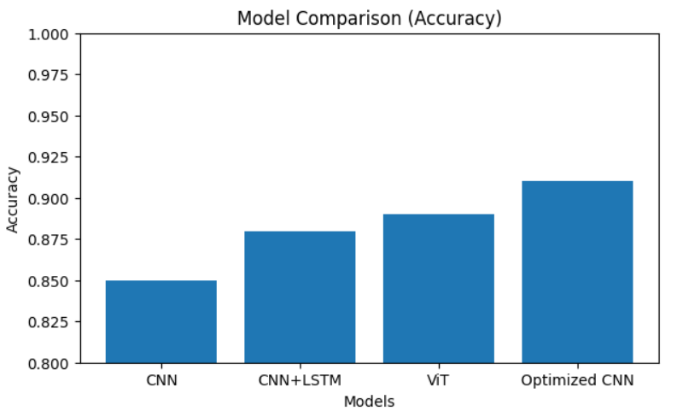
MODEL COMPARISON
Four deep learning architectures evaluated on the same solar magnetogram dataset
Accuracy
Precision
Recall
F1-Score
CNN
0.85
0.83
0.82
0.82
CNN + LSTM
0.88
0.86
0.84
0.85
Vision Transformer
0.89
0.87
0.86
0.86
Optimized CNN
0.91
0.89
0.87
0.88
Performance improves from CNN → Optimized CNN
Deep models capture complex magnetic patterns
Optimization significantly boosts accuracy
Insights :
Comparison of CNN, CNN+LSTM and Vision Transformer Models

Slide 8
CONCLUSION
Developed a CNN-based deep learning system for solar flare prediction using JSOC magnetogram images + NOAA data
Successfully deployed using Streamlit for real-time prediction
Applied preprocessing (normalization, noise reduction, hybrid labeling) to improve data quality
Demonstrates effectiveness of AI in space weather forecasting
SUMMARY
Optimized CNN achieved 91% accuracy, outperforming CNN+LSTM (88%) and ViT (89%)
Provides a scalable and automated pipeline for large-scale solar data analysis
Expand dataset for improved generalization
Extend to multi-class classification
(C, M, X flares)
FUTURE ENHANCEMENT
Integrate real-time NOAA/NASA data feeds
Apply Explainable AI (Grad-CAM, saliency maps)

Slide 9
REFERENCES
[1] M. Bobra and S. Couvidat, “Solar flare prediction using SDO/HMI vector magnetic field data with a machine-learning algorithm,” The Astrophysical Journal, vol. 798, no. 2, 2015.
[2] Y. Nishizuka et al., “Deep learning for solar flare prediction,” The Astrophysical Journal, vol. 858, no. 2, 2018.
[3] X. Huang, L. Liu, and Y. Wang, “Deep CNN for solar flare prediction using magnetogram images,” Solar Physics, vol. 293, no. 5, 2018.
[4] J. Ahmed, M. Qureshi, and S. Khan, “Solar flare prediction using support vector machines,” Int. J. Computer Applications, vol. 75, no. 7, 2013.
[5] F. Chollet, Deep Learning with Python, Manning Publications, 2017.
[6] NOAA SWPC, Solar Region Summary Data. https://www.swpc.noaa.gov
[7] JSOC Stanford, Solar Data Archive. http://jsoc.stanford.edu

