Slide 1
IBM University Engagement Project Submission
“Exploring the Power of Agentic AI with IBM Granite and IBM Bob”

Slide 2

Project Tile – [Library AI Agent]
Domain of Project – [ Education ]
Student Name | Recent Passport Photo | Email ID | Mobile number [WhatsApp]
Monisha K |  | eng24ds0029@dsu.edu.in (AICTE LINKED), monishak1249@gmail.com | 9449351721

Slide 3
Problem Statement -
Problem Statement : Library AI Agent
The Challenge
A Library AI Agent is an intelligent system designed to assist students in finding the right learning materials based on their academic needs. It can autonomously analyze user profiles, study topics, and course syllabi to suggest relevant books and resources.
Using natural language processing, it understands student queries and matches them with the most suitable books in the library database.
The agent can check real-time book availability, prioritize high-demand titles, and assist with reservation or waitlist actions.
It saves time by streamlining the search process and offering personalized recommendations aligned with current academic work. Library AI Agents enhance access, engagement, and resource utilization in educational environments.
Technology – Use of IBM Cloud Lite services / IBM Granite ..

Slide 4
Proposed Solution -
Proposed Solution – AI-Powered Smart Library Agent
The proposed solution is an AI-powered Smart Library Agent built using IBM Bob, IBM watsonx.ai, and Granite models to provide intelligent library services.
The system uses RAG to retrieve relevant information from the library database and provide accurate responses.
Key features include:
AI Library Assistant for answering book-related queries.
Smart Book Search based on title, author, category, or keywords.
Personalized Book Recommendations based on user interests.
Book Availability, Reservation & Waitlist management.
Student Dashboard for borrowings and recommendations.
Overall, the solution makes library resources faster, easier, and more personalized for students.

Slide 5
Technology Used
IBM Bob platform - For designing and orchestrating AI agents and managing their workflows visually.
IBM Grainte model - For natural language understanding, reasoning, and generating accurate library responses.
IBM Cloud Provides secure and scalable cloud infrastructure for running the application and AI services.
RAG (Retrieval-Augmented Generation)– Retrieves relevant library information first and then generates context-based answers.
IBM Watsonx.ai - Used for accessing AI models, embeddings, and managing AI-related services.
Vector Database (FAISS/Chroma) – Stores document embeddings and enables fast, relevant searching of library resources.

Slide 6
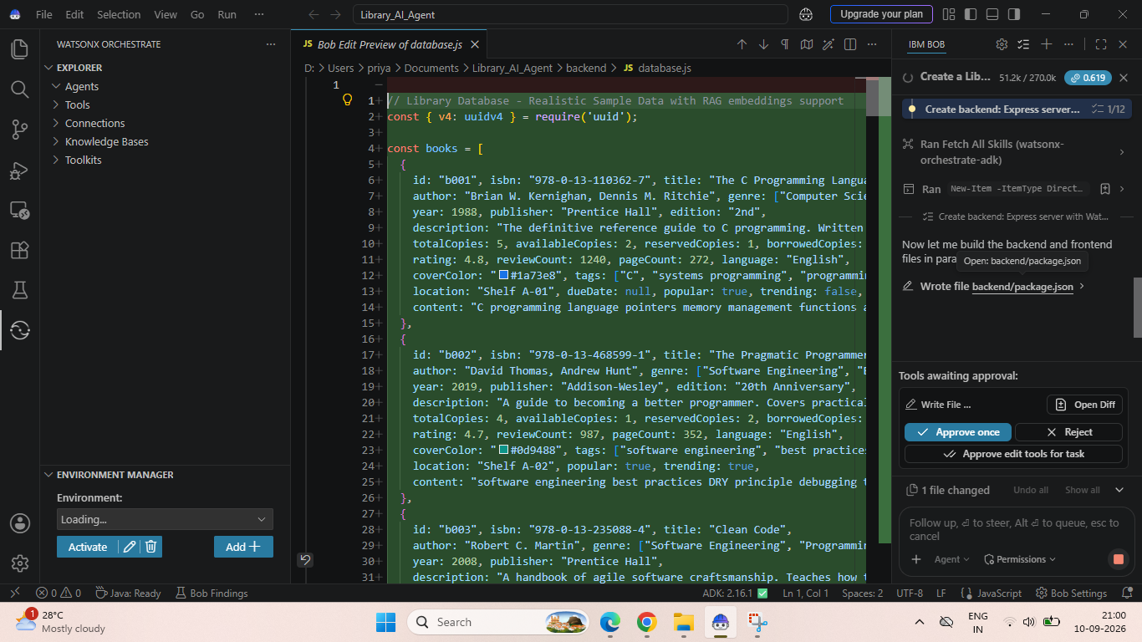
Required Files created using IBM bob -

Slide 7
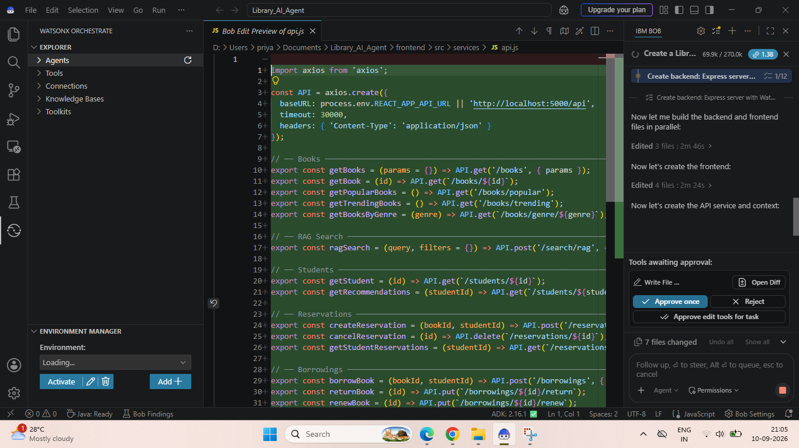
IBM Bob Screenshots:

Slide 8
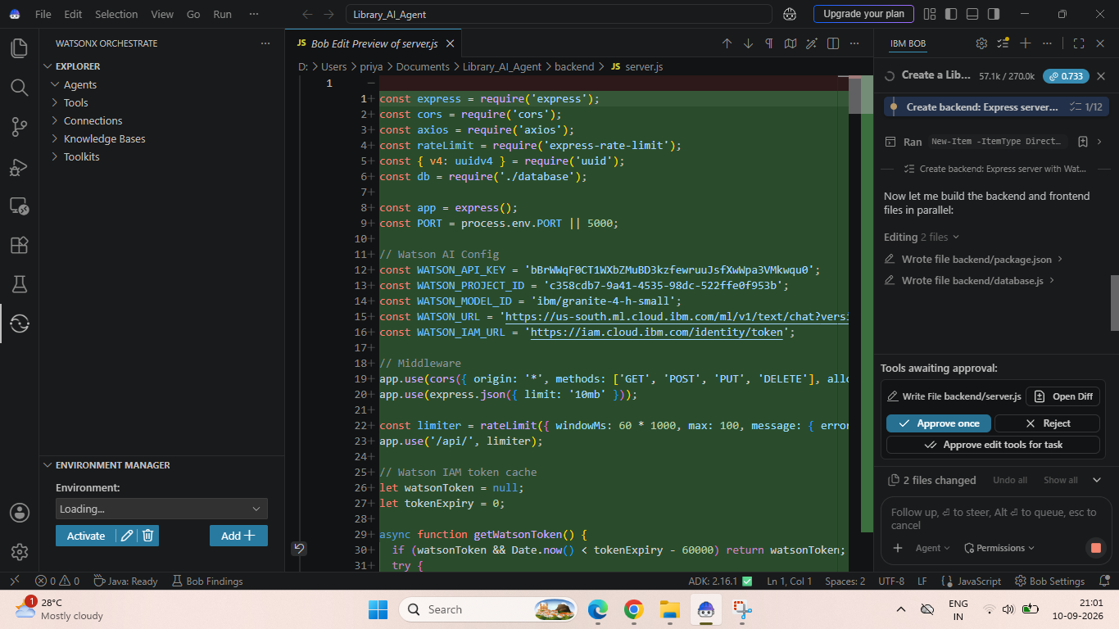

Slide 9
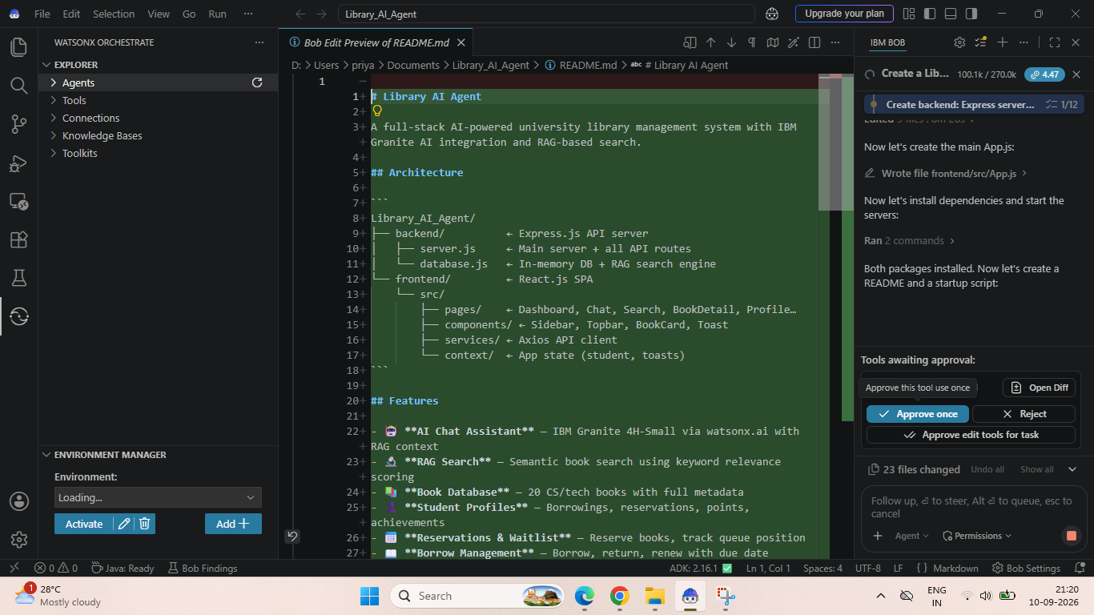

Slide 10
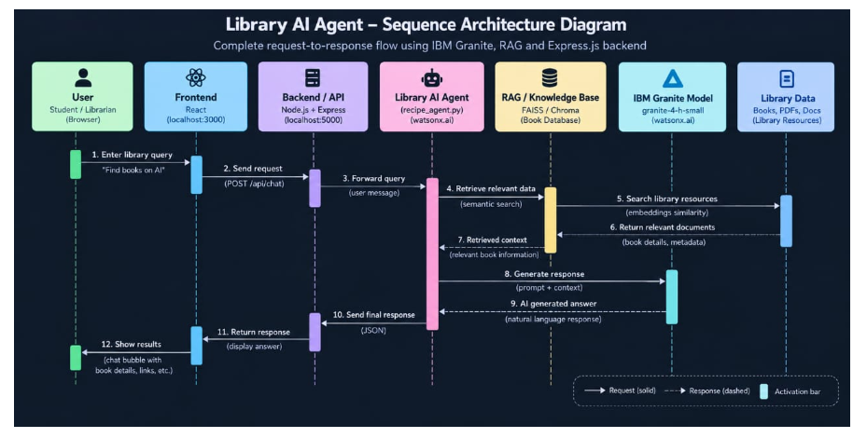
Architecture blueprint for IBM bob:

Slide 11

Role of Agentic AI in the solution
Role of Agentic AI in Library AI Agent
Agentic AI enables the Library AI Agent to work as an intelligent system rather than a simple chatbot.
Using IBM watsonx.ai and IBM Granite, it understands user queries and autonomously performs tasks such as searching books, retrieving relevant information, and providing recommendations.
The agent uses RAG to retrieve accurate information from the library knowledge base before generating responses. It can understand user intent, find suitable books, provide book details, and guide users toward reservation or borrowing.
Agentic AI also enables context-aware conversations, allowing users to ask follow-up questions without repeating their requirements.
Overall, Agentic AI makes the Library AI Agent intelligent, interactive, and capable of providing personalized library assistance.

Slide 12
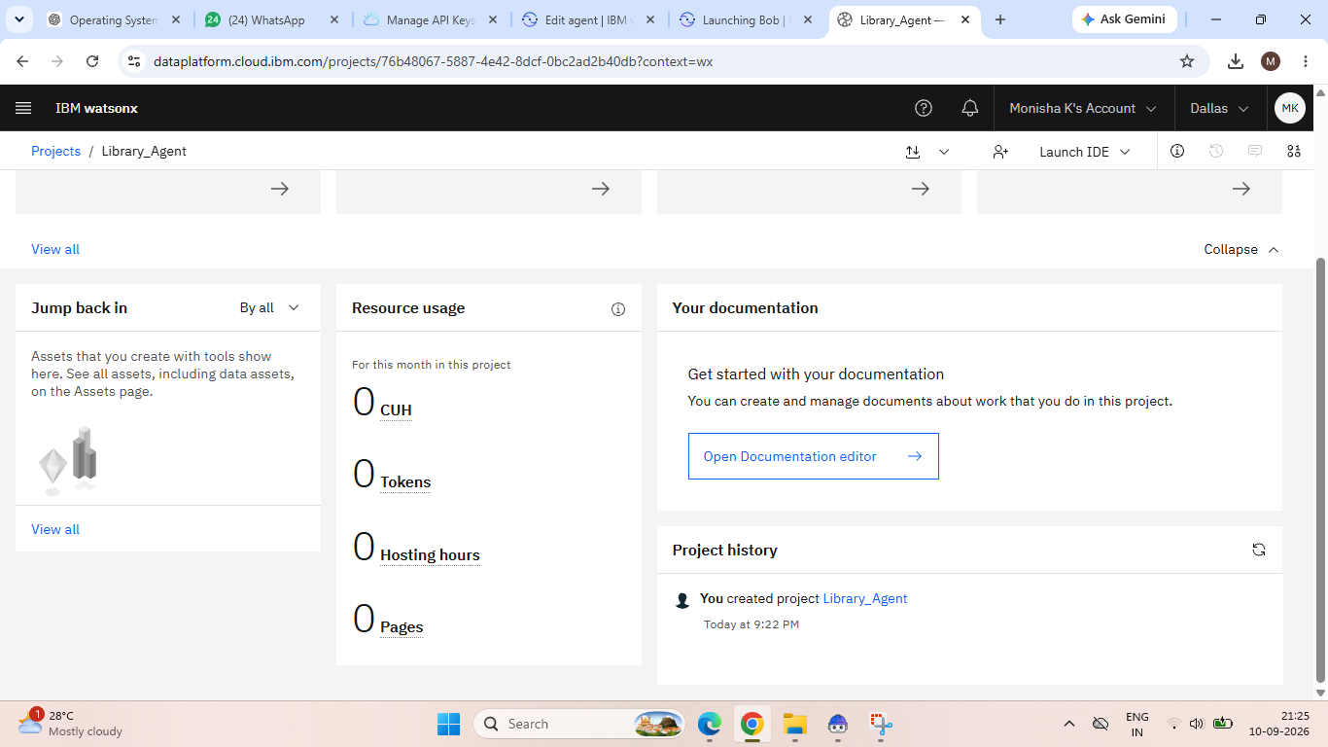
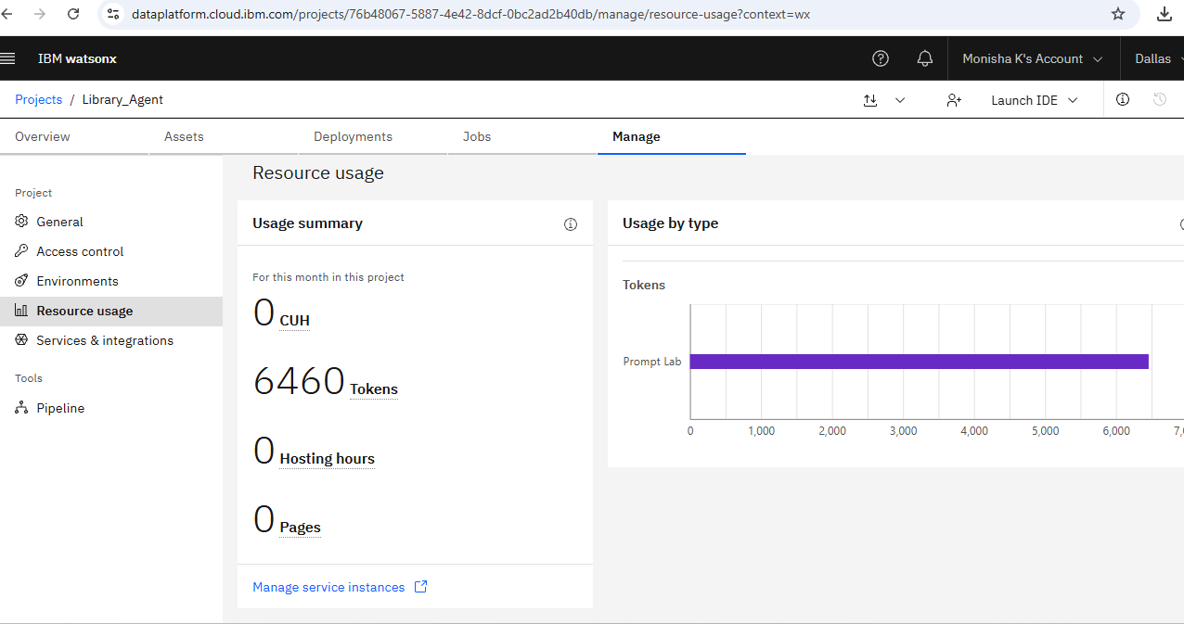
Token Usage
6460 token are used
Before Prompt
After the Prompt
·
·
·

Slide 13
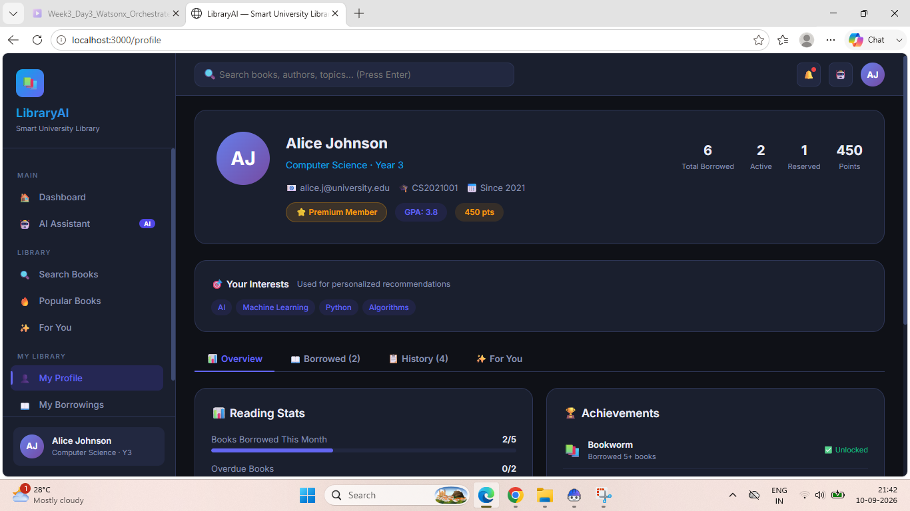
Project Output Screenshot
Please put IBM Bob output screenshots with 2-3 prompts.
You can take 2-3 more slides for each screenshot
·
·
·

Slide 14
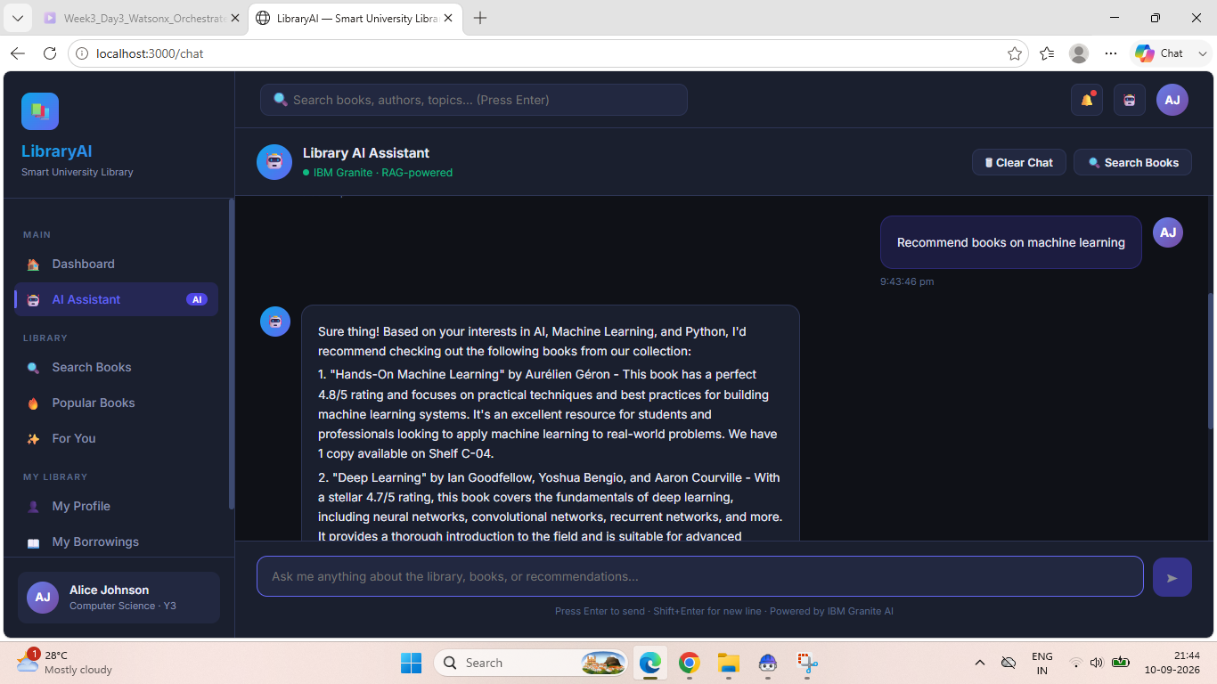
Project Output Screenshot
Please put IBM Bob output screenshots with 2-3 prompts.
You can take 2-3 more slides for each screenshot
·
·
·

Slide 15
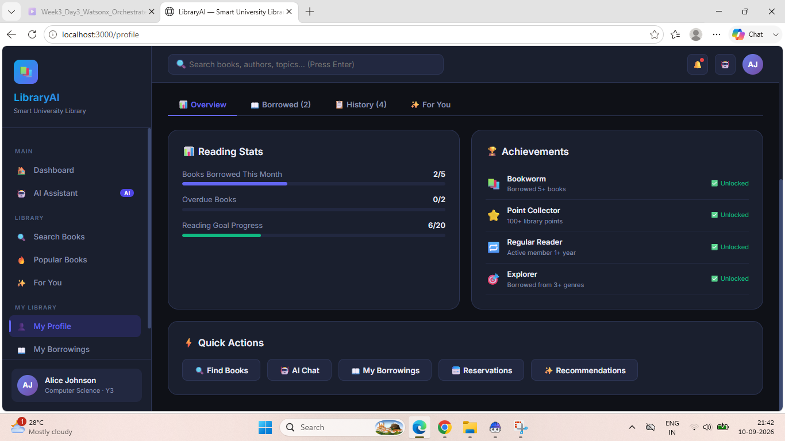
Project Output Screenshot
Please put IBM Bob output screenshots with 2-3 prompts.
You can take 2-3 more slides for each screenshot
·
·
·

Slide 16
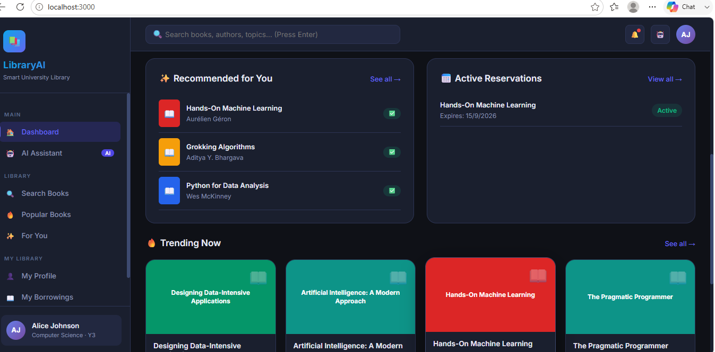

Slide 17
Novelty and Uniqueness
The proposed Library AI Agent stands out by combining Agentic AI, RAG, and IBM Granite to provide intelligent library assistance.
Agentic Intelligence – Uses AI to understand queries and perform library-related tasks.
RAG-Based Accuracy – Retrieves relevant book information from the library knowledge base before generating answers.
Smart Book Discovery – Helps users find books based on title, author, subject, or interests.
Personalized Recommendations – Suggests relevant books based on the user's requirements.
Context-Aware Interaction – Understands follow-up questions without requiring users to repeat their queries.
Real-Time Assistance – Provides instant information about book availability and library resources.
IBM Granite Integration – Uses Granite models for natural-language understanding and response generation.
Overall, the solution provides a smart, interactive, and efficient digital library assistant rather than a basic search system.

Slide 18
Git Hub Link
https://github.com/Monisha1710-moni/Library_Agent
·
·
·

Slide 19
Future Scope
1.Voice & Multilingual Support –Add voice interaction and multiple language support so users can search books and interact with the library agent more naturally.
2. Mobile Application –Develop a mobile app to allow users to search books, check availability, reserve books, and receive notifications from anywhere.
3. Smart Book Recommendations –Use user interests and borrowing history to provide personalized book recommendations.
4. Library Management Integration –Integrate with the library management system to provide real-time information about book availability, reservations, and returns.
·
·
·

Slide 20
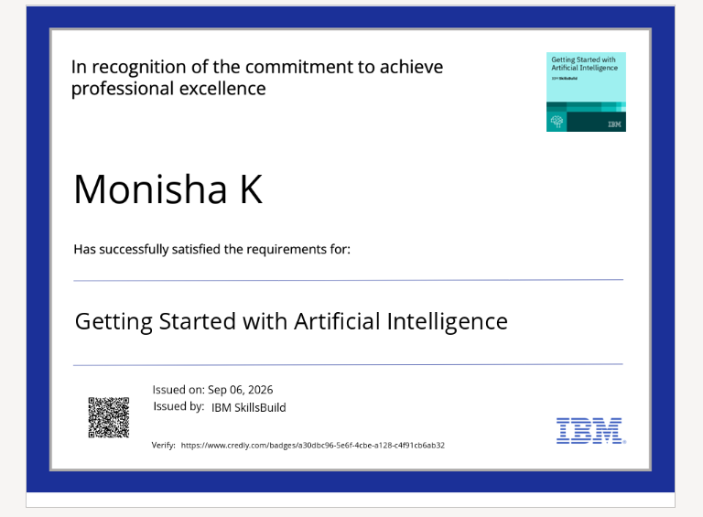
Certificates Earned:
Please add your credly certificate(Getting Started with Artificial Intelligence)

Slide 21
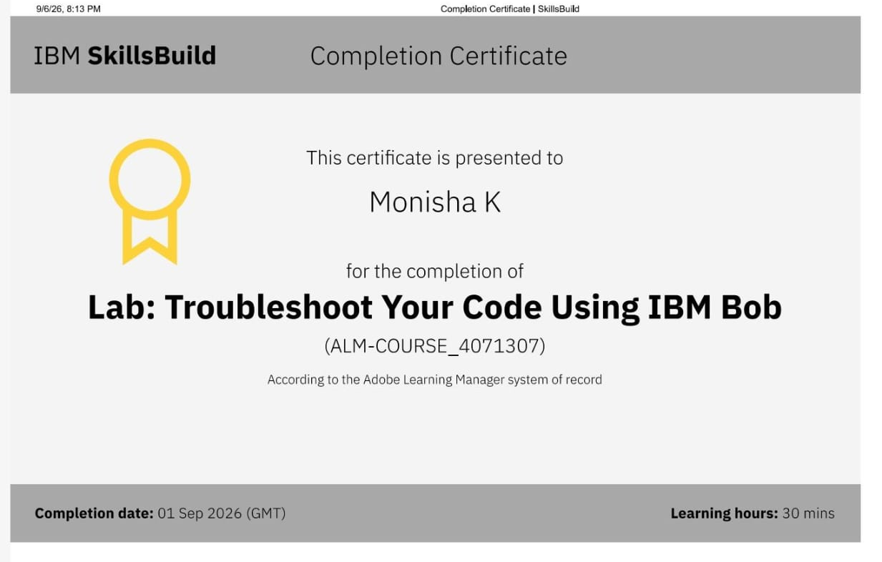
Certificates Earned:​
Add your IBM BOB Certificate

Slide 22


