Slide 1
PLACEMENT PORTAL
Guided by, Presented by,
Prasanth R Umarani K
Bhuvaneswari M Swapna M
Rufina J Sanjay V
Sri sai R Swathi k
Deepti sherly J Monisha B

Slide 2
INTRODUCTION
BACKGROUND
Placement portal manages student information in the college with regard to placement.
It has the facility of maintaining the details of the student and company, thereby reducing the manual work.
It will save time and energy which are spending in making reports and collecting data.
In many of the college the data about the company that are visiting to a particular college happening only through social media unofficially
So,the proposed placement portal system will be helpful for both admin and student to keep track

Slide 3
INTRODUCTION SOLUTION The proposed idea is to provide most convenient and easy way to keep track of the companies that are visited to the college and provide information to the student.
ADMIN CAN
STUDENT CAN
Post the company details
Explore about for a company how many student are eligible and applied
Can view the queries submitted by the student
Student can view all the companies and apply for only eligible companies
Student can keep track of the eligible companies
Can post any queries related to the application or company to the admin

Slide 4

OBJECTIVE
The main objective of this project to help student and admin of the college to post,view,apply for the visited companies.
It can be easily accessible and can save the time of both student and admin

Slide 5

TOOLS AND TECHNOLOGIES USED
Physical work model(draw.io)
UI/UX Design(Figma)
Database(MSSQL Server)
Backend(Java Spring boot)
Frontend(React.js)

Slide 6
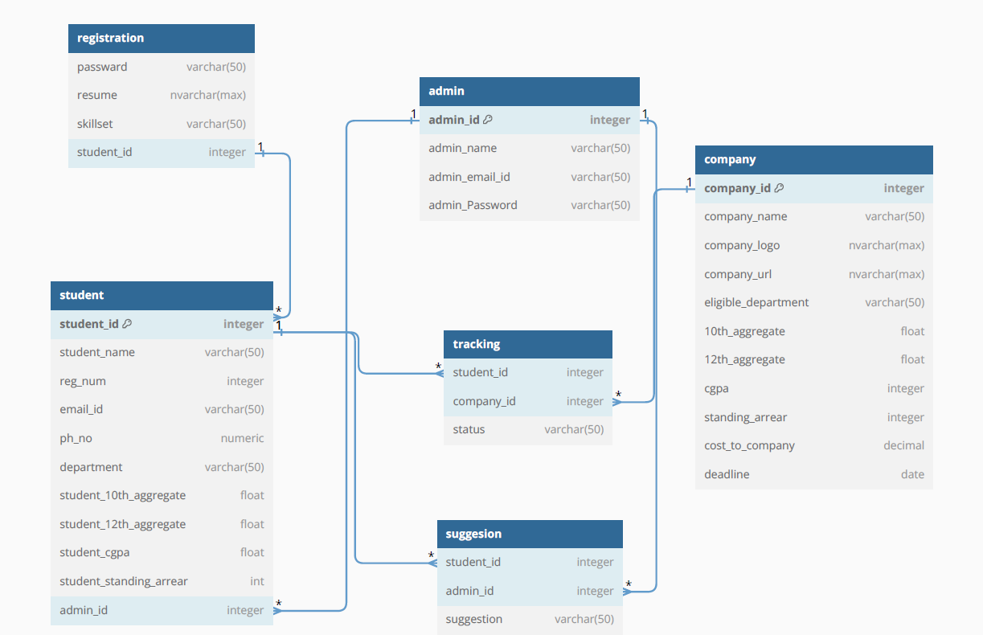
PHYSICAL WORK MODEL

Slide 7
WORKFLOW
Admin
Post companies details
View the querries from student
Student
Apply for the elligible companies
Post queries about the company
Success
Successfully apply the companies by student

Slide 8
HIGH LEVEL ARCHITECTURE
SPRING BOOT(java)
MSSQL SERVER
REACT JS

Slide 9
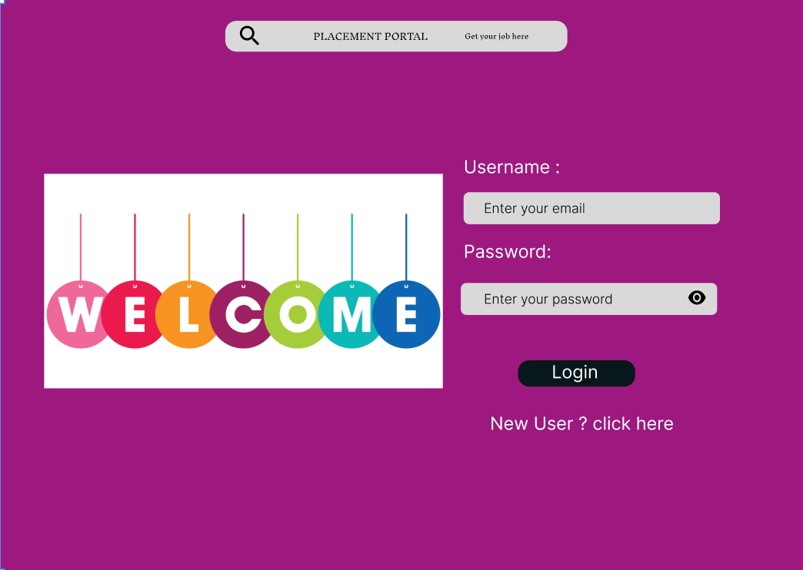
UI DESIGN
LOGIN PAGE

Slide 10
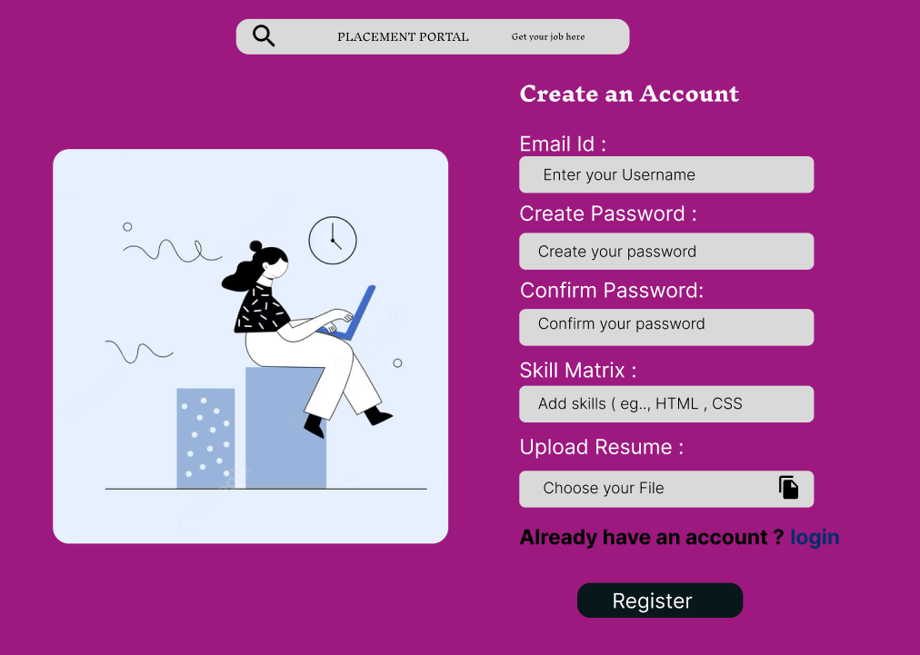
UI DESIGN
SIGNUP PAGE

Slide 11
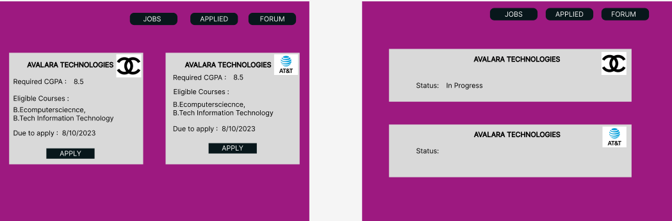
UI DESIGN
JOBS PAGE

Slide 12
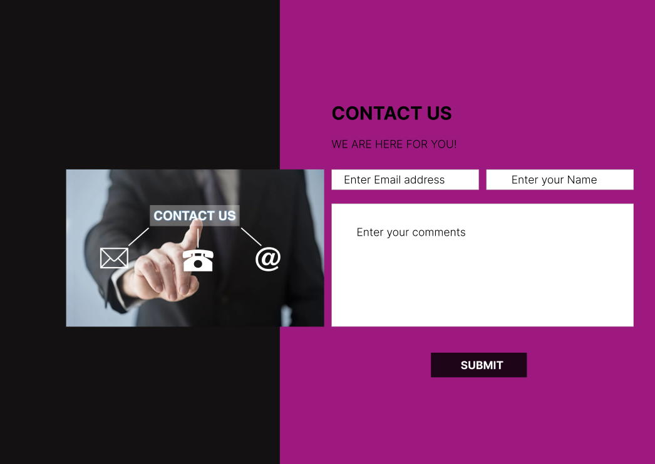
UI DESIGN
FORUM PAGE

Slide 13
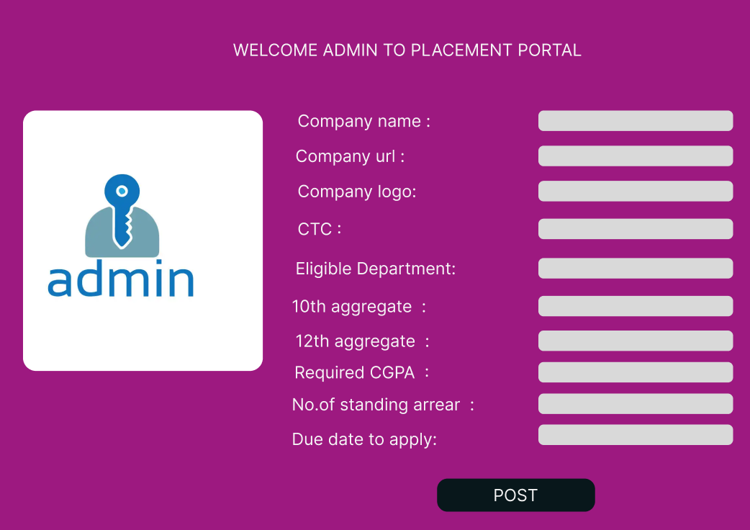
UI DESIGN
ADMIN PAGE

Slide 14
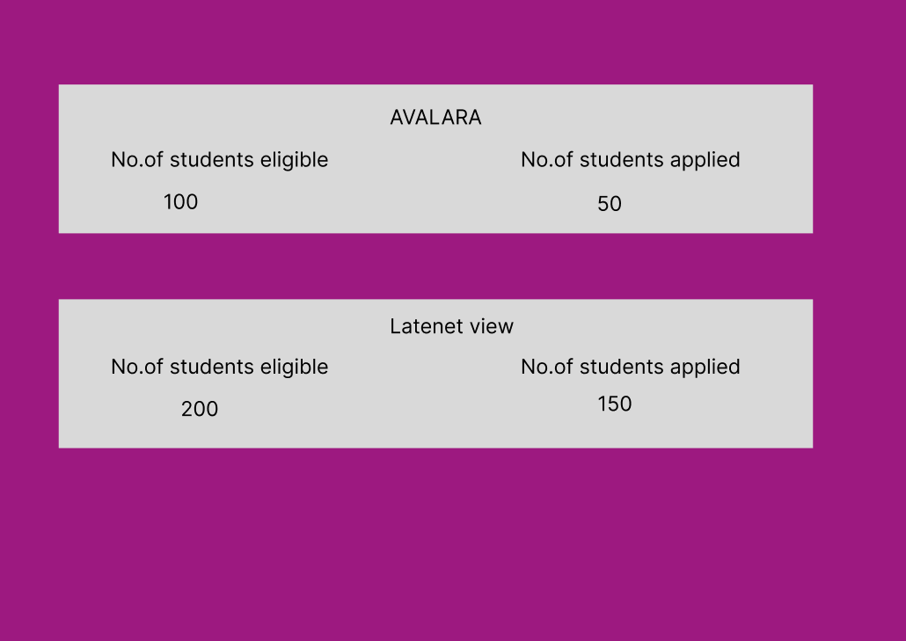
UI DESIGN
DETAILS PAGE

Slide 15
ADVANTAGE
Simplifies the process of uploading the resume and details about students
Save the time for both admin and student.
Students can apply to multiple company quickly.
Digital applications and document submissions reduce the need for physical paperwork.
It reduce the costs associated and traditional recuirment methods,such as printing and advertising.
Student can post any queries related to the application or companies to the admin

Slide 16

THANK YOU
Thanks to Mr.Cooper and Leadership Team for giving us the wonderful opportunity to explore more,be more fearless,and adapt to change better!

