Slide 1

Project Title - Seasonal Agriculture Performance Analysis
[Student Name: Monisha Kar
College Name: Institute Of Engineering & Management]
AICTE STU ID : STU6a5f9575e72671784649077

Slide 2

PROBLEM STATEMENT
Seasonal variations in environmental conditions, farming practices, resource availability, and market conditions can significantly influence agricultural performance.
As a result, agricultural performance may differ across different seasons, affecting factors such as production, resource usage, and economic outcomes.
However, raw agricultural data does not clearly reveal these seasonal differences, patterns, trends, relationships, and variations.
Therefore, the problem is to analyze the agricultural dataset and investigate how agricultural performance varies across seasons by identifying meaningful patterns, trends, relationships, and differences in the available data.

Slide 3
Project Description
The dataset contains information related to environmental conditions, farming practices, resource usage, crop production, and economic performance.
The project uses Data Analytics techniques and visualizations to identify seasonal patterns, trends, relationships, and differences in agricultural activities.
The analysis compares important factors such as crop yield, production, environmental conditions, water usage, resource efficiency, revenue, and profit across seasons.
The main aim is to generate meaningful insights and data-driven recommendations that can support better seasonal agricultural planning and efficient resource utilization.
This project focuses on analyzing agricultural performance across different seasons, including Kharif, Rabi, and Zaid.

Slide 4

WHO ARE THE END USERS?
Farmers – To understand seasonal patterns and make better decisions regarding crop selection, resource usage, and farming practices.
Agricultural Planners and Policymakers – To analyze seasonal agricultural performance and support better agricultural planning and resource allocation.
Agricultural Researchers and Analysts – To study relationships between environmental conditions, resource usage, crop production, and economic performance.
Agricultural Organizations and Institutions – To identify seasonal trends and areas that may require improvement or further investigation.
Students and Data Analysts – To use the analysis and findings for understanding how data analytics can be applied to real-world agricultural problems.

Slide 5

Technology Used
Google Colab – Used as the development environment to perform the complete data analysis.
Python – Used as the primary programming language for data processing, analysis, and visualization.
Pandas – Used for data loading, cleaning, preprocessing, manipulation, and analysis.
NumPy – Used for numerical operations and data handling.
Matplotlib and Seaborn – Used to create data visualizations such as bar charts, heatmaps, correlation plots, and other analytical graphs.

Slide 6
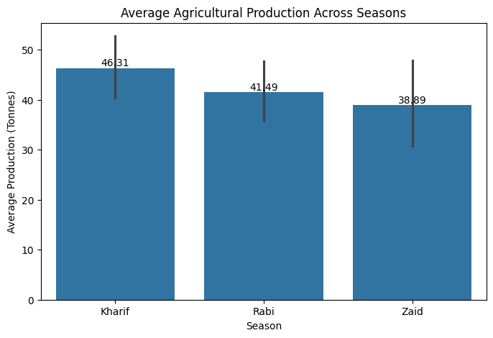
RESULTS
Result Explanation:
The graph shows that Kharif has the highest average agricultural production (46.31 tones) among the three seasons. Rabi follows with an average production of 41.49 tones, while Zaid has the lowest production at 38.89 tones. Overall, the results indicate that agricultural production varies across seasons, with Kharif showing the strongest production performance in the dataset.

Slide 7
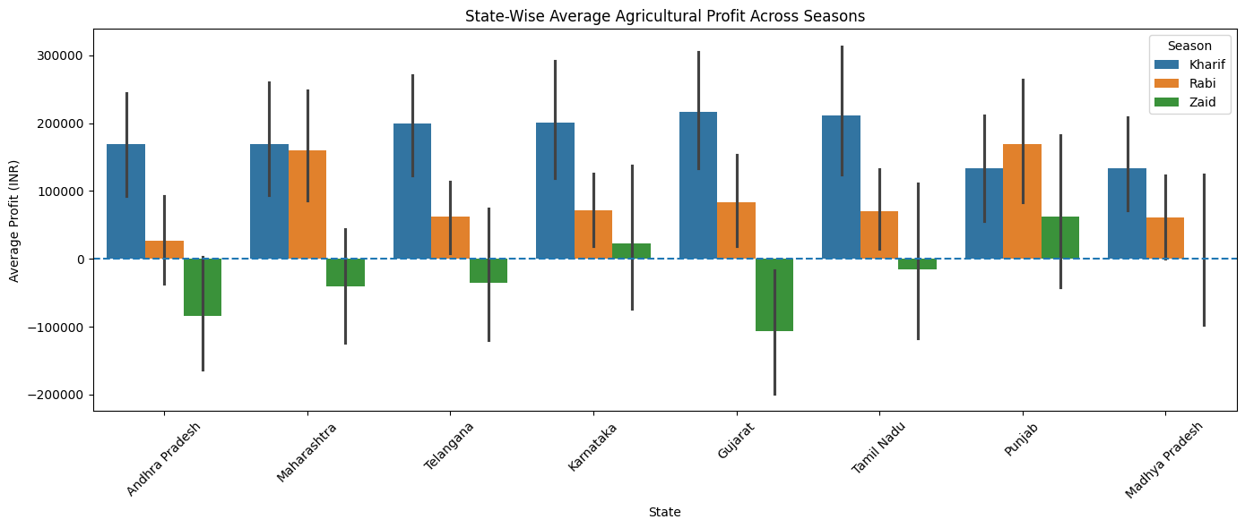
RESULTS
Result Explanation:
The graph shows that agricultural profit varies significantly across different states and seasons. Kharif generally shows positive profitability across most states, while Zaid shows negative profit in several states, indicating that seasonal and regional conditions influence economic agricultural performance.

Slide 8
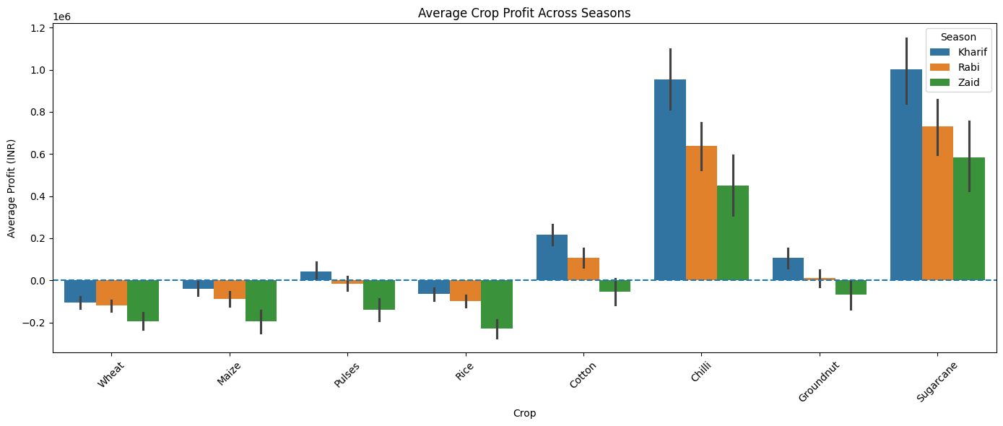
RESULTS
Result Explanation:
The graph shows that profitability varies significantly among different crops and seasons. Sugarcane and Chilli show the highest average profits, especially during Kharif, while crops such as Wheat, Maize, Rice, and Pulses show negative profits in some seasons. This indicates that both crop selection and seasonal conditions influence agricultural profitability.

Slide 9
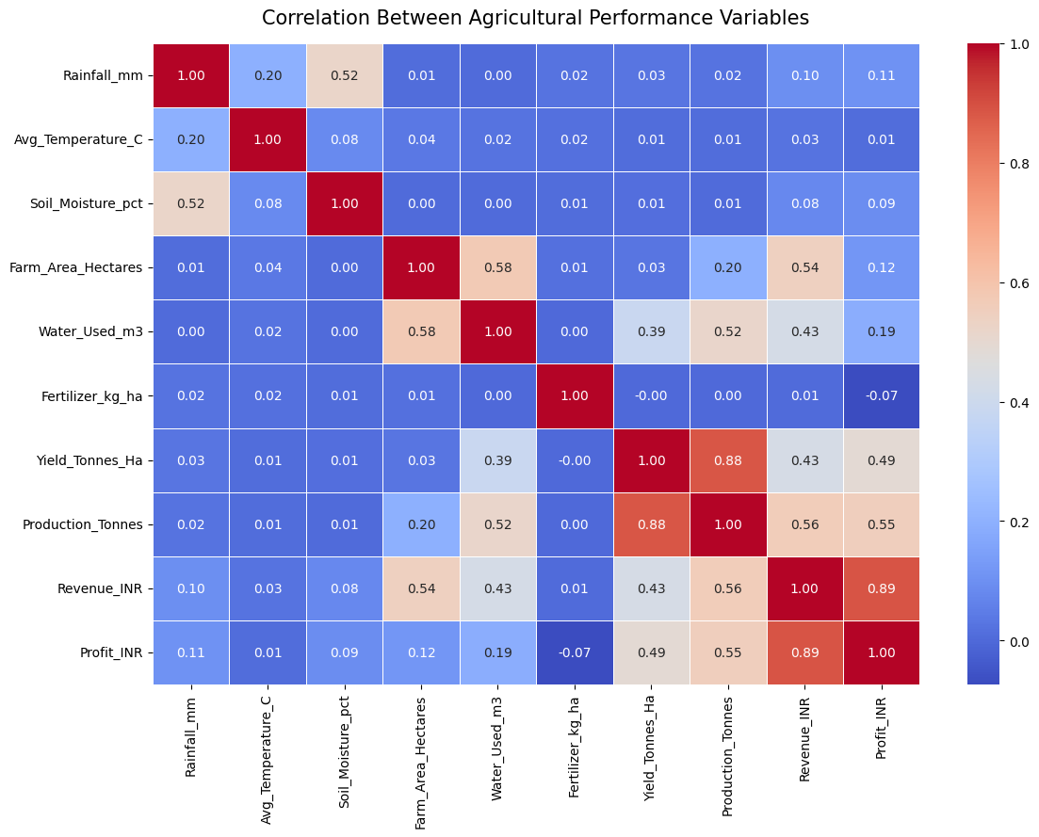
RESULTS
Result Explanation:
The heatmap shows the strength of relationships between important agricultural variables. Yield and production have a strong positive correlation (0.88), while revenue and profit also show a strong positive correlation (0.89). This indicates that higher production and revenue are generally associated with better overall agricultural performance.

Slide 10
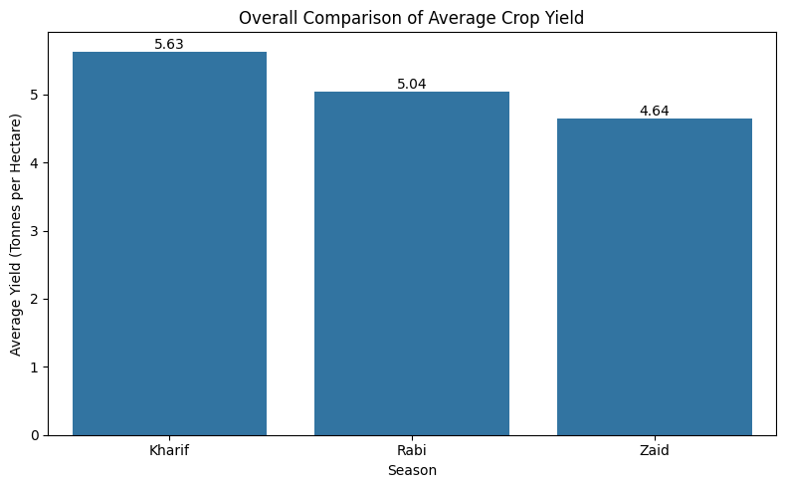
RESULTS
Result Explanation:
The graph shows that Kharif has the highest average crop yield at 5.63 tones per hectare, followed by Rabi at 5.04 tones per hectare. Zaid has the lowest average yield at 4.64 tones per hectare, indicating that crop yield varies across seasons and Kharif shows the strongest yield performance in the dataset.

Slide 11
Future scope
Real-Time Data Integration – Future work can include real-time agricultural, weather, and market data to provide more up-to-date seasonal analysis.
Advanced Predictive Analysis – Machine Learning techniques can be incorporated to predict crop yield, production, and profitability for future seasons.
More Detailed Regional Analysis – The project can be expanded by including more regions, districts, and geographical factors for deeper location-based insights.
Weather and Climate Data Integration – Additional climate variables such as rainfall forecasts, temperature changes, and extreme weather conditions can improve seasonal analysis.
Decision Support System – The analysis can be developed into a decision-support platform to help farmers and agricultural planners make better decisions regarding crop selection, resource usage, and seasonal planning.

Slide 12
GitHub Link
https://github.com/MonishaKar27/Seasonal-Agriculture-Performance-Analysis.git

Slide 13

VOIS Course completion certificate -
Course name- Data Visualization

Slide 14
Thank you
.

