Slide 1






ABA:- Sector analysis
Submitted by: Monisha Karmakar
Roll no 19202021
MBA 2019-21

Slide 2

Data preparation:
Importing of necessary library and given dataset.
Preparation:
Removing of the first few rows.
Extracting the year from the given dataset.
Renaming the column names as per the year.
Importing the Sector dataset (which is downloaded from BSE) that contains only company name.
Using merge() of python (which performs like inner join option in SQL) to extract the data for preparing sector dataset.
Finding for null value presence and filling them in.
Proceeding with further Descriptive analysis where have tried to answer the descriptive type of Question.
What is the central tendency recorded as per the features & by which company ?
What is the Maximum, median and mean value recorded on yearly basis.
Doing visual analysis to find the data distribution .
..

Slide 3
Assumption for such financial analysis: (W. R. T the features Given)
Promoters (In %) - Shares held : the percentage of shares that are held by the promoters of a company. The more the share holding means that they actually believe in the future path that the company is expected to take and want to benefit from that.
Total Assets: is all the assets, or items of value, a small business owns. The more the value the more the stable business is.
Equity dividend: is the annual cash flow that an equity investor receives. The more the equity dividend the higher the profit made by the company.
Return on net worth indicates the profitability of the company by providing the picture of how much return it earns on its capital.
Quick ratio: The quick ratio is an indicator of a company's short-term liquidity position and measures a company's ability to meet its short-term obligations with its most liquid assets.
Debt to equity ratio: shows the proportions of equity and debt a company is using to finance its assets. The less the value the better it is.
..

Slide 4
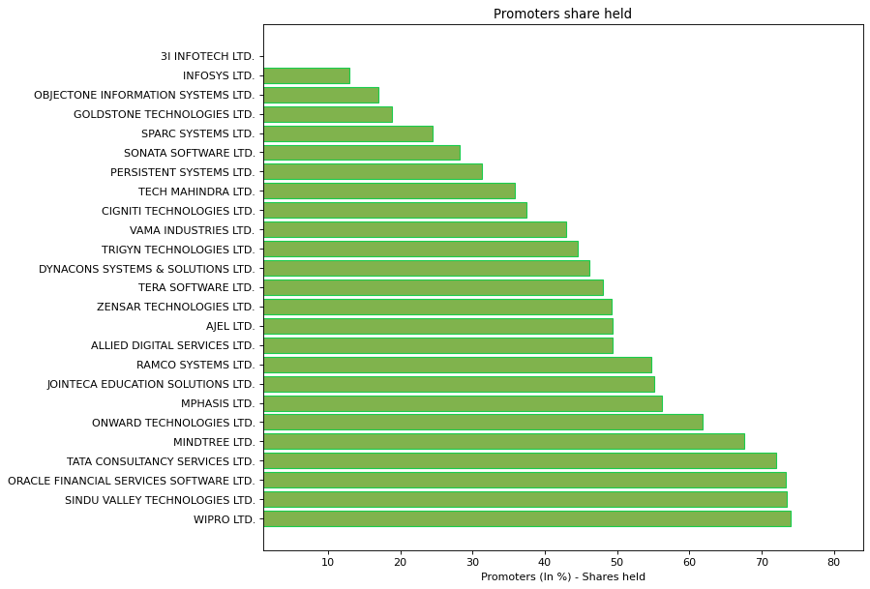
IT service and consulting analysis:-
Promoter Share-
The Maximum Share of promoters in IT Service And Consulting Sector is 74.02 by WIPRO LTD.
The Minimum Share of promoter in IT Service and Consulting Sector is 0.0 by 3I INFOTECH LTD.
..

Slide 5
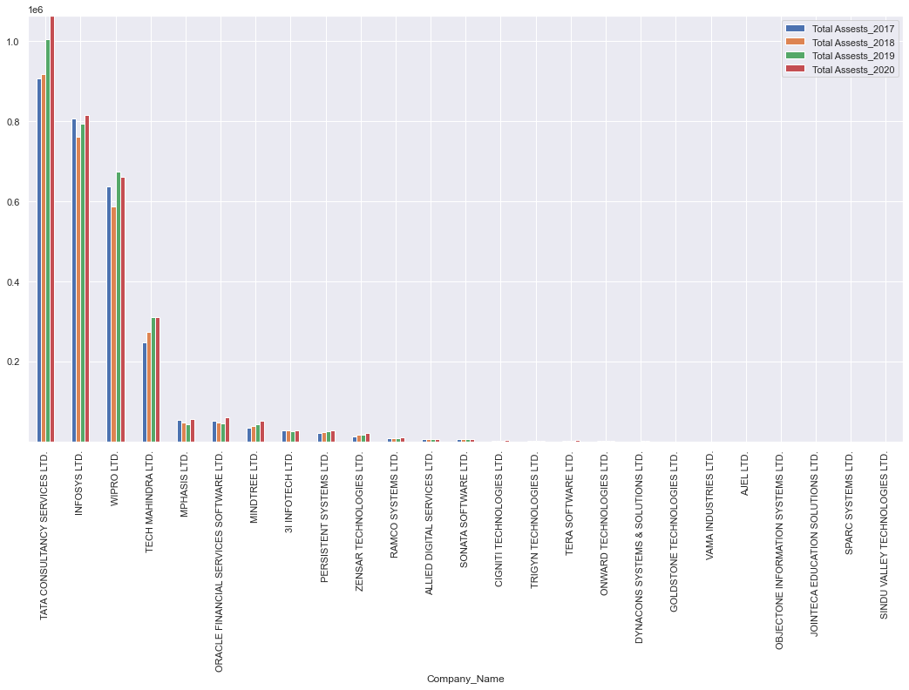
.
Total Assets-
The maximum total Assets is Recorded by TATA CONSULTANCY SERVICES LTD :
Total Assests_2017 = 907460.0 Total Assests_2018 = 917770.0
Total Assests_2019 = 1005670.0 Total Assests_2020 = 1064180.0
The minimum total Assets is Recorded by SINDU VALLEY TECHNOLOGIES LTD
Total Assests_2017 = 3.6 Total Assests_2018 = 2.3
Total Assests_2019 = 2.4 Total Assests_2020 = 1.1
..

Slide 6
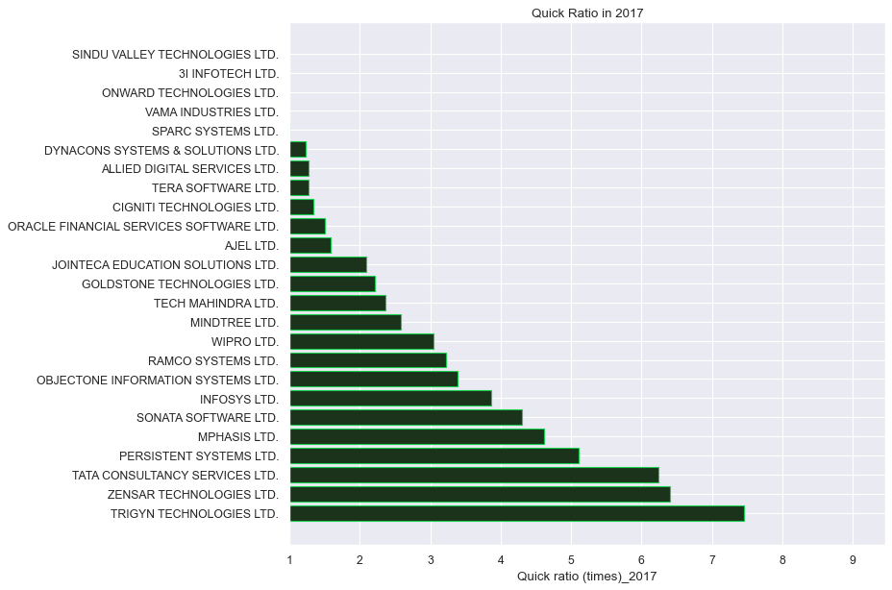
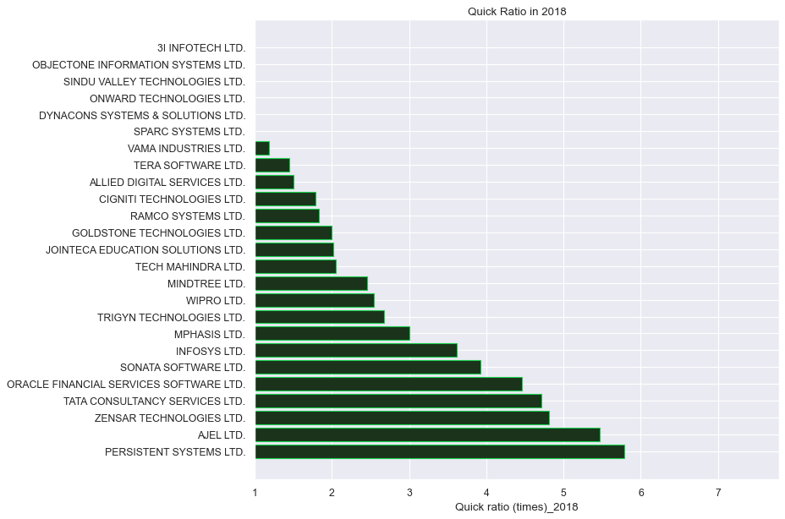
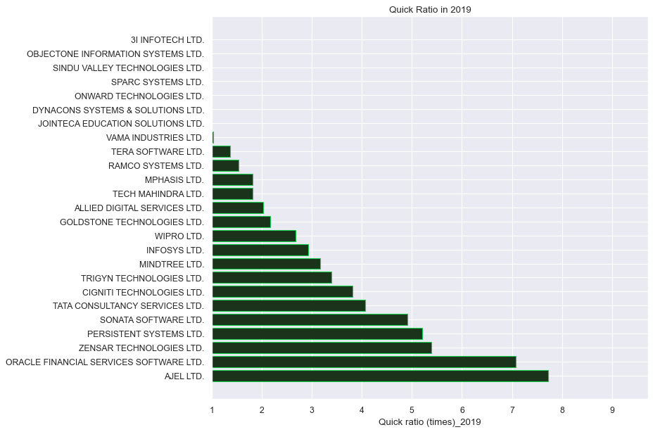
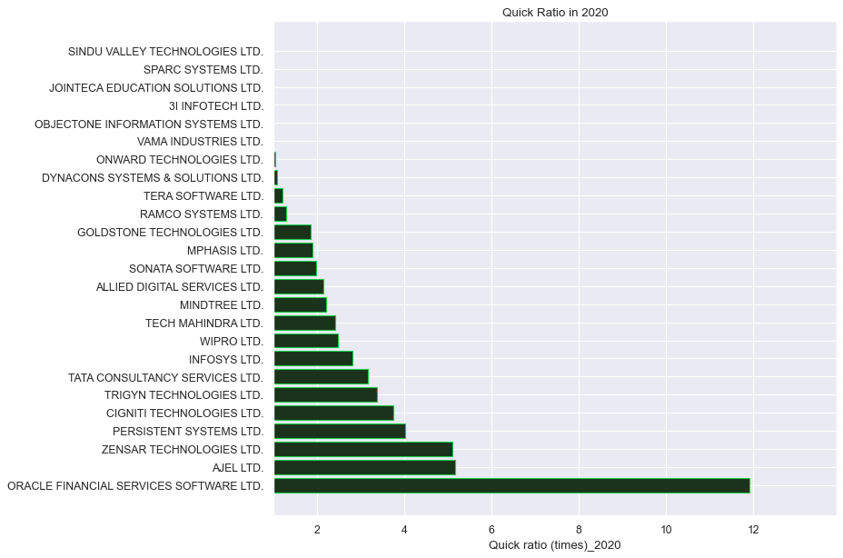
.
The Maximum Quick Ratio recorded on yearly basis
Quick ratio (times)_2017 is 7.46 by TRIGYN TECHNOLOGIES LTD.
Quick ratio (times)_2018 is 5.79 by PERSISTENT SYSTEMS LTD.
Quick ratio (times)_2019 is 7.72 by AJEL LTD.
Quick ratio (times)_2020 is 11.91 by ORACLE FINANCIAL SERVICES SOFTWARE LTD.
..

Slide 7
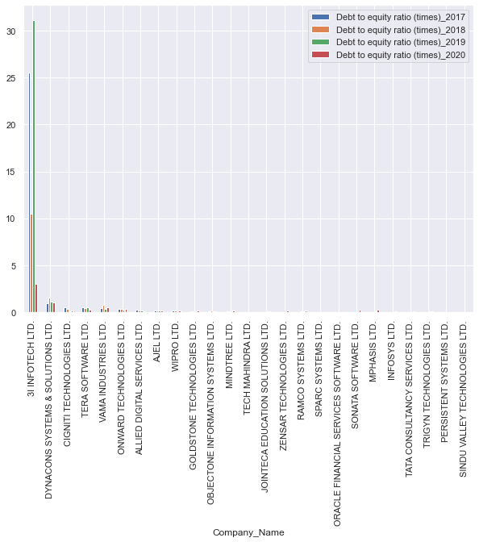
.
The maximum Debt to Equity recorded is by 3I INFOTECH LTD.
Debt to equity ratio (times)_2017 is 25.51
Debt to equity ratio (times)_2018 is 10.48
Debt to equity ratio (times)_2019 is 31.18
Debt to equity ratio (times)_2020 is 3.03
Total 10 companies have got Debt to equity ratio less than the recorded median value in 2017
Total 12 companies have got Debt to equity ratio less than the recorded median value in 2018
Total 12 companies have got Debt to equity ratio less than the recorded median value in 2019
Total 11 companies have got Debt to equity ratio less than the recorded median value in 2020
..

Slide 8
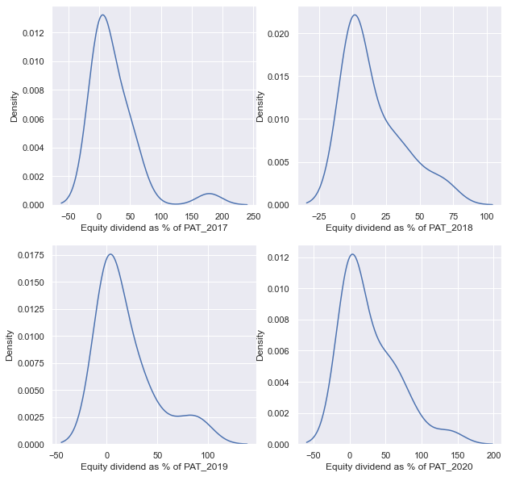
.
Equity dividend data distribution in IT service and consulting sector.
Shows the graphs are skewed which means few company are making higher profit then the rest.
. Here the graph are positively or right skewed where mean is greater than median under such condition median is considered for analysis.
..

Slide 9
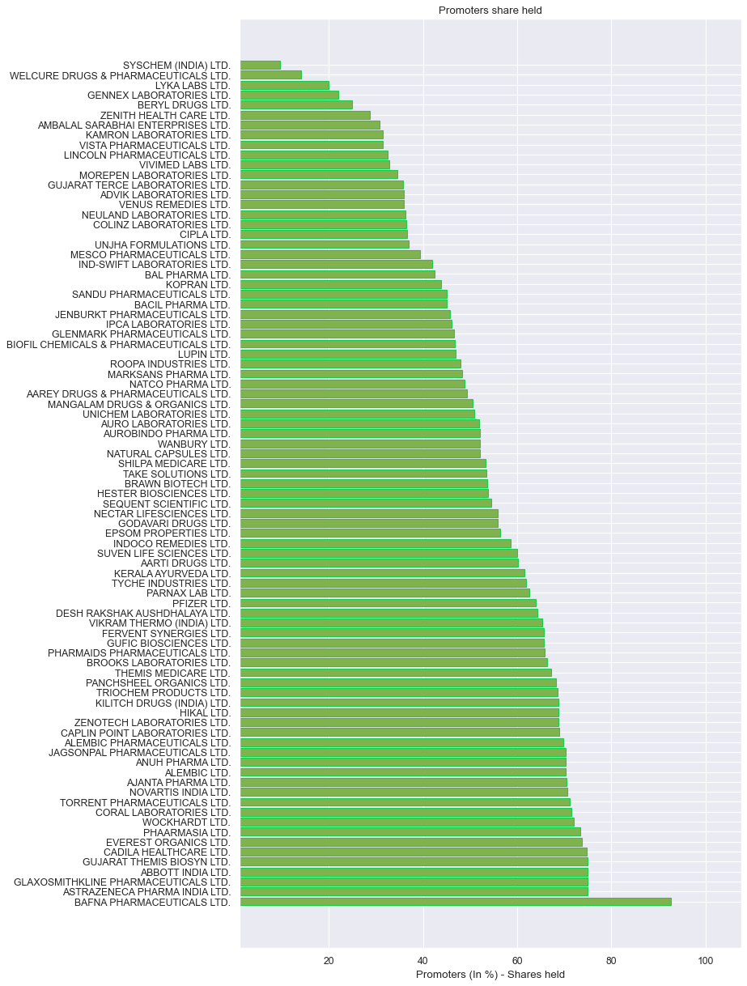
Pharmaceutical Sector analysis:-
Promoter Share-
Maximum Promoters share is recorded by BAFNA PHARMACEUTICALS LTD. as 92.64%
Minimum Promoters share is recorded by SYSCHEM(INDIA) LTD. as 9.54%
..

Slide 10
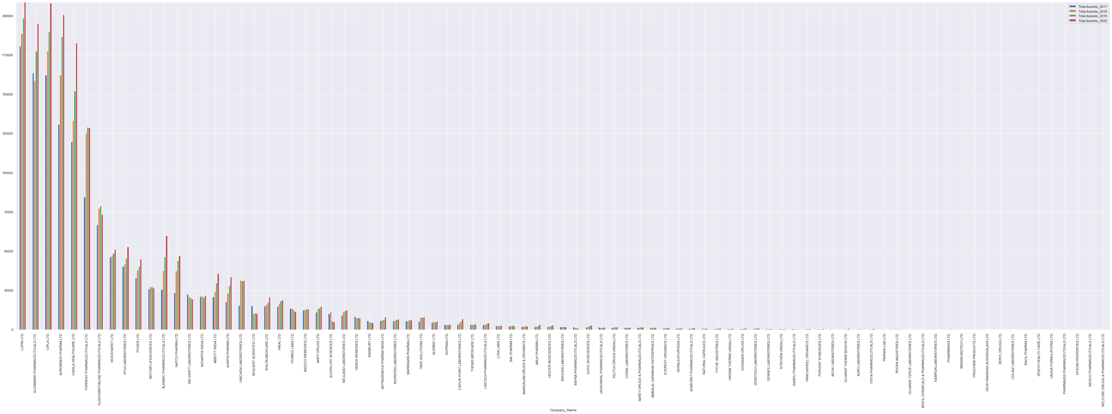
.
Total Assets-:
The Maximum total assests recorded is by LUPIN LTD. Total Assests_2017 is 180746.2
Total Assests_2018 is 188504.4, Total Assests_2019 is 198472.2, Total Assests_2020 is 208770.6
..

Slide 11
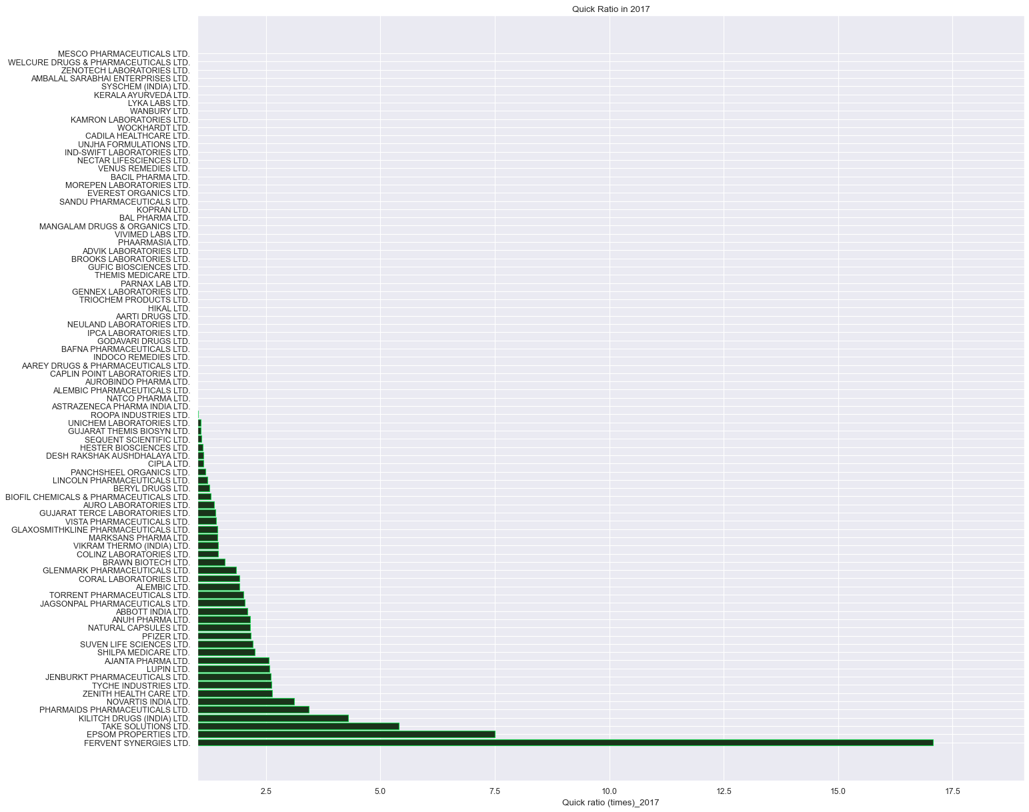
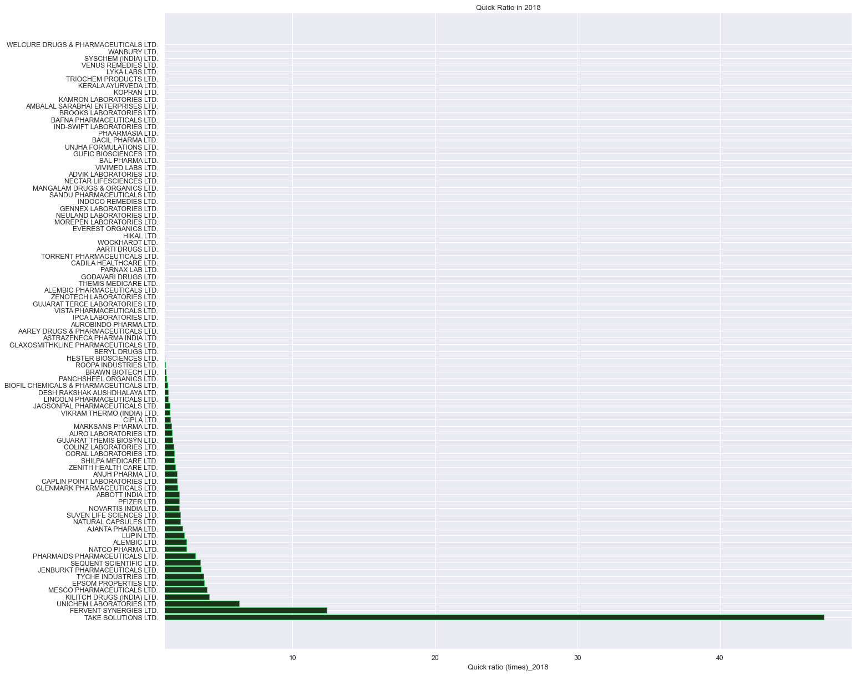
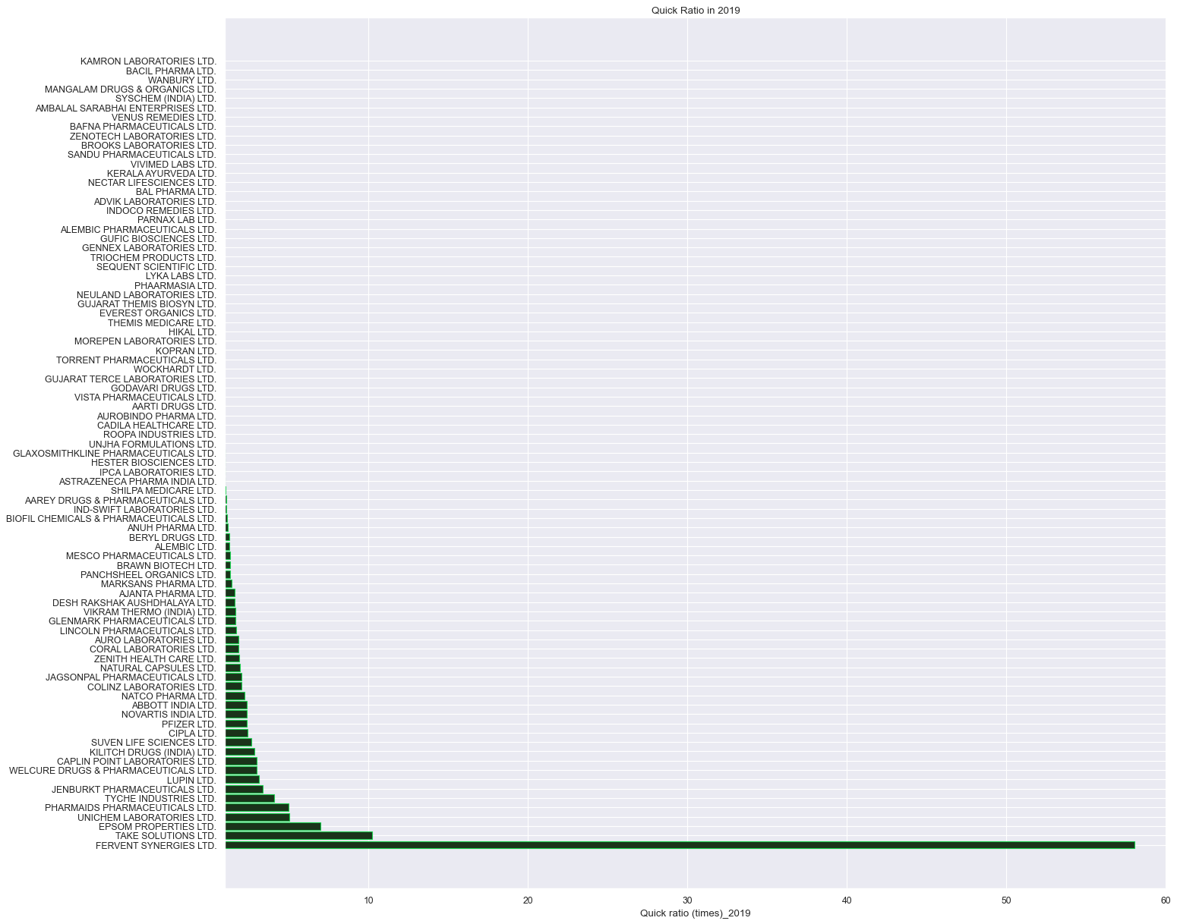
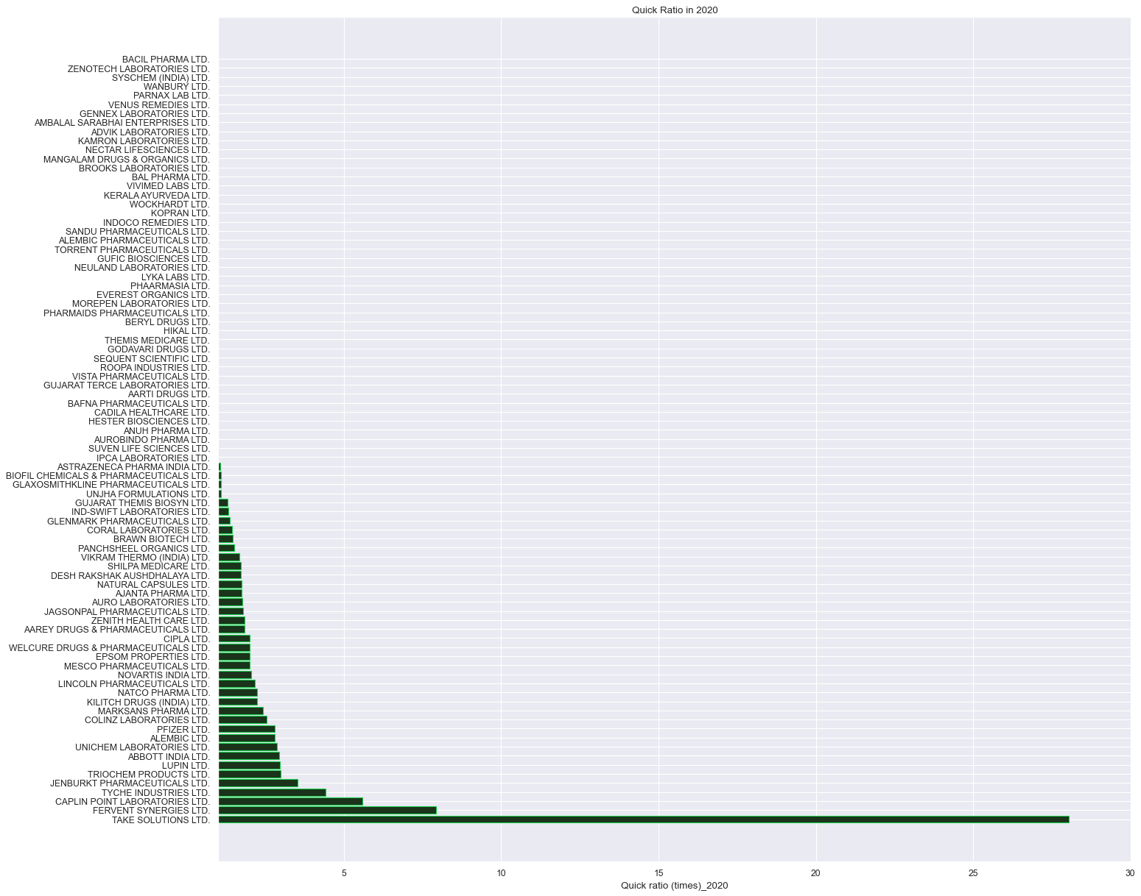
.
The Maximum Quick Ratio recorded on yearly basis:
Quick ratio (times)_2017 is 17.07 by FERVENT SYNERGIES LTD.
Quick ratio (times)_2018 is 47.26 by TAKE SOLUTIONS LTD.
Quick ratio (times)_2019 is 58.03 by FERVENT SYNERGIES LTD.
Quick ratio (times)_2020 is 28.03 by TAKE SOLUTIONS LTD.
..

Slide 12
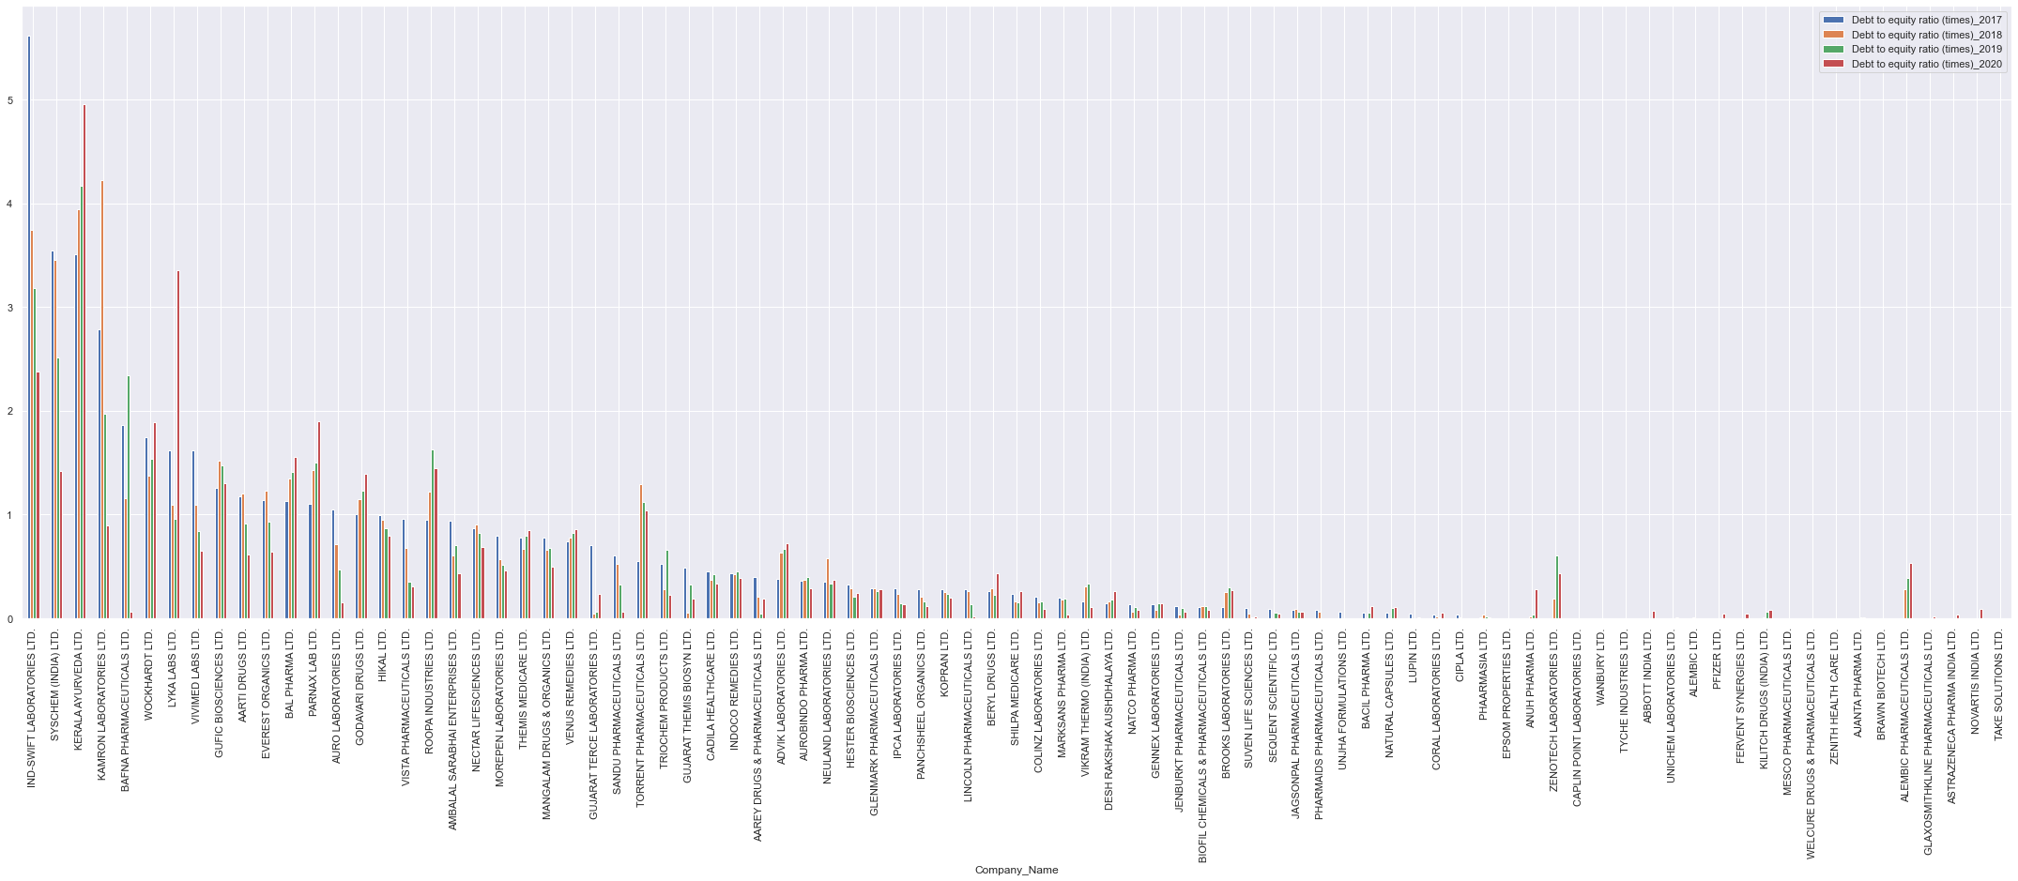
.
The Maximum Debt to Equity is recorded by:
Debt to equity ratio (times)_2017 is 5.62 by IND-SWIFT LABORATORIES LTD.
Debt to equity ratio (times)_2018 is 4.22 by KAMRON LABORATORIES LTD.
Debt to equity ratio (times)_2019 is 4.17 by KERALA AYURVEDA LTD.
Debt to equity ratio (times)_2020 is 4.96 by KERALA AYURVEDA LTD.
..

Slide 13
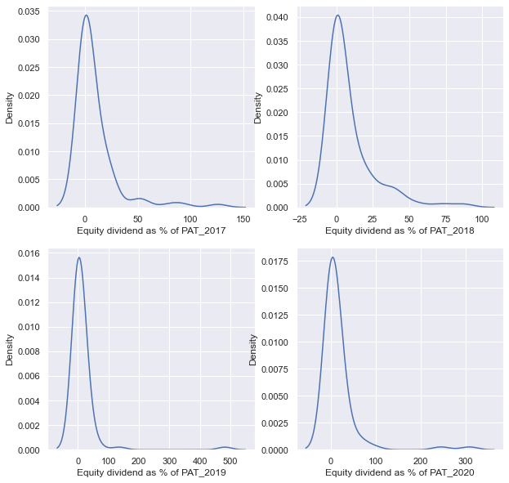
.
Equity dividend data distribution in Pharmecutical sector.
Shows the graphs are skewed which means few company are making higher profit then the rest
. Here the graph are positively or right skewed where mean is greater than median under such condition median is considered for analysis.
..

Slide 14
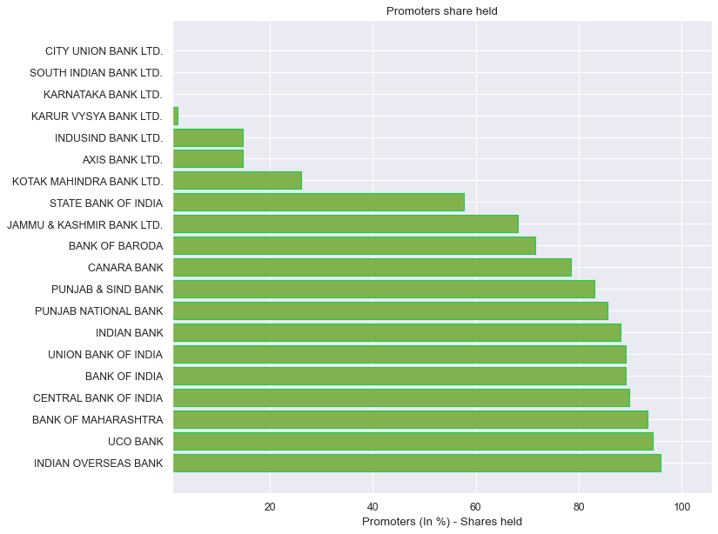
BANK Sector analysis:-
Promoter Share-
Maximum Promoters share is recorded by INDIAN OVERSEAS BANK as 95.84%
..

Slide 15
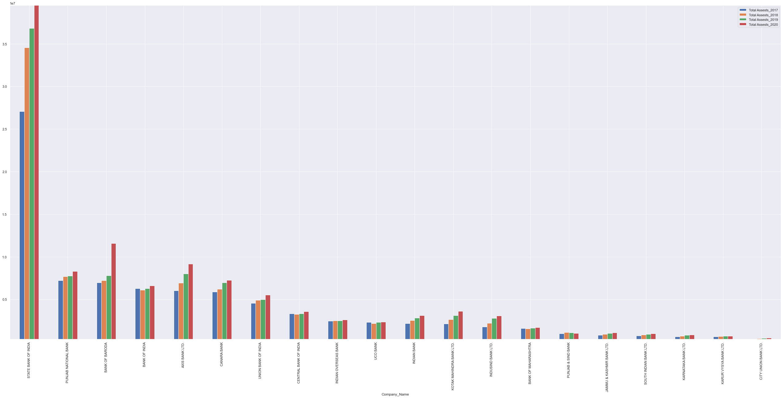
.
Total Assets-:
The Maximum Total Assets is recorded by STATE BANK OF INDIA :
Total Assests_2017 27059663.1, Total Assests_2018 34547520.0, Total Assests_2019 36809142.4, Total Assests_2020 39513939.2
..

Slide 16
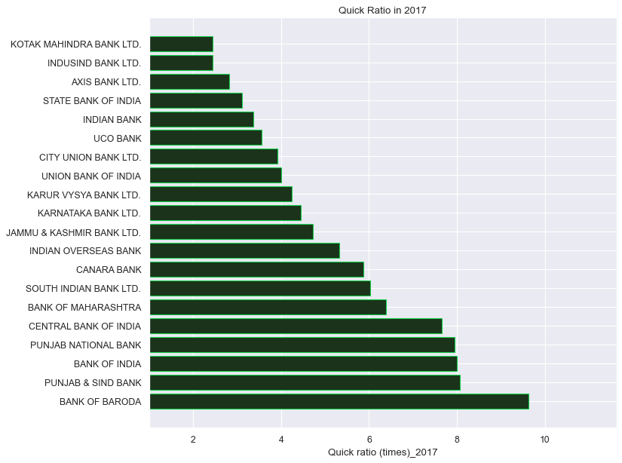
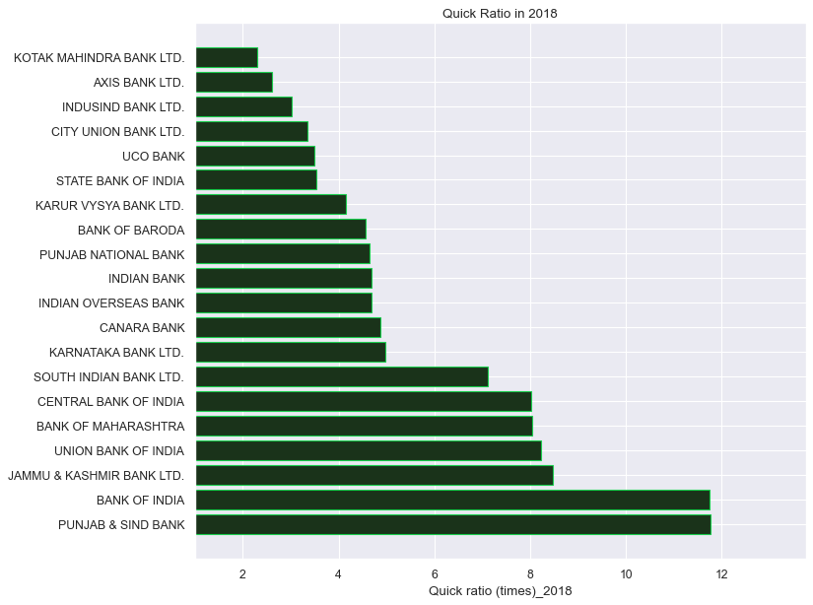
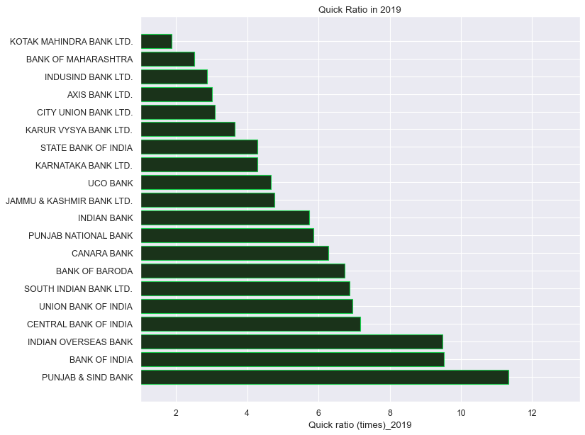
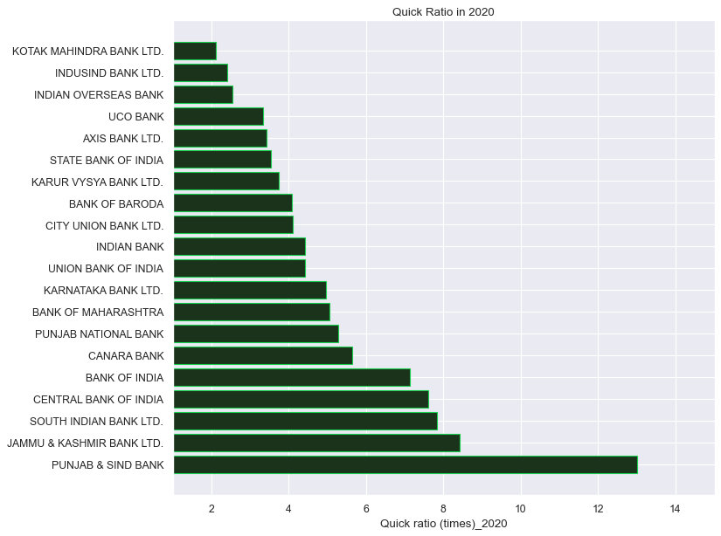
.
The Maximum Quick Ratio is recorded by
Quick ratio (times)_2017 9.63 by BANK OF BARODA
Quick ratio (times)_2018 11.76 by PUNJAB & SIND BANK
Quick ratio (times)_2019 11.34 by PUNJAB & SIND BANK
Quick ratio (times)_2020 13.02 by PUNJAB & SIND BANK
..

Slide 17
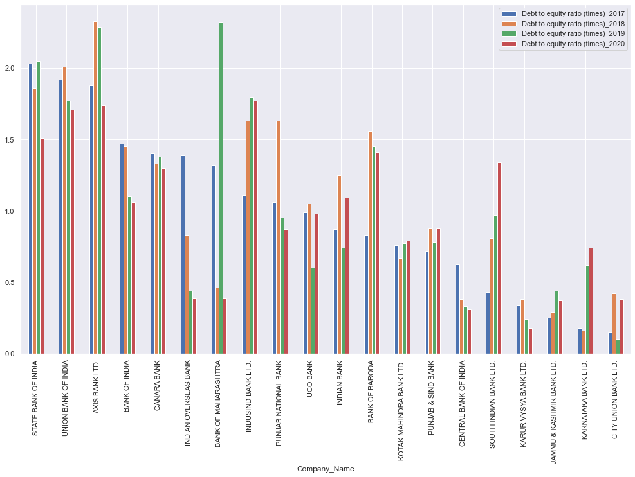
.
The Maximum Debt to Equity ratio recorded
Debt to equity ratio (times)_2017 2.03 by STATE BANK OF INDIA
Debt to equity ratio (times)_2018 2.33 by AXIS BANK LTD.
Debt to equity ratio (times)_2019 2.32 by BANK OF MAHARASHTRA
Debt to equity ratio (times)_2020 1.77 by INDUSIND BANK LTD.
..

Slide 18
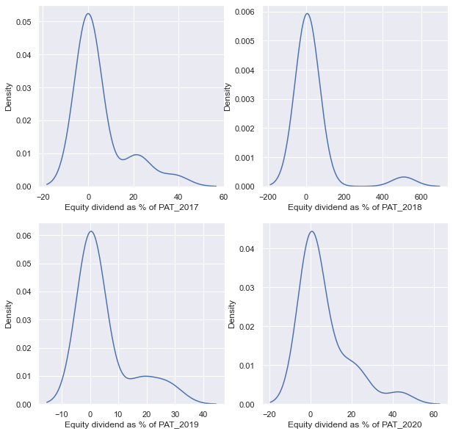
.
Equity dividend data distribution in Bank sector.
Shows the graphs are skewed which means few company are making higher profit then the rest
. Here the graph are positively or right skewed where mean is greater than median under such condition median is considered for analysis.
..

Slide 19
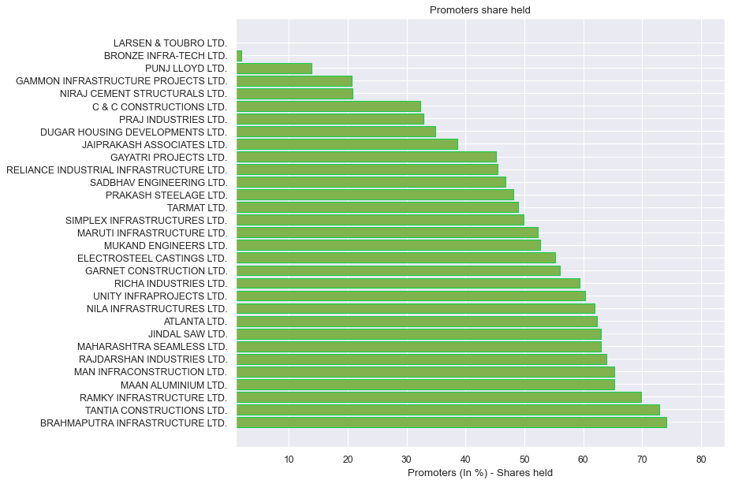
Construction and engineering Sector analysis:-
Promoter Share-
Maximum Promoters share is recorded by BRAHMAPUTRA INFRASTRUCTURE LTD. as 74.05%
..

Slide 20
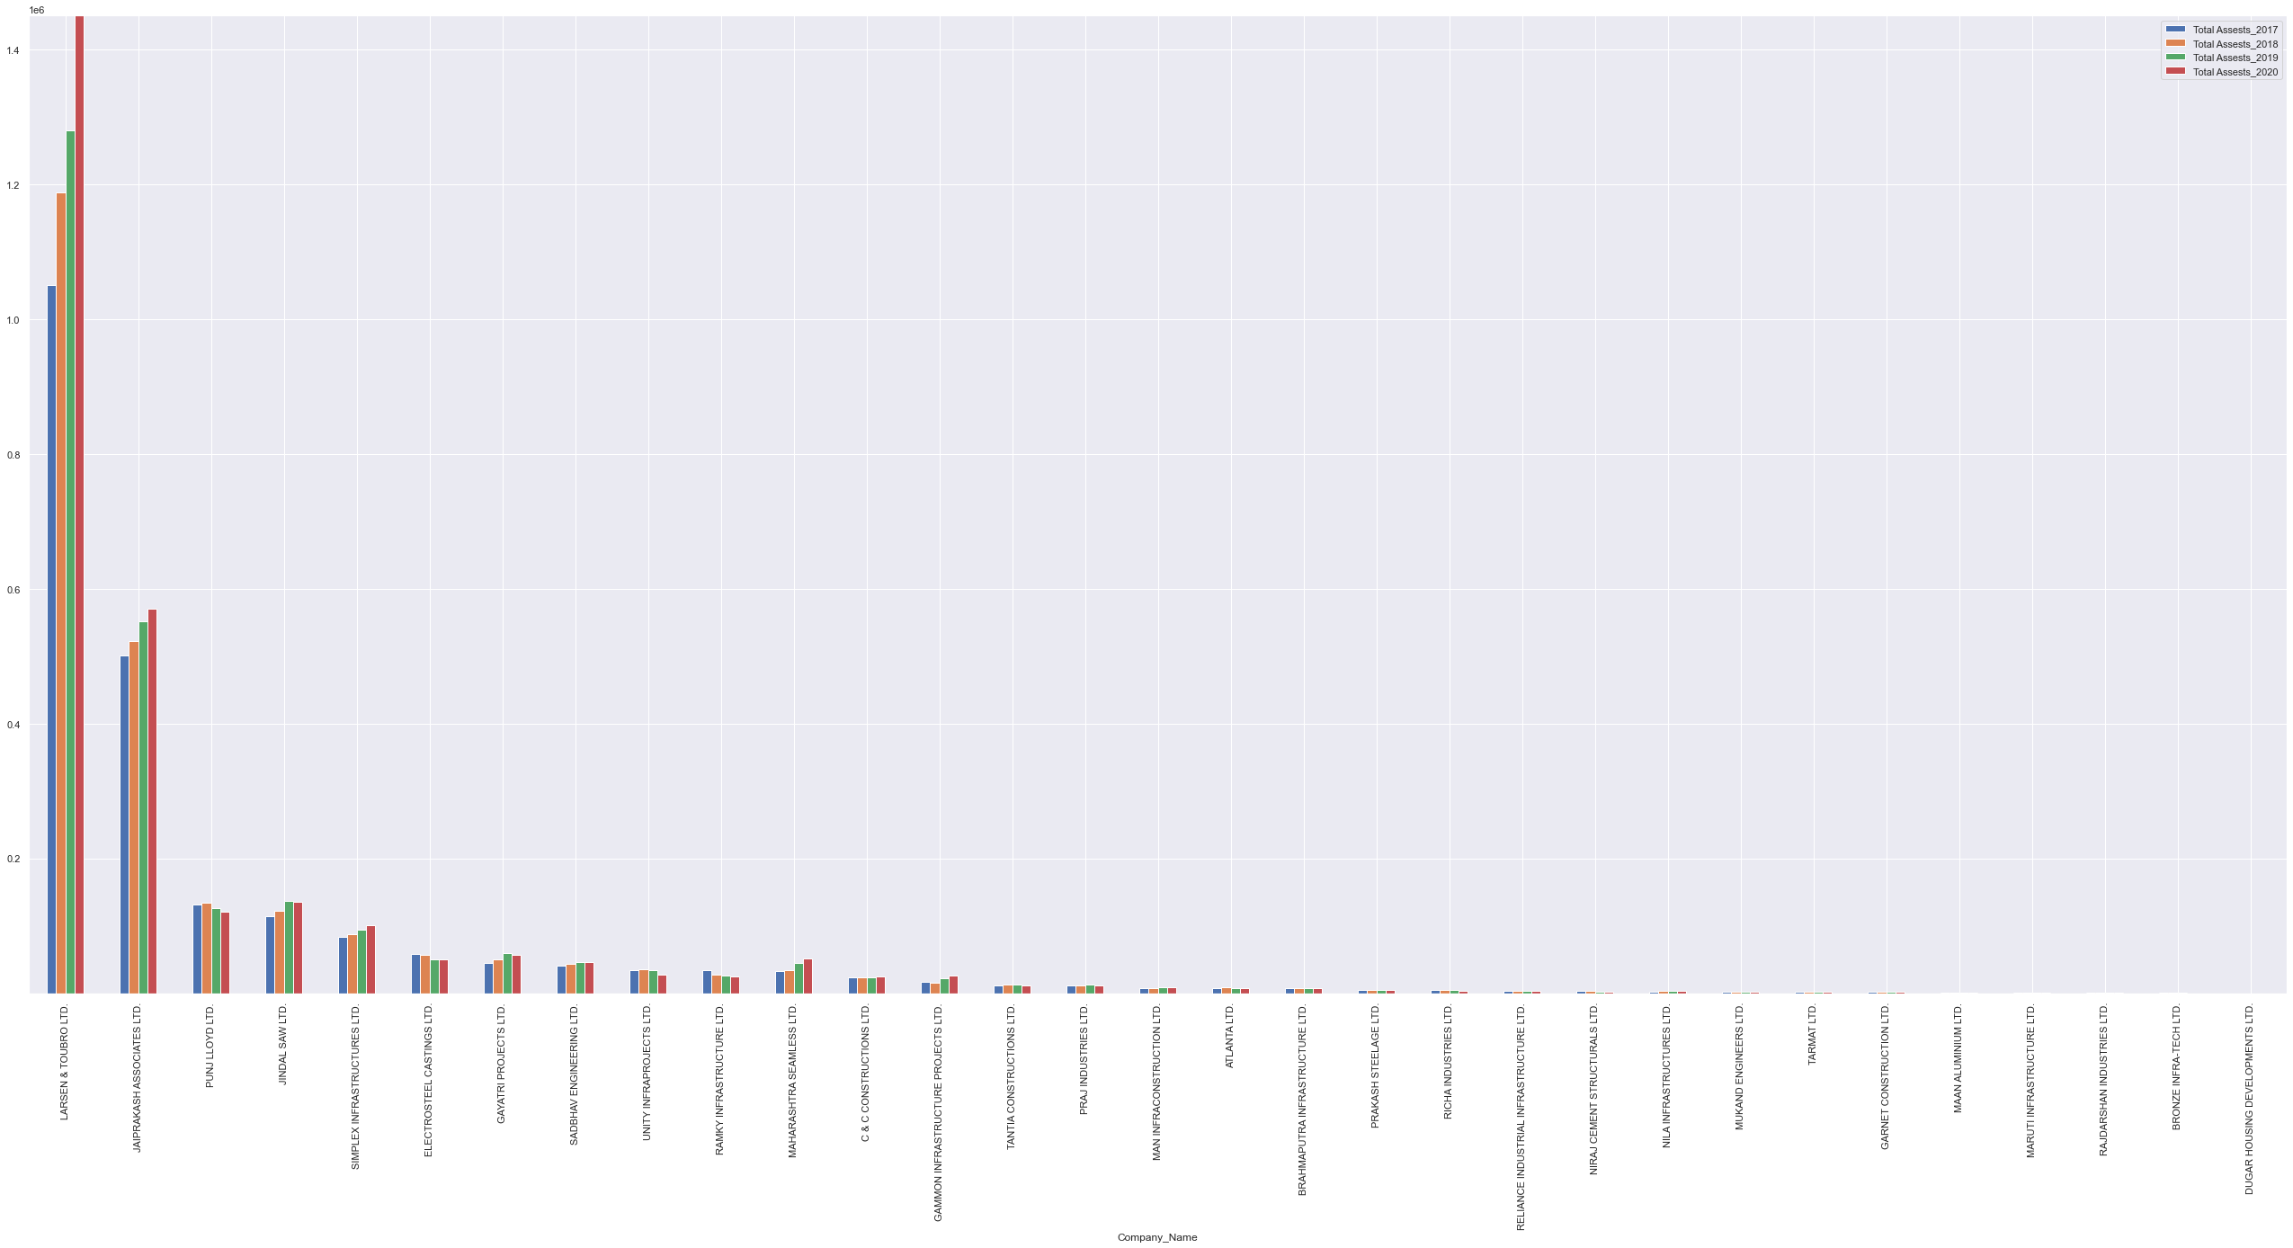
.
Total Assets-:
The Maximum total Assest is recorded by LARSEN & TOUBRO LTD.
Total Assests_2017 1049996.0, Total Assests_2018 1187250.5, Total Assests_2019 1280593.9 , Total Assests_2020 1450202.5
..

Slide 21
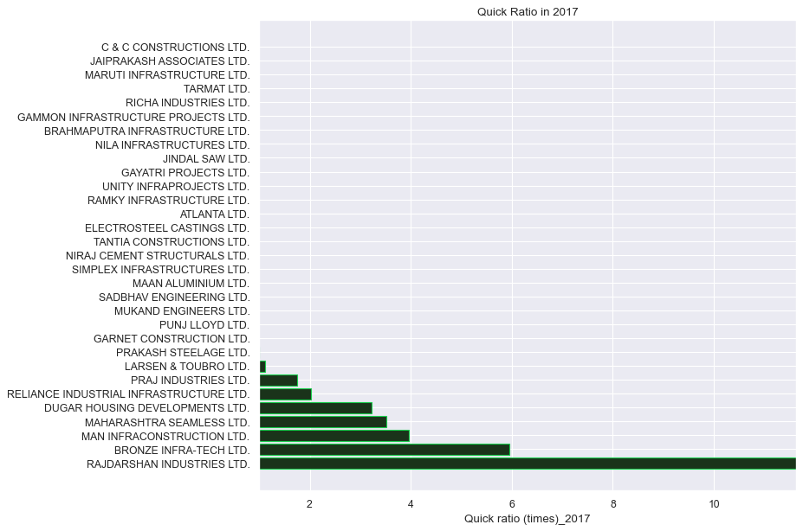
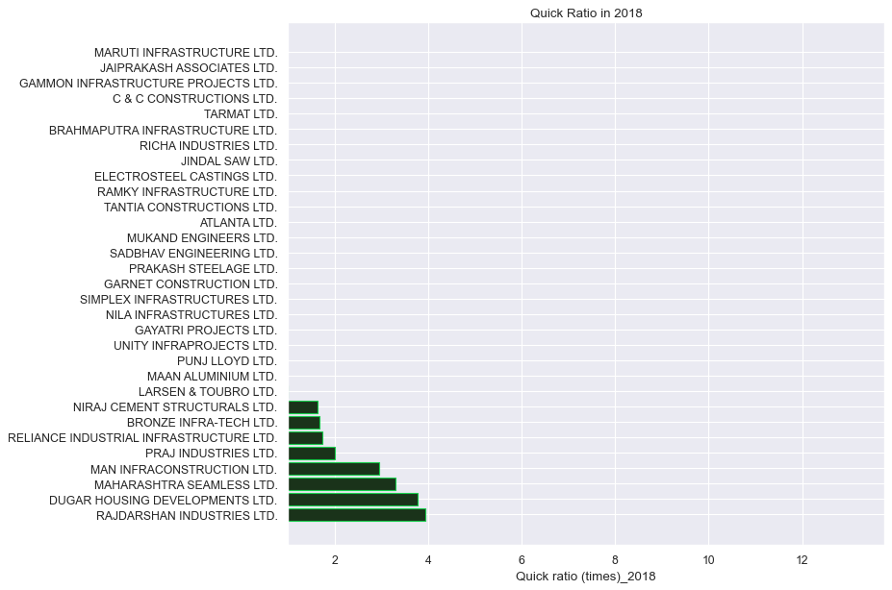
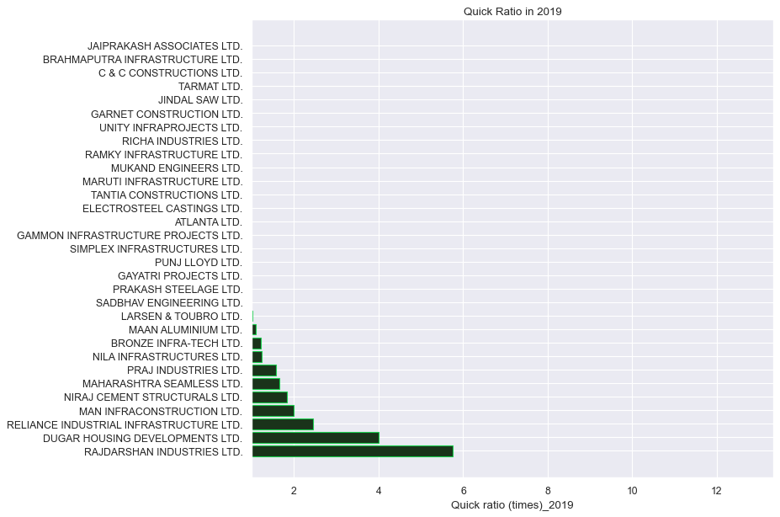
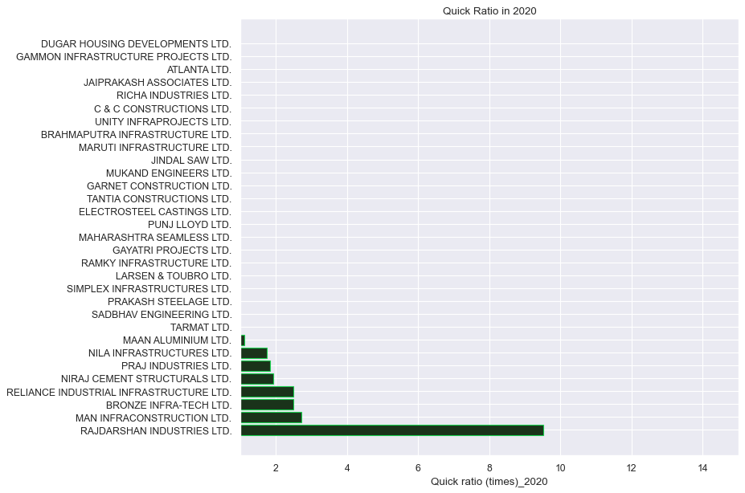
.
The Maximum Quick ratio recorded by RAJDARSHAN INDUSTRIES LTD.
Quick ratio (times)_2017 42.50, Quick ratio (times)_2018 3.94
Quick ratio (times)_2019 5.75, Quick ratio (times)_2020 9.53
..

Slide 22
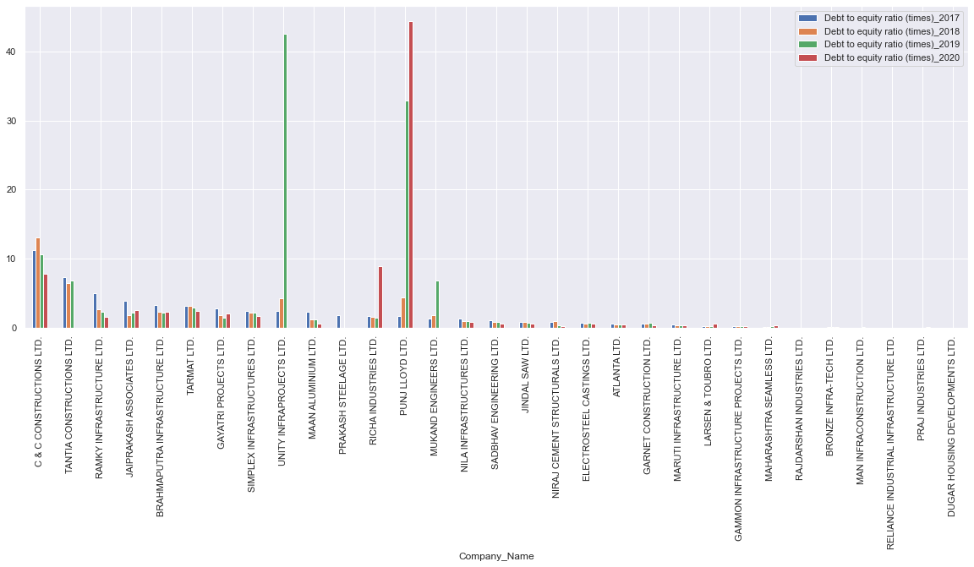
.
The Maximum Debt to equity ratio recorded
Debt to equity ratio (times)_2017 11.19 by C & C CONSTRUCTIONS LTD.
Debt to equity ratio (times)_2018 13.05 by C & C CONSTRUCTIONS LTD.
Debt to equity ratio (times)_2019 42.62 by UNITY INFRAPROJECTS LTD
Debt to equity ratio (times)_2020 44.40 by PUNJ LLOYD LTD..
..

Slide 23
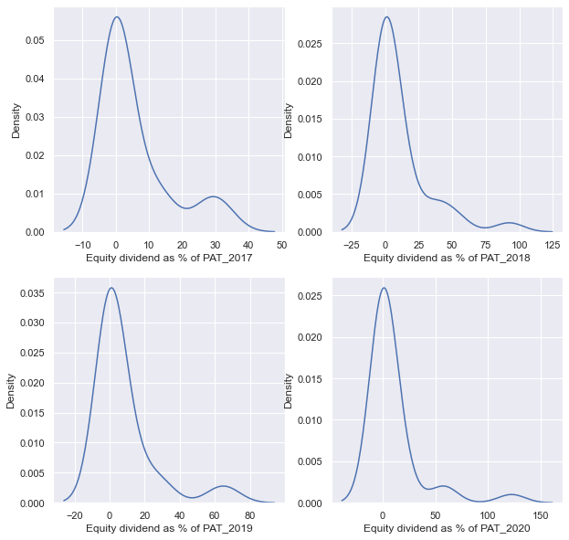
.
Equity dividend data distribution in Construction and Engineering sector.
Shows the graphs are skewed which means few company are making higher profit then the rest
. Here the graph are positively or right skewed where mean is greater than median under such condition median is considered for analysis.
..

Slide 24

.
Conclusion:
Upon analysis it can be concluded that the Banking Sector is performing well, and the promoters are holding share of 95.84% which is the highest share hold among the remaining sectors.
State bank of India hold the maximum assets 39513939.2 as of 2020.
The Maximum Debt to Equity ratio recorded
Debt to equity ratio (times)_2017 2.03 by STATE BANK OF INDIA
Debt to equity ratio (times)_2018 2.33 by AXIS BANK LTD.
Debt to equity ratio (times)_2019 2.32 by BANK OF MAHARASHTRA
Debt to equity ratio (times)_2020 1.77 by INDUSIND BANK LTD
..

Slide 25
THANK YOU
Analytics Project
- Monisha Karmakar

