Slide 1
EMPLOYEE MANAGEMENT SYSTEM

Slide 2
INTRODUCTION
It is an data based system to maintain employees report
Every organization uses an information system to store data of their staff, this can be achieved by using employee management system
It saves lots of time and has no error in database

Slide 3
OBJECTIVE
It is an easy way to maintain all functionalities of the employees of the company
It provides functional reports to management of the company
It maintains the information about the personal details of their employees

Slide 4
SYSTEM REQUIREMENTS
Operating System : Windows 7/8/10 etc.
JRE : Version 1.8.0
Software JDK : Version 1.8
Platform : Eclipse
Front end : Java
Back end : MySQL
Interface : JDBC

Slide 5
LIST OF MODULES
View_employee
Insert
Update
Delete

Slide 6
EXISTING SYSTEM
The records are maintained in a registers
Complicated searching, updating, inserting and deleting process
Requires more time

Slide 7
PROPOSED SYSTEM
Creating a data in MySQL database and connecting a Java program using JDBC connector
It can perform various operations like insert, update, delete and list out the employee details

Slide 8
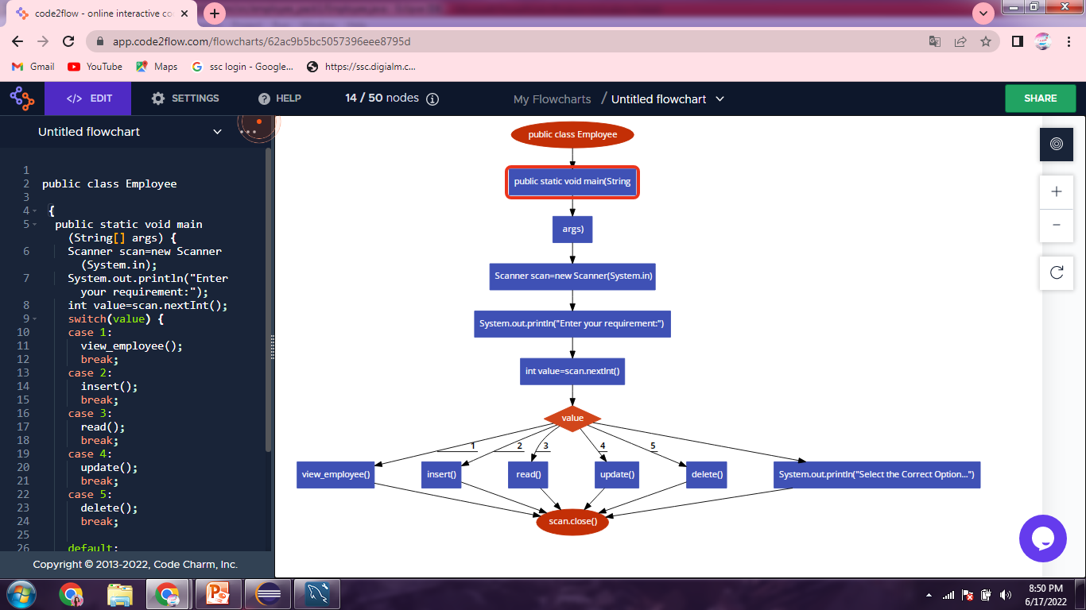
CODE TO FLOW

Slide 9
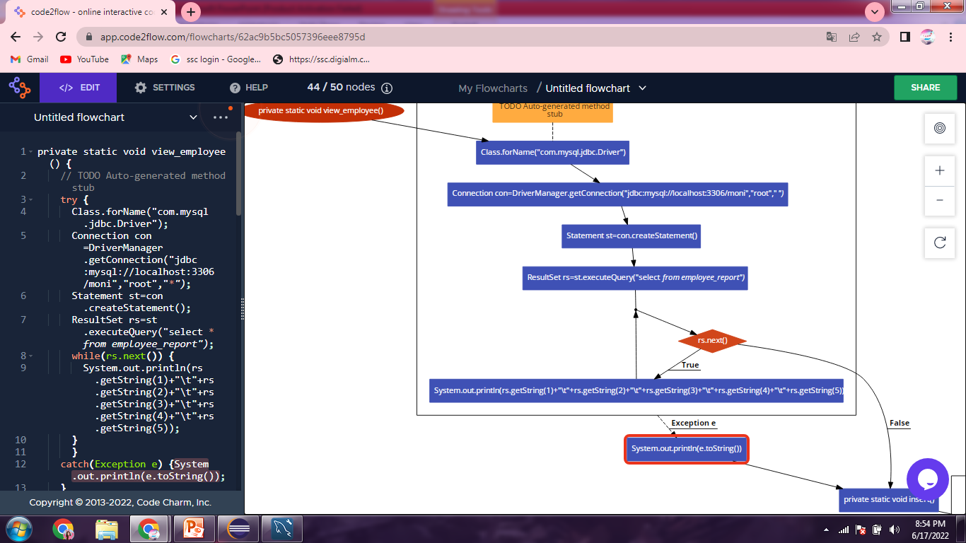

Slide 10
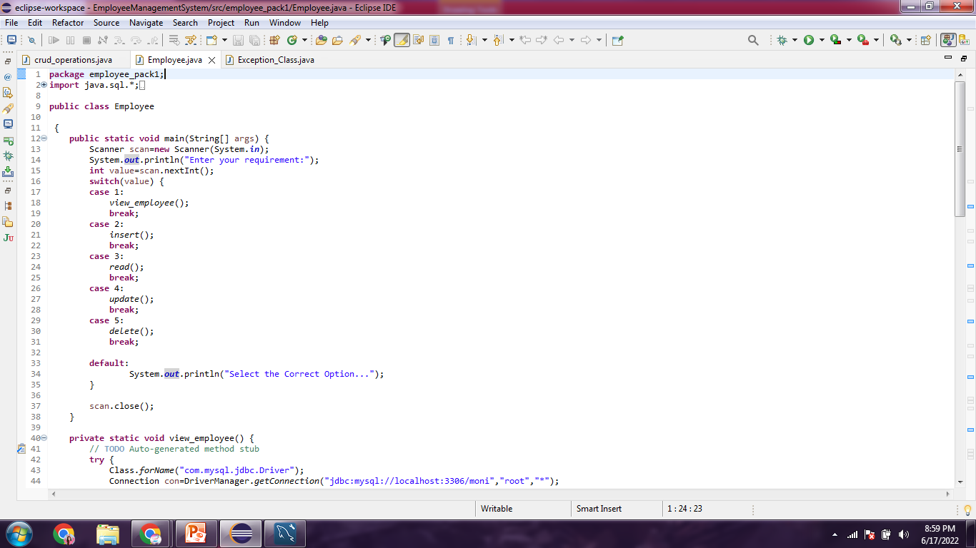
PROGRAM

Slide 11
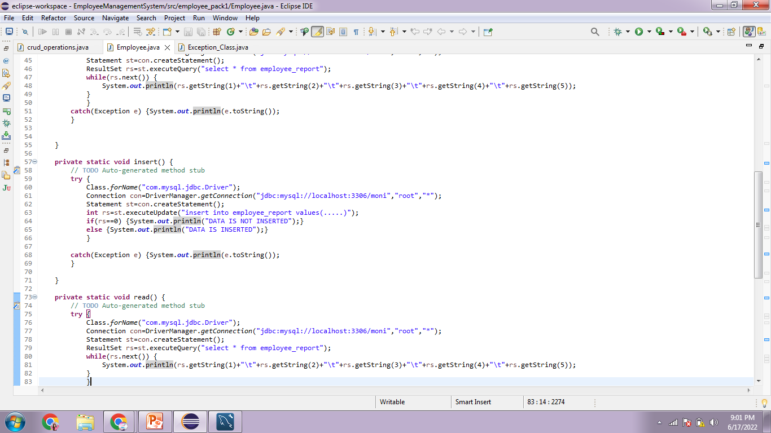

Slide 12
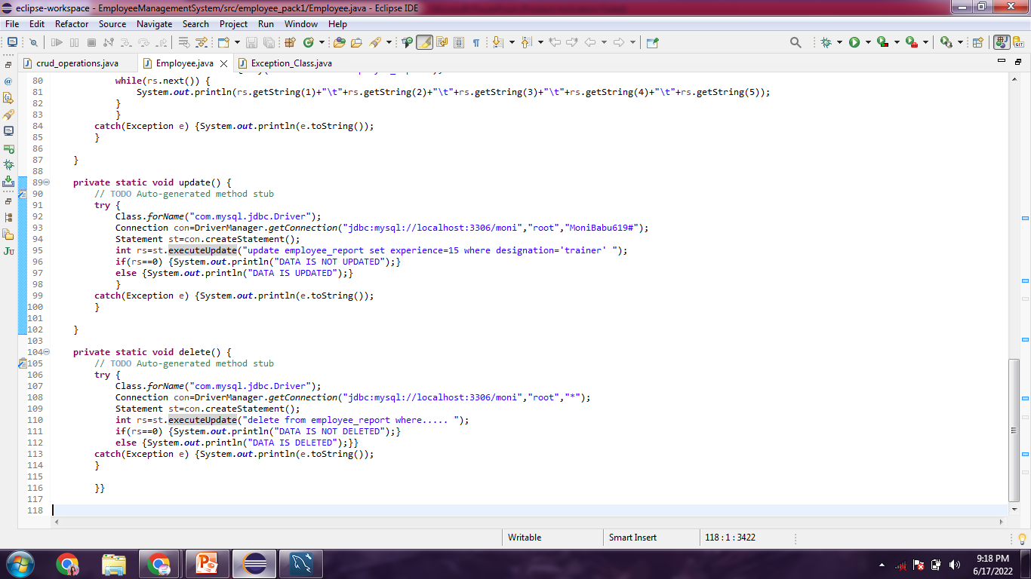

Slide 13
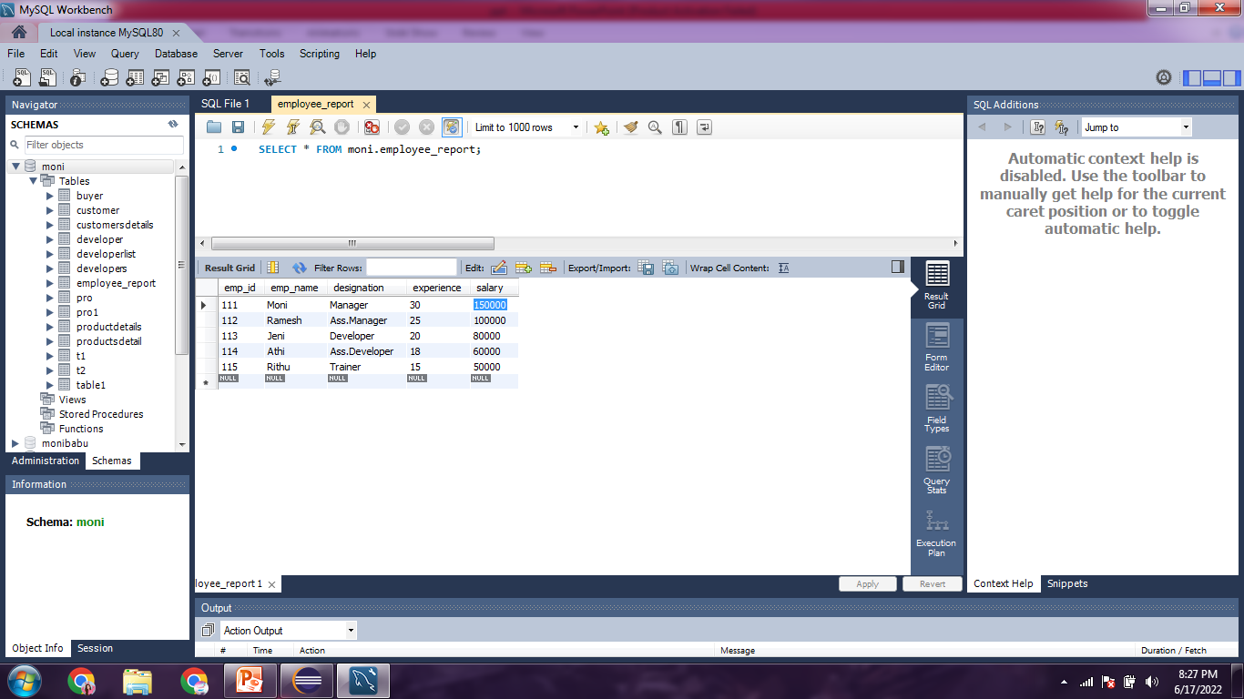
EMPLOYEE TABLE DETAILS

Slide 14
ADVANTAGES
Avoids manual work
Easy to perform operations
Huge data can be stored with less computer memory

Slide 15
LIMITATIONS
Salary was not automatically calculated without using formulae
It is not being automatically update the values(salary, attendance,…)

Slide 16
CONCLUSION
By using this system, it will always be user friendly
The system was well structured and also saves time

