Slide 1
Python Data Types
In Tamil
Lectured By
Monisha.S

Slide 2
Python Data Type
Variables can hold values, and every value has a data-type.
Python is a dynamically typed language,hence we do not need to define the type of the variable while declaring it.
The interpreter implicitly binds the value with its type.

Slide 3
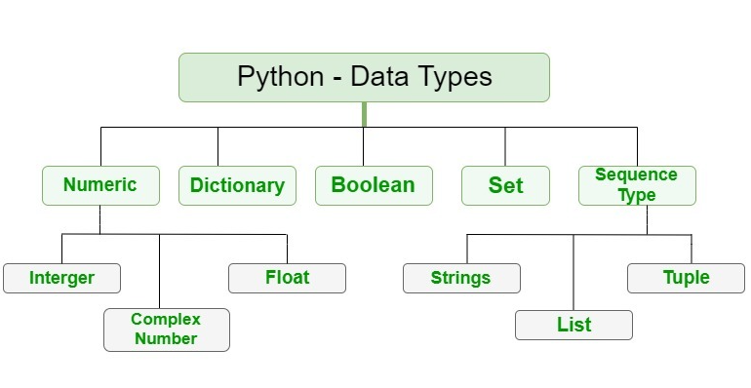
Classification

Slide 4
Integer
Int, or integer, is a whole number, positive or negative, without decimals, of unlimited length.
x=12
y=1234567
z=-4566
print(x,y,z)
Output:
12 1234567 -4566

Slide 5
Float
Float, or "floating point number" is a number, positive or negative, containing one or more decimals.
Ex:
x=34.5
y=12.89076545
z=-3456.12
print(x,y,z)
Output:
34.5 12.89076545 -3456.12

Slide 6
Complex
Complex number is represented by complex class. It is specified as (real part) + (imaginary part)j.
For example – 2+3j
import cmath
complexno=-2+3j
print(complexno.real)
print(complexno.imag)
Output:
-2.0
3.0

Slide 7

Numeric Data Types
#Numeric data types
a=10
print(type(a))
b=45.0
print(type(b))
c=2+4j
print(type(c))
Output:
Integer
➔ Represented by “int”
Float
➔ Represented by “float”
Complex
➔Represented by “complex”

