Slide 1
Python Syntax
In Tamil
Lectured By
Monisha.S

Slide 2
Indentation
Indentation refers to the spaces at the beginning of a code line.
Where in other programming languages the indentation in code is for readability only, the indentation in Python is very important.
.
x=5
if x>=10:
print(x)
else:
print(“no values found”)
output:
no values found

Slide 3
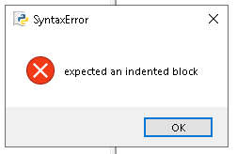
Examples
x=5
if x>=10:
print(x)
else:
print(“no values found”)
#include <stdio.h>
int main()
{
if(a==5)
{
printf(“%d”,a);
}
else
{
printf(“a is not equal to 5);
}
return 0;
}
Output : 5

Slide 4
The number of spaces is up to you as a programmer, the most common use is four, but It has to be at least one
You have to use the same number of spaces in the same block of code, otherwise Python will give you an error
#other example for no.of spaces
x=5
if x>=5:
print(x)
else:
print(“no”)
Output:
5

Slide 5
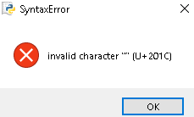
mark=90
if mark>=40:
print(“name ; monisha.s”)
print(“status : pass”)
else
print(“name : monisha.s”)
print(status : fail”)
Output:

Slide 6
Python Comments

Slide 7
Types: Single line Comments Multi line Comments
"""
Python Comments Lectured By Monisha.S
Date : 09-12-2022
Types of comments:
* Single line Comments
* Multi line Comments
"""
a=10
b=40
#addition of a and b
c=a+b
#display the sum of a and b
print(c)
Comments can be used to explain Python code
Comments can be used to make the code more readable.
Comments can be used to prevent execution when testing code

