Slide 1
While Loop Break and Continue
In Tamil
Lectured By
Monisha.S

Slide 2
While Loop :
With the while loop we can execute a set of statements as long as a condition is true.
Syntax
while (condition):
body
increasing or decreasing statement

Slide 3
Example 1:
con=1
n=10
while(con<n):
print(con)
con=con+1
Loop | Condition Status | Increment | Output
1 | 1<10 | True | 1
2 | 2<10 | True | 2
3 | 3<10 | True | 3
4 | 4<10 | True | 4
5 | 5<10 | True | 5
6 | 6<10 | True | 6
7 | 7<10 | True | 7
8 | 8<10 | True | 8
9 | 9<10 | True | 9
10 | 10<10 | False | Out of loop

Slide 4
Example 2 Using Break Statement
con=1
n=10
while(con<n):
if(con==5):
break
print(con)
con=con+1
Loop | Condition -1 (con<n) | Status | Output | Condition 2 (Con==5)
1 | 1<10 | True | 1 | True
2 | 2<10 | True | 2 | True
3 | 3<10 | True | 3 | True
4 | 4<10 | True | 4 | True
5 | 5<10 | True | 5 | False(Out of Loop)

Slide 5
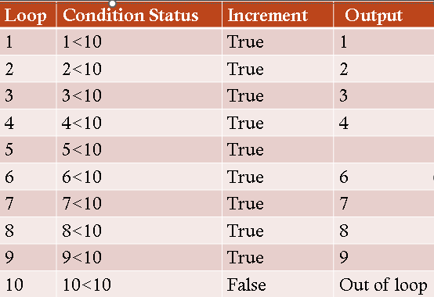
Example 3 Using Continue Statement
con=1
n=10
while(con<n):
if(con==5):
con=con+1
continue
print(con)
con=con+1

Slide 6
Practice Problem
Output Should be
1*2=2
2*2=4
3*2=6
.
.
.
10*2=20

Slide 7
Thank You ☺

