Slide 1
Introduction to Object Oriented Programming In Python
In Tamil
By
Monisha S

Slide 2
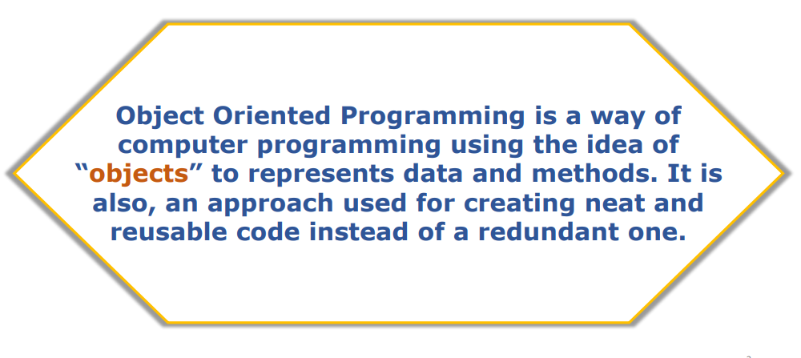
Introduction to Object Oriented Programming in Python

Slide 3
Object-Oriented Programming methodologies
• Inheritance
• Polymorphism
• Encapsulation
• Abstraction

Slide 4
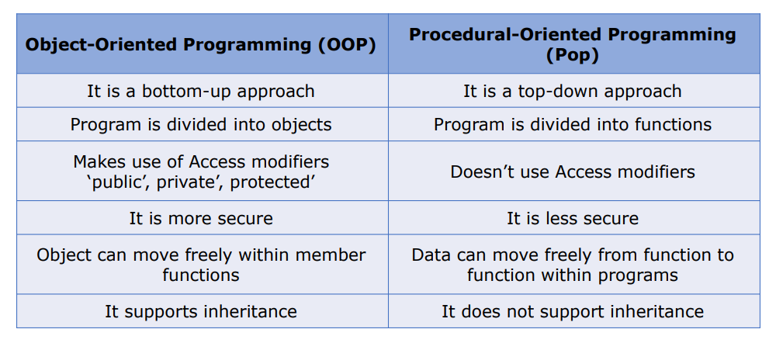
Difference between Object-Oriented and Procedural Oriented Programming

Slide 5
Advantages of Object-Oriented Programming
Modularity for easier troubleshooting
Reuse of code through inheritance
Flexibility through polymorphism
Effective problem solving

