Slide 1
Python Inheritance Type : Single PART - 1
In Tamil
By
Monisha S

Slide 2
INHERITANCE
Inheritance allows us to define a class that inherits all the methods and properties from another class.
Parent class is the class being inherited from, also called base class.
Child class is the class that inherits from another class, also called derived class.

Slide 3
Types Of Inheritance
Single Inheritance
Multi-Level inheritance
Multiple inheritance
Hierarchical inheritance
Hybrid inheritance

Slide 4
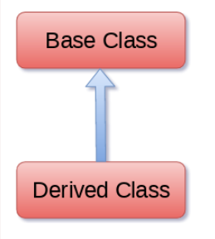
SINGLE INHERITANCE
A derived class is derived only from a single parent class and allows the class to derive behavior and properties from a single base class.
Syntax:
Class BaseClass:
{Body}
Class DerivedClass(BaseClass):
{Body}

Slide 5
Example:
class Animal:
def speak(self):
print("Animal Speaking")
#child class Dog inherits the base class Animal
class Dog(Animal):
def bark(self):
print("dog barking")
d = Dog()
d.bark()
d.speak()

