Slide 1
Monisha.H
Personality Prediction Through CV

Slide 2
PERSONALITY PREDICTION THROUGH CV
The "Personality Prediction through CV" project is centered around creating a platform that forecasts personality characteristics by leveraging the Big Five model and data extracted from CVs. This initiative targets enhancing the assessment of candidates and easing the burden in recruitment procedures.
Through the utilization of Natural Language Processing (NLP) methods for CV analysis and logistic regression for model development, the system offers a holistic approach to evaluating candidates based on their personality traits.
Its main components include effective CV analysis, precise model training, and a user-friendly interface for simplified candidate selection.
Moreover, the system allows for data storage in Excel format to facilitate further examination and comparison of candidate profiles.

Slide 3


AGENDA
PROBLEM STATEMENT
PROJECT OVERVIEW
END USERS
SOLUTION AND ITS VALUE PROPOSITION
THE WOW IN A SOLUTION
MODELLING
RESULTS
3/21/2024 Annual Review

Slide 4

PROBLEM STATEMENT
We aim to develop a system that predicts personality traits OCEAN (Openness, Conscientiousness, Extraversion, Agreeableness, Neuroticism) based on resumes and additional data. This system will significantly reduce the workload in the hiring process by providing a comprehensive candidate evaluation. By leveraging Natural Language Processing (NLP) techniques, the system will parse resumes, extract relevant information, and utilize logistic regression for model training. The system will be implemented in Python, utilizing libraries such as pandas, numpy, tkinter, and pyresparser. Key features include resume parsing, model training, and a user-friendly interface. Additionally, the system will store data in Excel for further analysis.

Slide 5

PROJECT OVERVIEW
The project aims to develop a system that predicts an individual's personality traits based on the Big Five Personality Traits model (Openness, Conscientiousness, Extraversion, Agreeableness, Neuroticism) using their resume and additional data.
This system targets various business areas requiring expert candidates, aiming to reduce the workload of hiring, training, and firing departments.
By employing Natural Language Processing (NLP) techniques, the system will parse resumes, extract relevant information, and use logistic regression for model training.
Implemented in Python, utilizing libraries such as pandas, numpy, tkinter, and pyresparser, key features include parsing resumes, model training, and providing a user-friendly interface.
The system will also allow administrators to easily shortlist candidates based on their personality scores, aiding in the selection of suitable candidates for specific job profiles, with data stored in Excel for further comparison and sorting.

Slide 6
WHO ARE THE END USERS?
The end users of this system are professionals involved in the hiring process within organizations including ,
HR departments,
Hiring managers, and
Recruitment teams
They will benefit from the system's ability to predict personality traits based on resumes and additional data, aiding in the selection of candidates who are the best fit for specific job profiles.
They are the individuals who will interact with the system to use its features and functionalities for the purpose of selecting candidates for job roles based on predicted personality traits.

Slide 7

MY SOLUTION AND ITS VALUE PROPOSITION
SOLUTION:
Our solution is a comprehensive system that predicts an individual's personality traits (Openness, Conscientiousness, Extraversion, Agreeableness, Neuroticism) based on their resume and additional data. It leverages NLP to parse resumes, extract information, and train a model using logistic regression. By focusing on personality traits, our system provides a holistic approach to candidate selection, aiding in identifying the right candidate for the job.
VALUE PROPOSITION:
Efficiency: Reduces hiring workload by automating personality assessment.
Accuracy: Utilizes the Big Five Personality Traits model for reliable predictions.
Comprehensive Evaluation: Considers both qualifications and personality for candidate selection.
User-Friendly: Easy-to-use interface for administrators to shortlist candidates.
Cost-Effective: Saves time and resources in the candidate selection process.

Slide 8

THE WOW IN MY SOLUTION
The wow factor in this solution lies in its integration of Natural Language Processing (NLP) techniques to parse resumes and extract relevant information. By combining NLP with the Big Five Personality Traits model and logistic regression, the system provides a comprehensive and automated way to assess candidates' personalities.
This not only reduces the workload of hiring departments but also enhances the selection process by considering key personality traits alongside qualifications. The user-friendly interface and data storage capabilities further enhance its value proposition, making it a valuable tool for businesses seeking to optimize their recruitment processes.
3/21/2024 Annual Review

Slide 9
MODELLING
The modeling involves using logistic regression to predict personality traits based on the OCEAN values and additional data extracted from resumes.
The system utilizes the Big Five Personality Traits model, which measures key dimensions of personalities.
Using the extracted data, the system trains a model to predict the personality traits of individuals.
The logistic regression model is trained on a dataset containing gender, age, and scores for openness, conscientiousness, extraversion, agreeableness, neuroticism, and experience.
This modeling approach allows for the prediction of personality traits, which can be valuable in various business areas for selecting the right candidate for a job profile.

Slide 10
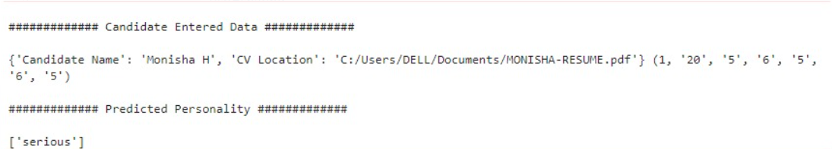
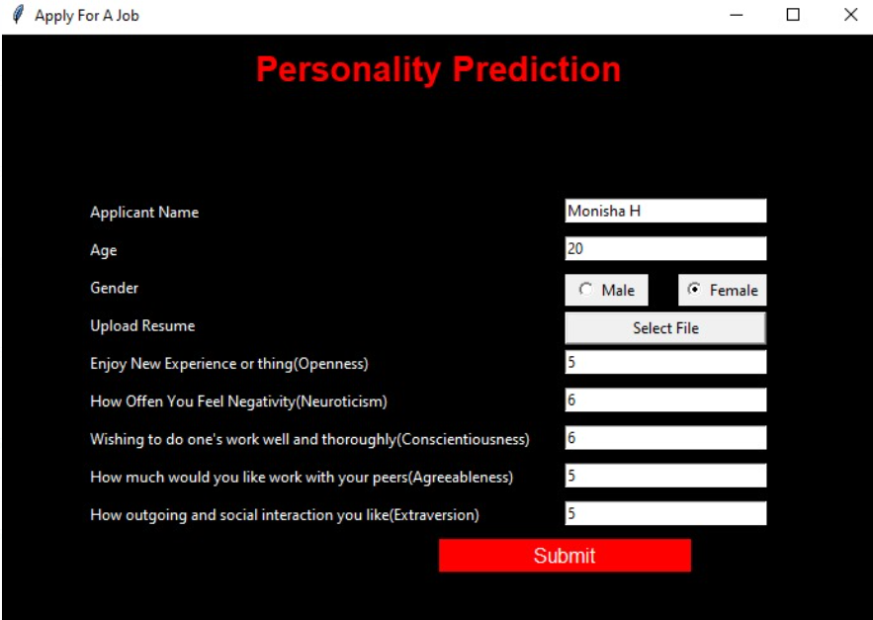
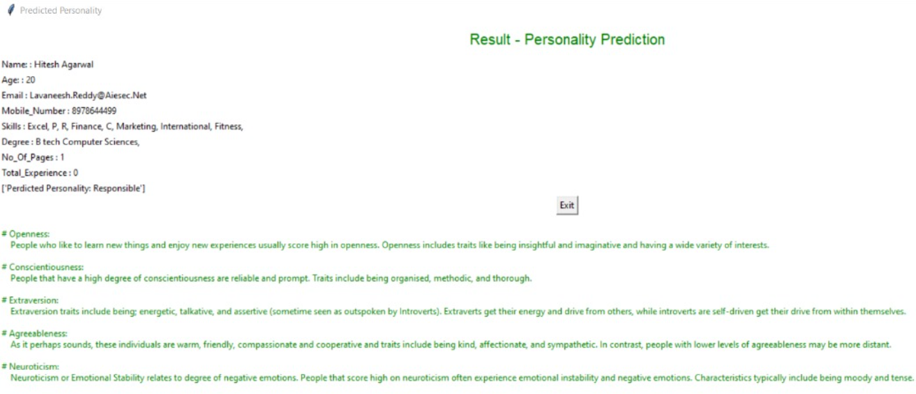
RESULTS
Demo Link

