Slide 1
MONISHA .H
SATELLITE IMAGE CNN CLASSIFIER

Slide 2
SATELLITE IMAGE CNN CLASSIFIER
The Satellite Image CNN Classifier is a deep learning model designed to automatically categorize land cover types in satellite images with high accuracy and efficiency.
By utilizing Convolutional Neural Networks (CNNs), the classifier can extract intricate patterns, textures, and spatial relationships from multi-channel satellite image data without the need for manual feature engineering.
This approach allows the classifier to achieve remarkable precision in classifying land cover types, such as forests, urban areas, water bodies, and agricultural fields.
The model's ability to learn from large-scale satellite datasets and adapt to different environmental conditions makes it a valuable tool for various applications, including environmental monitoring, urban planning, agriculture, disaster response, and commercial analysis.

Slide 3

AGENDA
PROBLEM STATEMENT
PROJECT OVERVIEW
END USERS
SOLUTION AND ITS VALUE PROPOSITION
THE WOW IN A SOLUTION
MODELLING
RESULTS
3/21/2024 Annual Review

Slide 4

PROBLEM STATEMENT
Develop a Satellite Image Classification system using Convolutional Neural Networks (CNN) in Python via Gen AI. The system should be capable of accurately categorizing satellite images into predefined classes such as urban areas, forests, water bodies, and agricultural land. The model should be trained on a labeled dataset of satellite images and optimized to achieve high classification accuracy, while also being efficient in terms of computational resources and memory usage. The goal is to create a robust and scalable solution for automated satellite image classification that can be deployed in real-world applications such as land use monitoring, environmental analysis, and urban planning.

Slide 5

PROJECT OVERVIEW
The satellite image classification project using CNNs aims to categorize satellite images into predefined classes. It involves data collection from sources like Sentinel-2, preprocessing for standardization, CNN model development (e.g., VGG, ResNet), training with optimization algorithms, and evaluation for accuracy. Deployment integrates the model for real-time or batch classification. Thorough testing, documentation, and reporting ensure the system's reliability and scalability, with applications in environmental monitoring, urban planning, and disaster response.

Slide 6

WHO ARE THE END USERS?
Environmental Monitoring Agencies: These government bodies use classified satellite images to monitor natural resources, land use changes, and environmental health, aiding in conservation efforts and tracking urban expansion.
Urban Planning Departments: Municipalities utilize the images to assess urban growth, land use patterns, and infrastructure development, supporting sustainable urban planning and zoning decisions.
Agricultural Sector: Farmers and policymakers benefit from the images for crop monitoring, yield prediction, and precision agriculture, aiding in decision-making regarding irrigation, fertilization, and pest management.
Disaster Response and Management Agencies: These agencies leverage the system to assess the impact of disasters like floods and wildfires on infrastructure, vegetation, and communities, aiding in effective response planning.
Remote Sensing Researchers: Scientists utilize the images for academic studies, modeling, and analyzing trends in land cover and land use change, contributing to the field of remote sensing and environmental science.
Commercial Applications: Industries such as real estate, insurance, forestry, mining, and infrastructure development integrate the system for site selection, risk assessment, asset management, and market analysis, supporting informed business decisions.

Slide 7

MY SOLUTION AND ITS VALUE PROPOSITION
MY Solution
I propose a satellite image classification system using a Convolutional Neural Network (CNN) tailored for land cover classification. The system will leverage multi-channel satellite image data, utilizing a custom CNN architecture optimized for this specific task. Transfer learning from pre-trained models will be employed to enhance performance, and hyperparameter tuning will be used to optimize the model.
Value Proposition:
Improved Accuracy: By using a custom CNN architecture tailored for land cover classification, the system aims to achieve higher accuracy in satellite image classification tasks.
Efficient Resource Utilization: Leveraging transfer learning from pre-trained models and hyperparameter tuning will help optimize the model's performance, making efficient use of computational resources.
Scalability and Adaptability: The system will be scalable and adaptable to different geographic regions and environmental conditions, making it a valuable tool for various stakeholders and organizations.
Real-time Analysis: The use of CNNs allows for scalable and real-time analysis of large-scale satellite datasets, empowering stakeholders to make informed decisions promptly.
Versatile Applications: The system's versatility extends to its potential applications in environmental monitoring, urban planning, agriculture, disaster response, and commercial sectors, providing a wide range of benefits to end users.

Slide 8

THE WOW IN MY SOLUTION
The wow factor in satellite image classification using Convolutional Neural Networks (CNNs) lies in their ability to autonomously learn intricate features from satellite images, eliminating the need for manual feature engineering.
This enables highly accurate classification of land cover types across diverse landscapes with remarkable precision and efficiency.
CNN-based classification facilitates scalable and real-time analysis of large satellite datasets, empowering stakeholders in environmental monitoring, urban planning, agriculture, disaster response, and commercial sectors.
Its adaptability across different geographic regions and environmental conditions makes it a transformative tool for global land cover monitoring and sustainable development initiatives.

Slide 9
MODELLING
Input Data: Satellite images are the CNN model's input, represented as multi-channel arrays, where each channel corresponds to a specific spectral band (e.g., red, green, blue, near-infrared).
Architecture Selection: Choose a CNN architecture (e.g., VGG, ResNet) based on the classification task complexity, available resources, and performance needs.
Layer Configuration: Configure layers (convolutional, pooling, activation, normalization) to extract features from satellite images.
Training Strategy: Define optimization algorithm, learning rate, batch size, and epochs. Monitor training using metrics like loss and accuracy.
Transfer Learning: Optionally, use pre-trained models (e.g., ImageNet) and fine-tune them for satellite image classification.
Loss Function: Select a loss function (e.g., cross-entropy) to measure model performance during training.
Evaluation Metrics: Define metrics (e.g., accuracy, precision, recall, F1-score) to evaluate model performance on a validation dataset.
Hyperparameter Tuning: Optimize hyperparameters using techniques like grid search or automated methods.

Slide 10
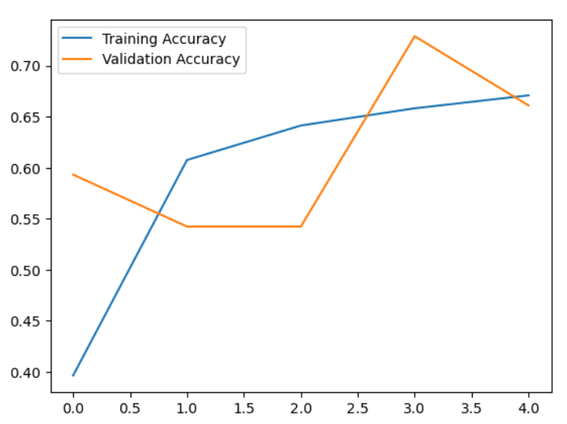
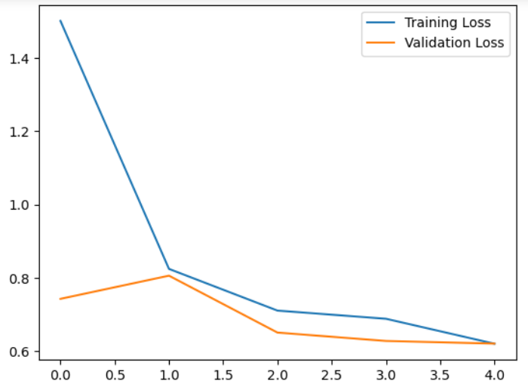
RESULTS

Slide 11
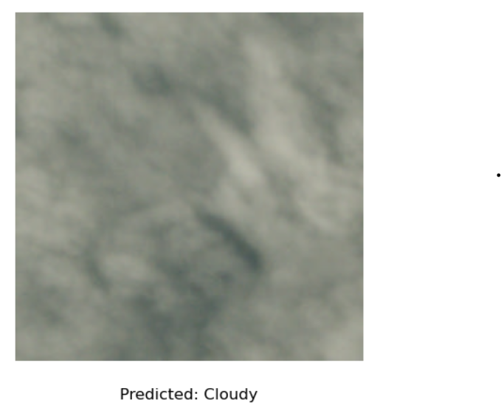
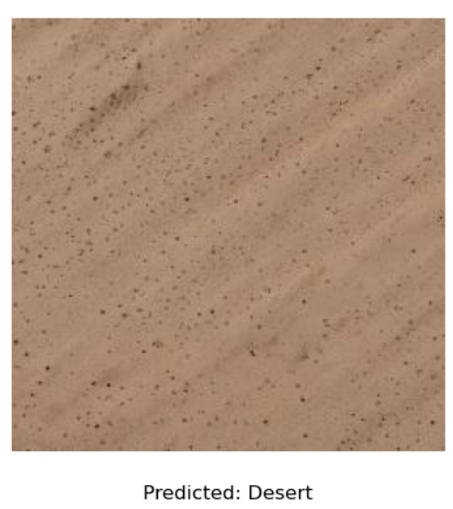
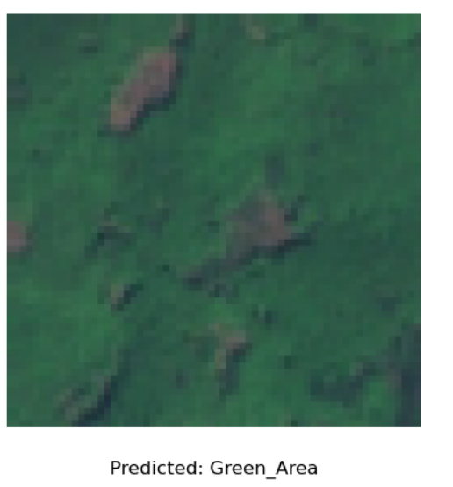

Demo Link

