Slide 1
Employee Data Analysis using Excel
STUDENT NAME: V. MONISHA
REGISTER NO: 312201859
DEPARTMENT: B.COM (GENERAL)
COLLEGE: SINDHI COLLEGE OF ARTS AND SCIENCE

Slide 2
PROJECT TITLE
Employee Performance Analysis using Excel

Slide 3


AGENDA
Problem Statement
Project Overview
End Users
Our Solution and Proposition
Dataset Description
Modelling Approach
Results and Discussion
Conclusion
3/21/2024 Annual Review

Slide 4

PROBLEM STATEMENT
The project aims to create an Excel-based system for employee performance analysis, providing structured data entry, automated calculations, and visual dashboards to streamline performance tracking, reduce errors, and enable data-driven decision-making for management.

Slide 5

PROJECT OVERVIEW
The objective is to develop an Excel-based tool for efficient employee performance analysis, automating calculations, and providing visual dashboards to enable data-driven decision-making and improve productivity.

Slide 6

WHO ARE THE END USERS?
HR Managers
Line Managers
Team Leads
Training and Development Professionals
Senior Leaders
Employees

Slide 7

OUR SOLUTION AND ITS VALUE PROPOSITION
SOLUTION:
Employee performance analysis system
VALUE PROPOSITION: 1.Streamline Performance Management 2.Data-Driven Insights 3.Improved Employee Engagement 4.Talent Optimization 5.Scalability and Flexibility

Slide 8
Dataset Description
DATASET NAME :
Employee performance Data DESCRIPTION:
This dataset contains employee performance data including: 1.Employee Information: Employee ID, Name, Job Title , Department, Location. 2.Performance Metrics: Sales Performance , Customer Satisfaction ,Quality Ratings , Attendance , Training Completion. 3.Goal Setting: Individual Goals, Teams Goals , Company Goals. 4.Feedback and Coaching : Manager Feedback , peer Feedback, Self- Assessment. 5.Development Planning: Training Needs, Career Development Plans Succession Planning. 6. Performance Evaluations; Regular Performance Reviews, 360-Degree.

Slide 9

THE "WOW" IN OUR SOLUTION
Focusing on the “WOW” factor in your solution can help highlight its unique value proposition and different it from other solutions. Here are some potential “WOW” factor for the Employee Performance Analysis System. 1.Predictive Analytics 2. Real-time Feedback 3.Personalized Development Plans 4.360- Degree Visibility 5.Automation and Efficiency 6.User-Friendly Interface 7.Integration and scalability 8.Integration and Scalability 9.Actionable Recommendations 10.Continuous Improvement
3/21/2024 Annual Review
9

Slide 10
MODELLING
This dataset contains employee performance data including: 1.Employee Information: Employee ID, Name, Job Title , Department, Location. 2.Performance Metrics: Sales Performance , Customer Satisfaction ,Quality Ratings , Attendance , Training Completion. 3.Goal Setting: Individual Goals, Teams Goals , Company Goals. 4.Feedback and Coaching : Manager Feedback , peer Feedback, Self- Assessment. 5.Development Planning: Training Needs, Career Development Plans Succession Planning. 6. Performance Evaluations; Regular Performance Reviews, 360-Degree.
10

Slide 11
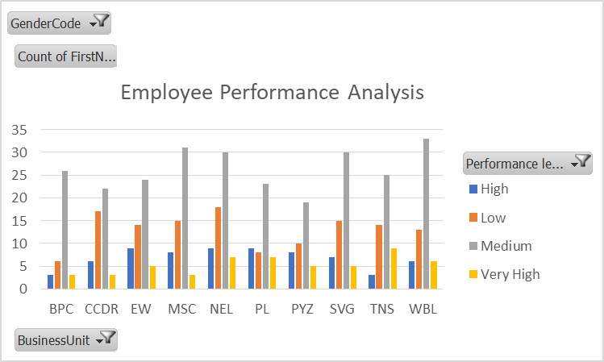
RESULTS
11

Slide 12
conclusion
The Employee performance Analysis System is a game-changing solution that transforms the way organizations approach talent management. By harnessing the power of advanced analytics , automation , and AI-driven insights , this system unlocks the hidden potential of employees, amplifies business performance, and fuels sustainable growth

