Slide 1
B.MONISHA
Final Project
3/21/2024 Annual Review

Slide 2
BRAIN TUMOUR DETECTION
3/21/2024 Annual Review

Slide 3


AGENDA
Problem Statement
Project Overview
End users
The wow factor
Modelling
Result
3/21/2024 Annual Review

Slide 4

PROBLEM STATEMENT
The objective of this project is to develop a system capable of detecting brain tumors from medical images such as MRI scans. Brain tumors are abnormal growths inside the skull that can be either benign (non-cancerous) or malignant (cancerous). Early detection of brain tumors is crucial for effective treatment and patient prognosis.
3/21/2024 Annual Review

Slide 5

PROJECT OVERVIEW
Developing a deep learning-based system capable of analyzing MRI scans to automatically detect and localize brain tumors.
Implementing preprocessing techniques to enhance the quality of MRI images before feeding them into the deep learning model.
3/21/2024 Annual Review

Slide 6

WHO ARE THE END USERS?
Medical Professionals
The brain tumor detection system is designed to cater specifically to the following medical professionals who diagnose and treat brain tumors:
Radiologists
Neurologists
Clinical Decision Making:
3/21/2024 Annual Review

Slide 7

YOUR SOLUTION AND ITS VALUE PROPOSITION
Value Proposition:
Early Detection: By automating the process of brain tumour detection, the system enables early diagnosis and intervention, leading to improved patient outcomes and survival rates.
Accuracy and Reliability: Leveraging advanced deep learning algorithms, the system offers high accuracy and reliability in detecting brain tumours, assisting medical professionals in making informed diagnostic decisions.
Time Efficiency: The automated detection process significantly reduces the time required for interpreting MRI scans, enabling healthcare providers to prioritize patient care and treatment planning.
Deep Learning Model: A sophisticated convolutional neural network (CNN) is employed to analyze MRI images and identify regions indicative of brain tumours.
Preprocessing Pipeline: MRI images undergo preprocessing steps such as noise reduction, normalization, and enhancement to ensure optimal input quality for the deep learning model.
3/21/2024 Annual Review

Slide 8

THE WOW IN YOUR SOLUTION
Advanced Deep Learning Technology
The use of state-of-the-art deep learning techniques, particularly convolutional neural networks (CNNs),
. Efficiency and Time Savings
Automating the tumour detection process reduces the time required for medical professionals to interpret MRI scans.
Early Detection and Improved Outcomes
The ability of the system to detect brain tumours at an early stage can have a profound impact on patient outcomes.
3/21/2024 Annual Review
8

Slide 9
MODELLING
Data Collection and Preprocessing
Data Acquisition: Gather a diverse dataset of brain MRI scans containing both tumour and non-tumour cases
Data Preprocessing: Preprocess the MRI images to standardize and enhance their quality. This may include resizing, normalization, noise reduction, and contrast adjustment to improve the input data for the deep learning model.. Model Selection
Convolutional Neural Network (CNN): Choose a suitable CNN architecture for tumour detection. Commonly used architectures include:
AlexNet
VGG (Visual Geometry Group)
ResNet (Residual Neural Network)
Inception
3/21/2024 Annual Review
9

Slide 10
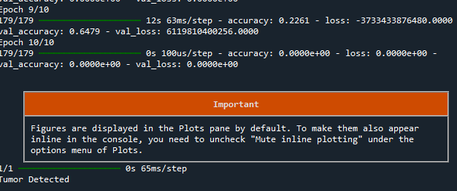
RESULTS
The result of brain tumour detection using deep learning techniques involves evaluating the performance of the trained model on unseen data and assessing its accuracy, reliability, and clinical relevance.
Deep learning represents a significant advancement in medical imaging and diagnostic capabilities. By leveraging sophisticated machine learning algorithms and interpretability techniques.
https://drive.google.com/file/d/1sjF4b6g1qItC8mUMr7WdFJ5oaf9RB1UH/view?usp=sharing
3/21/2024 Annual Review
10

