Slide 1
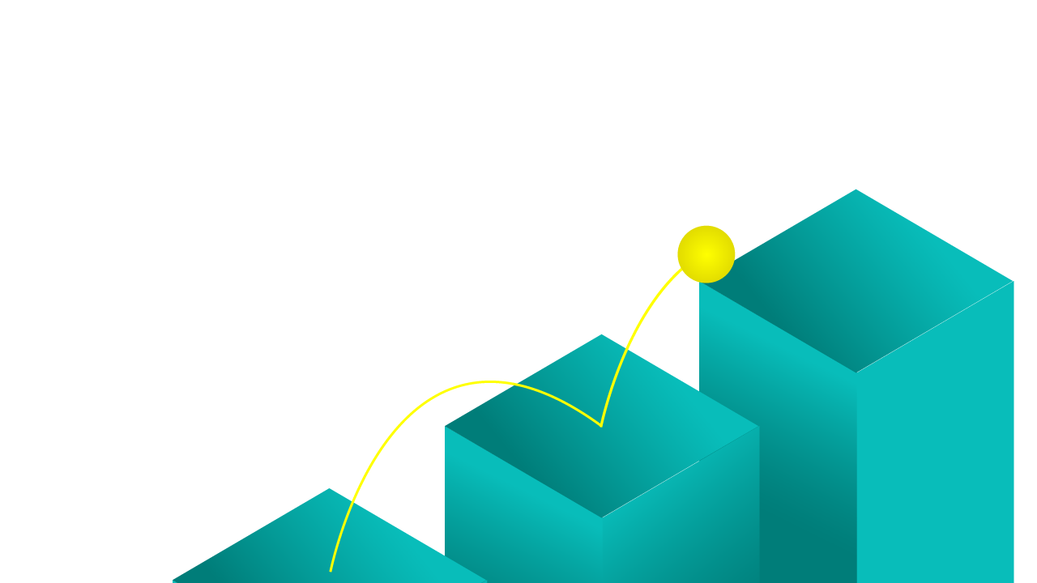

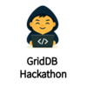
Connect, Optimize, Grow
Smart Factory IoT Pulse Platform​
using Azure & GridDB​
February 1st, 2026

Slide 2
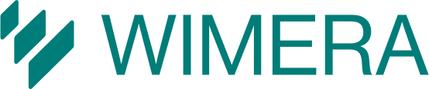
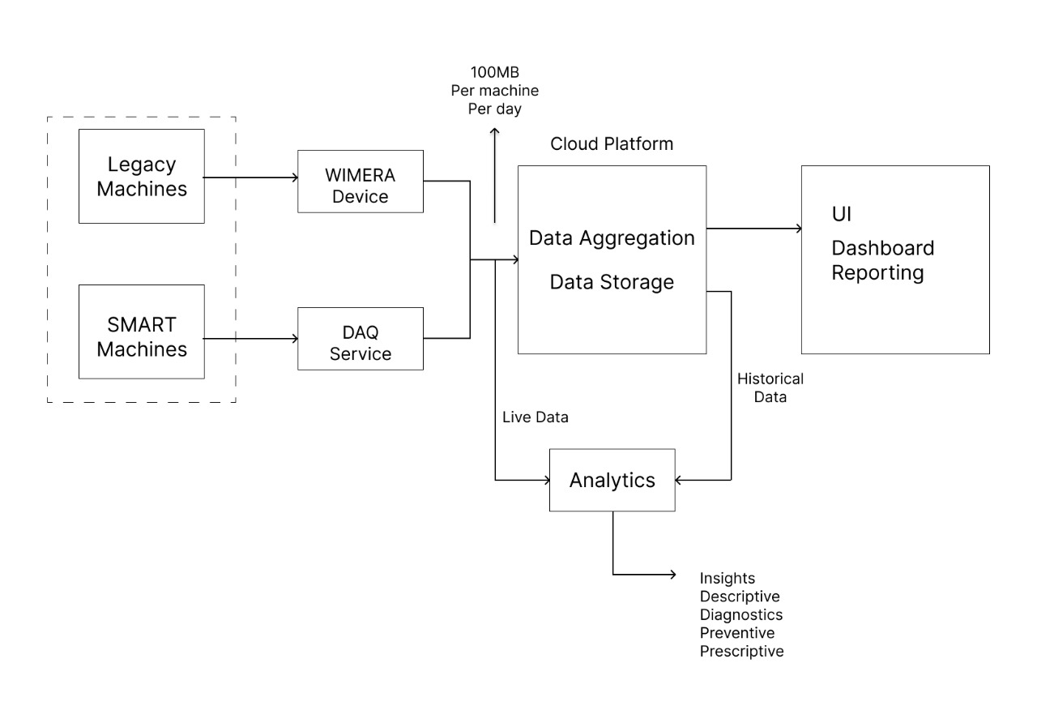
AT A GLANCE
# of Machines | Data Size Per day
10 | 1 GB
100 | 10 GB
1000 | 100 GB
10000 | 1 TB
Notes:
Factories generate massive amounts of machine data every second—status updates, production counts, energy usage, vibrations, and more. But most plants still have zero real-time visibility into what is happening on the shop floor. Machines fail silently, energy is wasted, and decisions rely on yesterday’s reports instead of today’s data. We wanted to solve this problem by creating a single system that could bring live insights, analytics, and intelligence to any manufacturing environment.

Slide 3
PROBLEM STATEMENT
IoT customers demand more than raw data—they want insights into
what happened
what’s happening now
what will happen next
and what they can do about it
When millions of time-series records stream in every millisecond, traditional databases hit their limits—performance drops, scalability fails.
The challenge: build systems and tools leveraging a database that is scalable, high-performing, and always available to unlock the true power of IoT.
Notes:
Hook/Problem: Technology availability are driving industries to accelerate the adoption of highly scalable and low cost IoT solutions. Customer expectations are very high – expecting to solve every problem they face during the entire production life cycle, and are expecting real time visibility into what is happening on the floor, what had happened in the past. Even more, they just don’t want the system to tell them what happened, and what is happening, they want to know what will happen and what can they do about it – ultimately maximising the productivity and profit.
To make their dream a reality, IoT solutions providers are required to collect massive amount of data from every machines and utilities (like quality of the material, performance and availability of the machines, temperature, pressure, current, people, etc). We are talking massive.. In GBs per minutes. The challenge for the solution provider is to collect, process and store this data often complex series. Add to that the need to access the data for analytics and ML models are increasing.
We need scalable infrastructure with high availability and reliability at reduced cost.
Traditional DBs struggle with processing such data. We are looking at GridDB to support storing, processing high frequency data.
Solution :
At wimera, we are building end to end data flow with gridDB as storage. With GridDB, we will be able to handle the large volume of data. Add other advantage of GridDB.
What is our WOW factor ?
Impact:
This will help ensure that our enterprise customers’ data are reliably stored and available at anytime.
We can run large scale analytics pipeline without any impact.
Differentiation :
Why this solutions is better than others ?
We will be able to scale and meet SLAs. Etc etc
What is next:
Closing:
“We just don’t collect the data – we can store the data at high rate and store for good and forever use if for anything………. With GridDB”
We are confident that we can power our IoT with GridDB to Go Faster and Scale Bigger.

Slide 4
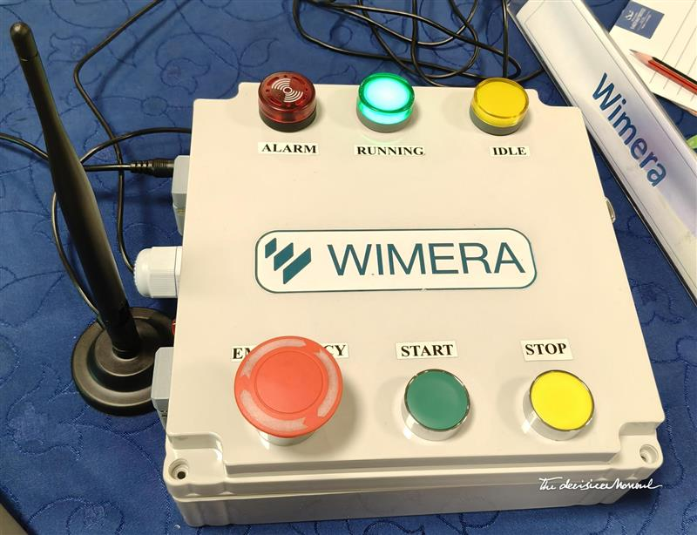
SOLUTION OVERVIEW
IoT Devices send telemetry data (Digital Input Signal, Current, Energy Consumption, Power and Voltage Monitoring) .​
Azure IoT Hub handles ingestion.​
Grid DB stores telemetry & configuration.
​
Angular UI visualizes real-time data.

Slide 5
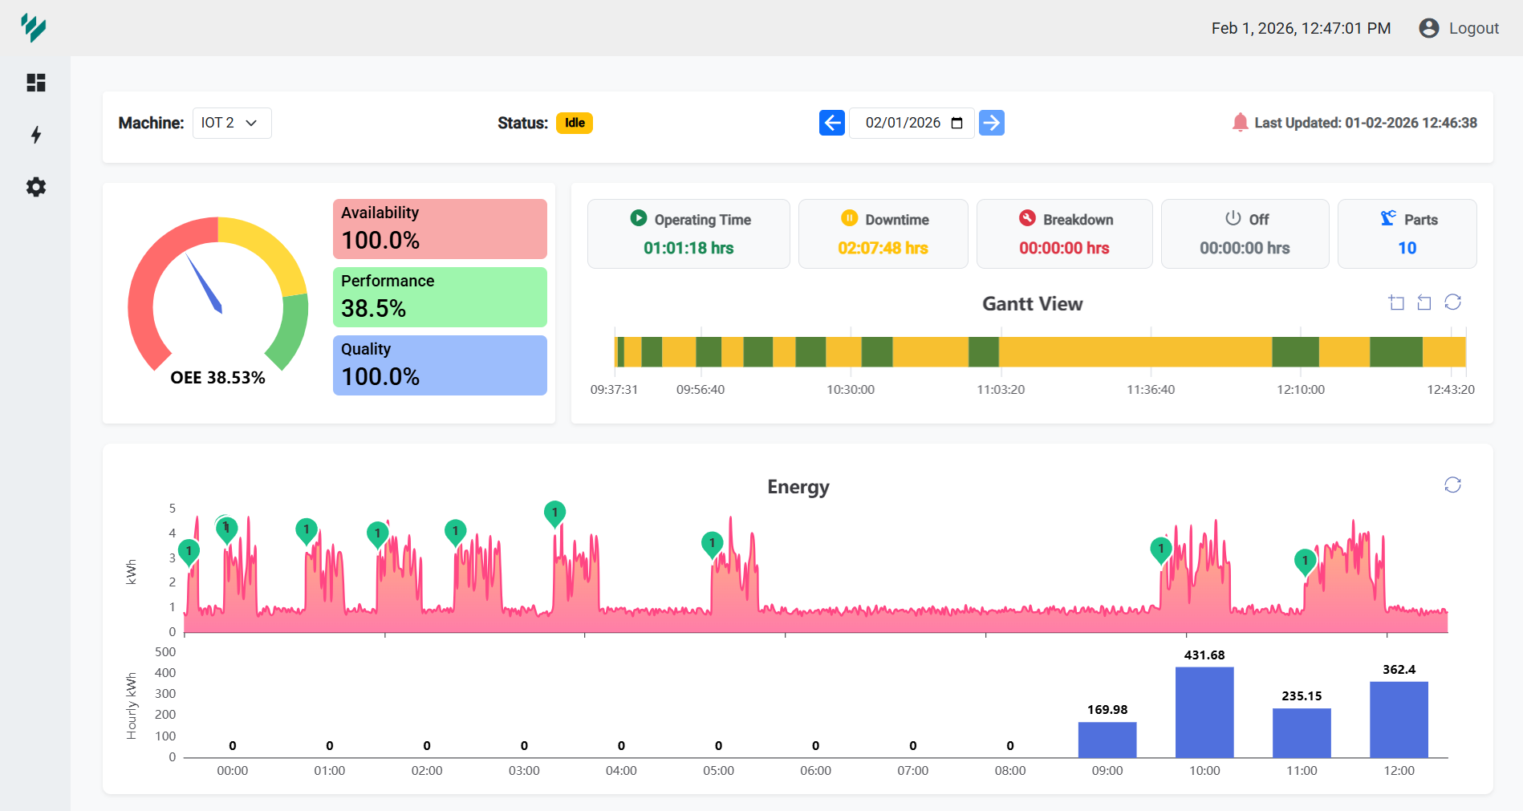
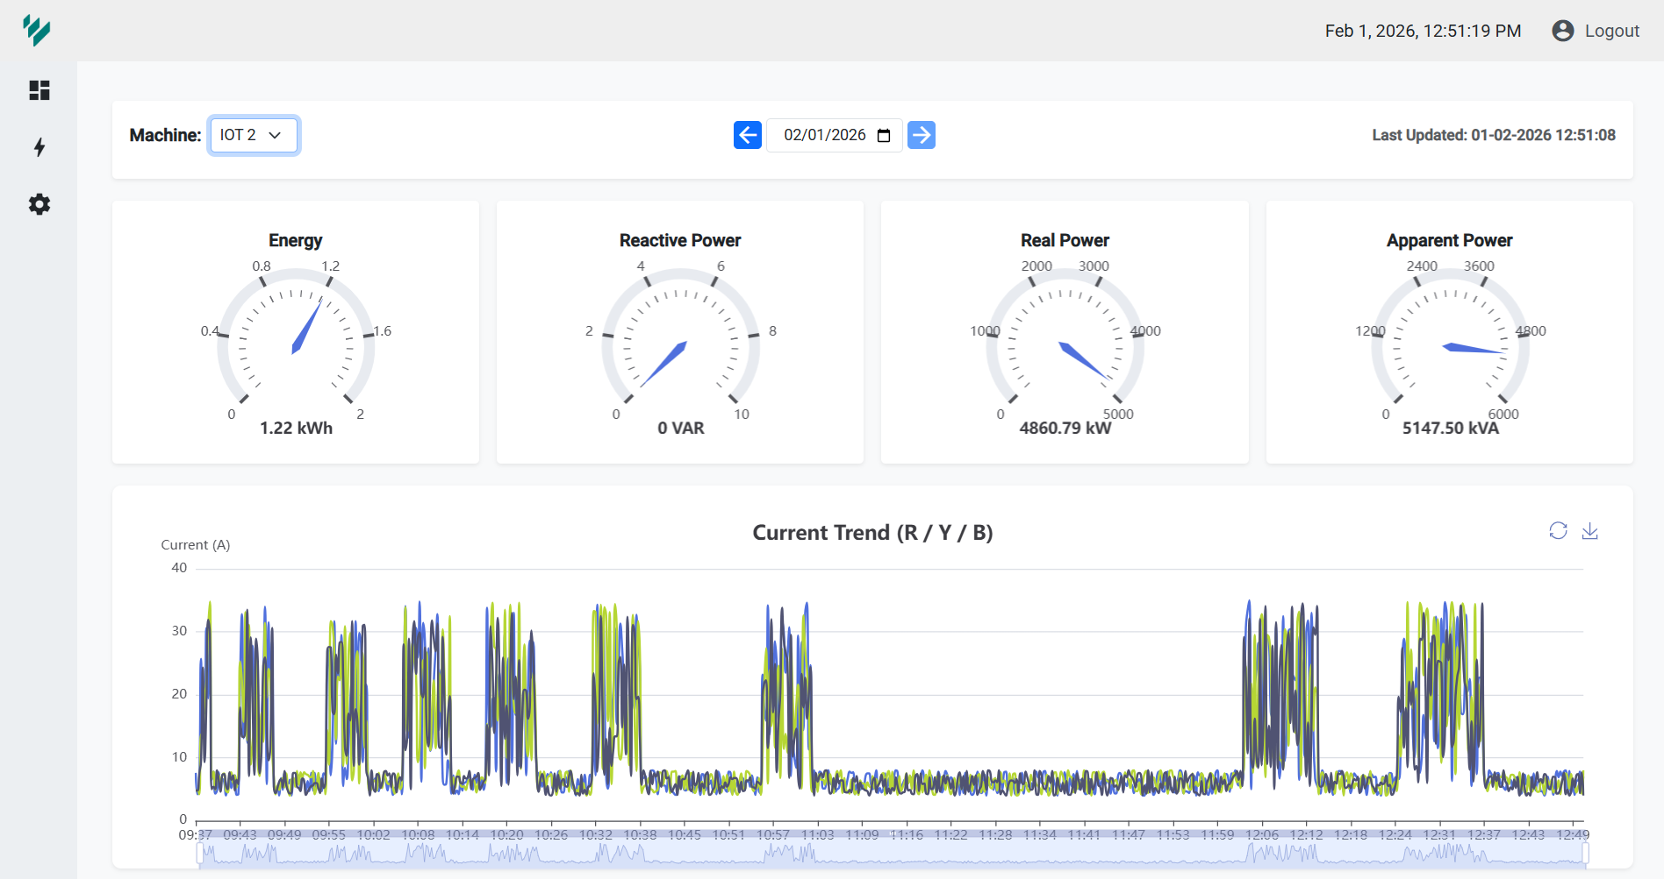
DASHBOARD AND VISUALIZATION
Tenant-based device management
​
Real-time sensor values and device status.
​
Historical trend analysis and reports.​
Angular-based custom dashboard UI.​
Connection status and last-seen tracking.

Slide 6
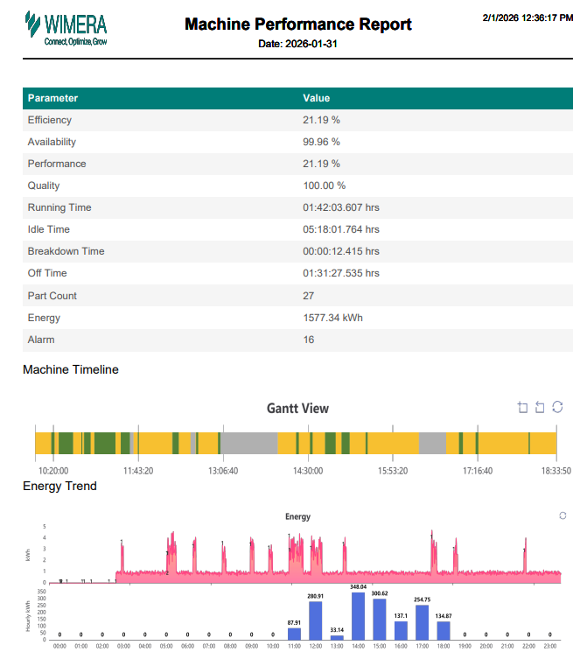
AUTOMATION AND AGGREGATION
Azure Logic Apps used for scheduled processing
Hourly aggregation of raw and calculated data.​
Optimized data availability for reports and dashboards.
Customer can access the Historical report via PDF, Excel or Mail.

Slide 7
DEMO

Slide 8
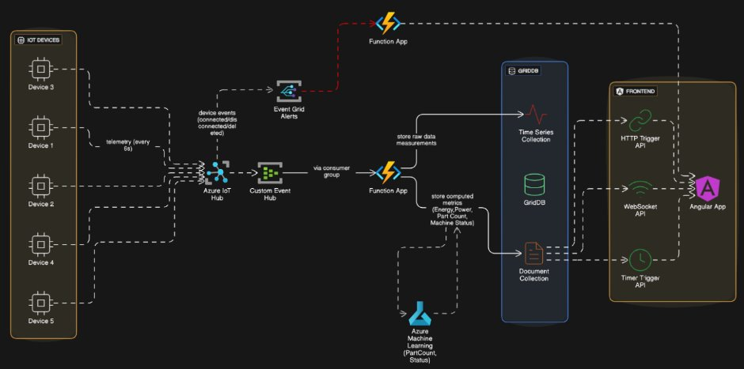
SYSTEM ARCHITECTURE

Slide 9
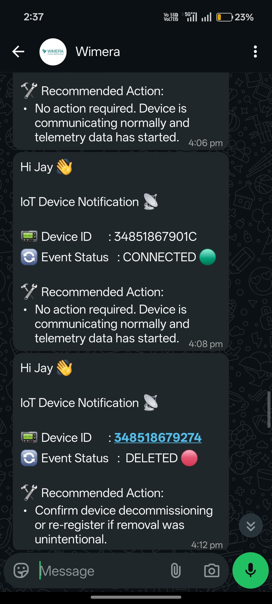
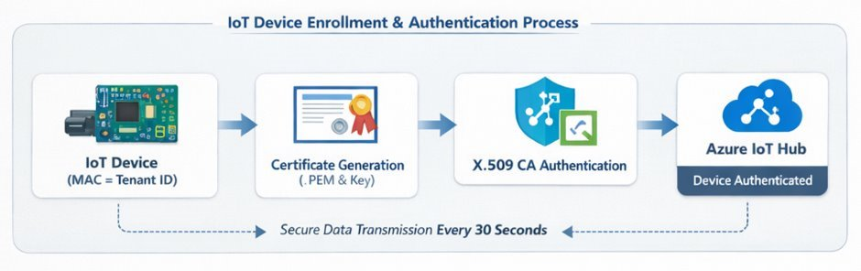
DEVICE REGISTARATION AND AUTHENTICATION
Each device identified using MAC address as Tenant ID
​
X.509 CA-based certificate authentication.​
Certificates (.PEM and private key) generated per device.
Azure IoT Hub validates and authenticates devices.​
Secure data transmission at 250 milli-second intervals.
Data Onboard notification send through any messaging medium (WhatsApp, Mail, etc.)

Slide 10
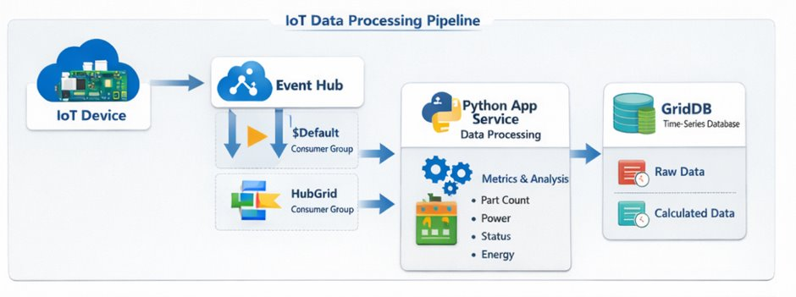
DATA INJECTION FLOW
IoT device publishes telemetry to Azure IoT Hub
​
IoT Hub routes data to Azure Event Hub.​
Multiple consumer groups for scalable processing.​
Python-based App Service consumes and processes events.

Slide 11
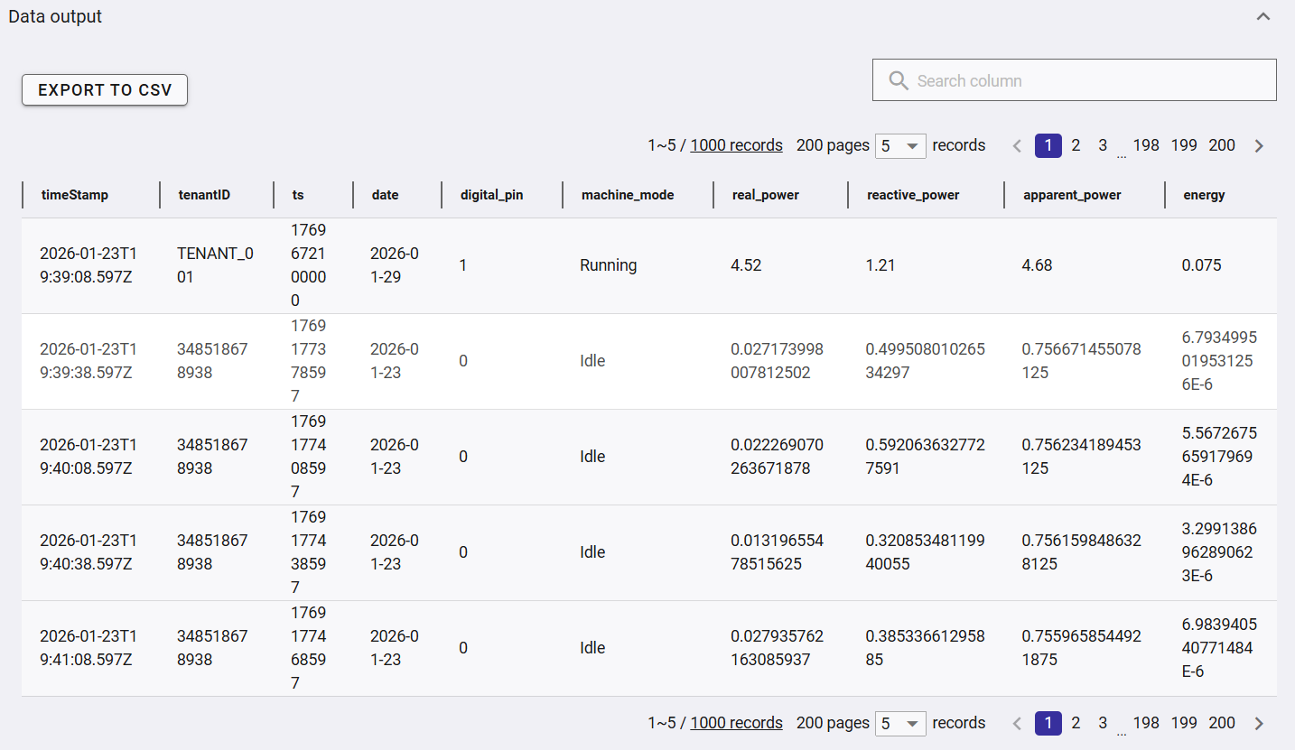
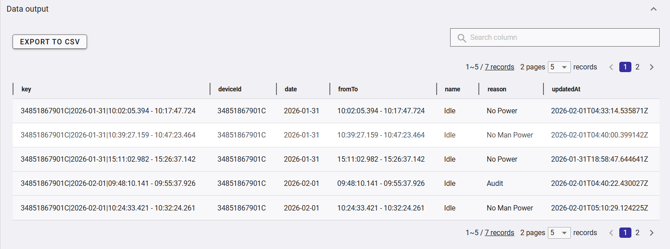
DATA PROCESSING AND STORAGE
Real-time metric calculations: Part Count, Power, Status, Energy
Raw sensor data stored as time-series data.​
Calculated metrics stored as derived time-series data.​
Grid DB used for high-performance time-series storage.

Slide 12
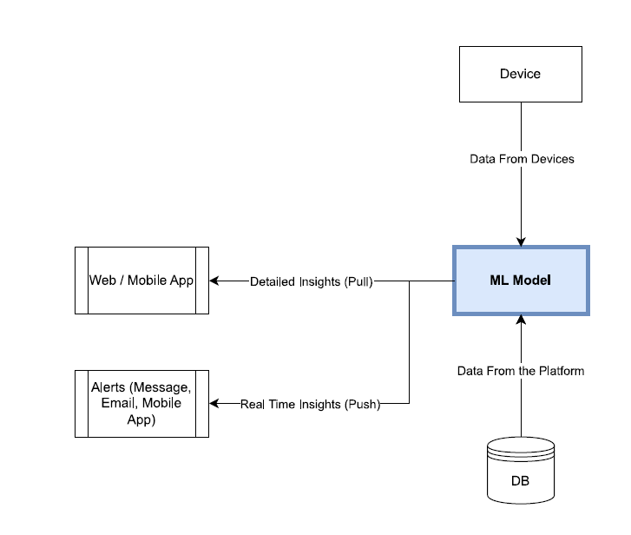
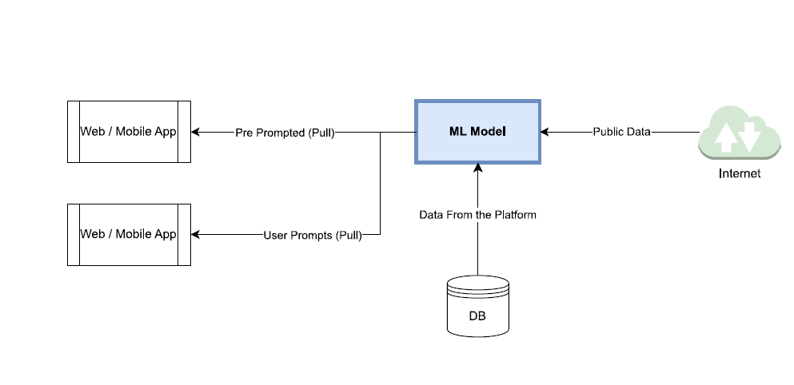
WHAT NEXT
Value Creation by leveraging the power of GridDB
Notes:
IoT customers demand more than raw data—they want insights into
what happened
what’s happening now
what will happen next
and what they can do about it

Slide 13
WHAT NEXT
Unified data store, OnPrem, Cloud and Hybrid
​Free Device
DIY installation kit
Scale to 1000 device per month
Leverage data – bench market, and target services like machine health for insurer
Anomaly detection​
AI/ML on time-series data
Alerts & automation​
Edge device integration
Mobile App

Slide 14

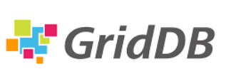
Connect, Optimize, Grow
Go Faster. Grow Bigger.
With GridDB we can deliver the insights to our customers:
what happened - Historical queries at lightning speed
what’s happening now - Live dashboards
what will happen next - Anomaly detection + ML forecasting
and what they can do about it – Alerts, Workflow Triggers, Auto-schedule maintenance, Move load to other Line etc

Slide 15






L175, Sanjeevini, 13th Cross Sector-6, HSR Layout,
Bengaluru, India – 560 102
Follow us on:
https://wimerasys.com

