Slide 1
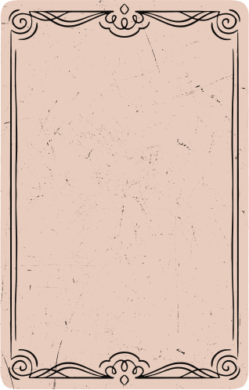

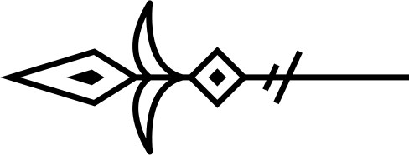
HACK FOR
HUMANITY

Slide 2

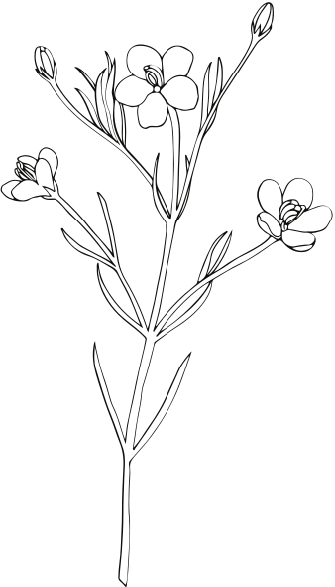
PROBLEM STATEMENT
Alzheimer’s disease affects millions worldwide, gradually erasing their most cherished memories. Patients struggle to recognize loved ones, recall personal experiences, and stay connected to their past. Traditional memory aids like photo albums and notes are passive, failing to provide the emotional engagement needed for recollection.
Current Limitations
❌ Lack of Interactivity: Traditional methods do not provide active engagement.
❌ Emotional Disconnect: Patients struggle to connect static images with memories.
❌ Fragmented Memory Support: Families find it hard to contribute to memory preservation.
❌ Cognitive Decline Progression: Without stimulation, memory loss accelerates.

Slide 3

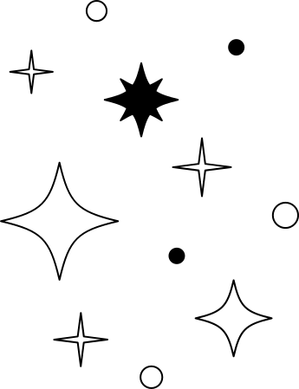
Why This Matters
Memory is more than just data—it defines identity, relationships, and emotional well-being. A better, AI-driven approach is needed to help patients actively retrieve, relive, and emotionally engage with their memories.

Slide 4


PROJECT
🧠 MemoryVault – Preserving Memories, Strengthening Bonds
🎙️ An AI-powered platform helping Alzheimer's patients reconnect with their past through natural conversations and AI-generated visuals.

Slide 5
🎗 WHY WE BUILT MEMORYVAULT?
💙 Inspired by the struggles of Alzheimer's patients
💡 A vision to go beyond static memory aids
🌟 Helping people maintain their identity & emotional bonds
“Memories fade, but connections shouldn’t.”

Slide 6
🚀 What MemoryVault Does
MemoryVault is an AI-powered memory companion designed to help Alzheimer’s patients and their families store, retrieve, and relive precious memories in an interactive and engaging way.
🌟 Key Features & Functionality
🗣️ Conversational Memory Retrieval
Patients can interact with MemoryVault and recall past experiences.
AI understands natural conversations and responds with relevant memories.
🎨 AI-Generated Visual Memories
Converts textual memories into AI-generated images to enhance recollection.
Helps patients visually connect with past moments.
Accessible UI for intuitive navigation.

Slide 7
🚀 What MemoryVault Does
📂 Secure Memory Storage
Stores personal memories in a digital vault with semantic search capabilities.
Organizes memories with tags, metadata, and family contributions.
🏡 Family Collaboration & Preservation
Family members can upload, edit, and organize memories for their loved ones.
Helps create a shared digital scrapbook for generations to come.
🔍 Smart Memory Retrieval
Uses vector embeddings & AI-powered search to find the most relevant memories.
Context-aware responses ensure personalized memory recall.

Slide 8
🚀 How MemoryVault Works
User enters a memory → Provides text and metadata.
Memory is split into chunks → Using CharacterTextSplitter.
Memory is encoded → Converted into embeddings using SentenceTransformer.
Memory is stored in Pinecone → Saved with unique document and chunk IDs.
User queries a memory → Enters a search query.
Query is encoded → Converted into embeddings.
Relevant memories are retrieved → Pinecone fetches the top 5 matches.
AI generates a response → Google Gemini creates a vivid memory recall.
Image is generated → FLUX API creates a visual representation.
Response is sent to the user → AI-generated text and image are returned.

Slide 9
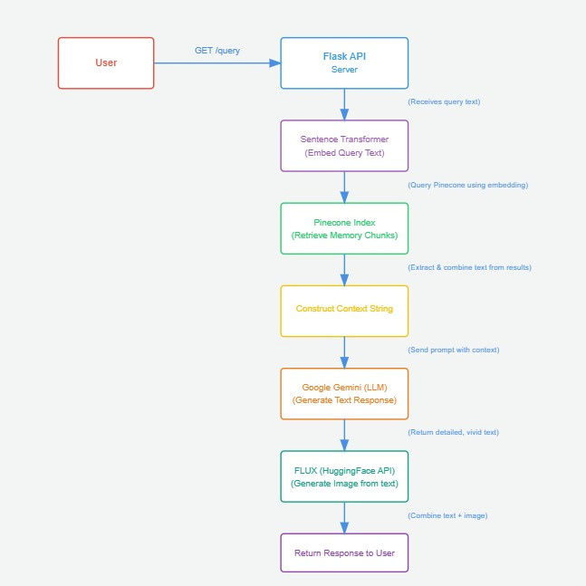

Slide 10
TECHNICAL ARCHITECTURE
🛠Frontend (React)
Built With...
🛠 Our Tech Stack
✅ Flask – Backend API
✅ Python – Core logic
✅ Pinecone – Vector memory search
✅ Google Gemini Pro – Conversational AI
✅ FLUX API – AI image generation
✅ React + Vercel – Frontend
🛠 Backend (Flask + Python)
✅ RESTful API for memory storage & retrieval
✅ SentenceTransformer for vector embeddings
✅ Pinecone vector database for efficient search
✅ Google Gemini Pro for natural conversation
✅ FLUX API for AI-generated memory visuals

Slide 11
WHAT’S NEXT FOR MEMORYVAULT?
🚀 Upcoming Features & Enhancements
🎙️ Voice Interactions – Talk & listen to memories
📂 Advanced Memory Organization – Categorization & tagging
🕶️ Virtual Reality (VR) Support – Immersive memory reliving
📱 Mobile Application – On-the-go access to stored memories
🌍 Expanding to New Audiences
🏥 Partnering with healthcare providers
🎓 Collaborating with research institutions
🔒 Enhancing security & privacy features

Slide 12



GitHub
https://github.com/Monishg2004/MemoryVault.git
Youtube
https://youtu.be/3EWIQxljLpQ

Slide 13


Thank You

