Slide 1



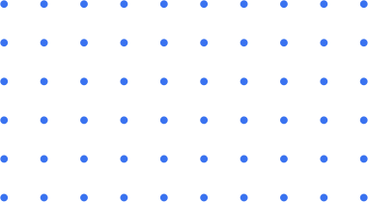
AI MOCK INTERVIEW
Webdev/AI

Slide 2

About
WHAT??
The AI Mock Interview app helps users practice interviews by providing AI-generated questions and real-time feedback on their answers. It records user responses, analyzes them, and gives suggestions for improvement, making it a great tool for preparing for job interviews.
KEY
Providing Free subscription for students
To improve students’ confidence
Has an higher demand in the market

Slide 3
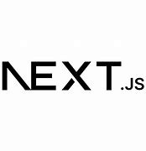
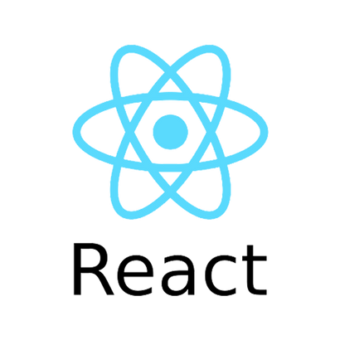
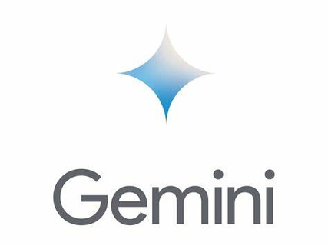

Tech Stack
APPROACH
Next.js: Used as the framework for the project.
React: Utilized to make the website responsive.
Drizzle ORM: Employed for database management with NeonDb.
Gemini AI: Integrated for generating AI-driven responses.
Clerk: Implemented for security and user authentication.

Slide 4
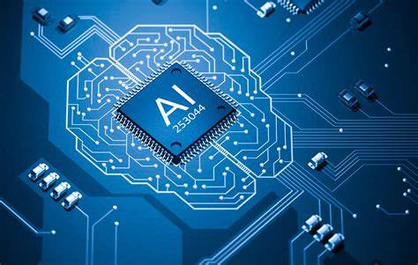

IDEA
outcome
AI-Powered Interview Simulation: Users can practice answering interview questions with real-time AI-generated feedback.
Real-time Answer Recording: Record and submit answers using speech-to-text capabilities.
Automated Feedback and Rating: AI provides instant feedback and a performance rating based on user responses.
User Authentication and Security: Secure login and session management using Clerk.
Responsive Design: Optimized for all device sizes using React and Tailwind CSS.
In the future, this project can be improved by allowing users to upload their resumes, practice interviews based on the resume, and receive an ATS-style score to evaluate their resume's effectiveness.

Slide 5

R&D
REFERENCES
About the project - You Tube
Documentation - GitHub
Design inspiration - Pinterest

