Slide 1

SMART INDIA HACKATHON 2026
TITLE PAGE
Problem Statement ID - 26033
Problem Statement Title - Multiple intermediaries reduce farmers earnings and increase consumer prices
Theme - Agriculture, FoodTech & Rural Development | PS Category - Software
Project: KisanSetu — Direct Farm-to-Fork 2G/Voice Fair Trade & 2-Opt Logistics Platform

Slide 2
PROPOSED SOLUTION: KisanSetu
Your Team Name
KisanSetu: Autonomous 2G/Voice Direct Farm-to-Consumer & B2B Trade Network
1
1. Zero-Internet 2G Voice/SMS Gateway
2
2. Anti-Distress Pricing & Dual Marketplace
3
3. 2-Opt Optimized Direct Logistics
• 10-Digit Missed-Call Gateway (+91-80-6900-5472) for instant zero-cost listing.
• Templated SMS parser (SELL <CROP> <QTY> <PRICE> <VILLAGE>) in Hindi/Tamil/English.
• Dual-mode Voice AI (Whisper + Sarvam) for non-literate dial-in farmers.
• Real-time APMC Mandi Modal & MSP cross-check prevents distress underpricing.
• Dual Buyer Personas: Consumer retail baskets vs B2B Wholesale (MOQ >=50kg, 5-15% bulk off).
• Fair Trade Payout: 98% paid directly to farmers with 2% transparent fee.
• 2-Opt Traveling Salesperson (TSP) algorithm cuts driver mileage by 28-35%.
• Farm-to-fork transit compressed from 4-6 days down to 24-36 hours.
• 5-Stage Mirrored Order Lifecycle (Placed -> Confirmed -> In Transit -> Delivered).
END-TO-END OPERATIONAL PIPELINE
1. Farmer (2G Call/SMS)
→
2. NLP & Mandi Price Engine
→
3. B2C & B2B Marketplace
→
4. 2-Opt Clustered Dispatch
→
5. 98% Direct Pay Settlement

Slide 3
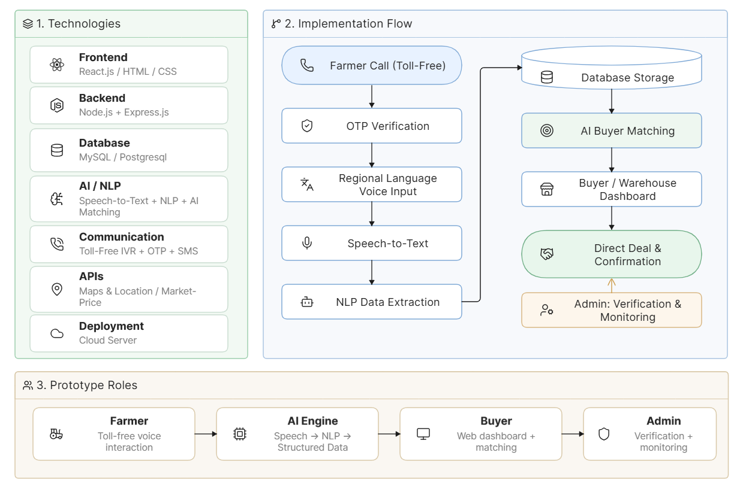
TECHNICAL APPROACH & SYSTEM ARCHITECTURE
Your Team Name
TIER 1: Multimodal Ingestion & Inclusivity
• GSM/PSTN Missed Call & SMS Gateway: +91-80-6900-5472 for zero-internet 2G phones.
• Multilingual NLP Parser: Regex & entity extraction (SELL <CROP> <QTY> <PRICE> <VILLAGE>).
• React 18 + Tailwind Responsive Web Portal for urban consumers and bulk retailers.
• Web Speech API Voice Interface: Multilingual Kisan Crop Doctor in Tamil/Hindi/English.
TIER 2: Core Transaction & Price Engine
• Express.js REST API Server: JWT Auth with strict 3-Tier Scoped RBAC.
• APMC Price Benchmark Service: Normalizes live Mandi Modal & MSP rates to ₹/kg.
• Anti-Underpricing Protection: Automated warning & fair-price recommendation at listing.
• Mirrored 5-Stage State Machine: Placed -> Confirmed -> Dispatched -> In Transit -> Delivered.
TIER 3: AI & Operations Research Microservices
• Python Flask Microservice (Port 5001): Fast ML inference & route optimization.
• Random Forest Demand Regressor: 6-month crop forecast factoring rainfall & festivals.
• 2-Opt TSP Route Optimizer: Haversine distance matrix minimizing total delivery mileage.
• Kisan Crop Pathology: Rule-based & LLM plant diagnosis with IPM organic remedies.
TIER 4: Data Persistence & GIS Layer
• SQLite / PostgreSQL Database: ACID transactions for 98% direct farmer payouts.
• OpenStreetMap Leaflet GIS: Real-time driver GPS waypoints & route polylines.
• Two-Way SMS Dispatcher: Instant Kisan Alerts on order placement & driver arrival.
• Audit & Analytics Ledger: Live GMV, 2% platform fee & driver earnings ledger.
Tech Stack: React 18 • TailwindCSS • Node.js / Express • Python Flask • Scikit-Learn • Leaflet GIS • SQLite / PostgreSQL • GSM SMS/IVR

Slide 4
FEASIBILITY, RISK MITIGATION & PILOT ROADMAP
Your Team Name
1
1. Technical Feasibility
2
2. Real Challenges & Edge Cases
3
3. Engineering Mitigations
• Operates over standard 2G GSM cellular networks on ₹1,200 feature phones (JioBharat / Nokia 105).
• Low compute footprint: Lightweight Express REST + Python microservices run on standard cloud servers.
• Fully open-source foundation (React, Python, SQLite, Leaflet) eliminates recurring enterprise licensing costs.
• Acoustic Noise & Dialects: Background farm noise can degrade raw voice recognition.
• Listing Authenticity: Risk of spurious or phantom produce listings.
• Rural Aggregation: Small farmers with 20-50kg lots face uneconomic solo transport.
• Structured SMS syntax fallback (SELL CROP QTY PRICE) + DTMF keypad backup.
• OTP mobile verification + driver physical quality inspection at farm gate.
• 2-Opt route clustering groups farmers within a 25km radius into shared 1-tonne pickups.
→
→
PHASED COMMERCIAL & OPERATIONAL ROADMAP
→
→
A
Phase 1: Working Prototype (Done)
B
Phase 2: District Pilot (M1-M4)
C
Phase 3: State Federation (M5-M12)
Full 2G Gateway, Mandi Price Engine, B2C/B2B Cart & 2-Opt TSP live in testbed.
Pilot with 500 farmers & 3 FPOs in Salem / Nashik vegetable belts.
Onboarding 50+ FPOs, Kirana B2B networks & cold-chain transport integration.

Slide 5
QUANTIFIABLE IMPACT & SOCIO-ECONOMIC VALUE
Your Team Name
🌾 Economic Impact (Direct Farmer Income)
• 98% Direct Farmer Realization: Up from 18-25% in traditional 5-tier mandi chains.
• +45% to +60% Net Profit per harvest cycle by eliminating broker commissions.
• Zero Distress Selling: Instant Mandi/MSP price guidance at point of listing.
• Immediate Settlement: T+0 digital escrow payout upon confirmed delivery.
🥦 Consumer & Retailer Savings
• 15% to 20% Cheaper than supermarket MRP and quick-commerce dark stores.
• Harvest-to-Table in 24-36 Hours: Peak nutritional value & pesticide traceability.
• Wholesale B2B Tiering: Kirana stores get 5-15% volume discounts on 50kg+ lots.
• Flexible Standing Contracts: Weekly recurring deliveries for restaurants.
🌱 Environmental & Post-Harvest Waste Reduction
• Spoilage Slashed: Post-harvest loss cut from 30%+ down to <8% via direct pull.
• 28% to 35% Fuel Savings: 2-Opt TSP routing consolidates multi-pickup paths.
• Reduced Carbon Footprint: Eliminates empty return truck trips across districts.
• Eco-Packaging: Encourages reusable crate pooling between farms and hubs.
📱 Digital & Social Inclusion
• 100% 2G Feature Phone Accessible: Zero smartphone or 4G data barrier for farmers.
• Multilingual Parity: Voice and SMS interfaces in Tamil, Hindi, Marathi & English.
• Kisan Crop Doctor: AI plant pathology guidance for smallholder pest management.
• Empowering Women Farmers & Self-Help Groups (SHGs) with direct market access.

Slide 6
RESEARCH BENCHMARKS, DATA SOURCES & REFERENCES
Your Team Name
1. Government Agricultural Data Sources
• Agmarknet (Directorate of Marketing & Inspection, Ministry of Agriculture): Daily APMC mandi modal price datasets across 3,000+ wholesale markets.
• Commission for Agricultural Costs & Prices (CACP): Price Policy Reports & MSP baseline price calculation formulas for Kharif/Rabi seasons.
• e-NAM (National Agriculture Market): Interoperability standards & digital trade guidelines.
2. Post-Harvest & Intermediary Studies
• ICAR-CIPHET (2022) Assessment of Post-Harvest Losses: Quantifying 15-30% perishable food spoilage due to 5-tier mandi delays.
• NITI Aayog Strategy for Agricultural Marketing (2020): Highlighting 75-85% consumer price markups extracted by commission agents & middlemen.
• NABARD Rural Inclusion Survey: Documenting 55%+ 2G feature phone reliance among smallholder farmers.
3. Algorithmic & Engineering Foundations
• Lin, S. & Kernighan, B. (1973): 'An Effective Heuristic Algorithm for the Traveling Salesman Problem' — Foundation for our 2-Opt Route Optimizer.
• Breiman, L. (2001): 'Random Forests' (Machine Learning) — Used for our 6-month demand regressor factoring rainfall and festive seasonality.
• OpenStreetMap & OSRM Geocoding API: Open-source geospatial routing & distance matrix.
4. Policy & National Mission Alignment
• Digital Agriculture Mission (DAM 2024-25): Promoting inclusive AI & open digital public infrastructure.
• PM Kisan Sampada Yojana: Supporting integrated cold chain & direct farm-gate preservation.
• Atmanirbhar Bharat Agri-Logistics: Empowering rural transport drivers & FPO self-reliance.

