Slide 1
CONTENTS/AGENDA
Sl. No | CONTENTS / AGENDA
1 | Introduction
2 | Literature survey
3 | Problem statement
4 | Proposed methodology and Project Objectives
5 | Requirement specification
6 | Project Design
7 | Project Implementation
8 | Project Testing
9 | Results & Discussions
10 | Conclusion and Future Scope
11 | References

Slide 2
1. INTRODUCTION

Slide 3
INTRODUCTION
Existing Traffic System
Uses fixed-time traffic signals.
Same signal timing regardless of real traffic conditions.
Causes:
Long waiting time.
Traffic congestion during peak hours.
Emergency vehicles do not get priority.
Manual control is required in critical situations.

Slide 4
INTRODUCTION
TraffiXSense Solution
Developed an IoT-Based Emergency Priority Traffic System.
Uses ESP32 microcontroller as central controller.
Provides:
Automated traffic signal control.
RFID based emergency vehicle detection.
Real time status display using OLED.
Remote monitoring & control via web dashboard.
Instantly clears traffic for emergency vehicles.
Reduces delays and improves overall traffic flow.

Slide 5
INTRODUCTION
Real-World Problem
Ambulances get stuck in traffic due to non-prioritized signals.
Even simple distances (100 m) can become major delays when traffic is congested and sirens go unheard
50% of trauma patients in India fail to receive treatment within the first 60 minutes “golden hour.”
Victims died while being transported to the hospital :
2021: 175 victims
2022: 168 victims
2023: 292 victims
2024: 375 victims
Ambulances may take 30–40 min to cover 3 km during peak traffic.
In major cities (Bengaluru, Chennai, Mumbai) 5–15 emergency cases daily suffer late arrival due to traffic.
Bengaluru sees ~3,000 ambulance trips daily, and many face traffic challenges that slow traffic clearance.
Traditional signals use fixed timers, offering no emergency clearance, no remote control, and no real-time adaptation.
Notes:
Field reports show that ambulances regularly get stuck in traffic with sirens blaring, forcing drivers to struggle to make space even when motorists try to cooperate

Slide 6
2. LITERATURE SURVEY

Slide 7
LITERATURE SURVEY
S.N | Paper title | Publication details | Problem addressed in the paper | Author’s idea/approach | Shortfalls in author’s approach and solution provided in the proposed methodology
1 | Smart Traffic Management System with Emergency Vehicle Prioritization and Vehicle Detection | 2024 | Abhirami Js, Dinesh Kumar M, Prasanth S. | Arduino-based traffic control that automatically clears emergency vehicles and detects stolen vehicles. Uses real-time data to adjust signal timings dynamically. | Fixed-timer signals cause congestion and delay emergency vehicles. No automated vehicle monitoring.
How Addressed: Introduces automated clearance system + RFID-based vehicle detection.
Paper Link: 🔗 https://www.ijert.org/smart-traffic-management-system-with-emergency-vehicle-prioritization-and-stolen-vehicle-detection-using-arduino-technology

Slide 8
LITERATURE SURVEY
S.N | Paper title | Publication details | Problem addressed in the paper | Author’s idea/approach | Shortfalls in author’s approach and solution provided in the proposed methodology
2 | An Optimal Control Strategy for Emergency Vehicle Priority System in Smart Cities Using Edge Computing and IoT Sensors | 2023 | R. Pradeep, M. Ramesh, P. Suresh. | Uses IoT sensors and edge computing to detect ambulances and compute optimized signal timings for priority movement. | Manual emergency clearance causes confusion; relies on human intervention.
How Addressed: Edge computing reduces delay and minimizes disruption to normal traffic.
Paper Link: 🔗 https://www.sciencedirect.com/science/article/pii/S2665917423000338

Slide 9
LITERATURE SURVEY
S.N | Paper title | Publication details | Problem addressed in the paper | Author’s idea/approach | Shortfalls in author’s approach and solution provided in the proposed methodology
3 | IoT-Based Traffic Management System Prioritizing Emergency Vehicles | 2023 | Sharma, R. Kumar, S. Gupta. | IoT-enabled signal controller with online manual override. Traffic density and signal status monitored through a GUI. | No remote signal control; manual override requires physical presence.
How Addressed
Dashboard provides live updates and remote adjustments.
Paper Link: 🔗 https://www.ijert.org/iot-based-traffic-management-system-prioritizing-emergency-vehicles

Slide 10
LITERATURE SURVEY
S.N | Paper title | Publication details | Problem addressed in the paper | Author’s idea/approach | Shortfalls in author’s approach and solution provided in the proposed methodology
4 | IoT-Based Emergency and Theft Vehicle Identification in Traffic System Using RFID | 2023 | Velmurugan V, Arunkumar B, Deepika B, Dhanasree M, Kumaram S. | RFID-based system for automatic emergency lane clearance and stolen vehicle identification. | No automated stolen vehicle tracking; emergency vehicles get delayed.
How Addressed:
RFID tags enable automatic detection and light color switching.
Paper Link: 🔗 https://ijireeice.com/papers/iot-based-emergency-and-theft-vehicle-identification-in-traffic-system-using-rfid/

Slide 11
LITERATURE SURVEY
S.N | Paper title | Publication details | Problem addressed in the paper | Author’s idea/approach | Shortfalls in author’s approach and solution provided in the proposed methodology
5 | RFID-Based Traffic Control System for Emergency Vehicle | 2023 | Gowtham M, Adhwanth D, Manojkumar G, Naveen R, Nazeem K. | RFID sensor detects emergency vehicles and changes signals instantly. | Traditional systems lack automated emergency priority; require manual control.
How Addressed: Implements automated detection-trigger system using RFID and microcontroller.
Paper Link: 🔗 https://ijetms.in/Vol-7-issue-3/Vol-7-Issue-3-34.html

Slide 12
3. PROBLEM STATEMENT

Slide 13
PROBLEM STATEMENT
Current traffic signals work on fixed timers and do not adjust to real traffic conditions. This leads to long waiting, slow movement, and congestion at junctions. Emergency vehicles also get stuck because there is no automatic priority system. To solve these issues, a smart IoT-based traffic signal system is needed that can control timings dynamically, provide emergency clearance, and improve overall traffic flow.

Slide 14
4. PROPOSED METHODOLOGY & PROJECT OBJECTIVES

Slide 15
PROPOSED METHODOLOGY
ESP32 controls all traffic lights and hosts a web dashboard for remote monitoring.
RFID detects authorized emergency vehicles and clears the route instantly.
OLED display shows real-time status of Signal and emergency Signal.
Traffic signals run automatically, but the system allows quick manual changes through the dashboard or RFID when an emergency vehicle arrives.

Slide 16
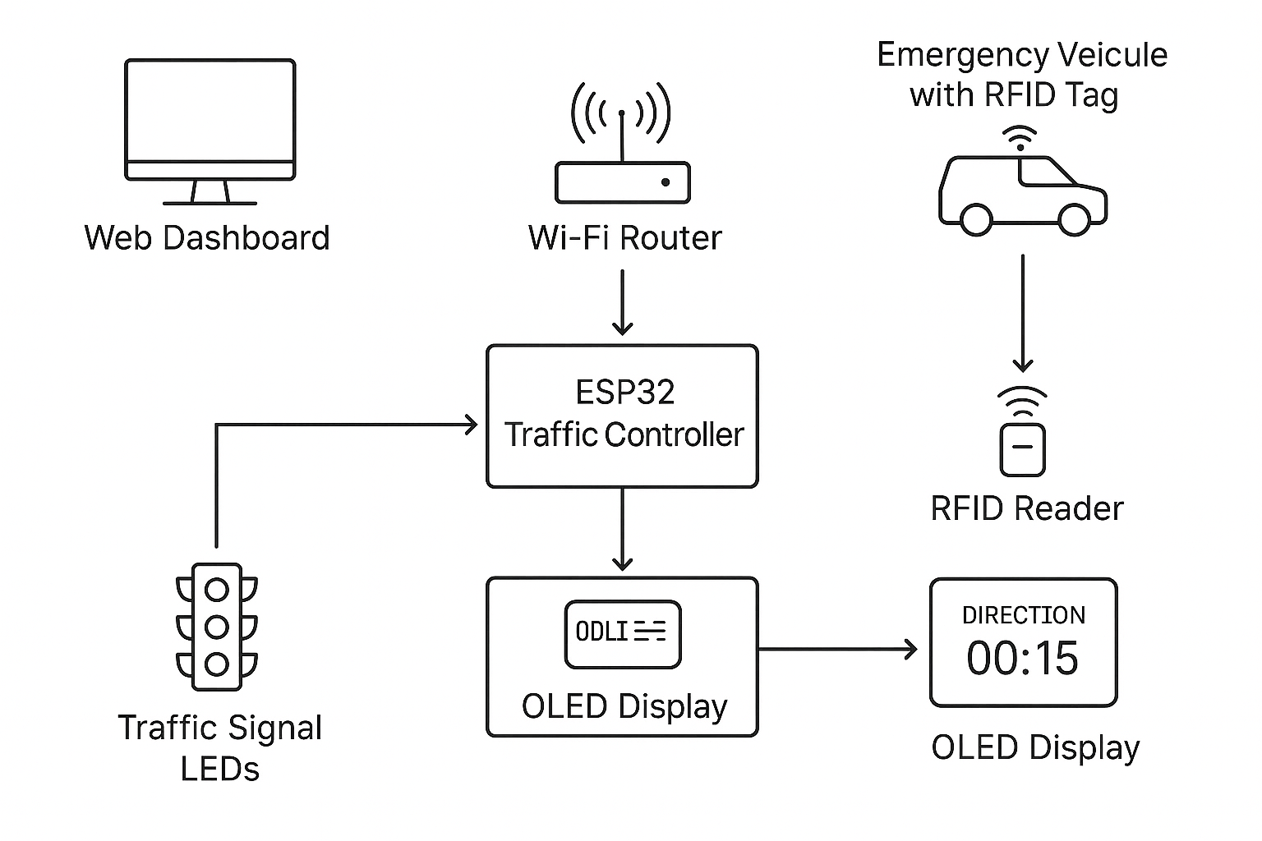
BLOCK DIAGRAM OF PROPOSED METHODOLOGY

Slide 17
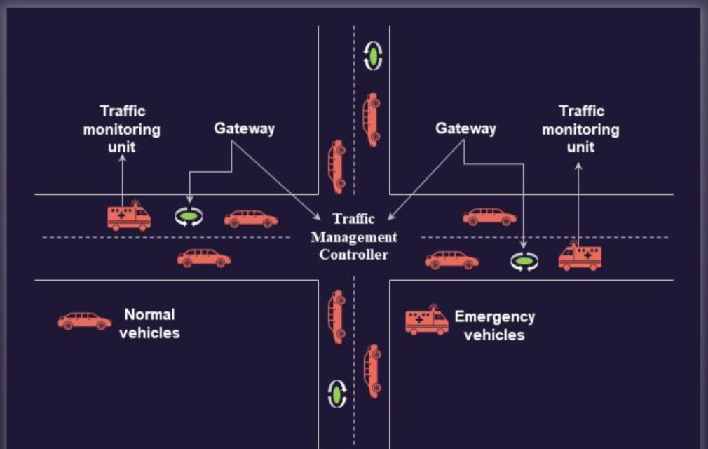
PROPOSED METHODOLOGY

Slide 18

PROJECT OBJECTIVES
Objective-1:
Identify research gaps & review existing traffic management solutions.
Objective-2:
Develop software for density-based traffic light control
Objective-3:
Design and prototype IoT hardware-based traffic signal system implemented using ESP32 with Wi-Fi web interface, enabling manual control of three directions.
Objective-4:
Integrate hardware and software for seamless intelligent traffic signal operation.

Slide 19
5. REQUIREMENT SPECIFICATION

Slide 20
Requirement Specification
Functional Requirements:
Sl. No | Functional Requirement specification | Purpose
1 | Automatic control of Red/Yellow/Green signals | Ensure smooth, uninterrupted traffic flow
2 | Manual timer control via Web Dashboard | Allow operator to override timing when required
3 | RFID-based emergency priority activation | Provide instant green signal for emergency vehicles
4 | OLED display showing countdown & direction | Give clear real-time visibility at the junction
5 | Real-time status update to dashboard | Support accurate monitoring and quick decision-making

Slide 21
Requirement Specification
Non-Functional Requirements:
Sl. No | Non-Functional Requirement | Purpose
1 | Low-latency updates between ESP32 & dashboard | Achieve near real-time responsiveness
2 | Stable Wi-Fi connectivity | Maintain continuous system communication
3 | High operational reliability | Ensure system works safely for long durations
4 | Simple and user-friendly UI | Make operation easy for any user
5 | Efficient ESP32 memory usage | Avoid performance issues during execution

Slide 22
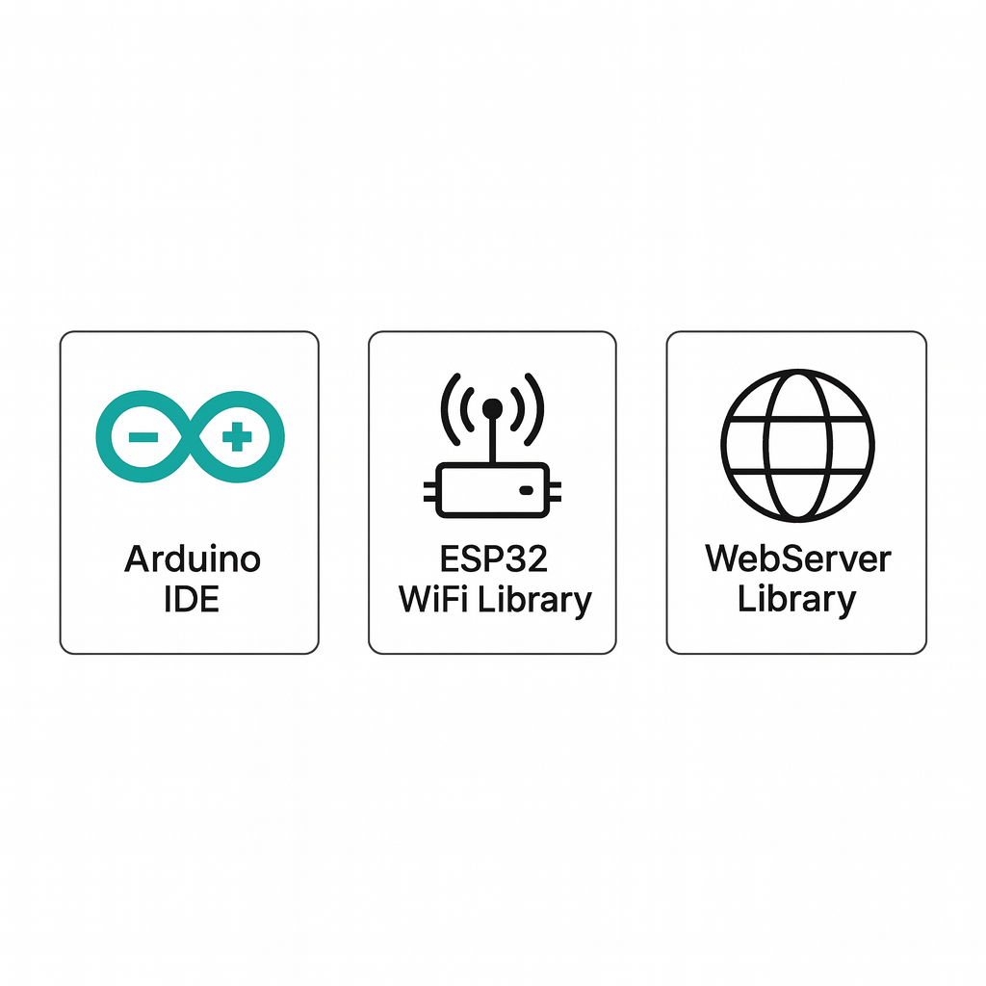
Requirement Specification
Software Requirements:
Sl. No | Software Requirement detail
 | Software Tool Name | Purpose
1 | Arduino IDE | Write, compile, and upload code to the ESP32 microcontroller.
2 | ESP32 WiFi Library | Enable Wi-Fi connectivity, HTTP server communication.
3 | WebServer Library | Handle HTTP requests for dashboard control and status updates.

Slide 23
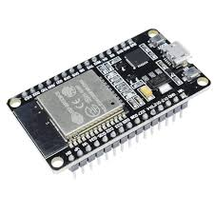
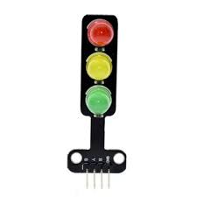
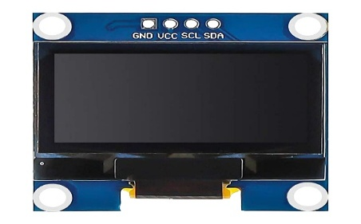
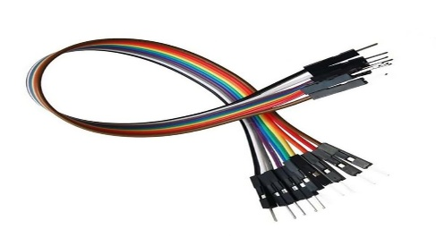
Requirement Specification
Hardware Requirements:
Sl. No | Hardware Requirement details
 | Hardware device Name | Purpose
1 | ESP32 Dev Module | Central controller: runs traffic logic, hosts web server, interfaces with sensors and LEDs.
2 | Red/Yellow/Green LEDs (per lane) | Visual traffic signals driven by ESP32 GPIOs.
3 | OLED Display (SSD1306) | Local status: shows active direction, phase, and countdown.
4 | Jumper Wires / Connectors | Prototyping and interconnections between modules.

Slide 24
6. PROJECT DESIGN

Slide 25
Details of Project Modules Identified
Project Module Number | Project Module Name | Functional Requirement achieved | Project Objective Achieved
Module 1 | Traffic Flow Simulation Module | • Visual 3-way junction simulation • Lane-wise vehicle counting • Phase visualization | • Understand traffic density patterns • Validate phase timing logic
Module 2 | Hardware Traffic Light Control Module | • Dynamic signal switching • OLED status display • Lane-wise LED control | • Achieve reliable signal automation • Provide real-time junction visualization
Module 3 | Emergency Override & Adaptive Logic Module | • Emergency mode handling • Automatic prioritization • Adaptive timing logic | • Ensure fast ambulance clearance • Reduce congestion using adaptive control

Slide 26
PROJECT MODULE:
Functional Requirements Achieved
Handles ESP32 WiFi initialization
Serves web dashboard UI (HTML/CSS/JS)
Accepts user timer inputs for each direction
Updates traffic signal durations dynamically
Runs Auto Mode (Green → Yellow → Red)
Manages Emergency Override mode
Transmits real-time status through REST API (/status)
Controls LEDs for R/Y/G via GPIO pins
Updates OLED display with timer + active direction

Slide 27
PROJECT MODULE-1:
Non-Functional Requirements Achieved
Low-latency UI refresh (500ms interval)
Stable WiFi connectivity for continuous control
High responsiveness for emergency pre-emption
Fault-tolerant timing logic (resets if overflow)
Readable UI with clean design and usability
Efficient memory use in ESP32 (lightweight HTML/JSON)
Secure device-level operation (local network only)

Slide 28
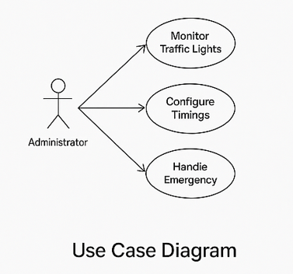
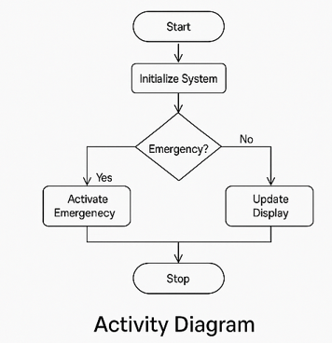
UML DIAGRAMS OF PROJECT MODULE-1:

Slide 29
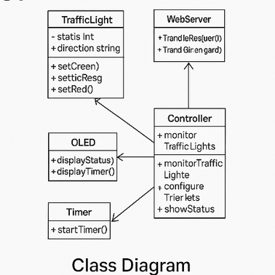
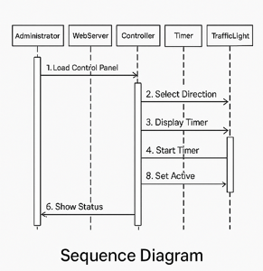
UML DIAGRAMS OF PROJECT MODULE-1:

Slide 30
7. PROJECT IMPLEMENTATION

Slide 31
Details of Project Modules Identified
Project Module Number | Project Module Name | Functional Requirement achieved | Project Objective Achieved
1 | Traffic Flow Simulation (Software) | • Visual 3-way junction simulation• Lane vehicle counting & phase animation | • Validate timing logic and phase strategy before hardware
2 | Hardware Traffic Control (ESP32 + LEDs + OLED) | • GPIO control of Red/Yellow/Green LEDs• OLED shows active direction & countdown | • Demonstrate physical signal control and local feedback
3 | Web UI & Adaptive Logic (Integration) | • ESP32 WebServer, /status, /settimes, /setall, emergency routes• Per-direction configurable timers, auto & emergency modes | • Remote control + real-time monitoring; emergency vehicle prioritization

Slide 32
IMPLEMENTATION OF PROJECT MODULE
Start-Up
ESP32 turns on
Connects to Wi-Fi
LEDs & OLED get ready
Main Working
Auto Mode: Green → Yellow → Red
Emergency Mode: instant Green to one side
Web Page Controls
Change timer values
Check live status
Emergency & Reset buttons
Hardware Actions
GPIO controls LED lights
OLED shows active direction + countdown
Testing Results
Lights change correctly
Timers update immediately

Slide 33
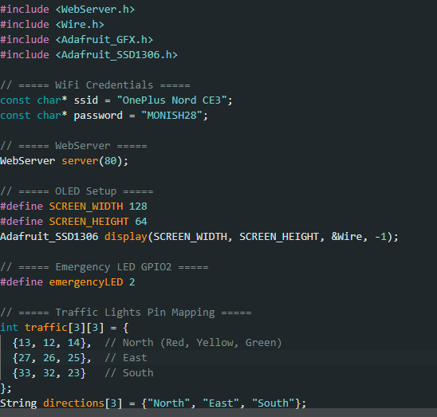
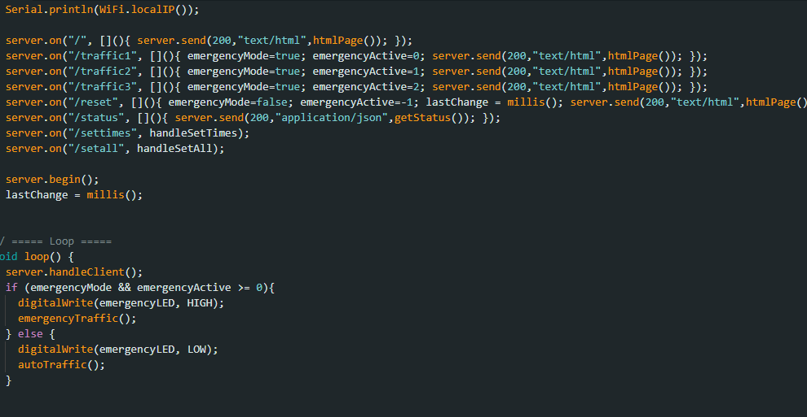
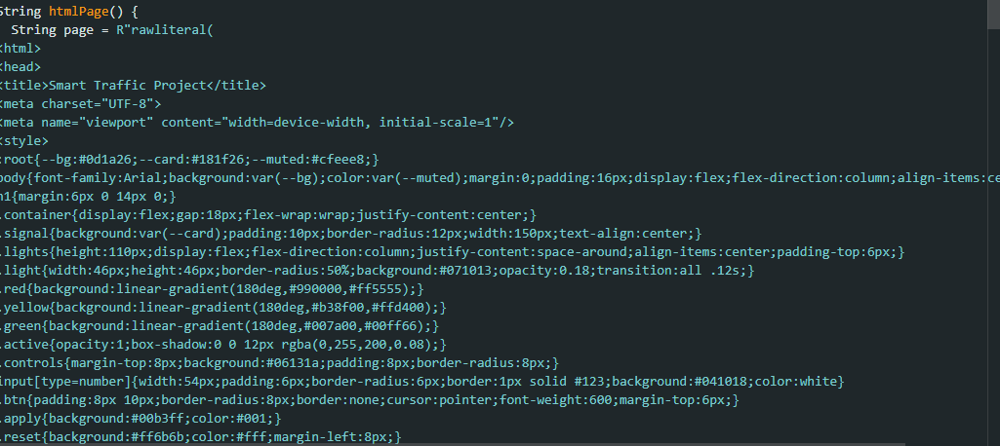
PROJECT MODULE CODE
Traffic Light Pin-Mapping Configuration
Backend Traffic Control Logic & Emergency Handling
Web Dashboard UI Rendering Module

Slide 34
8. TESTING

Slide 35
PROJECT TESTING
Objectives of Testing
Ensure traffic lights change correctly
Confirm emergency mode works instantly
Check web dashboard controls work
Verify OLED shows correct countdown
Types of Testing Performed
LED testing
Auto mode testing
Emergency mode testing
Web UI testing
OLED display testing

Slide 36
PROJECT TESTING
Testing Tools/frameworks used:
Sl. No | Testing tool/framework name | Purpose
1 | Serial Monitor (Arduino IDE) | Observe logs, check timer values, debug system flow
2 | Web Browser (Chrome/Edge) | Test dashboard buttons, API calls, live updates
3 | ESP32 WebServer Library | Validate backend responses & status API
4 | Multimeter (Basic Hardware Testing) | Check voltage, continuity, LED connections
5 | OLED Display (SSD1306) | Verify countdown, phase display, real-time updates

Slide 37
PROJECT TESTING
Details of Test cases and Results:
Test case | Inputs | Expected output | Actual output | Result
1. Auto Mode Light Change | Power ON, default timers | Lights switch R→Y→G correctly | Works as expected | Pass
2. Emergency Mode Activation | Click “North Ambulance” | North turns Green instantly | Turned Green immediately | Pass
3. Timer Update (Web UI) | Set G=10s, Y=3s, R=2s | New timings applied to cycle | Timings updated correctly | Pass
4. OLED Countdown | Auto Mode running | Correct countdown shown | Countdown displayed correctly | Pass
6. System Stability | Run 20+ minutes | No freeze or reset | System stable | Pass

Slide 38
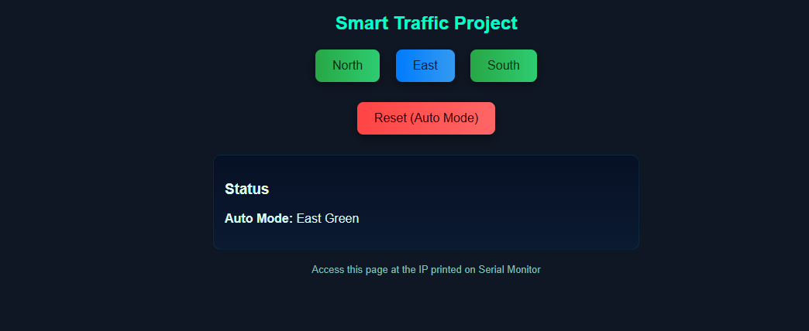
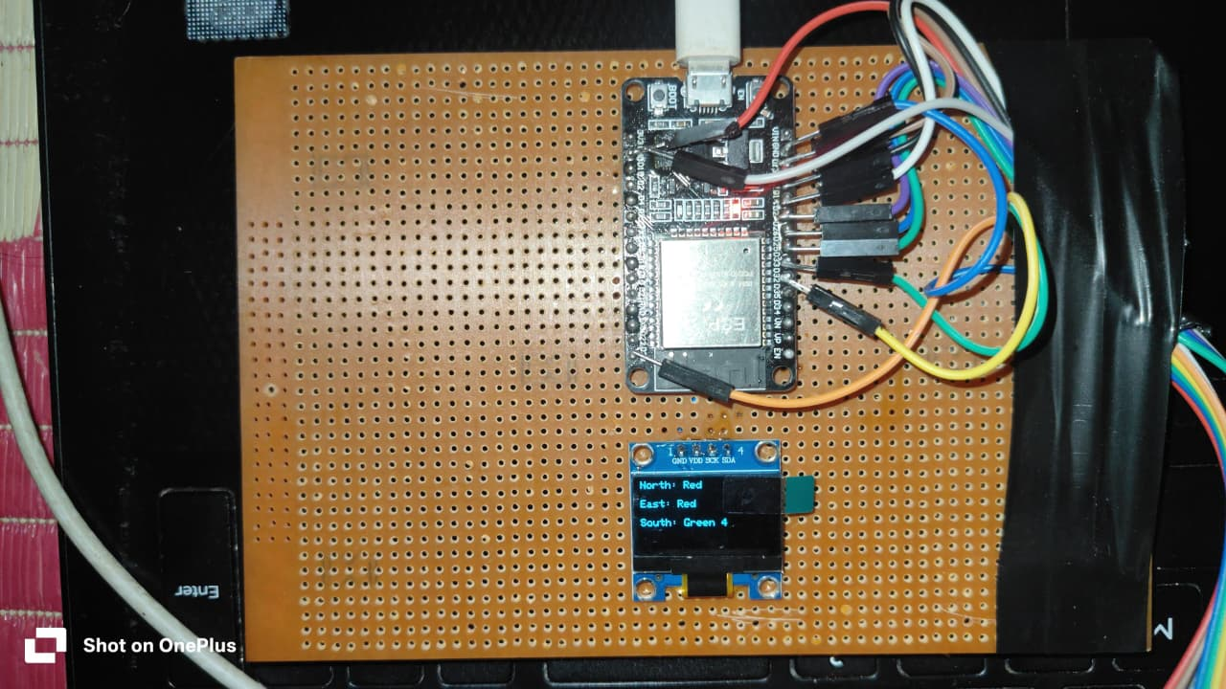
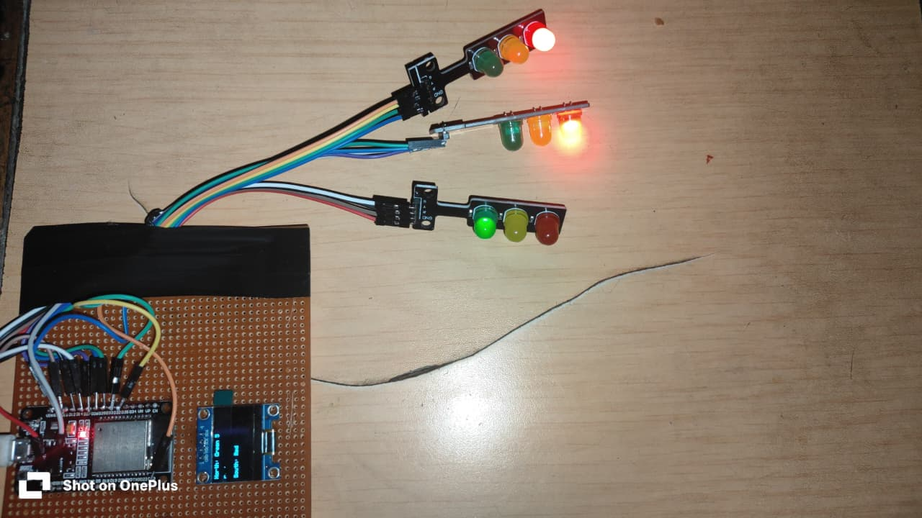
PROJECT TESTING SCREEN SHOTS
Smart Traffic System — Web Interface & On-Board Hardware Layout

Slide 39
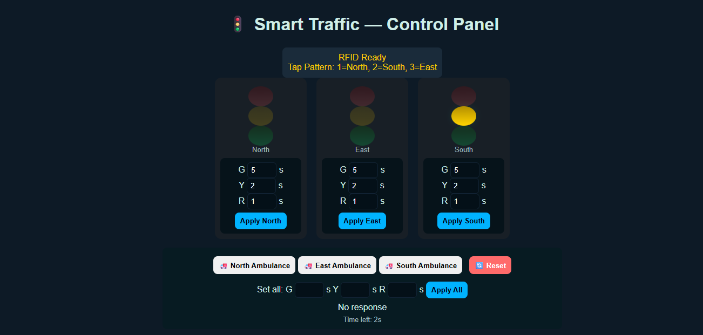
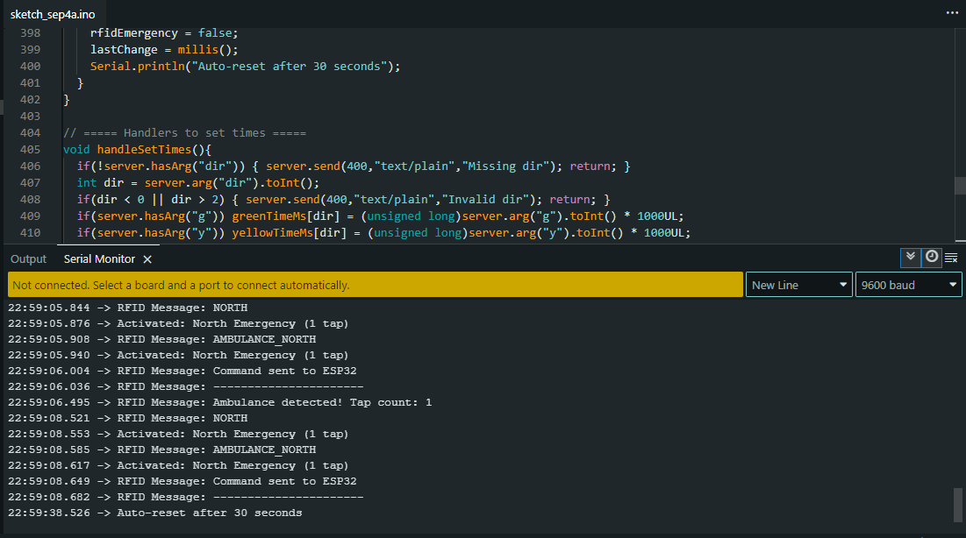
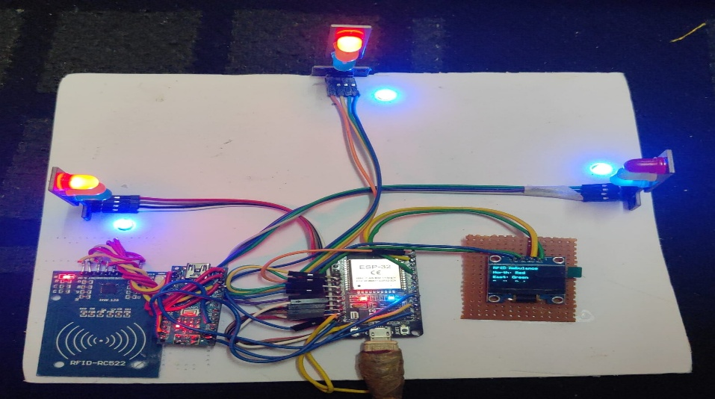
PROJECT TESTING SCREEN SHOTS
Smart Traffic System — Control Panel & Hardware Deployment Overview

Slide 40
9. RESULTS & DISCUSSIONS

Slide 41
RESULTS & DISCUSSIONS
Results
Traffic lights switched correctly in Auto Mode
Emergency mode turned selected lane green instantly
Web dashboard updated every 0.5 sec without lag
OLED displayed proper countdown and lane status
Timer changes from UI applied immediately
System stayed stable during long-run testing
Discussion
Adaptive timers reduced unnecessary waiting
Emergency clearance improved response efficiency
ESP32 handled both control logic + web server smoothly
UI was simple, fast, and user-friendly
Lack of sensors limited real-time adaptability

Slide 42
10. CONCLUSION & FUTURE SCOPE

Slide 43
CONCLUSION & FUTURE SCOPE
Conclusion
ESP32 traffic controller working reliably
Web dashboard enables live timing control
Dynamic cycle + emergency mode functional
OLED shows direction + countdown
Future Scope
Add sensors / camera for real-time vehicle detection
Add vehicle detection sensors / YOLO camera for true adaptive timing Add authentication for dashboard
Add AI/ML prediction models for peak traffic forecasting

Slide 44
11. REFERENCES

Slide 45
REFERENCES
Mutambik, I. (2025) IoT-Enabled Adaptive Traffic Management: A Multiagent Framework for Urban Mobility Optimisation Sensors, 25(13):4126 https://www.mdpi.com/1424-8220/25/13/4126
Kwesiga, D. K., Guin, A., Hunter, M. (2025) Adaptive Traffic Signal Control based on Multi-Agent Reinforcement Learning: Case Study on a Simulated Real-World Corridor arXiv preprint https://arxiv.org/abs/2503.02189
Luo, Z., Xu, J., Chen, F. (2024) Multi-agent Reinforcement Traffic Signal Control via Interpretable Influence Mechanism & Biased ReLU Approximation arXiv https://arxiv.org/abs/2403.13639
Balashov, A., Ponomarova, O., et al. (2025) Adaptive Traffic Signal Optimization with Thermal Sensors & Reinforcement Learning SSRN https://ssrn.com/abstract=5414064

Slide 46



