Slide 1

Hotel Revenue Analytics & Management Dashboard
End-to-end pipeline — Python, PostgreSQL, Power BI
Monish Raj V · GitHub: [Monishrajv/Hotel-analytics] · May 2026

Slide 2

The Problem: Fragmented Data, Hidden Risks
Booking data sits in silos — across cities, room classes, and platforms — making it impossible to spot revenue leakage or act on trends.
Revenue Leakage
Cancellations erode realized revenue, but root causes are invisible without unified tracking.
Uneven Occupancy
Properties perform inconsistently, yet there is no single view to compare or diagnose gaps.
Unclear Channel Mix
Platform-level performance is buried in raw data — stakeholders cannot optimize distribution.

Slide 3

Datasets & Scope
Atliq Hotels — Fictional Multi-City Chain
4 cities: Delhi, Mumbai, Bangalore, Hyderabad
25 properties across Luxury and Business segments
~134,573 booking records; May–July 2022 focus
Room types: RT1–RT4 with daily aggregated capacity
Star Schema Design
Fact tables: fact_bookings, fact_aggregated_bookings
Dimension tables: dim_hotels, dim_rooms, dim_date

Slide 4






Methodology: The Analytics Pipeline
Phase 3 — Load
PostgreSQL: ALTER types, PK/FK, repaired dim_date April gaps
Phase 2 — Clean
Phase 4 — Model
Date parsing, revenue fixes, capacity imputation, exports
SQL KPIs and views for downstream BI
Phase 1 — Profile
Jupyter: nulls, types, anomalies (e.g., negative guests)
Phase 5 — Visualize
Power BI: DAX measures, slicers, interactive reports
Each phase builds on the last — clean data in, trusted insights out.

Slide 5
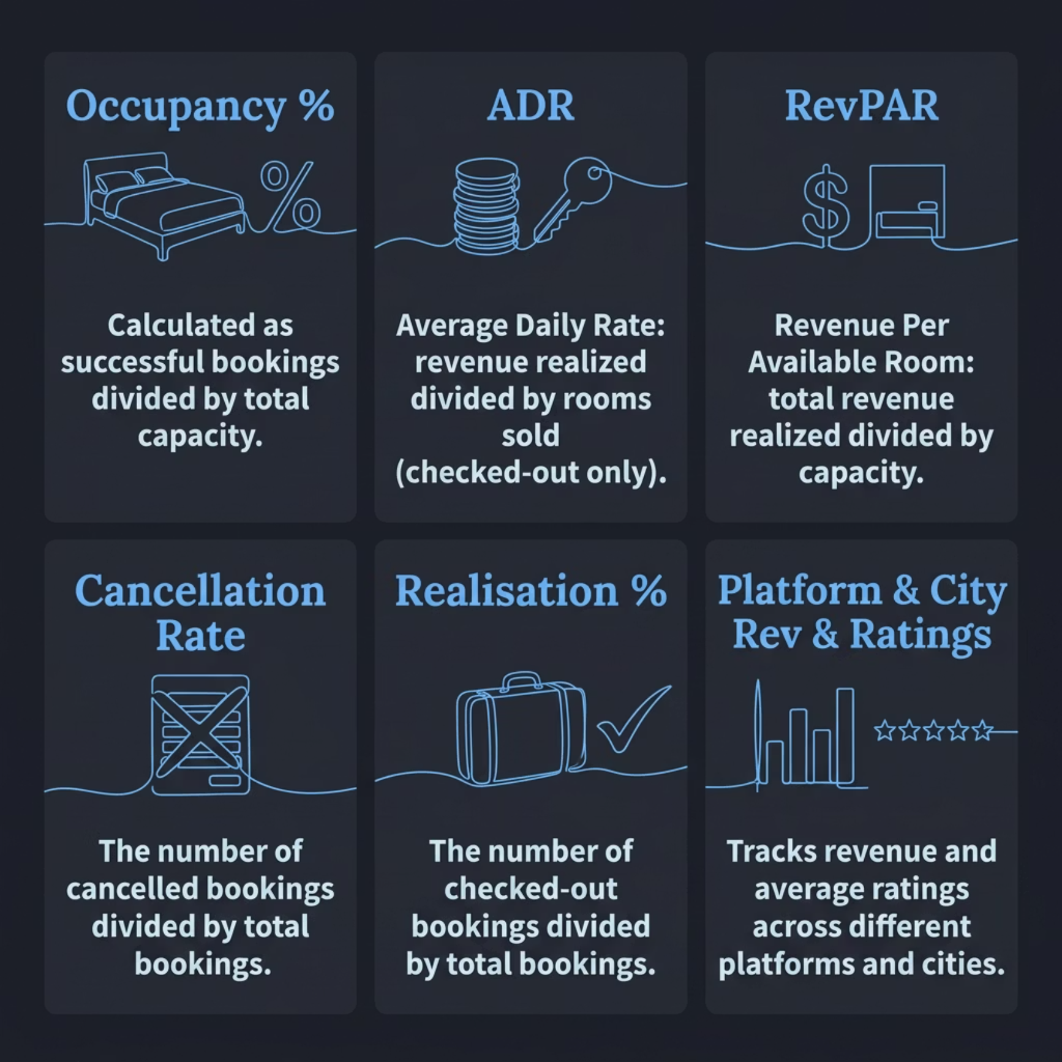

KPIs Analyzed
Core Metrics
Occupancy % = successful bookings ÷ capacity
ADR = revenue realized ÷ rooms sold (checked out only)
RevPAR = revenue realized ÷ capacity
Supporting Metrics
Cancellation rate and realisation %
Platform and city-level revenue breakdown
Average guest ratings by property

Slide 6
Key Findings
₹1.71B
58%
₹12,696
Total Revenue
ADR
Occupancy Rate
₹7,351
70%
RevPAR
Realisation %
Revenue Mix & City Performance
Risk Signals
Luxury segment drives 62% of revenue vs. Business at 38%
Mumbai leads with ₹552M; Delhi tops ratings at 3.78 avg
Cancellation rates cluster at 24–25% across properties
Occupancy varies materially — roughly mid-40s to mid-60s % by property

Slide 7


Dashboard Showcase
What the Dashboard Covers
KPI cards — Revenue, RevPAR, Occupancy, ADR, Realisation %
Weekday vs. Weekend table for demand pattern analysis
Category donut — Luxury vs. Business revenue split
Trend lines — ADR, RevPAR, Occupancy over time
Platform realisation combo chart with cancellation overlay
City/property matrix — cancellation % and avg ratings drill-down
Interactive slicers enable filtering by city, property, room type, and date range.

Slide 8

Tech Stack, Learnings & Next Steps
Tools Used
Key Learnings
Star schema design is critical for BI performance
Date dimension quality directly impacts time-series accuracy
KPI definitions must be agreed upon before building
Pandas & Jupyter
PostgreSQL & SQL
Power BI (DAX)
Git / GitHub
What's Next
Demand forecasting with time-series models
Cohort-based cancellation analysis
Automated data refresh pipeline
🔗 View the full project on GitHub: [Monishrajv/Hotel-analytics]

