Slide 1
CREVO
AI creator marketplace
Discover creators. Build clearer briefs. Collaborate through delivery.
Working prototype • React + FastAPI + Supabase + Gemini

Slide 2
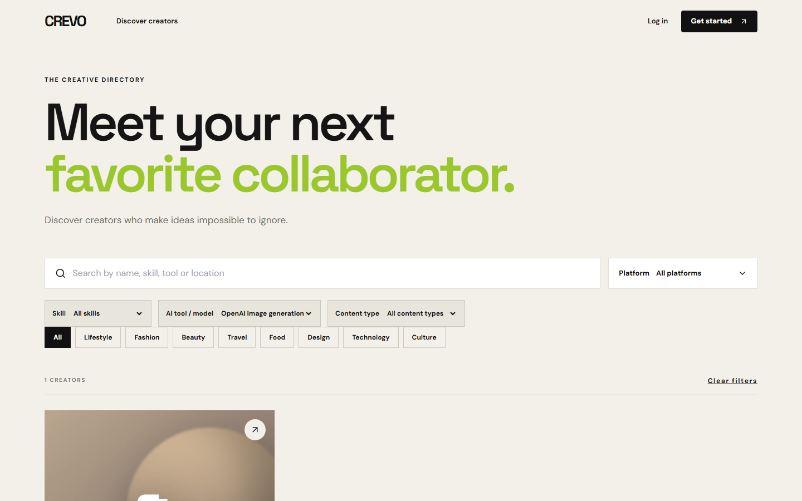
CREVO / DISCOVERY
Find creators by the work they make
Search by skill, specialization, platform, AI tool, or content type. Empty results can be cleared in one click.
crevo-hackathon.onrender.com

Slide 3

CREVO / PORTFOLIO
Inspect the work and the workflow
Each item shows media, tools, process, format, and commercial-use terms. The public sample is explicitly labeled as illustrative.
crevo-hackathon.onrender.com

Slide 4
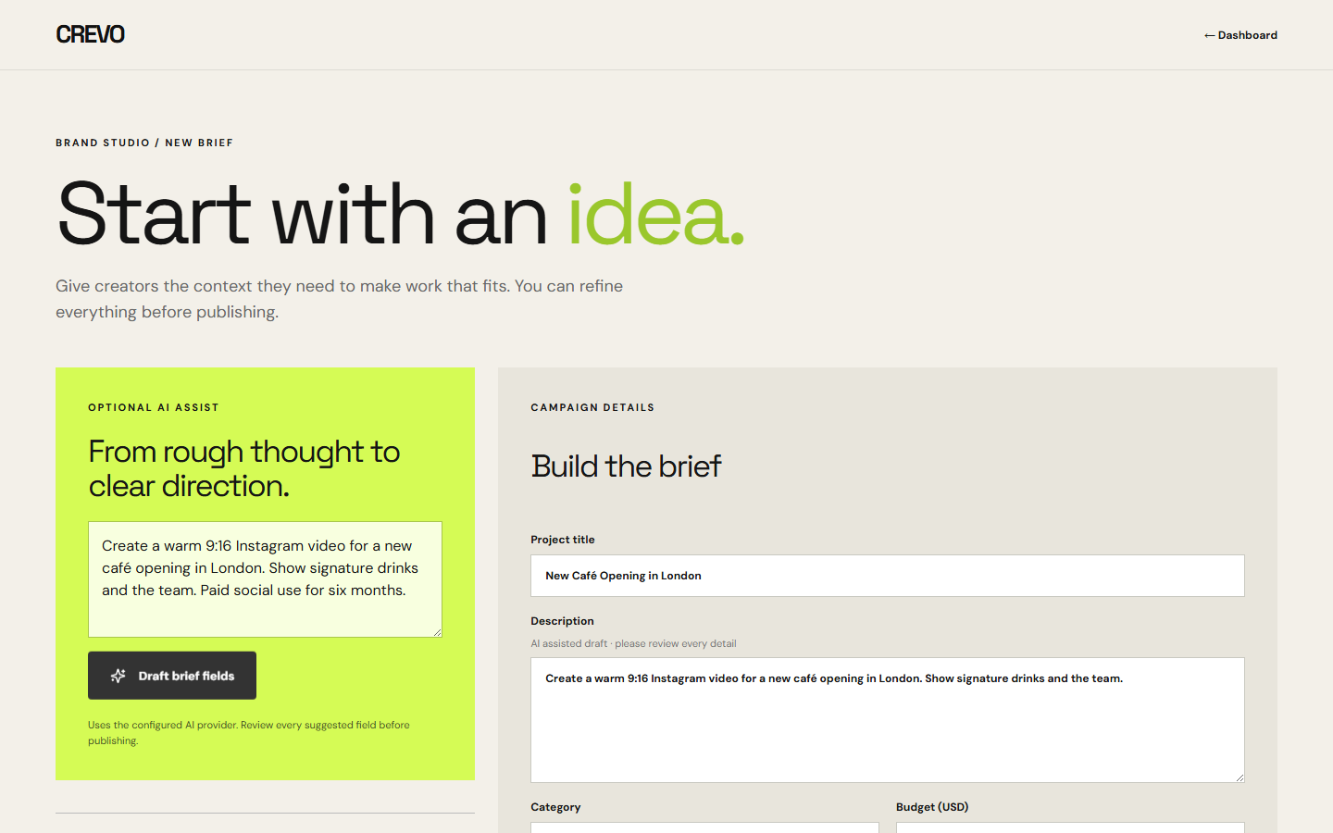
CREVO / BRIEFS
Turn an idea into editable fields
Gemini suggests title, category, content type, style, format, and usage terms only when the idea supplies them. Brands review the brief before publishing.
crevo-hackathon.onrender.com

