Slide 1

HomeFood
Locating nearby home cooked food

Slide 2
HomeFood
HomeFood is a mobile app that helps in connecting users who want to avail home cooked food from nearby places , keeping in mind the hygiene , flavour and price of the food.
At the same time giving an opportunity to housewives & other food lovers to earn at the same time by providing in expensive home cooked food service to their customers

Slide 3
Consider it as Zomato , but for hotels run by housewives or food lovers from their home.

Slide 4
Why HomeFood app
Its always difficult for bachelors , students and sometimes family to eat food from outside , due to price and hygiene.
There was no platform that provide food consumers to avail food from their nearby locations.
Availability of tiffin service in certain places are less.
Give food lovers an opportunity to sell there food service and earn for the same thing they love and do regularly.
More opportunity to try new food regularly by paying less.

Slide 5
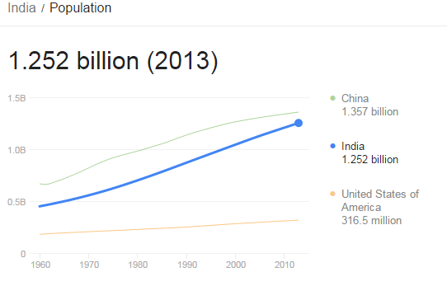
Market
This is a void space , and no one bothered to fill it. Considering around =~ 31 crores
Housewives , it can be great opportunity for them to earn and be a part of this growing shared economy.

Slide 6
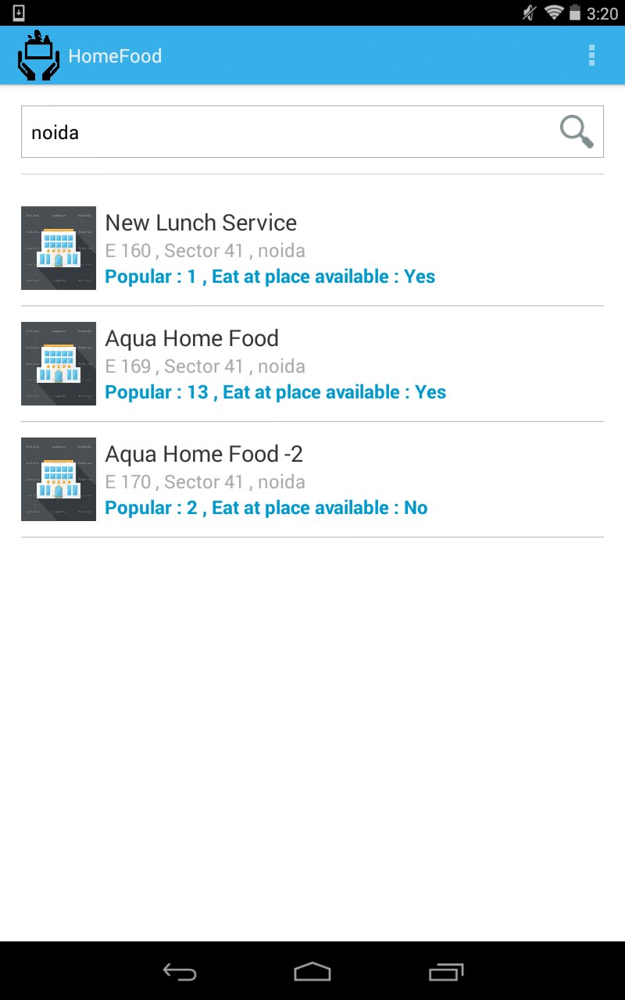
Search home cooked food in
nearby locations.
Search results will be in sorted
order of relevance.
Also can see if food provider
avail the service at their home ,
with eat at place option.

Slide 7
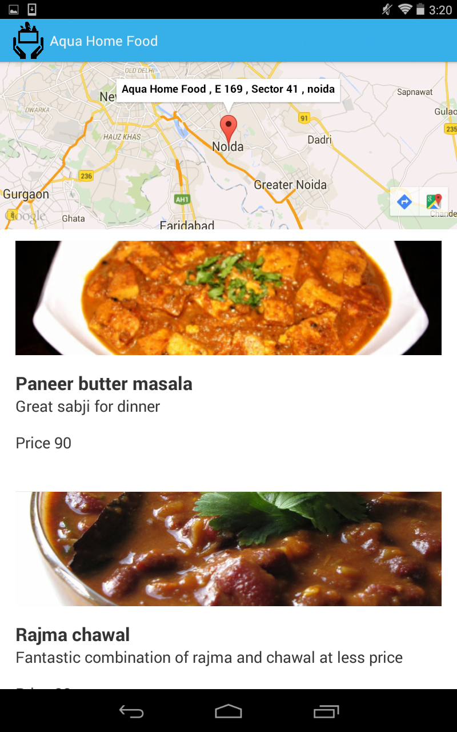
Find location of food
provider.
Listing all available food
items, with description
and price.
Select any dish to
confirm the order

Slide 8
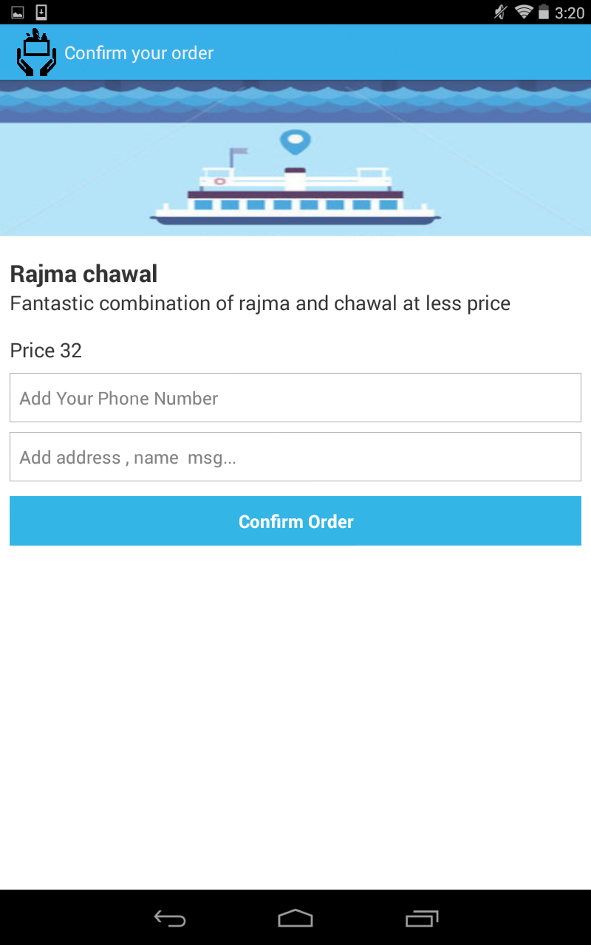
Enter your mobile number , address or any description along with your order and confirm.

Slide 9
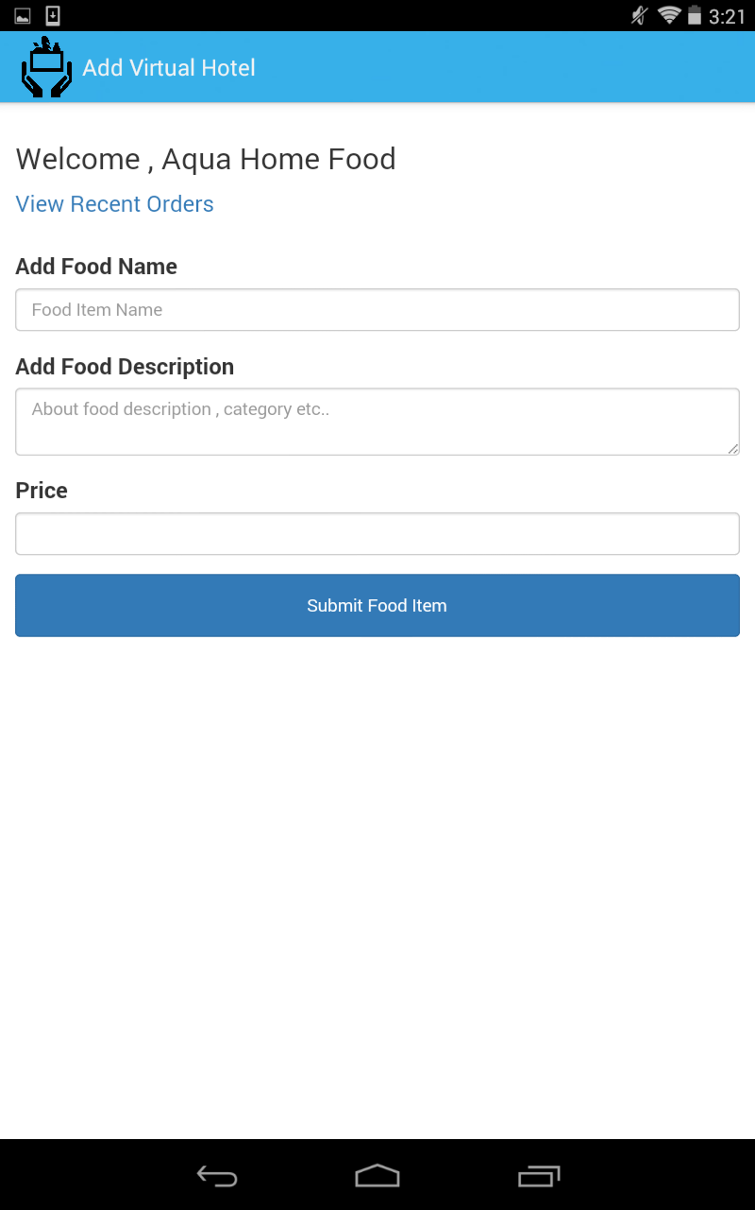
Registered Users can add their dishes with description and price.

Slide 10
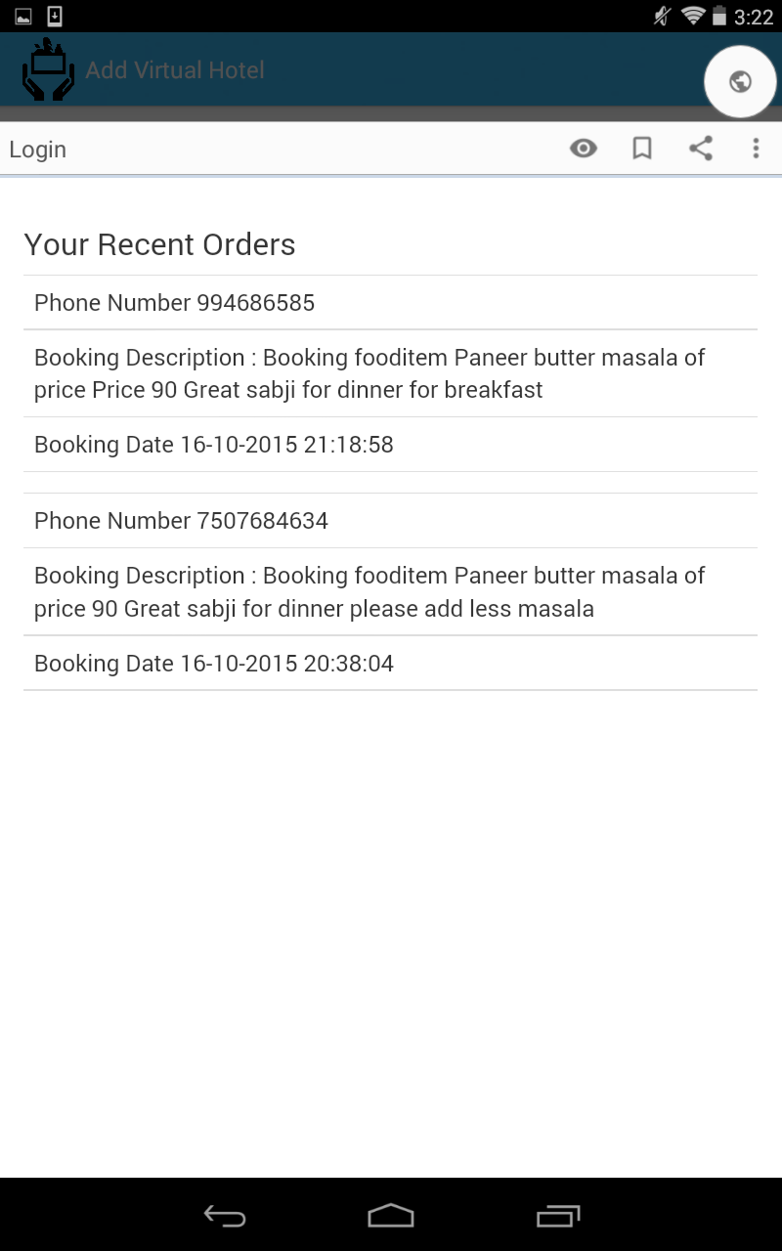
Registered users can view recent orders
& can respond accordingly.

Slide 11
Challenges
No middle man for delivery , both parties have to arrange their own delivery way.

Slide 12
Improvements
Notification to food provider once order is booked.
Food provider can upload his/her dish photos.
Messaging system between food provider and consumer.
Review system to ensure good quality food is
served.

Slide 13
Thank you

