Slide 1
Employee Data Analysis using Excel K
STUDENT NAME: Kokilamani R
REGISTER NO: 422200796
DEPARTMENT: B.com ISM
COLLEGE: Soka Ikeda College

Slide 2
PROJECT TITLE
Employee Performance Analysis using Excel

Slide 3


AGENDA
Problem Statement
Project Overview
End Users
Our Solution and Proposition
Dataset Description
Modelling Approach
Results and Discussion
Conclusion
3/21/2024 Annual Review

Slide 4

PROBLEM STATEMENT
An effective problem statement includes evidence to support any unbiased claims. This evidence should demonstrate the scope of the problem, such as the loss it's causing, a decrease in activity, staff attrition or other specific and measurable problems it is causing.

Slide 5

PROJECT OVERVIEW
.
Analyze employee data to identify trends and insights, informing HR strategies and driving business growth. This project will explore key metrics such as employee turnover, engagement, and performance, leveraging data visualization and statistical techniques to uncover actionable recommendations.

Slide 6

WHO ARE THE END USERS?
1. Company
2. Employee

Slide 7

OUR SOLUTION AND ITS VALUE PROPOSITION
1. Conditional Formatting – Highlights the cells
2. Filter – Editing the blank cells
3. Chart

Slide 8
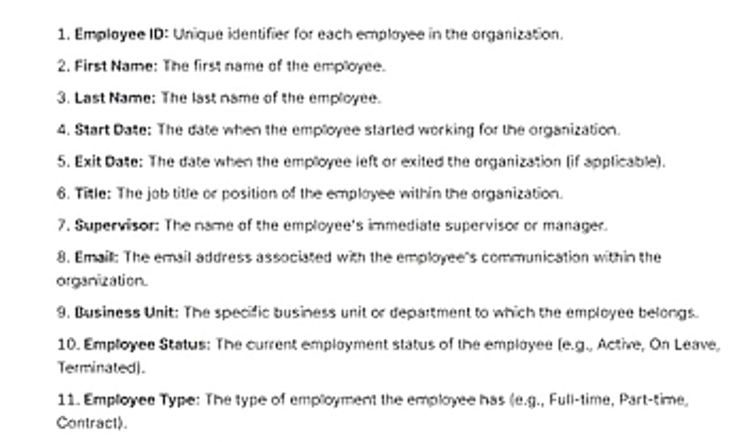
Dataset Description
Notes:
1.Employeer ID

Slide 9


THE "WOW" IN OUR SOLUTION
3/21/2024 Annual Review
9

Slide 10
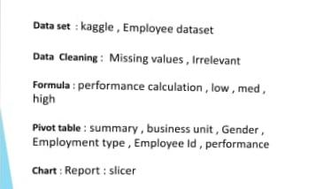
MODELLING
10

Slide 11
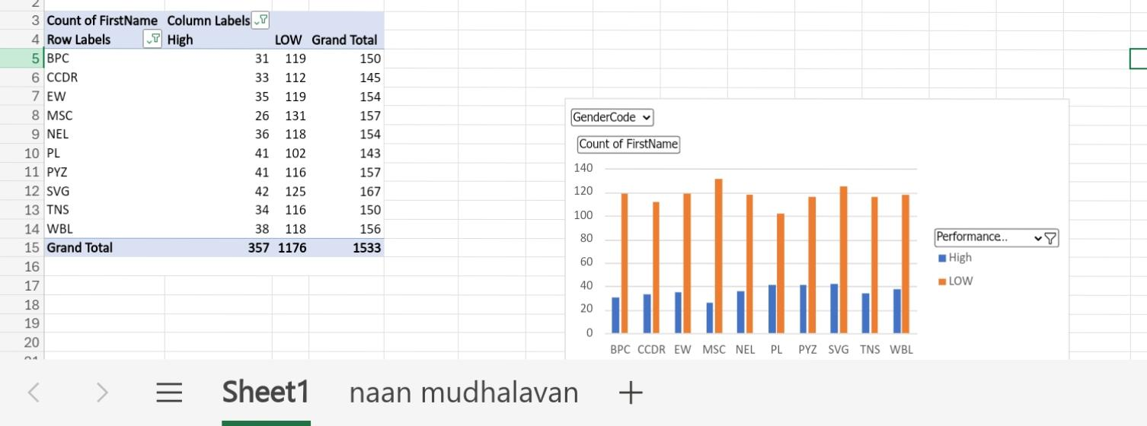
RESULTS
11

Slide 12
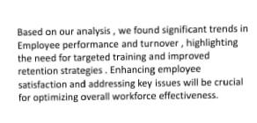
conclusion

