Slide 1


Slide 2
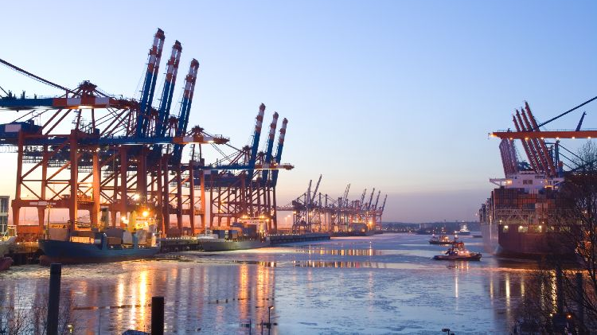
Introduction
The Port of Hamburg is the third largest port in Europe and ranked 18 worldwide in 2020
Analysis of potential projects for the Port of Hamburg
Notes:
Steven

Slide 3
Potential Projects
Modelling of inbound containers movements
Emergency protocols modelling incase of a collision
Outbound lorry traffic modelling to avoid congestion
Harbor ships environmental impact modelling
Port Operations optimization (Ship, Cargo, Warehouse, Inland)
Berth allocation to reduce Ship waiting time
Simulation to optimize running costs using autonomous vehicles
Notes:
Danyal
Container movements from ship using cranes to transport vehicles such as trucks/lorrys
Modelling emergency protocols in the event of a collision between a tanker and the harbour
Outbound traffic from port to improve traffic movement and avoid congestion
Pollution/Environmental impacts of the ships at the port
Optimization of port operations (Ship, Cargo, Warehouse, Inland)
Allocation of births to improve operations and reduce ship waiting time
Niche idea: using autonomous vehicles for cargo handling

Slide 4
Ranking Criteria
Feasibility
Ease of physical implementation
Usefulness:
Advantages/benefits of the project
Complexity of Components involved:
Simplicity of the simulation
Potential Environmental Impact:
Environmental benefits of the project
Data requirements:
Ease of acquiring the required data for modelling
Notes:
Thomas

Slide 5
Project Rankings
No. | Project | Feasibility | Usefulness | Components Complexity | Environmental Impacts | Data Requirements | Total
1 | Modelling of inbound containers movements | 3 | 5 | 3 | 3 | 3 | 17
2 | Emergency protocols modelling incase of a collision | 2 | 4 | 2 | 4 | 2 | 14
3 | Outbound lorry traffic modelling to avoid congestion | 4 | 3 | 3 | 2 | 4 | 16
4 | Harbor ships environmental impact modelling | 3 | 4 | 3 | 5 | 3 | 18
5 | Port Operations optimization | 4 | 5 | 3 | 1 | 4 | 17
6 | Berth allocation to reduce Ship waiting time | 4 | 5 | 4 | 1 | 4 | 18
7 | Simulation to optimize running costs using autonomous vehicles | 2 | 4 | 4 | 1 | 2 | 13
Notes:
Mingjiao

Slide 6
Findings from the Focus Group
Goals
Berth Allocation to reduce Ship waiting time
Stakeholders
port manager, shipping logistics company, ship operator, ship owner
Simulation Methods
Discrete Event
Finding results
In our group discussions, this project was found to be really flexible and usable, and hence scored a high ranking. All focus group participants listed it as a critical in most criteria's.
The long waiting time for ships affects the operation, communication traffic and customer satisfaction of the port. By implementing this project the efficiency of the port can be greatly improved.
Notes:
Liang
Why DES？ The ships arriving at the port and carrying the cargo are random.
Two main project, one is reduce ship waiting time, and Harbor ships environmental impact modelling.
Our main project reduce waiting time Feasibility, Usefulness,Components Complexity
Reduce ship waiting time and improve general port efficiency, improve customer satisfaction ,Increase port flow

Slide 7
Simulation Plan
Main
Ports=0
Block A
park
Block A
Ship arrived
Is empty
Calculate time
query
Ports++
Is the best
Notes:
Danyal
Container movements from ship using cranes to transport vehicles such as trucks/lorrys
Modelling emergency protocols in the event of a collision between a tanker and the harbour
Outbound traffic from port to improve traffic movement and avoid congestion
Pollution/Environmental impacts of the ships at the port
Optimization of port operations (Ship, Cargo, Warehouse, Inland)
Allocation of births to improve operations and reduce ship waiting time
Niche idea: using autonomous vehicles for cargo handling

Slide 8
Conceptualization Summary
The focus of this project is investigating the effect of berth amounts related to ship waiting time and general port efficiency. Issues cause time consumption but not related to the focus will be assumed or simplified.
Objectives | 90% ships won’t wait more than two business day to dispatch their cargo on harbour
Constraints | Max of eight berths can be used for a time(space limits)
Experimental factors | Number of the berths
Responses | % of ships waiting less than 2 days Histogram of waiting time for each ship in queue Port utilization
Content | Berth allocation Ship arriving rate cargo amount on ships Time consumption of “dealing” one cargo
Assumptions | Both ship arriving rate and cargo use random value from distribution based on real world observation
Simplifications | Transportation related issues are ignored: once a ship is dock, it can release cargo immediately
Notes:
Jingchun

Slide 9
Thank You!

