Slide 1

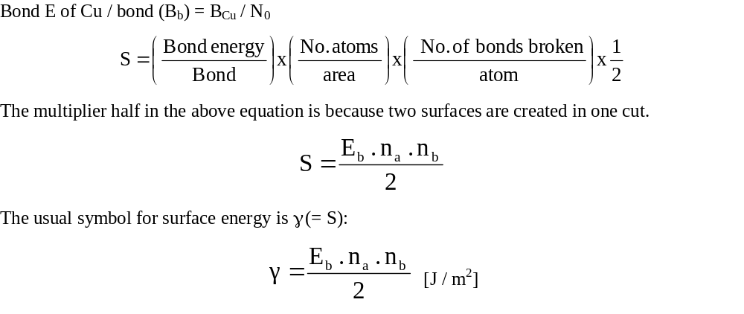
Solved
Example
Calculate the surface enthalpy of Cu crystal, when the external surface is of {100}, (110}, {111} type.
Data for Cu:
Bond energy of Cu (B_{Cu}) = 56.4 KJ / mole of bonds
a_{Cu} = 3.61 Å

Slide 2
The difficult part of the calculation is the number of bonds broken per atom
In CCP Cu each atoms is bonded to 12 neighbours → for a surface atom some of these ‘bonds are broken’
We shall visualize the formation of each of these three surfaces [(100), (110), (111)] in a different way to calculate the number of bonds broken per atom
When a cut is made to create two surfaces, the bonds in plane are intact, the bonds below are intact → only the bonds above the cut are broken
Note: the cut has to be made above or below the atomic layers!

Slide 3
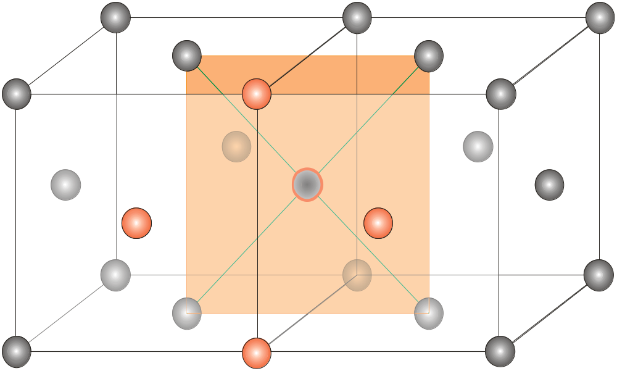

(100)
Atoms whose bonds are broken =4
Calculation of atoms/area is easy: in a area of a × a there are 2 atoms
Bonds in and below the plane are intact; bonds above the plane are broken

Slide 4
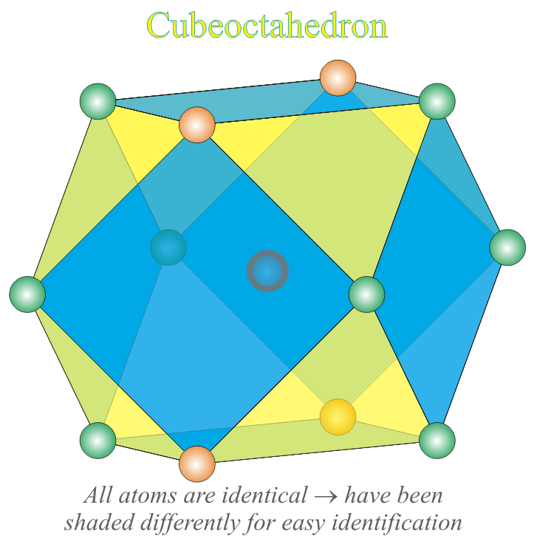
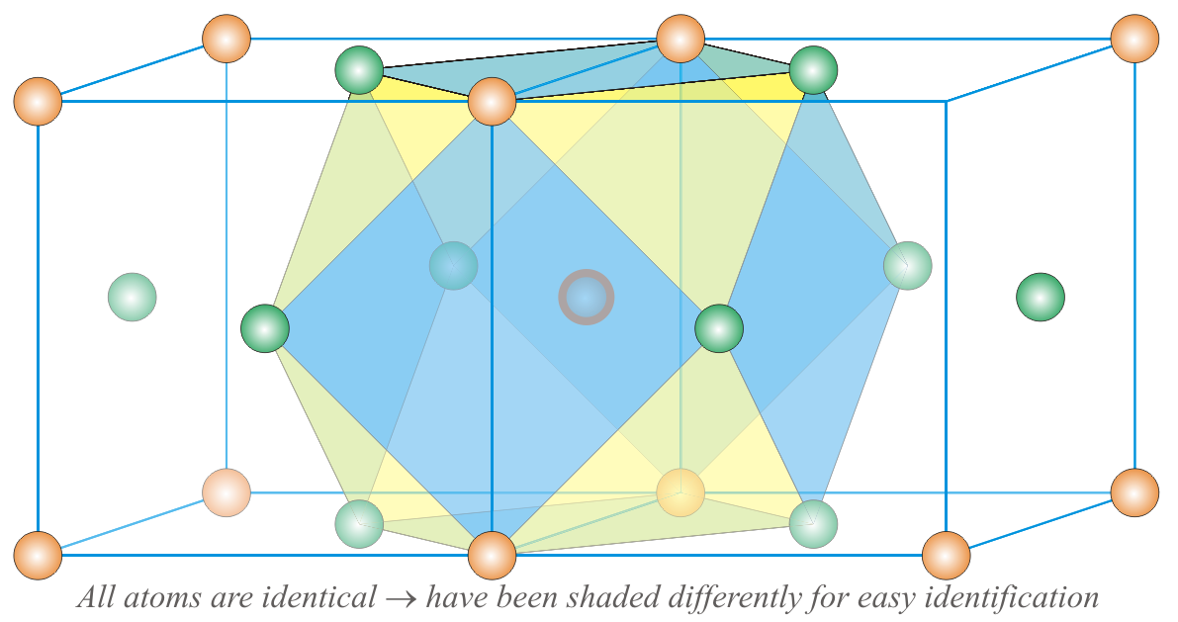
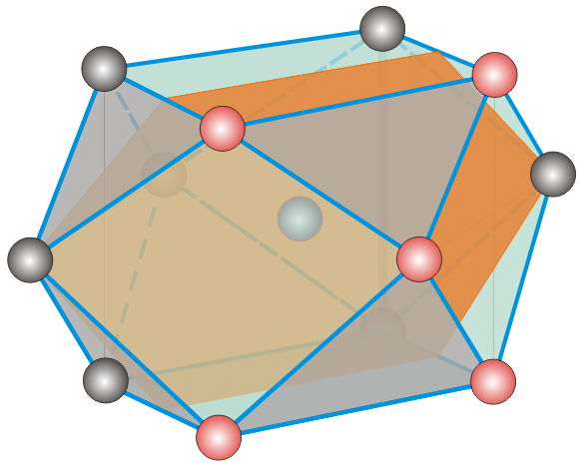
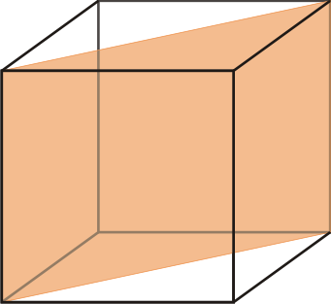
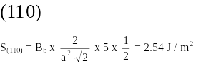
(110)
In a area of √2a × a there are 2 atoms
Atoms whose bonds are broken = 5
Bonds in and below the plane are intact; bonds above the plane are broken

Slide 5
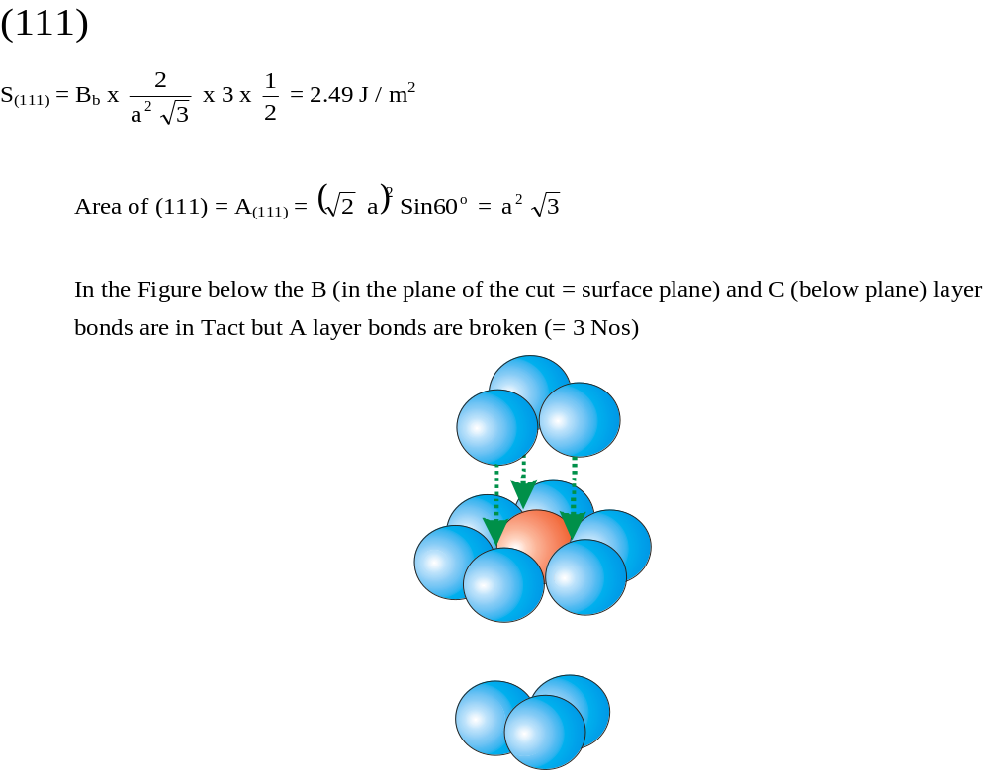
Atoms whose bonds are broken = 3

