Slide 1
Clean Code
Duc Le
July 2017

Slide 2
What is clean code
Clean code
- is pleasing to read.
- is readability.
- makes it easy for other people to enhance it.
- has been taken care of.
- is simple and focus.
- have no duplication.

Slide 3
Bad code
Reason
Lack of time
Tired of working on current program
Pressure from another task that you promised to get done
They decided that working mess is better than nothing.
Notes:
Take time to understand the feature and find out the bug.
Doctor and patient

Slide 4
Contents
Meaningful Name
Functions
Comments

Slide 5
Meaningful Name

Slide 6
Use Intention – Revealing Name
Name should reveal the intent
Choosing a good name may take times but it saves more than it takes
Name of function, class, variable should answer questions:
Why it exists
What it does
How it is used
Example:
int d; // Current time in days
int m; // Current time in months
int y; // Current time in years
Notes:
If name requires comment then it does not reveal it intents.

Slide 7
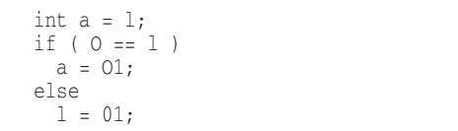
Avoid Disinformation
It’s probably better not to encode the container type into the name
Grouping of accounts: accountList -> accounts
Beware of name that vary in the small ways
XYZControllerForEfficientHandlingOfStrings
XYZControllerForEfficientStorageOfStrings
Disinformative name:
Notes:
String[] accountList; //It is an array not a list

Slide 8
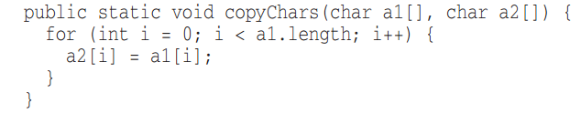

Make Meaningful Distinction
Avoid noninformative
Avoid noise word
NameString vs Name
CustomerObject vs Customer
theMessage vs message
Notes:
We can’t use the same name for two different thing in the same scope, so we index them with number
Could Name is an floating point number

Slide 9
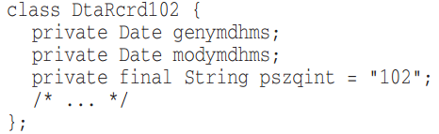
Use Pronounceable Names
Use Searchable Names
Single-letter name and numeric constants have a particular problem in that they are not easy to locate across the whole body of text
Single-letter can only be used as a local variable in a short method.
Notes:
Humans are good at words. A significant part of our brains is dedicated to the concept of words .
If you can’t pronounce it, you can’t discuss it without sounding like idiot.

Slide 10
Pick one word per concept
Pick one word for one abstract concept and stick with it
fetchData
retrivePackages
getItems
Don’t pun
Avoid using the same word for two purposes. Using the same term for two different ideas is especially a pun.
AddElem
vs InsertElem
vs AppendElem

Slide 11
Avoid add gratuitous context
Shorter name is generally better than longer name, so long as they clear.
Class:
AgentAddress
CustomerAddress
Address

Slide 12
Functions

Slide 13
Small
Rule:
The function should be small.
They should be smaller than that.

Slide 14
Descriptive Name
Choosing a descriptive names
Don’t be afraid to make a name long.
Smaller and focus
The block within if, else, while statements should be one line long.
Probably that line should be a function call.
Blocks and Intending
Notes:
In order to make sure function is doing “one thing”, we need to make sure that the statements should be all the same level of abstraction
Choosing a descriptive names will clarify the design of module in your mind and help you improve it.
Don’t be afraid to make a name long. A long descriptive name is better than short enigmatic name. A long descriptive name is better than a long descriptive comment.
The smaller and more focused are the function, the easier it is to choose a descriptive name.

Slide 15
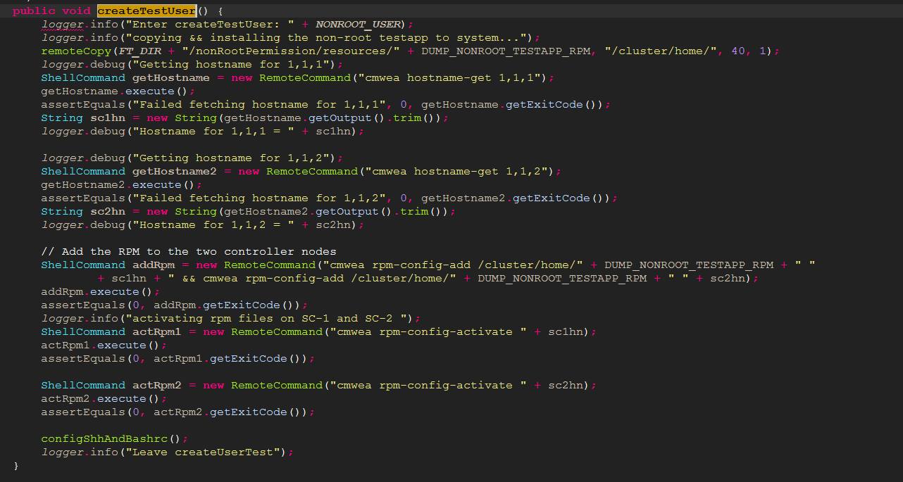
Example F.1

Slide 16
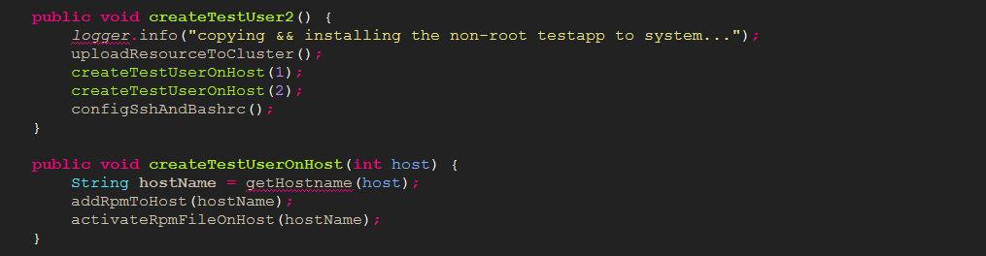
Example F.2

Slide 17


Do one thing
The reason we write function is to decompose a larger concept into a set of steps at the next level of abstraction.
The way to know that a function is doing more than “one thing” is if you can extract another function from it with a name that is not merely a restatement of its implementation.

Slide 18
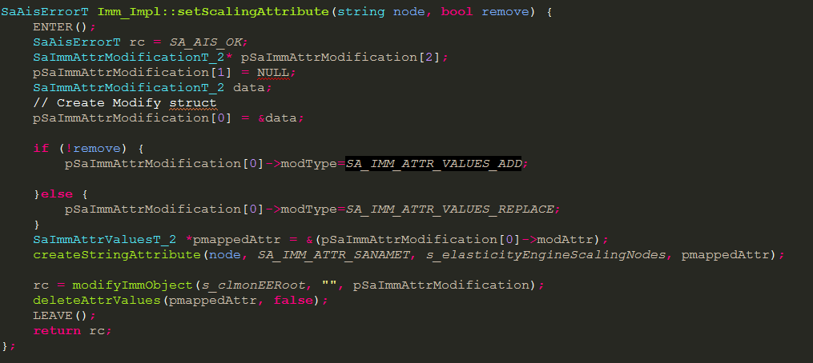
Function arguments
Number of function arguments:
Zero => Ideal
One, Two => Fine
Three => Should be avoided
Argument are even harder from testing point of view
It need to check a various combination of argument to make sure it work properly.
Output arguments is harder to understand than input argument.
appendFooter(s)
Flag arguments *
Passing a Boolean into a function is truly terrible practice.
Split it into smaller function instead.
Notes:
Number of argument: Reader need to interpret each time they saw it.

Slide 19
Monadic functions
Common forms of monadic function:
Ask a question – isFileExist(“FilePath”);
Transforming it into something else and return it – String getHostName(int host)
Event – setNewStatus(bool newStatus)
Functions with 2 argument is harder to understand than monadic function.
assertEquals(expected, actual)
assertExpectedEqualActual(expected, actual)
If it’s possible then try to convert it into monadic function
setName(name, value)
name.set (value)
Name.setName(value)
Create objects
Dyadic functions
Many arguments
Notes:
Use Argument object in case of many argument

Slide 20
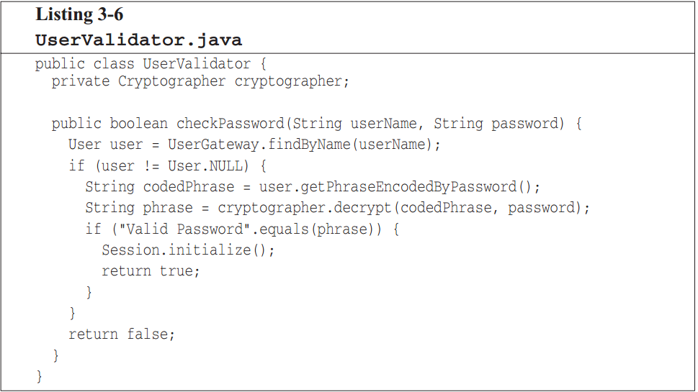
Have no side affect
Can you spot it?
checkPasswordAndInitializeSession
Command query separation
Function should either do something or answer something, but not both
if (set(“username”, “uncleBob”))…
public bool set(String attribute, String value);
Notes:
Temporal coupling
When two actions are bundled together into one module just because they happen to occur at the same time.

Slide 21
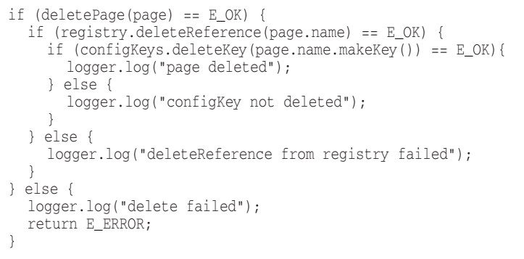
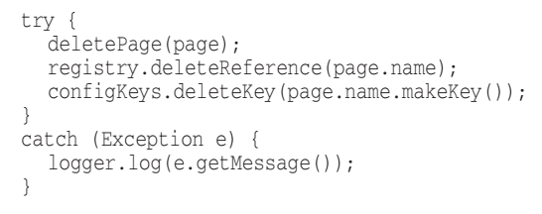
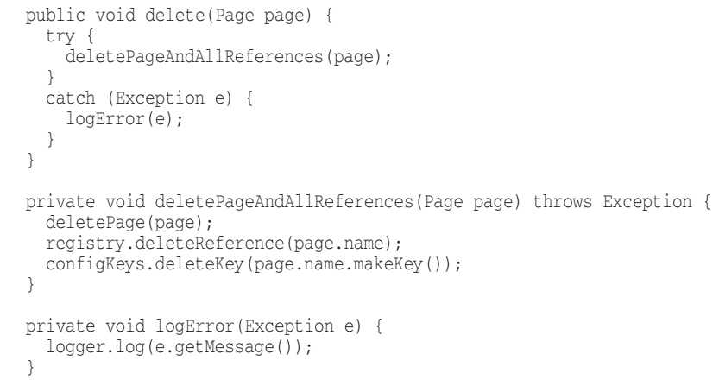
Prefer exception to runtime error code
Extract try/catch blocks
It is better to extract the bodies of try and catch blocks out into functions of their own.

Slide 22
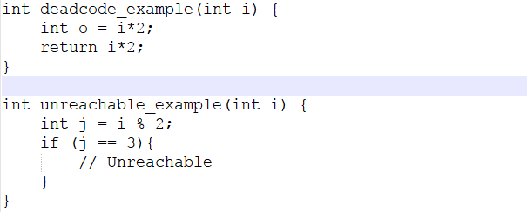
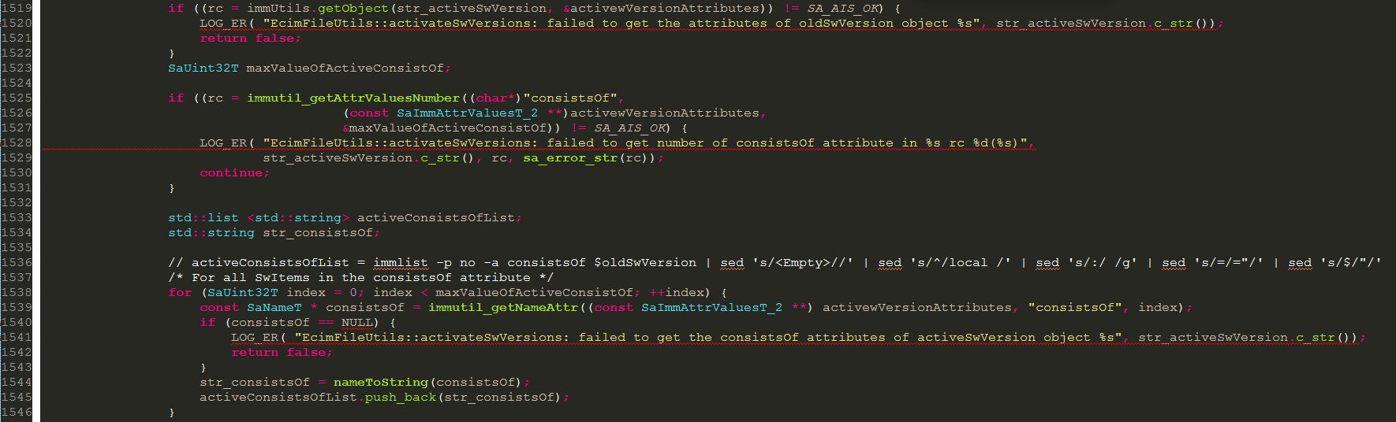
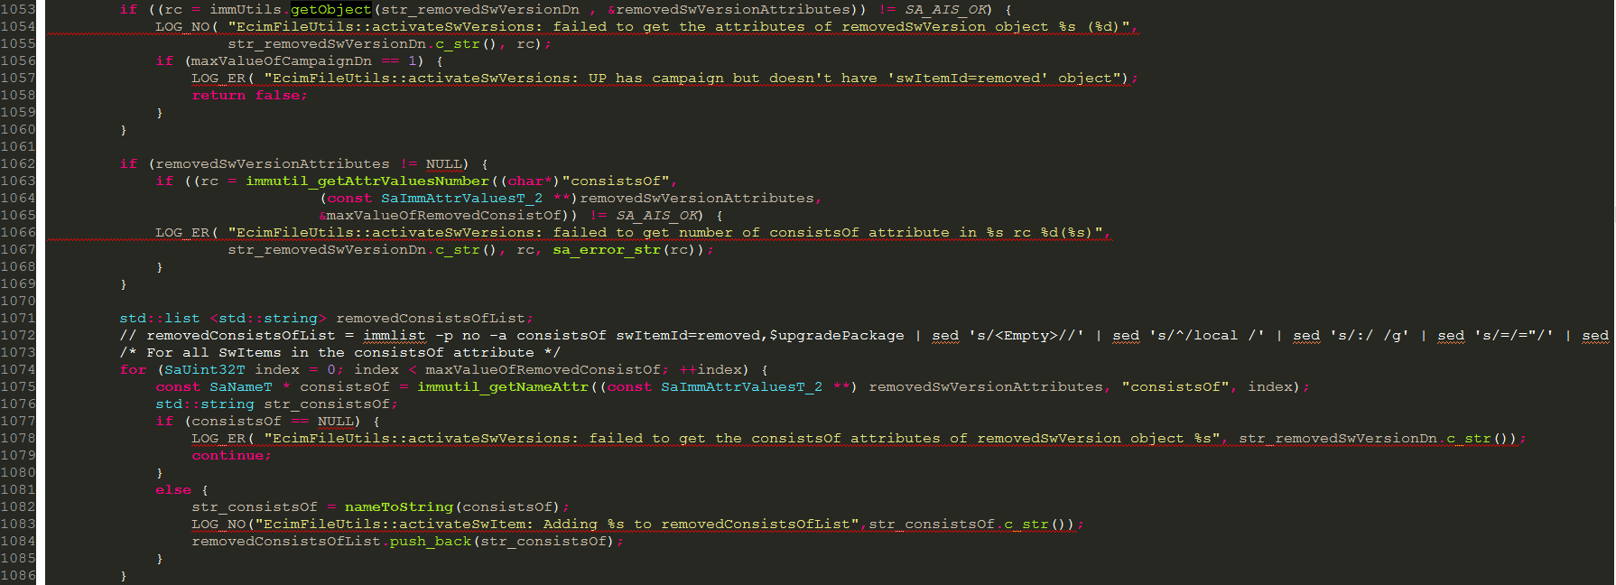
Redundant code
Don’t repeat yourself
Notes:
An example for dependency magnet, error class that other class need to import them, then once it change, other class need to recompile and redeploy.

Slide 23
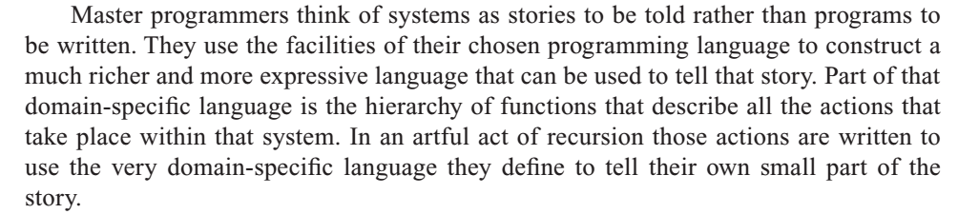
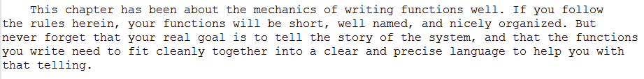
Conclusion

Slide 24

Comments
Notes:
The proper use of comment is compensate the failure to express ourself in code.

Slide 25
Comments do not make up bad code
Rather than spend your time to write comment that explain the mess you’ve made, spend it cleaning that mess.
Explain yourself
It’s simply a matter of creating a function that says the same thing as the comment you want to write.
// Check to see if the employee is eligible for full benefits
if ((employee.flags & HOURLY_FLAG)
&& (employee.age > 65))
if (employee.isEligibleForFullBenefits())

Slide 26
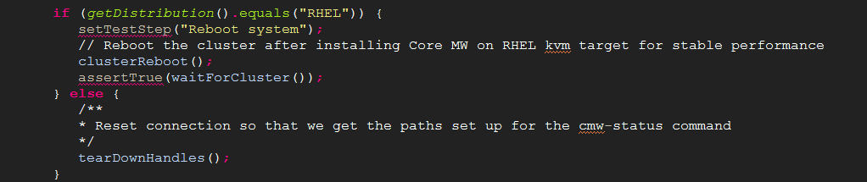
Legal comments
Your cooperate force use to write certain comments for legal reasons, for example: copyright and authorship statement,..
Refer to standard license or external document rather than putting all the terms and conditions into the comment.
Explanation of intent
Comment goes beyond useful information of the implementation and provides the intent behind the decision.

Slide 27
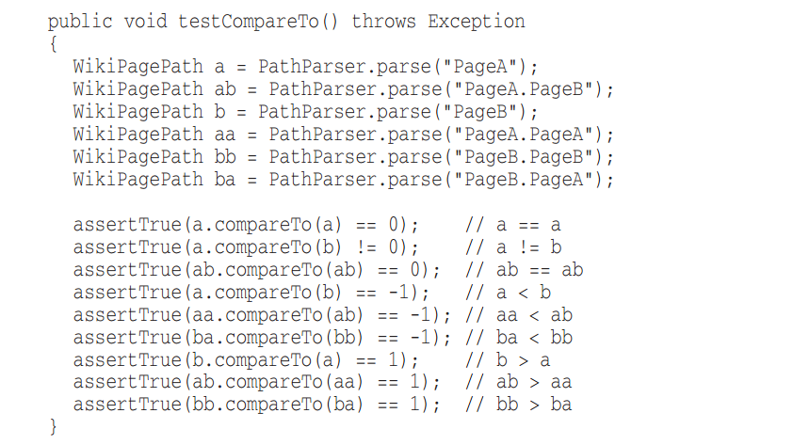

Clarification
Helpful comment
Substantial risk
TODO Comments
TODOs are jobs that programmer think it should be done, but for some reason it is not at the moment.
Resolve TODO and clean it.
Notes:
Using standard library, you can’t alter it. So we use comment to clarify it.

Slide 28
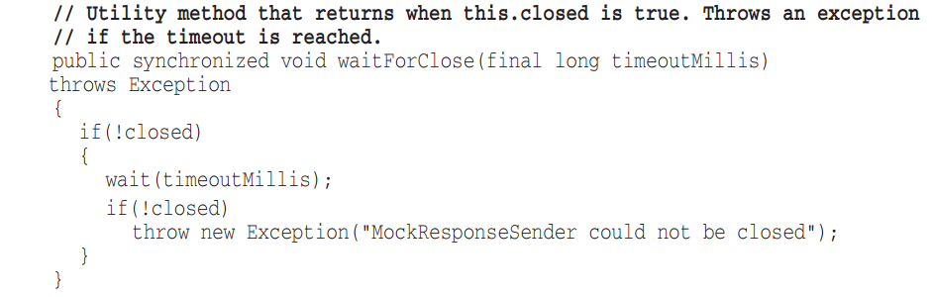
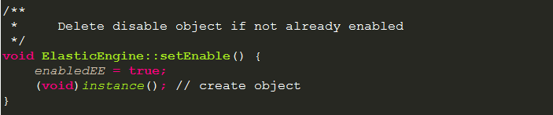
Redundant comments
No more informative than the code
Comment is not precise enough to be accurate
Misleading comments

Slide 29
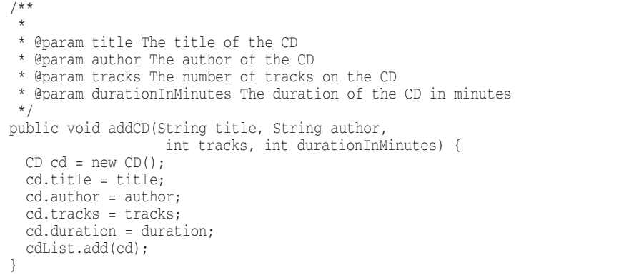
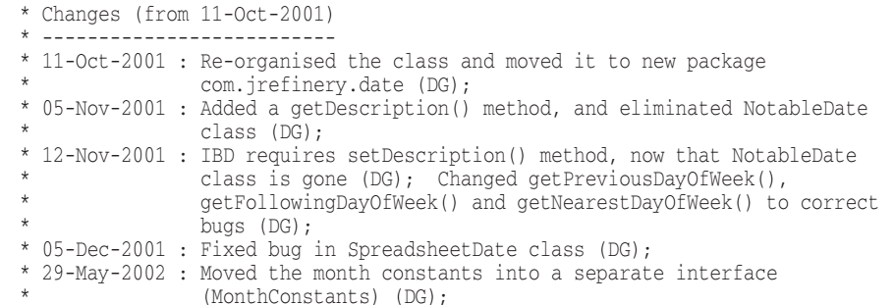
Mandated comments
Use meaningful name for parameter
Journal comments
Use source code control instead
Noise comments
private String name; // The Name
private String version; // The version
private String licenseName; // The license Name
private String info; // The version
Use meaningful name

Slide 30
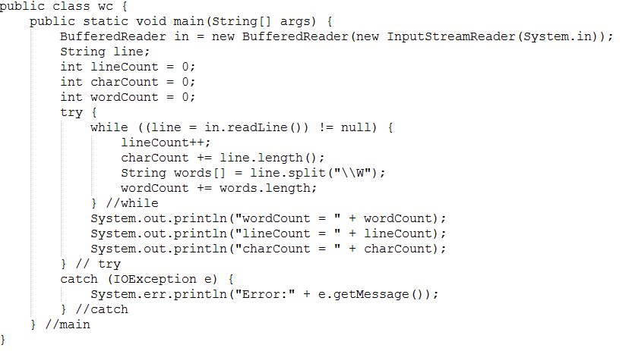
Closing bracket comments
Shorten it instead
Commented-Out Code

Slide 31
Reference
Clean Code: A handbook of Agile Software Craftsmanship – Robert C. Martin

Slide 32

Question & Answer

Slide 33
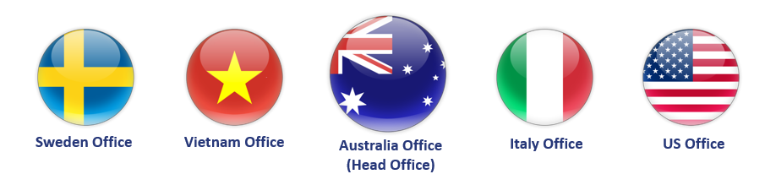

THANK YOU
Lê Minh Đức
www.dektech.com.au
Skype: minhduc.cm
duc.m.le@dektech.com.au

