Slide 1
Clean Code
xleeduc

Slide 2
Bad code
Reason
Lack of time
Tired of working on current program
Pressure from another task that you promised to get done

Slide 3
Use Intention – Revealing Name
Name should reveal the intent
Choosing a good name may take times but it saves more than it takes
Name of function, class, variable should answer questions: Why, What, How
Example:
int d; // Current time in days
int m; // Current time in months
int y; // Current time in years

Slide 4
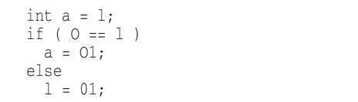
Avoid Disinformation
It’s probably better not to encode the container type into the name
Grouping of accounts: accountList -> accounts
Beware of name that vary in the small ways
XYZControllerForEfficientHandlingOfStrings
XYZControllerForEfficientStorageOfStrings
Disinformative name:

Slide 5
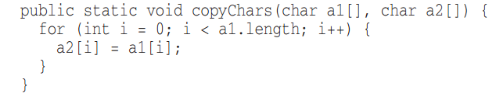
Meaningful Distinction
Noninformative
Avoid noise word
NameString vs Name
CustomerObject vs Customer
theMessage vs message

Slide 6
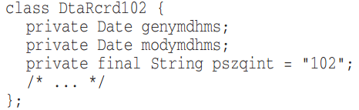
Use Pronounceable Names
Use Searchable Names
Single-letter name and numeric constants have a particular problem in that they are not easy to locate across the whole body of text
Single-letter can only be used as a local variable in a short method.
Notes:
Humans are good at words. A significant part of our brains is dedicated to the concept of words .
If you can’t pronounce it, you can’t discuss it without sounding like idiot.

Slide 7
Avoid Encodings
“One difference between a smart programmer and a professional programmer is that the professional understands that clarity is king. Professionals use their powers for good and write code that others can understand. “
Avoid:
Mental mapping name
IE: x,y,z as an iterator
Use slang words:
whackProcess = killProcess

Slide 8
Pick one word per concept
Pick one word for one abstract concept and stick with it
fetchData
retrivePackages
getItems
Don’t pun
Don’t pun
Avoid using the same word for two purposes. Using the same term for two different ideas is especially a pun.
AddElem
vs InsertElem
vs AppendElem

Slide 9
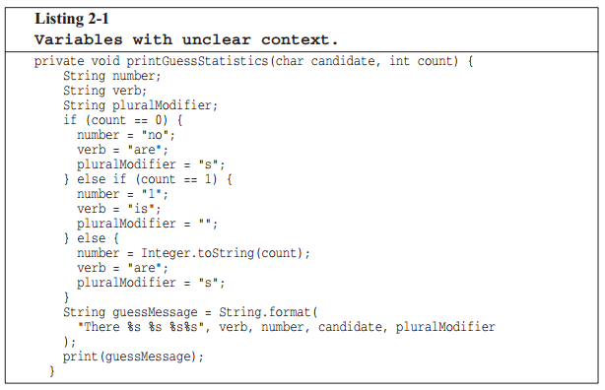
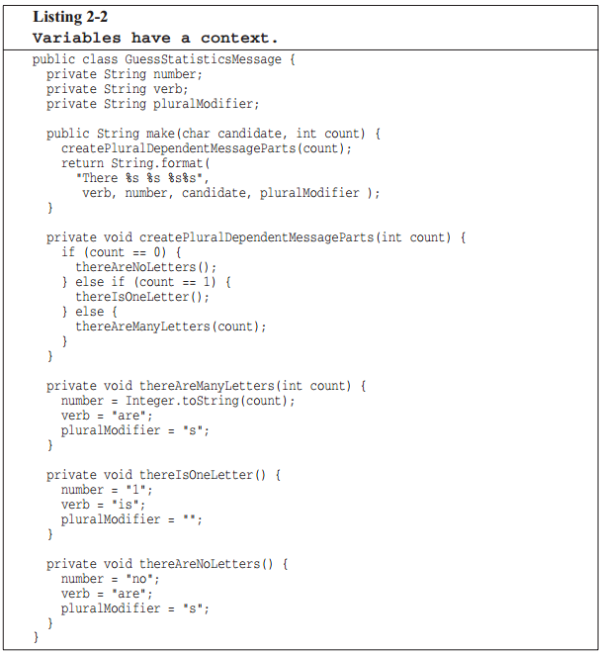
Add meaningful context
Age, Height, Weight, …
PersonAge, PersonHeight, PersonWeight

Slide 10
Avoid using gratuitous context
Shorter name is generally better than longer name, so long as they clear.
Class:
AgentAddress
CustomerAddress
Address
Final word
Good descriptive skills
Shared cultural background
People are afraid of renaming things for fear that the other developers will object.
Notes:
Assume that you have an ecim class, each member will start with ECIM. For ie, EcimCreateUpgradePackage, EcimPrepareUpgradePackage…

Slide 11
Functions

Slide 12
Small
Rule:
The function should be small.
They should be smaller than that.
The block within if, else, while statements should be one line long.
Probably that line should be a function call.
Blocks and indenting

Slide 13
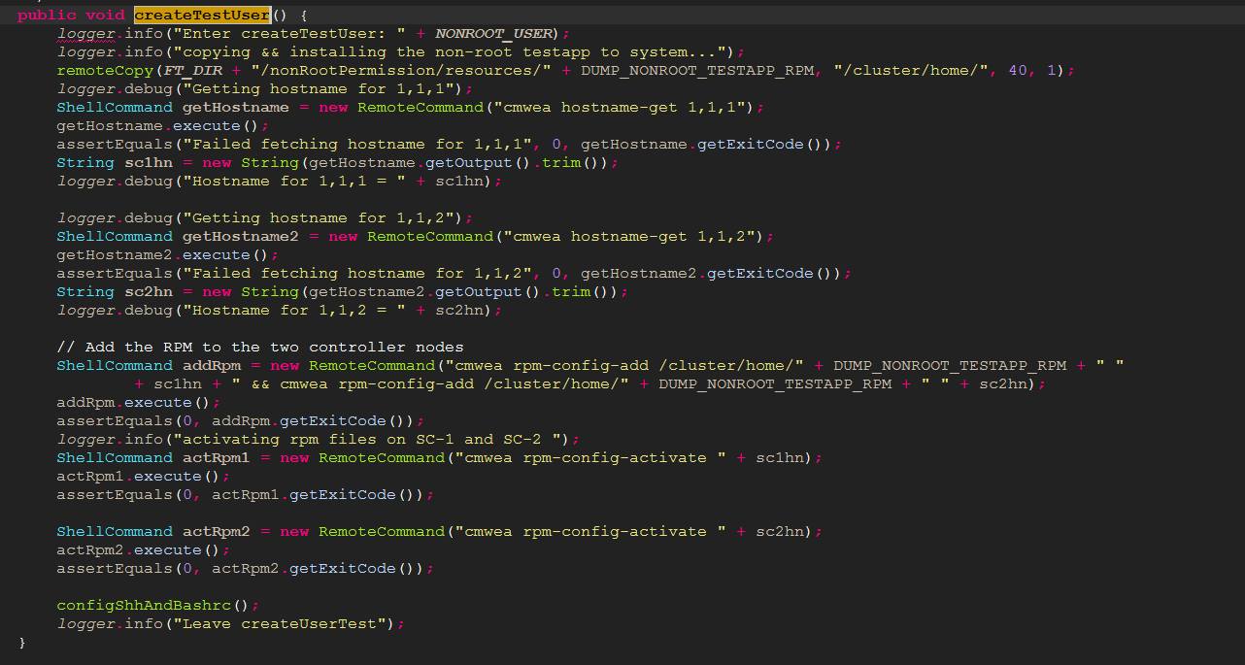
Example F.1

Slide 14
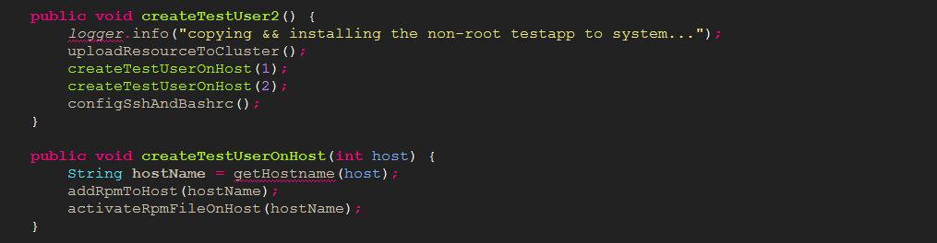
Example F.2

Slide 15


Do one thing
The reason why write function is to decompose a larger concept into a set of steps at the next level of abstraction.
The way to know that a function is doing more than “one thing” is if you can extract another function from it with a name that is not merely a restatement of its implementation.
Notes:
Example: LoginWithPassword
Create connection
Type username and password
Initialize the environment
Return

Slide 16
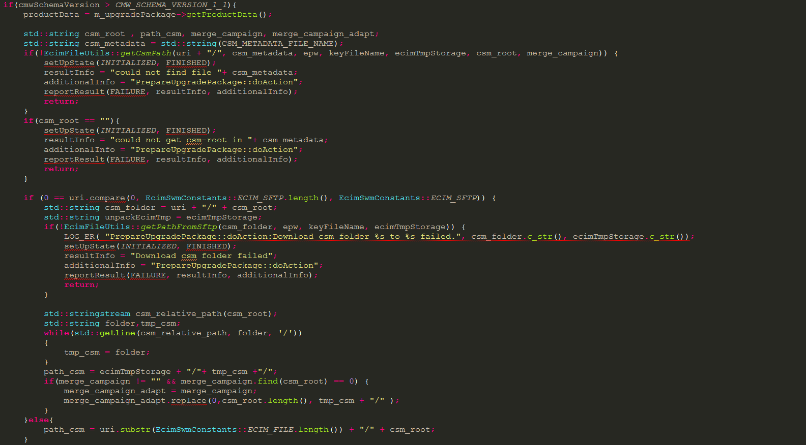

Slide 17
One level of abstraction
Mixing level of abstraction within functions are always confusing.
In order to make sure function is doing “one thing”, we need to make sure that the statements should be all the same level of abstraction
Choosing a descriptive names will clarify the design of module in your mind and help you improve it.
The smaller and more focused are the function, the easier it is to choose a descriptive name.
Descriptive name

Slide 18
Function arguments
Number of function arguments:
Zero => Idea
One, Two => Fine
Three => Should be avoided
Argument are even harder from testing point of view
It need to check a various combination of argument to make sure it work properly.
Output arguments is harder to understand than input argument.
appendFooter(s)
Passing a Boolean into a function is truly terrible practice.
Split it into smaller function instead.
Flag arguments

Slide 19
Monadic functions
Common forms of monadic function:
Ask a question – isFileExist(“FilePath”);
Transforming it into something else and return it – String getHostName(int host)
Event – setNewStatus(bool newStatus)
Functions with 2 argument is harder to understand than monadic function.
assertEquals(expected, actual)
assertExpectedEqualActual(expected, actual)
If it’s possible then try to convert it into monadic function
Dyadic functions

Slide 20
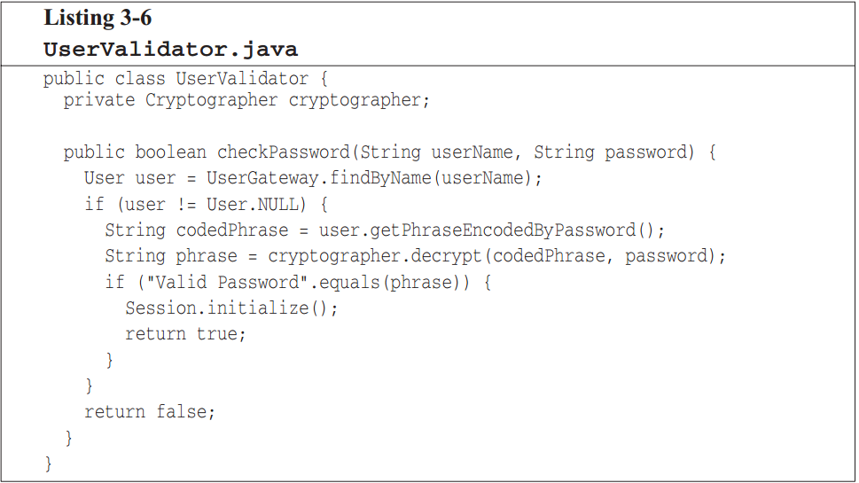
Have no side affect
Can you spot it?
Function should either do something or answer something, but not both
checkPasswordAndInitializeSession
Command query separation
if (set(“username”, “uncleBob”))…
public bool set(String attribute, String value);
Notes:
Temporal coupling
When two actions are bundled together into one module just because they happen to occur at the same time.

Slide 21
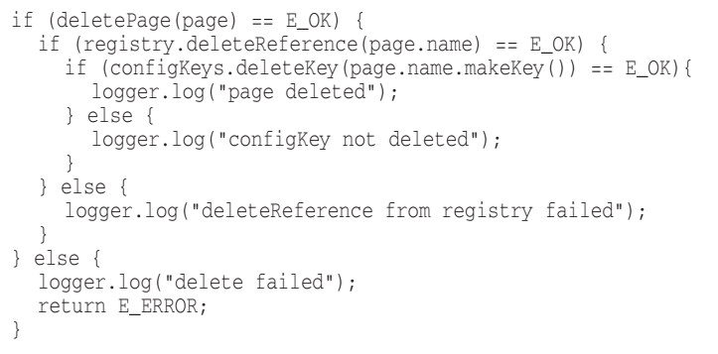
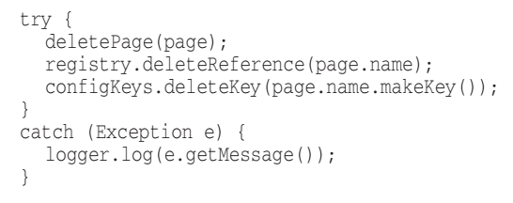
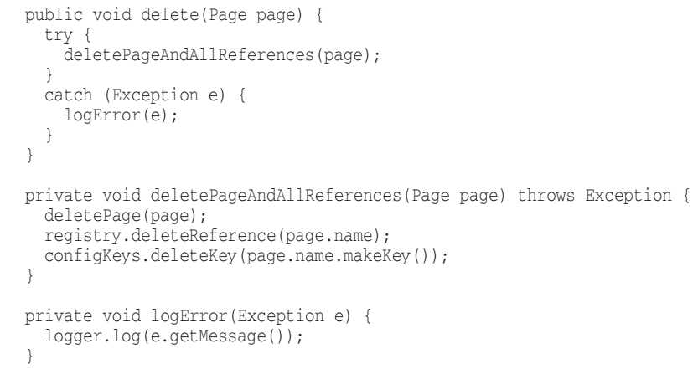
Prefer exception to runtime error code
Extract try/catch blocks
It is better to extract the bodies of
try and catch blocks out into functions of their own.

Slide 22
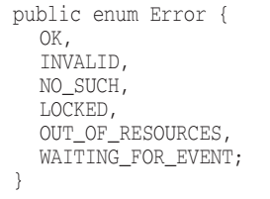
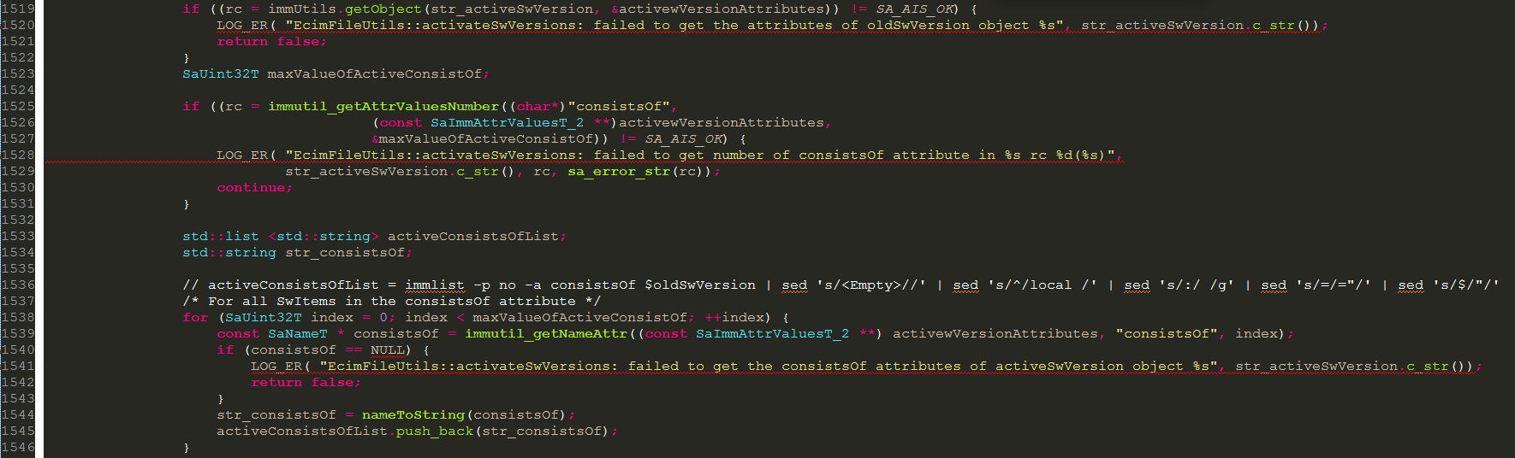
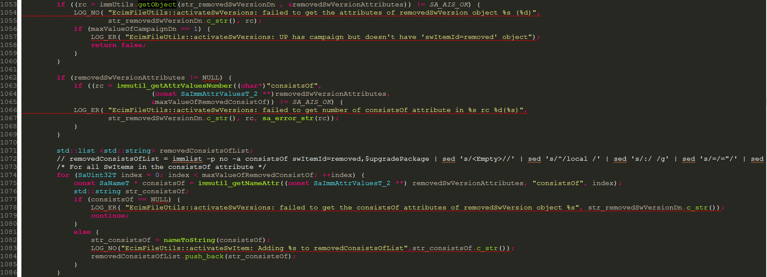
Dependency magnet
Using exception for dependency magnet
Don’t repeat yourself

Slide 23
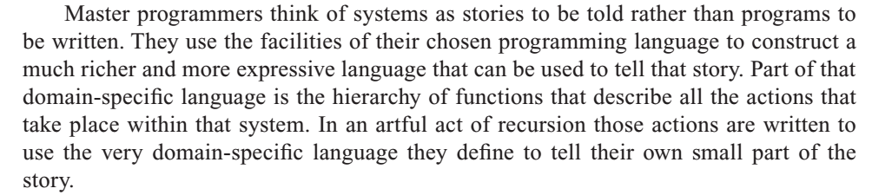
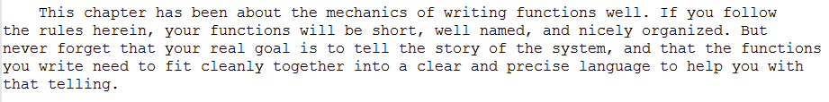
Conclusion

Slide 24

Comments

Slide 25
Comments do not make up bad code
Rather than spend your time to write comment that explain the mess you’ve made, spend it cleaning that mess.
Explain yourself in code
It’s simply a matter of creating a function that says the same thing as the comment you want to write.
// Check to see if the employee is eligible for full benefits
if ((employee.flags & HOURLY_FLAG)
&& (employee.age > 65))
if (employee.isEligibleForFullBenefits())

Slide 26
Legal comments
Your cooperate force use to write certain comments for legal reasons, for example: copyright and authorship statement,..
Refer to standard license or external document rather than putting all the terms and conditions into the comment.
Explanation of intent
Comment goes beyond useful information of the implementation and provides the intent behind the decision.

Slide 27
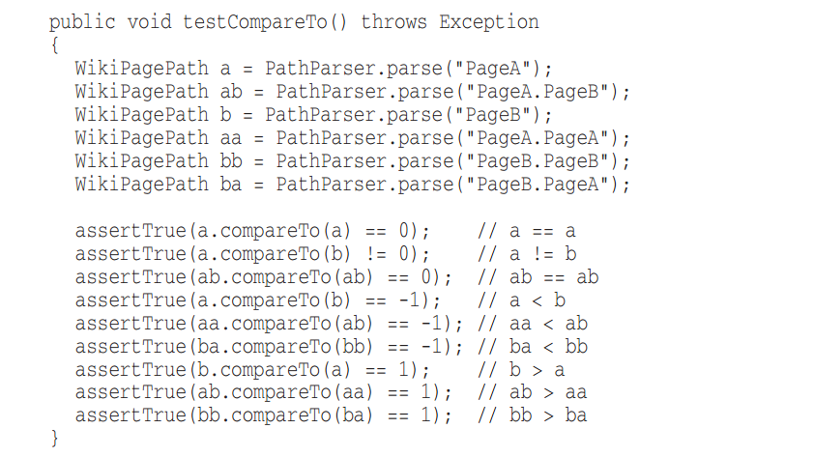

Clarification
Helpful comment
Substantial risk
TODO Comments
TODOs are jobs that programmer think it should be done, but for some reason it is not at the moment.
Resolve TODO and clean it.

Slide 28
Legal comments
Your cooperate force use to write certain comments for legal reasons, for example: copyright and authorship statement,..
Refer to standard license or external document rather than putting all the terms and conditions into the comment.
Explanation of intent
Comment goes beyond useful information of the implementation and provides the intent behind the decision.

