Slide 1
Clean Code
xleeduc

Slide 2
Bad code
Reason
Lack of time
Tired of working on current program
Pressure from another task that you promised to get done

Slide 3
Use Intention – Revealing Name
Name should reveal the intent
Choosing a good name may take times but it saves more than it takes
Name of function, class, variable should answer questions: Why, What, How
Example:
int d; // Current time in days
int m; // Current time in months
int y; // Current time in years

Slide 4
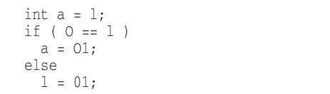
Avoid Disinformation
It’s probably better not to encode the container type into the name
Grouping of accounts: accountList -> accounts
Beware of name that vary in the small ways
XYZControllerForEfficientHandlingOfStrings
XYZControllerForEfficientStorageOfStrings
Disinformative name:

Slide 5
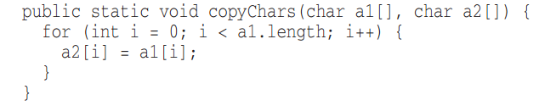
Meaningful Distinction
Noninformative
Avoid noise word
NameString vs Name
CustomerObject vs Customer
theMessage vs message

Slide 6
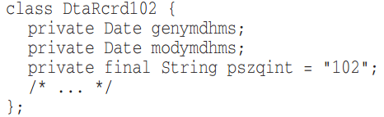
Use Pronounceable Names
Use Searchable Names
Single-letter name and numeric constants have a particular problem in that they are not easy to locate across the whole body of text
Single-letter can only be used as a local variable in a short method.
Notes:
Humans are good at words. A significant part of our brains is dedicated to the concept of words .
If you can’t pronounce it, you can’t discuss it without sounding like idiot.

Slide 7
Avoid Encodings
“One difference between a smart programmer and a professional programmer is that the professional understands that clarity is king. Professionals use their powers for good and write code that others can understand. “
Avoid:
Mental mapping name
IE: x,y,z as an iterator
Use slang words:
whackProcess = killProcess

Slide 8
Pick one word per concept
Pick one word for one abstract concept and stick with it
fetchData
retrivePackages
getItems
Don’t pun
Avoid using the same word for two purposes. Using the same term for two different ideas is especially a pun.
AddElem
vs InsertElem
vs AppendElem

Slide 9
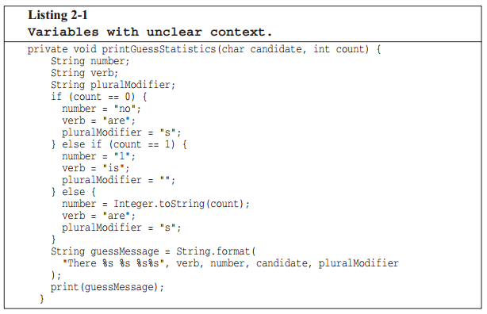
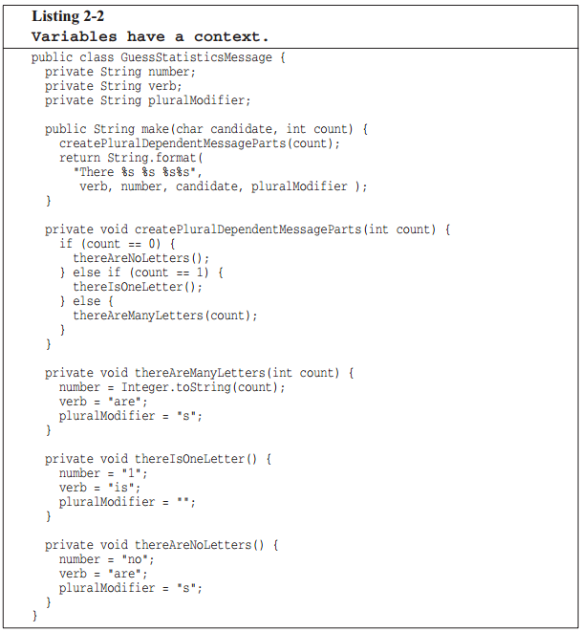
Add meaningful context
Age, Height, Weight, …
PersonAge, PersonHeight, PersonWeight

Slide 10
Avoid using gratuitous context
Shorter name is generally better than longer name, so long as they clear.
Class:
AgentAddress
CustomerAddress
Address
Final word
Good descriptive skills
Shared cultural background
People are afraid of renaming things for fear that the other developers will object.
Notes:
Assume that you have an ecim class, each member will start with ECIM. For ie, EcimCreateUpgradePackage, EcimPrepareUpgradePackage…

